Slide 1

Two Pathways to Donation
Kathryn Beheshti

Slide 2

Objectives
Understand the referral process for potential organ donors
Identify potential donors
Understand the process of Donation after Circulatory Death (DCD)
Recognize your role in the donation process
Discuss patient management
Explore surgical recovery of organs
Understand the importance of transitional language and teamwork
Discuss registry status

Slide 3
The Critical Shortage
Nationally, more than 123,158 people are waiting for a life-saving organ transplant
More than 11,000 waiting in Texas
21 people die each day while waiting for a transplant in this country
A new name is added to the waiting list every 10 minutes
In reality only 2% of the population can be a brain dead organ donor
Source: www.unos.org February 2015
Notes:
Emphasize that only a rare percentage of people can be donors so we need to do everything we can to facilitate OD by following best practices (notifying OPO, management, pronouncing, effective request)
We cant control them saying yes but we can increase our chances of getting a yes

Slide 4
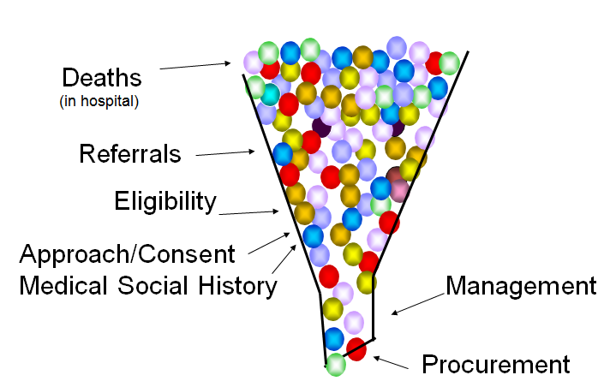
Why only 2%?

Slide 5
Two Pathways
Donation after Circulatory Death (DCD)
Brain Death Donation

Slide 6
Recognizing a Potential Donor
Neuro insult
  Trauma
  Hypoxic Injury
    Drowning
    Cardiac / Respiratory Arrest
  Disease Processes
    Infections
    Parasites
    Cancer
2. GCS of 5 or less
(three or more absent brainstem reflexes)
3. Intubated and Ventilated

Slide 7
Referral Process
Nurse calls the Donor Referral Line when patient meets referral criteria
On-call coordinator calls back and gathers information
Coordinator goes onsite, reviews chart, and sets plan with staff
Coordinator follows by phone
Notes:
I think its important to point out especially for ED staff that Tissue, eye and organ are three different agencies. DRL is a triage line out of denver colorado. Same number you call with CTOD and how the triage system works. Who gets paged with what kind of call?

Slide 8
Other Times to Call the DRL
When the patient’s condition changes
Prior to code status discussion
If family mentions donation
At Cardiac Time of Death
REMEMBER:
Do not mention donation to the family!

Slide 9
Code Status Discussion
Maintain the patient and preserve the family’s opportunity for donation
Registry status
Code status options
Notes:
Request for modified code, until family has decided to withdraw care continue basic support.
If pt is on the registry and is not brain dead it is still first person consent
Allowing the family to have to option to donate prior to withdraw is their right
Continue pressors, fluids, electrolyte replacement, temp, acidosis

Slide 10
If Family Mentions Donation…
“Someone will be here later to share information about the possibility of organ and tissue donation.”
“One of the end-of-life decisions to be made concerns the possibility of organ and tissue donation, and later, someone will talk with you about it.”
Call the Donor Referral Line

Slide 11
The Brain Death Pathway

Slide 12
Scenario
2-year-old male SIDS case
Last seen breathing by parents 1 hour prior to being found
CPR given for 30 mins
Patient is areflexic and hemodynamically unstable upon arrival
LNOK mother and father
What happens next?

Slide 13
Pathophysiology of Brain Death
Herniation
  Cushing’s Triad- “sympathetic storm” – brief period
    Vasoconstriction
    ↑contractility + ↑SVR = ↓ CO (LVF)
Followed by
  spinal shock - prolonged period
    Massive vasodilation = ↓ preload, ↓afterload & ↓ contractility
Notes:
Due to catecholamine surge

Slide 14
Pathophysiology of Brain Death
Thyroid dysfunction
  T3 and T4 levels are low
    due to hypothalamus and pituitary no longer working, TSH does not rise in response
  Diabetes insipidus
    ADH, ACTH and cortisol dramatically decline post brain death
    This depletion further worsens hypovolemia
  Hyperglycemia
    Peripheral insulin resistance

Slide 15
Pathophysiology of Brain Death
Disseminated intravascular coagulation
  Large amounts of thromboplastin released following “sympathetic storm” caused by brain herniation
Hypothermia
  caused by the massive vasodilation and loss of temperature control

Slide 16
Prior to Brain Death Testing
Consider placing central line and arterial line
Prerequisites
  Ensure core body temp > 35C
  Maintain acceptable BP with vasopressors
  Correct acidosis and replace electrolytes
  Give blood products and reverse coagulopathies
  if needed
  Reverse sedatives/analgesics

Slide 17
Consider Starting T-4 Infusion
TSH is no longer secreted after brain death
T4 converts to T3 and replaces TSH
T4 decreases cardiac sensitivity to catecholamines released during herniation
T4 enables weaning of inotropes

Slide 18
Brain Death Exam
Two different physicians will perform two different clinical exams separated by a
period of time
  If post cardiac arrest/other severe acute brain injury, first exam should be deferred for 24 to 48hrs
  Time period may be shortened if massive, clinically obvious central nervous system destruction exists
Same physician can perform apnea test

Slide 19
Interim Between Two Exams
37 weeks gestational age to 30 days old
  24 hours between exams
31 days to 18 years
  12 hours between exams
Interim period may be shortened if ancillary study is done but second exam is still required

Slide 20
Clinical Exam
Check for brainstem responses:
  Pupillary response
  Corneal reflex
  Gag reflex
  Cough reflex
  Oculocephalic reflex (Doll’s Eyes)
  Oculovestibular reflex (Cold Calorics)
Notes:
Gold Standard is clinical exam with apnea test

Slide 21
Clinical Exam
Flaccid tone and absence of spontaneous or induced movements, excluding spinal cord events such as reflex withdrawal or spinal myoclonus
  The patient’s extremities should be examined to evaluate tone by passive range of motion
  Observe patient for any spontaneous or induced movements
    If abnormal movements are present, clinical assessment should be done to determine whether
    or not these are spinal cord reﬂexes

Slide 22
Apnea Test
Adjust pressors for SBP ≥100 mm Hg
Preoxygenate for 10 min (FiO₂ 100%)
  PaO₂ >200 mm Hg
Reduce ventilator rate to establish eucapnia
  Perhaps to reverse hyperventilation in neuro pts
PEEP 5 cm H₂O
  Desaturation may suggest difficulty w/ testing
Baseline ABG if pulse ox >95%

Slide 23
Apnea Test
Patient temperature is normalized > 35 C
Disconnect from ventilator
Provide passive oxygen
  Place catheter through ETT to carina
  Oxygen @ 6 L/min
Monitor for 8-10 minutes
  Abd or chest excursions (including brief gasps)
If PCO2 rises 20mmHg from normal baseline and ≥ 60mmHg

Slide 24
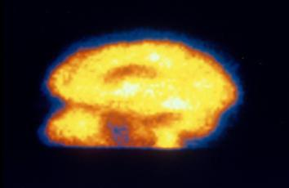
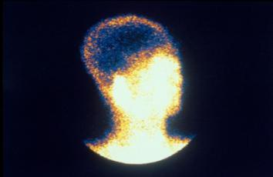
Ancillary Study
When to use:
  apnea test cannot be performed
  there is uncertainty about results of clinical exam
  medication effect may be present

Slide 25
Notifying Family- Decoupling
Hospital’s role: Attending physician informs family of brain death
TOSA’s role: Discusses donation opportunity
Why?
  Family may perceive conflict of interest
  Patient may not be eligible to donate
  Timing may not be appropriate

Slide 26
Approaching the Family
When family is emotionally ready, TOSA staff will offer the opportunity to donate
  Private room
  Support for family (minister, priest, rabbi, others)
Written authorization is obtained

Slide 27
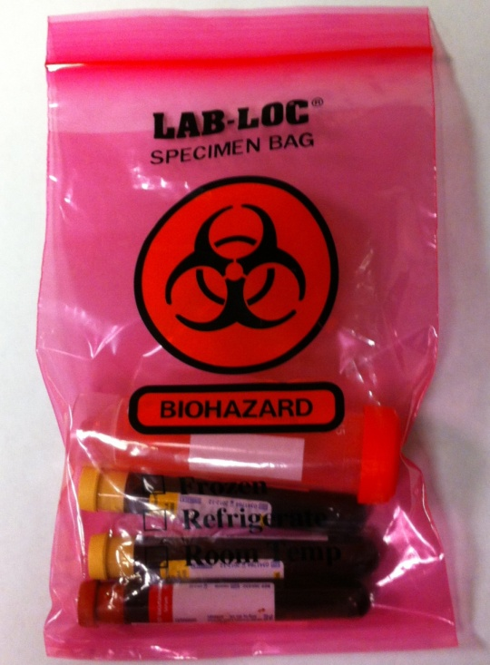
Initial Steps Upon Authorization
Blood for HLA / Virology testing drawn and sent to San Antonio
  Results take 8 hours
Account changed to TOSA
Previous orders discontinued
TOSA assumes care of patient
Average case time 18-36 hrs

Slide 28
Management – Key Issues
Volume Status
Oxygenation
Electrolyte Imbalances
Arterial & Central Line Access
Hemodynamic Stability

Slide 29
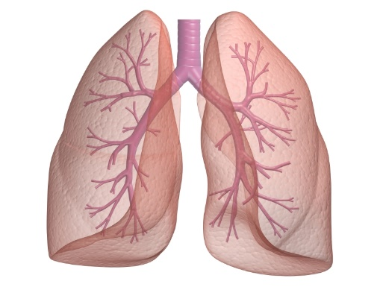
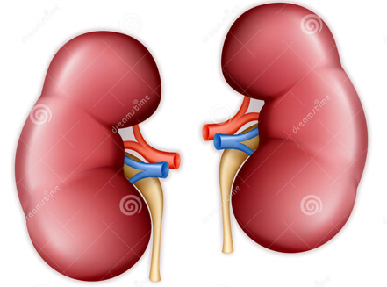
Fluid Status
Organ Outcome
Dehydrated
Good
Over-hydrated
Poor

Slide 30
Management - Pulmonary
CXR
ABGs
Bronchoscopy
Recruitment
BEFORE
AFTER

Slide 31
Management - Cardiac
Echocardiogram
  Structural/ functional integrity of walls, valves, and chambers
  Pump quality
ECG
  Post brain death to evaluate damage due to cytokine and catecholamine release
Serial Cardiac Enzymes
Possible Heart Catheterization

Slide 32
Organ Allocation
A donor is registered with the United Network for Organ Sharing (UNOS)
using the following:
  ABO
  Height and weight
  Age
  Gender
  Race

Slide 33
Allocation Process
Sickest,
Closest
first

Slide 34
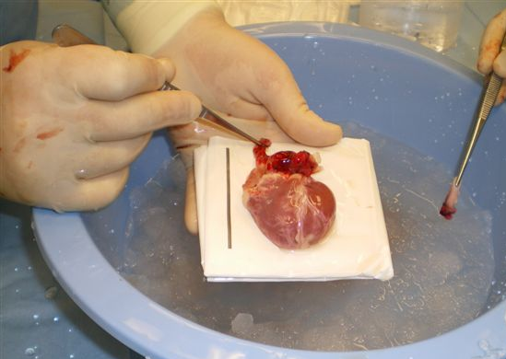
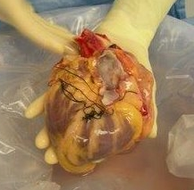
OR - Cardiectomy
Heart at back table
First organ to be recovered
Must be implanted within 4 hours of cross clamp

Slide 35
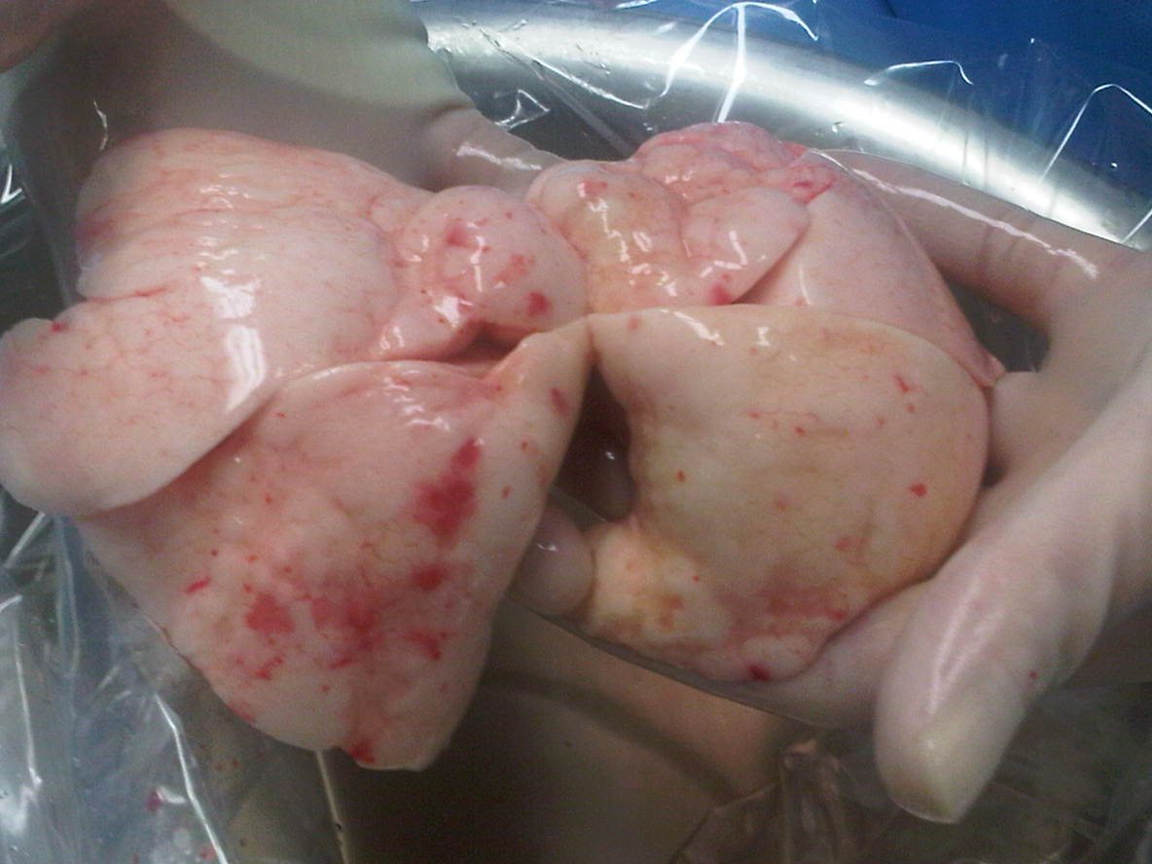
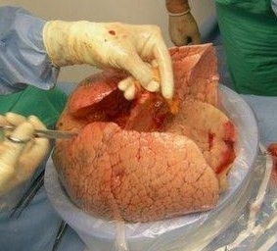
OR - Pneumonectomy
Lung(s) at back table
Second organ recovered
Transported fully inflated
Must be implanted within 4 hours of cross clamp

Slide 36
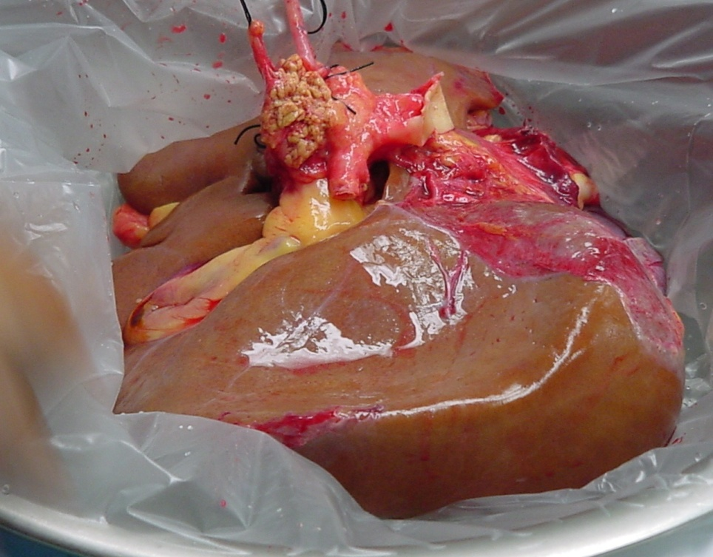
OR - Hepatectomy
Liver at back table
Most vascular organ transplanted
Can remain outside body for up to 12 hours after cross clamp

Slide 37
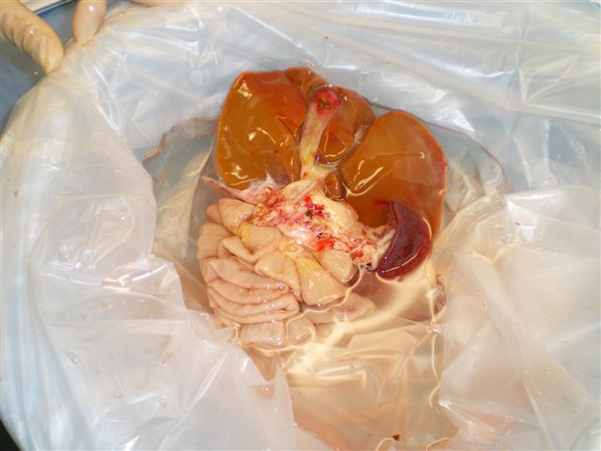
OR - Small Bowel
The small bowel is sometimes recovered attached to the liver and pancreas to provide a multi-visceral transplant to one recipient

Slide 38
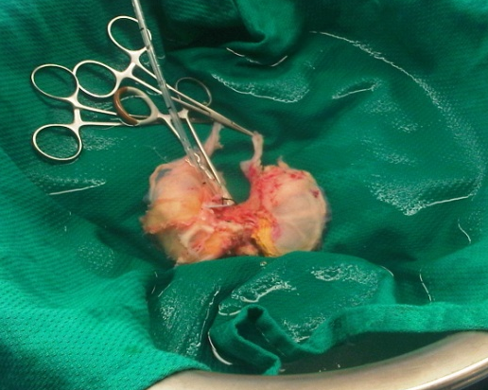
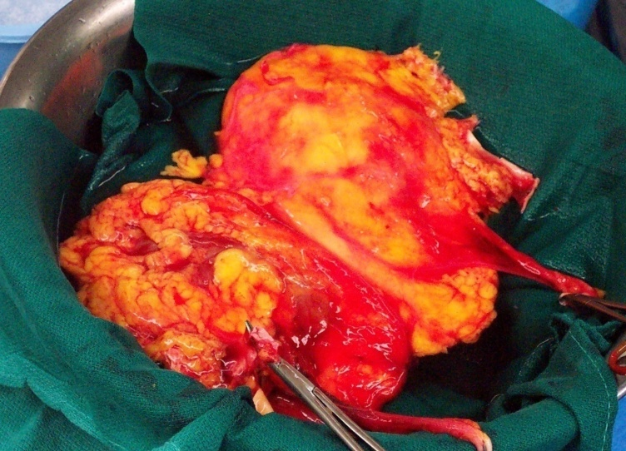
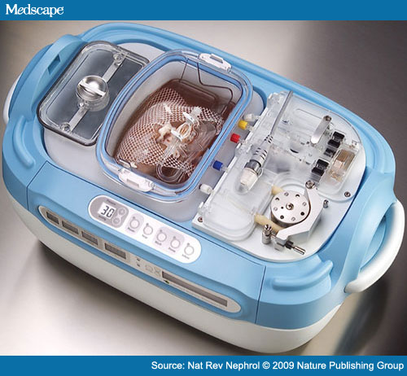
OR - Nephrectomy
Kidneys at back table
Most versatile organ
Can remain on ice for 48 hours
On pump for 72 hours

Slide 39
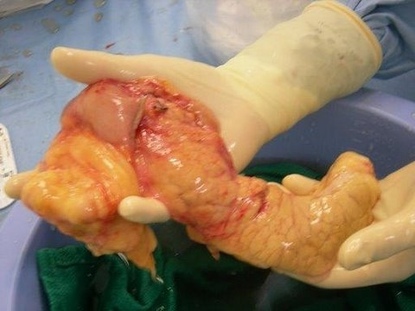
OR - Pancreaectomy
Pancreas at back table
Most delicate organ
Can be kept on ice for 12 hours

Slide 40
Donation After Circulatory Death

Slide 41
Scenario
16 year old Self inflicted GSW to head
Evacuation done with bone flap
GCS 3 for 7 days with no improvement, no sedation
Family had discussion with physician regarding trach and peg vs. withdraw of support
Family has elected to withdraw support
TOSA has been following patient since arrival
What happens next?

Slide 42
DCD process
Staff notifies TOSA of family wishes
TOSA coordinator goes onsite and does a DCD evaluation
If patient meets DCD criteria (predicted to expire within 1hr following withdraw of support) TOSA will approach family

Slide 43
DCD Management Process
Account number remains the same
Orders are flagged for billing
Primary MD will manage patient with assistance from TOSA staff

Slide 44
DCD Allocation
Liver and kidneys are evaluated for transplant
Pancreas is evaluated for research

Slide 45
DCD in OR
MD/RN will administer comfort care medication
MD/RN administers Heparin approximately 5 minutes prior to extubation
MD will pronounce CTOD in OR
Five minutes after CTOD, transplant surgeons begin recovery process

Slide 46
Family in the OR
Family may be with loved one until CTOD
All staff prepped prior to family being escorted to OR
TOSA staff member will remain with family throughout the OR process
Immediately following CTOD, family is escorted out

Slide 47
What if the patient does NOT expire?
Room is pre-arranged with house supervisor, OR and ICU charge nurses
Patient is moved to a designated room and comfort care is continued

Slide 48
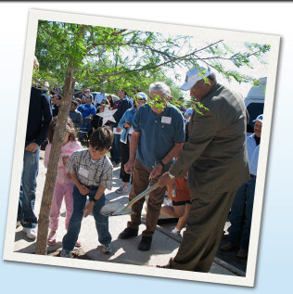

Case Follow-Up
Post-donor survey
Letters to staff and family
Post-donor conference
Donor family ceremonies
Donor tributes

Slide 49
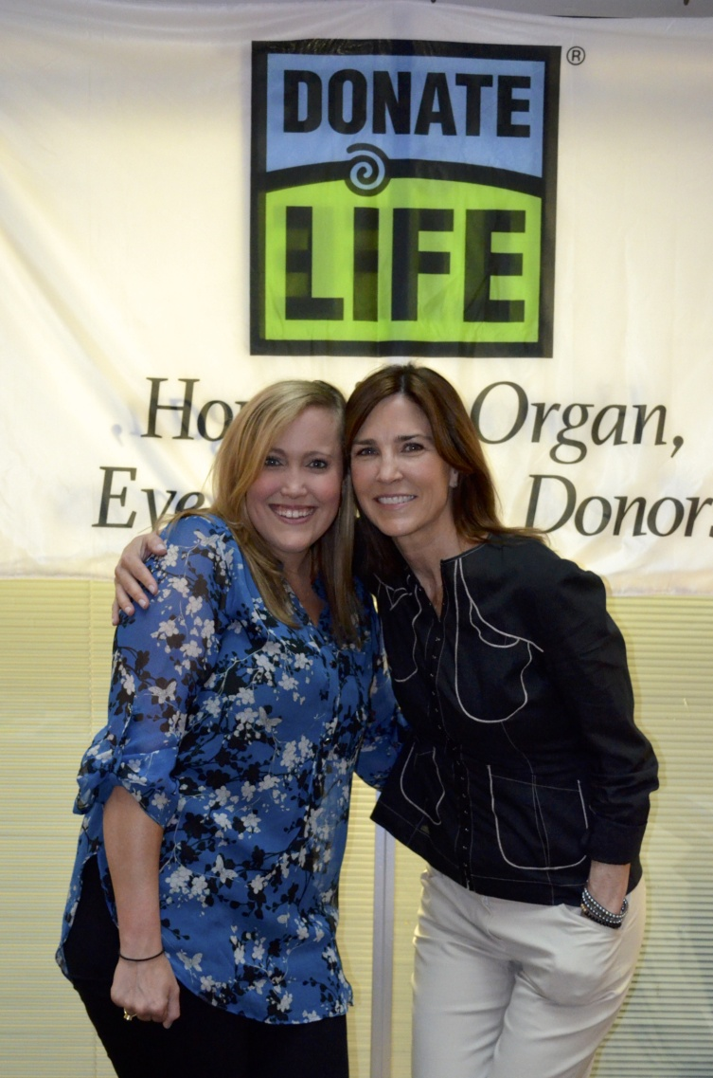
Melisa and Adele
“We know Carson would have wanted to help others…He saved 4 lives through his organ donation. We feel like it is important to publicly share our story and raise awareness on the importance of organ donation. It has touched our family in so many ways, and we are grateful that we chose to Donate Life” - Melisa Cummings.

Slide 50

Donatelifetexas.org

