Slide 1
The Clark Workplace Civility Index ©
While we are waiting to begin – please take a moment to complete the Clark Workplace Civility Index©.
Don’t overthink it – Read each item carefully and respond truthfully by answering yes or no.
This is for your use only – no one will see your responses.

Slide 2
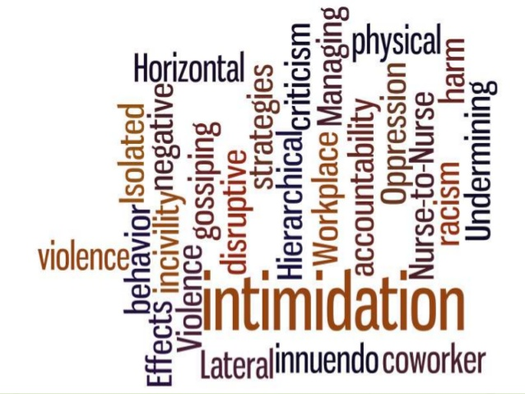
The Price of Silence: The impact of ignoring incivility, lateral violence and bullying in the professional practice environment.
Nancy Mastronardi, MSN, RN, CPHQ
Seton Heathcare Family
October 27, 2017

Slide 3
Outcomes
The attendee will be able to:
Identify the key behaviors of incivility, lateral violence and bullying that negatively impact the professional work environment.
Describe the impact of ignoring incivility, lateral violence and bullying on the nurse, the patient and the organization.
Commit to zero tolerance and apply strategies discussed to manage these behaviors when witnessed or experienced in the professional work environment.

Slide 4

Ascension is the largest nonprofit health system in the U.S. and the world’s largest Catholic health system.
In Texas, Ascension operates Providence Healthcare Network and Seton Healthcare Family, which includes Dell Children’s Medical Center of Central Texas and 120 related clinical facilities that together employ more than 13,000 employees.
Seton Healthcare Family has 3 Magnet and 3 Pathway to Excellence designated hospitals.
Notes:
Say a little about your position and how you became interested in this topic.

Slide 5
It’s Time to Confront Reality...
Recognizing incivility/lateral violence and bullying...
getting our heads out of the sand
Notes:
In his book the speed of trust, Stephen Covey talks about 13 behaviors that create an atmosphere of trust. One of these is the commitment to take issues head on – even the “undiscussables”. Lead out courageously in conversation and don’t skirt the real issues.
What are we not saying that needs to be said...
What will happen if we don’t face the issues here...

Slide 6
Let’s call it what it is!
Incivility: “Rude or disruptive behaviors which often result psychological or physiological distress for the people involved – and if left unaddressed, may progress to threatening situations” (Clark, 2013)
Lateral Violence: “Sabotage directed at coworkers who are on the same level within an organization’s hierarchy” (Dunn, 2003)
Bullying: “The persistent, demeaning, and downgrading of humans through vicious words and cruel acts that gradually undermine confidence and self-esteem” (Adams, 1997)
Notes:
Important to define what incivility is because perpetrators don’t often view their behavior as problematic or abusive
Nurses tolerate so much behavior because they try to dismiss as not serious
Most common is lateral incivility (nurse to nurse) and hierarchical (supervisor or manager to nurse, faculty to student, physician to nurse)

Slide 7

Why?
Oppressed-Group Theory
An increasing sense of powerlessness in the practice environment (downsizing, competition)
Generational differences
Personality issues...some people are just “jerks”...and they are everywhere.

Slide 8
Incivility/Bullying – Covert to Overt
Nonverbal - eye rolling
Incomplete information
Rude or snide comments
Gossiping
Broken confidences
Sarcasm/teasing
Exclusion / Ignoring
Judging / criticism
Invading personal space
Undermining / not available
Toxic email
Accusing / blaming
Public ridicule
Intimidation

Slide 9
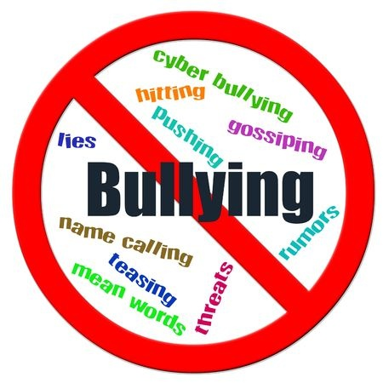
So....
Have you witnessed or experienced incivility, lateral violence or bullying in your practice environment?
Notes:
90-95% of participants will raise their hand – this mirrors the literature

Slide 10
Have you spoken up to the perpetrator?
Absolutely, “We don’t play like that on my unit”
No, that’s just part of the culture; people need to get over it
I used to, but nothing ever happened so I quit
What?? Are you smoking crack??... I have to work here!!

Slide 11

Recent Research on New RN Experiences
During first year of practice, novice nurses report:
Undervaluing by team members
Blocked learning opportunities
Emotional neglect
Being given too much responsibility without support
Rude or humiliating comments

Slide 12
What is “reverse bullying”?
“At the heart of "reverse bullying" is technology, because newer nurses are highly familiar with the latest gizmos. They are fast with tablets and they can navigate through an electronic health record [EHR] with ease.
Younger nurses can bully older nurses by treating them as if their knowledge is antiquated, “washed up,” or out of step with the times. Older nurses can be excluded from social activities in the unit, made fun of for physician limitations, and ignored by the younger nurses”. (Greg Thompson)
Notes:
“Last week, I came out of my patient’s room. Several of the younger nurses were talking about a new product trial that was going to start the next day. I asked one of them about it, and she said, ‘You should have paid attention during the morning huddle. You might need to turn up your hearing aid battery.’ She walked away, laughing with one of the other nurses. I felt humiliated and embarrassed.”

Slide 13
Why Should You Care?
Repeatedly compromising one’s integrity causes moral distress - research shows that nurses who experience burnout, more often than not feel like they haven’t been living up to their moral values.
80% of nurses who experience long term incivility will leave the organization. Cost of replacing a nurse is estimated at $65-$90k depending on specialty.
Patient’s may pay the price – 67% nurses report a percieved link between bullying and adverse events (Rosenstein & Daniel, 2008).
Notes:
The cost of replacing a nurse has been estimated at $65k -$90k
As Nurse Leaders– you are expected to be role models and help create a sense of team.

Slide 14
The Price of Silence...
The Downstream Impact of Ignoring Incivility/Lateral Violence/Bullying

Slide 15
The Price of Silence – Impact on the Organization
Low staff morale
Increased turnover
Attendance issues
Decreased productivity
Decreased staff and patient satisfaction
Negative impact on patient safety
Decreases quality of care and unit effectiveness

Slide 16
The Price of Silence – Impact on Nurses
Decreased self-esteem
Depression/Isolation
Feelings of hopelessness and worthlessness
Lack of connection to the organization
Frequent illness/Sick Calls
More likely to make errors

Slide 17

  So….Why don’t we speak up??

Slide 18
What Does the Research Say?
  Fear of retaliation – powerlessness
  These nurses are often the clinical experts and “Queen Bees” of the unit
  Don’t believe anything will change
  Don’t want to be ostracized
  No idea what to say – caught off guard
Notes:
18

Slide 19
Everyone is accountable to zero tolerance!
Organization
Must have zero tolerance/focus on patient safety
Clear policies/consequences
Culture of high reliability behaviors
Nurse Leaders
Model desired behavior
Assessment of the culture/address issues early
Round on clinical staff
Staff Nurses
“If you permit it, you promote it” (Quint Studer)
Understand and embrace generational differences
Use Chain of Command
Notes:
Create a workplace where asking questions is valued
Have a day when everyone brings a picture of themselves in nursing school
Display the photos and see if people can be identified
Have nurses pull clips from the headlines of the year they graduated from nursing school
Have nurses tell stories from their early working days – some practices will be funny and antiquated
Sharing stories makes everyone human and can be the glue – help create a team that sticks together.

Slide 20
ANA Code of Ethics
  With the granting of licensure nurses agree to uphold 9 non-negotiable ethical standards.
  Provision One (interpretive statement)
  Nurses are required to “create an ethical environment and culture of civility and kindness, treating colleagues, co-workers, employees, students, and others with dignity and respect.” Similarly, nurses must be afforded the same level of respect and dignity as others (ANA, 2015). Thus, the nursing profession will no longer tolerate violence of any kind.
Notes:
The Texas BON expects that nurses will know and conform to these ethical standards.

Slide 21
Resources/Tools
  ANA – multiple educational resources/toolkit
  AACN Position Statement on Zero Tolerance
  BON Standards of Professional Practice/UC
  Teaching/building resilience
    “Three Good Things” – gratitude exercise
    Brene Brown – Vulnerability TED talk (2010)
  Cognitive Rehearsal Techniques
Notes:
Talk a little about each of these

Slide 22
Cognitive Rehearsal
Behavior
Non-Verbal Innuendo
Eye rolling
Making faces
Sighing
Response
“I sense (or see) that there may be something you wanted to say to me. It is okay to speak directly to me”

Slide 23
Cognitive Rehearsal
Behavior
Infighting
Scapegoating
(blaming all that is wrong on one person)
Response
“This is not the time or the place. Please stop” (walk away)
“I don’t think that is the right connection”

Slide 24
Cognitive Rehearsal
Behavior
Backstabbing
(complaining to others about an individual and not speaking directly to them)
Response
“I don’t feel right talking about him/her/situation when I wasn’t there or don’t know the facts. Have you spoken to him/her?”

Slide 25
Situations ripe for incivility/LV and bullying…
Important for leaders and clinical nurses to be aware of the unit atmosphere. Be proactive dealing with:
Newbies – young grads, 2nd career, returning to workforce
Generational and educational differences
Stressors caused by high turnover rates, staffing issues
Energy vampires
Shift riffs
Cliques
Notes:
Many of our new nurses are second career or returning to the workforce nurses

Slide 26
Leaders – be proactive
Don’t wait for this to happen on your unit. Remind yourself to be ABLE!
A: Act now to address conflict, relational aggression
B: Bolster your belief in all team members, and show that you believe they are talented, important and appreciated
L: Lead through example. Role model the behavior you expect from staff.
E: Expect excellence and empower your employees
(Dellasega & Volpe, 2013)

Slide 27
Closing Thought
“Our lives begin to end the day we
become silent about things
that matter.”
- Martin Luther King -

Slide 28
Clark Workplace Civility Index - Scoring
After you’ve responded to each question, total the number of yes responses to determine your overall civility score. Scores range from 0-20.
18 to 20 yes responses (90%): Very civil
16 to 17 yes responses (80%): Moderately civil
14 to 15 yes responses (70%): Mildly civil
12 to 13 yes responses (60%): Barely civil
10 to 11 yes responses (50%): Uncivil
< 10 yes responses: Very uncivil

