Slide 1

Driving Excellence in a Pediatric Heart Center
CHILDREN’S HOSPITAL ASSOCIATION OF TEXAS
OCTOBER 28, 2017
CL Hancock Friesen, MD, Msc, FRCS(C), FACS
Professor, UTSW
Medical Director, Pediatric Cardiovascular Surgery, Dell Children’s medical Center

Slide 2
Scenario
Just started a new job as the solo pediatric cardiac surgeon
Three months into the job there have been four cases with neurologic injury
What do you do?

Slide 3
A. Cry
B. Claim this is an acceptable rate of neurologic outcomes according to the STS dataset
C. Claim that this is an unacceptable rate of neurologic complications and you are stopping the program until it is sorted out
D. Call for an inquiry into the events

Slide 5
Disclosure Statement
Within the past two years:
X
I have not had an affiliation (financial or otherwise) with a commercial organization that may have a direct or indirect connection to the content of my presentation.
I have had an affiliation (financial or otherwise) with a commercial organization that may have a direct or indirect connection to the content of my presentation. Details below.
Does your presentation describe the off-label use of a device, product, or drug that is approved for another purpose?
X
No
Yes
If you answered YES, you must disclose this to the audience within your presentation
Type of Relationship | Organization Name
 | Modest (less than $10K) | Significant (greater than $10K)
A - Consulting Fees/Honoraria
B - Officer, Director, Or In Any Other Fiduciary Role
C – Clinical Trials
D - Ownership/Partnership/Principal
E - Intellectual Property Rights
F - Other Financial Benefit
Notes:
Here’s who I am

Slide 6


Slide 7
Requirements for “useful” outcomes monitoring (or “How I Do It”)
1. Risk Stratification
2. Definitions
3. Data collection
4. Data analysis
5. Close-the-loop

Slide 8

“How I Do It”

Slide 9
1. Risk Stratification
“Surgical volume seems to account for only a small proportion of the overall between-center variation in outcome.”
Kalfa, Chai, Bacha Pediatric Cardiol e-pub 2014

Slide 10
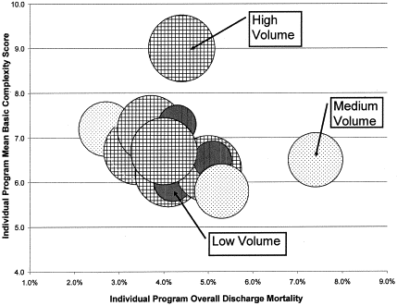
Jacobs JJ Eur J Cardiothorac Surg 2004;25:91

Slide 11
“Thus, the use of center-specific risk-adjusted outcome as a tool for quality assessment may be more reliable than relying on volume alone.”
Kalfa, Chai, Bacha Pediatric Cardiol e-pub 2014
Notes:
Program volume is now understood as a blunt stick for measuring outcomes.
There are much more sophisticated methods of assessing outcomes, such as Emile Bacha recommends…

Slide 14
STAT 1 Mortality Risk

Slide 15
STAT 2 Mortality Risk

Slide 16
STAT 3 Mortality Risk

Slide 17
STAT 4 Mortality Risk

Slide 18
STAT 5 Mortality Risk

Slide 19


Slide 20
2. Definitions

Slide 21
3. Data Collection: Retrospective
Patient Morbidity Table Patient Identifier: _________ U#K: ____________ DOB: ___________ Age at OR: __________ Weight: __________ Height: __________ BSA: __________ Dx: ____________________________ Procedure: _________________________________ Surgeon: _________ RACHS Code: _________ Procedure Code: _______ Adm Date: _______ Surg Date: _______ CCT: _____ CPB: _____ ICU D/C: ______ D/C Date: _______ ICU LOS: _____ NICU/MSNU LOS: ______ Hosp LOS: _____
1. Death-intraoperative/ intraprocedural | 2. Death – operative mortality | 3. Readmission – unplanned with 30 days of surgery or intervention 2 | 4. Multiple – multi-system organ failure/ multi- system organ dysfunction syndrome 3 | 5. Cardiac – cardiac arrest, during or following procedure 2 | 6. Cardiac – cardiac dysfunction resulting in low cardiac output 2 | 7. Cardiac – cardiac failure (severe cardiac dysfunction) 3 | 8. Cardiac – endocarditis, postoperative infective endocarditis 3 | 9. Cardiac – pericardial effusion, requiring drainage 3
10. Cardiac – pulmonary hypertension 3 | 11. Cardiac – Pulmonary hypertensive crisis (PA pressure > systemic pressure) 3 | 12. Cardiac – Pulmonary vein obstruction 2 | 13. Cardiac – systemic vein obstruction 2 | 14. Operative/ Procedural – bleeding, requiring reoperation 2 | 15. Operative/ Procedural – sternum left open, planned 1 | 16. Operative/ Procedural – sternum left open, unplanned 2 | 17. Operative/ Procedural – unplanned cardiac reoperation 2 | 18. Operative/ Procedural – unplanned interventional cardiovascular catheterization procedure 2
19. Operative/ Procedural – unplanned reoperation 2 | 20. Mechanical support utilization – Postoperative/ postprocedural mechanical circulatory support (IABP, VAD, ECMO, or CPS) 3 | 21. Arrhythmia – arrhythmia 1 | 22. Arrhythmia – arrhythmia requiring drug therapy 2 | 23. Arrhythmia – arrhythmia requiring electrical cardioversion or defibrillation 2 | 24.Arrhythmia necessitating pacemaker – permanent pacemaker 2 | 25. Arrhythmia necessitating pacemaker – temporary pacemaker 1 | 26. Pulmonary – chylothorax 2 | 27. Pulmonary – pleural effusion, requiring drainage 1
28. Pulmonary – pneumonia 1 | 29. Pulmonary – pneumothorax 1 | 30. Pulmonary – post-op/post procedural respiratory insufficiency requiring mechanical ventilatory support > 7 days 1 | 31. Pulmonary – postop/ postprocedure respiratory insufficiency requiring reintubation 2 | 32. Pulmonary – respiratory failure, requiring tracheostomy 3 | 33. Renal – renal failure, acute requiring dialysis at the time of hospital discharge 3 | 34. Renal – renal failure, acute requiring temporary dialysis with the need not present at hospital discharge 2 | 35. Renal – renal failure, acute requiring temporary hemofiltration with need for dialysis not present at hospital discharge 2 | 36. Infectious – sepsis 3
37. Neurologic – neurological deficit persisting at discharge 3 | 38. Neurologic – transient neurological deficit not present at discharge 2 | 39. Neurologic – paralyzed diaphragm (possible phrenic nerve injury) 2 | 40. Neurologic – peripheral nerve injury, neurological deficit persisting at discharge 2 | 41. Neurologic – Seizure 2 | 42. Neurologic – spinal cord injury, neurological deficit persisting at discharge 3 | 43. Neurologic – stroke 3 | 44. Neurologic – vocal cord dysfunction (possible recurrent laryngeal nerve injury) 2 | 45. Wound – wound dehiscence (sterile) 1
46. Wound – wound dehiscence (sterile), median sternotomy 1 | 47. Wound – wound infection 1 | 48. Wound – deep wound infection 2 | 49. Wound – mediastinitis 2 | 50. Wound – superficial wound infection 1 | 51. Other – other complication | 52. Other – other operative/ procedural complication | 53. None – no complications
Reference: Jacobs, Cardiology of Young 2008; 18(Suppl 2) pg 30-37.
Date Form Revised: December 9, 2009
Notes:
We then took the short list of intra and post-operative complications from the MultiSocietal Database group and made them into a table form which goes on each patient chart during hospitalization. The red numbers on this list of 52 complications are a severity coefficient that we developed by expert concensus. This was in an effort to help us factor in not only complication frequency of occurrence but also severity. We wanted to be notified if there was an excess of low severity complications but likewise wanted to discern if/when there was an occassional but life-threatening complication .
One other thing to note on this table even though it doesn’t transmit that well, is that the complications are grouped into organ systems. So for instance, complicaitons 26-32 are pulmonary complications, 33-35 are renal etc.

Slide 25
Notes:
Describe the concept of morbidity burden (frequency x severity)

Slide 26

Notes:
1. I love to operate

Slide 27
3. Data Collection: Prospective
Notes:
We then developed a system of capturing and analyzing complications prospectively. The real innovation here was the development of “Flags” that are generated in real-time when there is an excess of morbidity burden in our patients.
Procedures were stratified according to RACHS category and the cumulative morbidity burden for each category was calculated by summing the morbidity burden for each procedure in the risk strata. Average morbidity burden per procedure was calculated by dividing the cumulative morbidity burden in each RACHS category by the number of procedures in that category. For the O:E plots, the expected morbidity was provided by the average morbidity burden per procedure in a given RACHS category for year 1, whereas the observed morbidity was the actual morbidity burden of the procedure. Observed morbidity burden was then subtracted from expected morbidity and plots were generated first for overall complications experienced in the entire cohort and then for each of the 5 classes of complications. The slope of the line for each O:E plot was monitored. If the observed minus expected value increased by a predetermined amount over 5 cases, a flag was generated to indicate that those cases should be reviewed. The values at which all the flags occurred were empirically chosen based on complication incidence in the first year of data. The overall plot was flagged if there was an increase of more than 20 units over 5 cases. Arrhythmia, pulmonary, neurologic, and infectious plots were flagged if the O:E plot increased by 5 units over 5 cases. The cardiac/operative category was flagged if the O:E plot increased by 8 units over 5 cases.

Slide 32


Slide 33
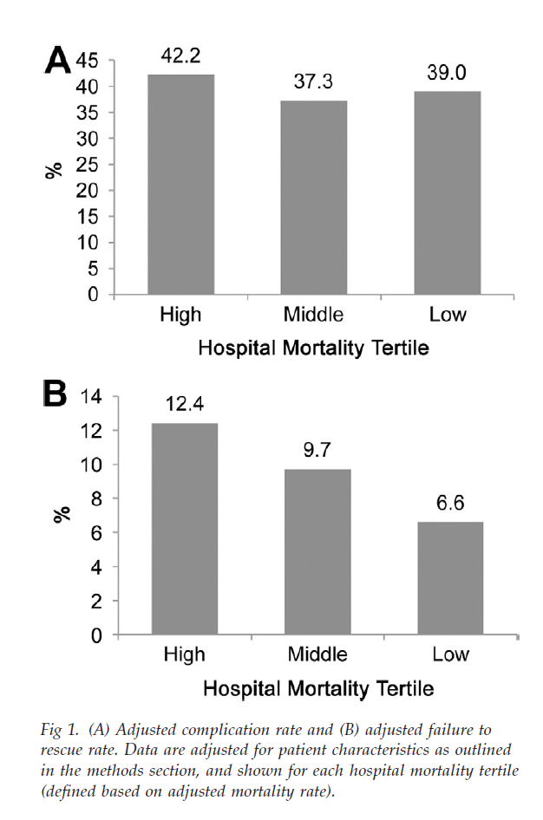

Slide 34


Slide 35
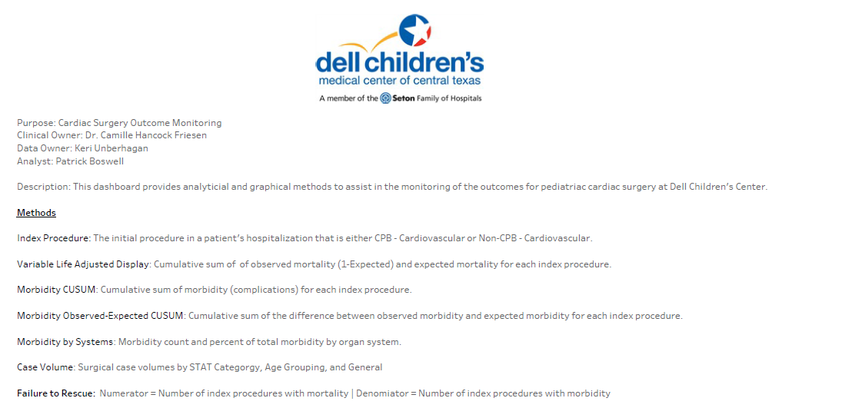

Slide 37
3. Data Collection: Prospective DCMC

Slide 38
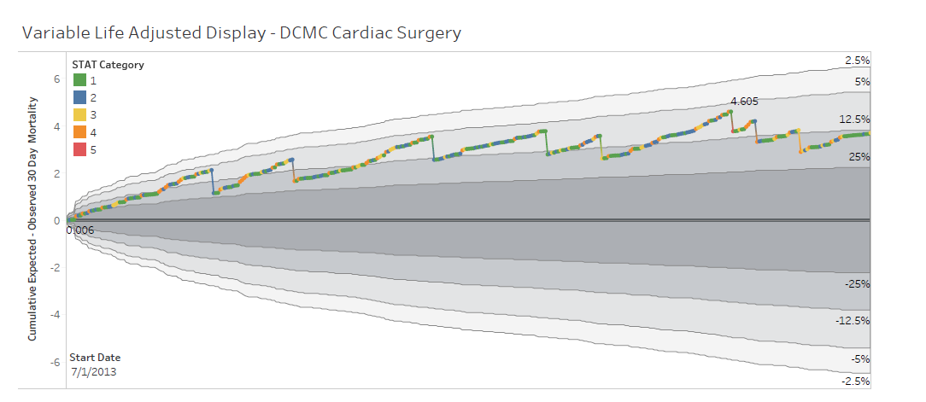

Slide 42
4. Data Analysis

Slide 45
5. Closing the Loop

Slide 46

Notes:
Blessing from Uganda

Slide 47


Slide 49
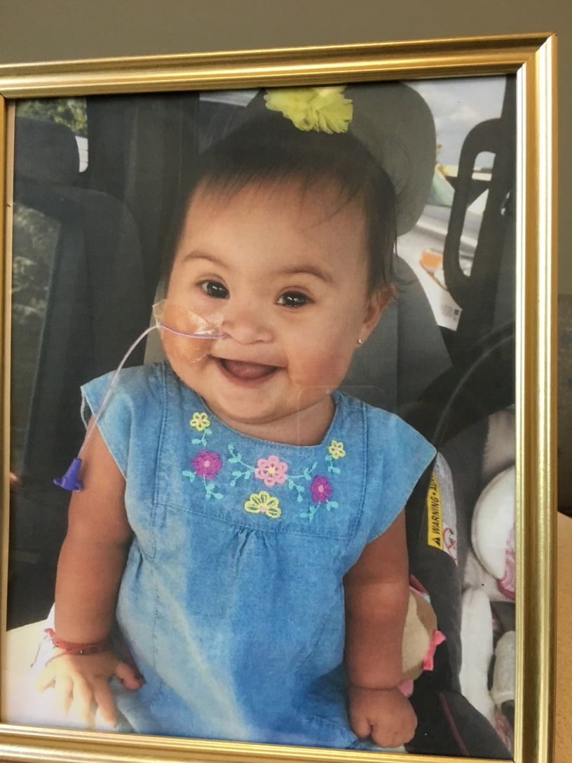

Slide 50


Slide 51


Slide 52
Conclusions
1. Data and systems are important (and coming to a theatre near you).
2. Risk stratification is critical to contextualize outcomes.
3. Resource allocation is critical to ensure accurate and timely data entry and extraction.
4. For us at DCMC Regional Heart Center, every data point is a child who lives in a family, who has a context and a story that we are a small part of.

Slide 53


