Slide 1
Leadership Essentials
Improving Injury Prevention Capacity in Texas
Stewart R Williams, Dell Children’s Medical Center

Slide 2
Situation in Texas
In 2009, DCMC conducted a study to describe the Texas injury and violence prevention workforce:
This study identified several areas of need among injury prevention programs in TX, particularly in evaluation of program strategies and formal injury prevention/public health training of staff who are conducting programming.
Less than half (48.8%) of the respondents reported having received any injury prevention training
Notes:
many had received training at a conference (76.6%)
OR
through an in-service training provided by their organizations (68.9%)

Slide 3
Governor’s EMS & Trauma Advisory Council (GETAC) Injury Prevention Committee
Developed a resource document (guidance) in 2014 to help enhance Texas injury prevention programming.
(i.e., Hospital-based Injury Prevention Components)
This resource describes five core components:
1-Data 2-Collaboration 3-Training 4-Strategies 5-Evaluation

Slide 4
A recent national survey (not yet published)
Surveyed 591 trauma centers throughout the United States.
316 (53%) Level I & II facilities responded.
Although trauma center-based injury prevention coordinators tend to have significant experience in the field, nearly one-third reported that they did not participate in any IVP training during the past five years.

Slide 5
Leadership Essentials
Improving Injury Prevention
Capacity in Texas

Slide 6
Essential Leadership
Hard Skills | Soft Skills
Are usually tangible, they come from experience, training, or practice. | Are usually related to personality, behavior, and emotional intelligence.
EXAMPLES: | EXAMPLES:
Budgeting & Finance | Active Listening
Strategic Planning | Mindfulness
Business Planning | Presence
Change Management | Creating Safe Space

Slide 7
Active Listening Exercise 1
Do this exercise at your table in pairs.
1st person: try to explain something interesting about yourself to your partner
2nd person: do not listen

Slide 8
Active Listening Exercise 2
Do this exercise at your table in pairs.
1st person: try to explain something interesting about yourself to your partner
2nd person: Listen (do not write anything down)

Slide 9
Debrief
What did it feel like to not be listened to?
What did it feel like not to listen?
What did it feel like to listen?
What did it feel like to tell your story when someone was listening?

Slide 10
Leadership Presence
Leadership presence is a tangible quality. It requires full and complete nonjudgemental attention in the present moment. Those around a mindful leader see and feel that presence.
Finding the space to lead
by: Janice Marturano

Slide 11
Characteristics of Leaders
Think of a time/episode where you had a difficult/poor interaction with a leader/person.
(Purposeful Pause)
Take a moment and write 3-5 sentences about this experience.
What did it feel like to think about this experience?

Slide 12
Characteristics of Leaders
Think of an individual who you’ve known who has influenced your own leadership.
(Purposeful Pause)
What characteristics did this leader have?

Slide 13
Leadership Presence
A mindful leader embodies leadership presence by cultivating focus, clarity, creativity, and compassion in the service of others.
Finding the space to lead
by: Janice Marturano

Slide 14
FOCUS
Notes:
Do you find your mind wandering during a conversation with a colleague, friend or family member? I often accuse my husband of having selective hearing, but the same can be said of me.
What are the ramifications of shaky focus?
Less productivity
What are your distractions? Email, social media, etc.
Have you ever attempted to start a project or report and get distracted? How easy or difficult is it to get back to the project once you’ve been distracted?
What about when you lose focus during a conversation? When your mind wanders, you lose connectivity to the other person.
Working with mindful leadership practices designed to strengthen focus, you can learn to notice when your mind begins to wander and redirect your attention back to the present. Over time, you can build your mind’s capacity to sustain focus. This helps you to connect to others.

Slide 15
CLARITY
Notes:
In the constant busy-ness of our lives, we often find ourselves moving from one subject to another so quickly that we don’t clearly see what is in front of us. We only see what we expect to see or want to see. We don’t use our ability to challenge our own assumptions.
Learning to stop long enough to notice when we are stuck in a model or reactive mode is part of mindful leadership. Sometimes clarity will help us decide that the right response to a situation is to do nothing, because there are times when the wisest decision is to wait and see what develops. Cultivating our ability to develop greater clarity applies not only to seeing clearly the events and environment around us, but also to see ourselves more clearly.

Slide 16
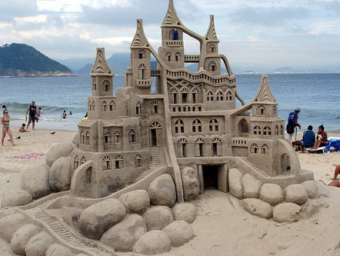
CREATIVITY
Notes:
How many of us have a packed calendar – just moving from one meeting to the next, one situation to the next, one patient to the next? We move from one task to the next. We’ve already learned that we need space, yet the spaciousness we require for creativity is minimal.
Creative solutions and ideas have a better chance of arising when the mind is not constantly busy with to-do lists.
How many times have you awakened in the morning with an answer to a problem? Or in the shower? The mind needs some time to pull away from analytical thinking for the creative and innovative solutions.
Why? Believe it or not, but a constant stream of thinking actually gets in the way of wisdom that lies deep within us. The good news is that you an train your mind to stand in a different relationship to the constant stream of thoughts and leave more room for creativity.

Slide 17
COMPASSION
Notes:
Compassion arises from our understanding of suffering and our desire to alleviate that suffering.
Compassion reminds us that when we see someone suffering, we are separated from the sufferer by only the thinnest lines of time and circumstance, and we feel a pull to lessen the suffering.
CRYSTAL
Just as we know that we can develop our body’s capacity for strength and flexibility, we also know from neuroscience that we can develop the mind’s capacity to focus, see clearly, be creative and act with compassion.
Cultivating compassion begins with self-compassion. For those who read Change your questions, change your life, remember the references to learner and judger. One of the things the book talks about is being in the judger pit, and often we are judging ourselves.
We may not think we need compassion because it may feel selfish or self-indulgent. Yet compassion cannot be truly offered to others until we first offer it to ourselves. It is an integral part of knowing ourselves more deeply and opening our hearts more fully.
Compassion helps us understand the overwhelming similarities we all share. The best leaders work in the service of others while also caring for their own well-being.

Slide 18
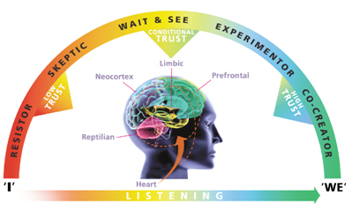
Upregulating

Slide 19
Safe Spaces
If leaders do not create safe spaces that support creative conversation and reduce the risk for amygdala hijack, there cannot be discovery
Source: Carolyn Cumpsty-Fowler, PhD

Slide 20
Creating Safe Spaces for Discovery
Requires Us to Use Both Sides of Our Brain
Notes:
Left side is analytical, processing
Right side is were we connect with people

Slide 21
Connections
To create a safe space for discovery, the most important connection a leader must have is to:
Other people in the space?
His/her own space?
What do you think?

Slide 22
Staying Connected to Yourself
Intrapersonal
Notice and name (describe)
Be curious (Learner vs. Judger)
Calm your anxious/fearful/defensive brain
Ground yourself (feet & hands)
Breathe – OUT – Deeply
Open your “heart space”
Hold Your Own Safe Space
Source: Carolyn Cumpsty-Fowler, PhD

Slide 23
Creating Safe Inter-Personal Space
Is not intuitive; may require us to change our usual experience/practice with meetings
Connect with the right brain first
Describe don’t interpret/explain
Listen in Learner
Make space for silence (Purposeful Pause)
Ask humble questions
Create an expectation of, and vision for a success (“what will it look like”)
Source: Carolyn Cumpsty-Fowler, PhD

Slide 24
Creating Safe Group Space
Involves everything we discussed previously, plus
Clarify expectation about:
How we will BE together
What we will DO together
Manage group expectations about:
How we will BE together
What we will DO together
Source: Carolyn Cumpsty-Fowler, PhD

Slide 25
Make careful decisions about what to introduce to the space and when
Less is more
People upregulate when they feel rushed
Sequence carefully
Start with items that can build connection and which are seen as important
Honor your commitments to time
People upregulate when they feel unheard
Agree on your “parking lot” of choice
Notice, name & tame threats to perceived safety – take a time-out & regather if necessary
Source: Carolyn Cumpsty-Fowler, PhD
Notes:
Consider developing and using a set of norms or even a social contract
At every meeting, get agreement around these
•It may be done verbally each time
•- very important if you anticipate conflict
•It can also be incorporated into agendas

Slide 26
Preserve the Space
Express Gratitude
Include an honorable closure whenever possible:
What I learned
What I appreciated
What I may do differently because of our time together
Source: Carolyn Cumpsty-Fowler, PhD

Slide 27
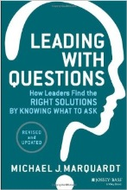
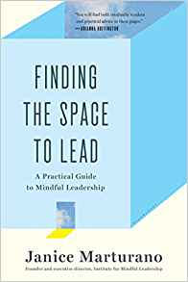
Resources

