Slide 1
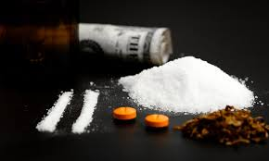
I Want a new Drug
Current fads and trends
with street drugs
CHAT conference
October 27, 2017
DeAnna S. Gillespie,
BSN, RN, CEN, CPEN
Emergency Department RN IV
Dell Children’s Medical Center
Austin, Texas

Slide 2
A little about me…
Just a few fun facts!
I have been an ED Nurse for a LONG time
I have rural and urban experience
I love ED nursing!
Lastly, MY “Join your professional organization” PSA!
I have no conflicts of interest to disclose and I am not being paid for this lecture.

Slide 3
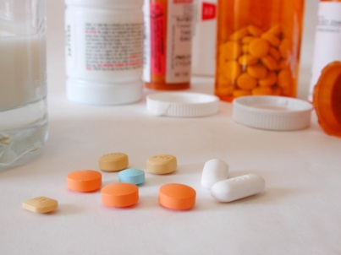
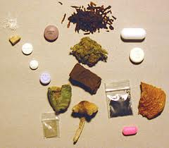
Why did I choose this topic?
The challenges involved in treating these patients are overwhelming. Where do we even begin?
The wording/terms patients use for various drugs changes constantly. It is hard to keep up with. I thought other nurses might have the same problem.

Slide 4
Objectives
Identify nine varieties of substances being used/abused currently in Texas, including increased your knowledge of the slang terms for each
Identify methods of abuse for each substance: how used/ingested
Identify some of the actions of these substances including signs of overdose
Identify current treatment modalities for the various categories

Slide 5
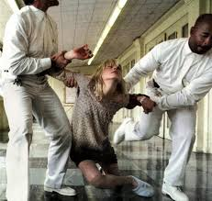
what categories will we cover during this lecture?
K-2
Bath Salts
Dextromethorphan
Inhalants
Ketamine
Methamphetamines
Pink
Palcohol
Prescription Drug Abuse-Opioids, Xanax, etc…

Slide 6
K-2 “Spice” Synthetic Marijuana

Slide 7
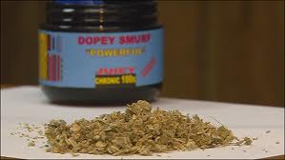
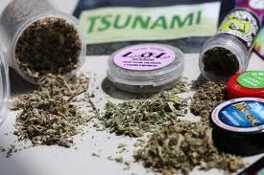
K-2
“KUSH”, “SPICE”, Bliss, Black Mamba, Bombay Blue, Fake Weed, Genie
Sold as dried leaves and marketed as incense/potpourri

Slide 8
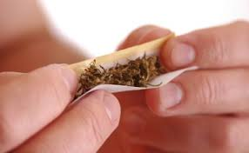
How is K-2 Used?
Generally smoked using joints or pipes
Can be made into a tea to drink
Generally around $8 per gram

Slide 9
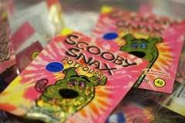
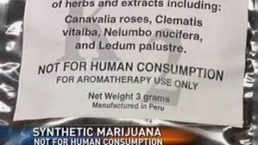
K-2 What does it do and how does the patient look?
Increased heart rate and BP
Paranoia
Panic attacks
Giddiness
Obviously not FDA approved…every batch unique!
“It is okay, nurse. It was just Spice…it is not illegal”.
“I got it from a different homeboy this time”.

Slide 10
K-2 Treatment/Care
Care is mostly supportive
No reversal agent
Airway support/management
CPR if patient develops cardiac arrest
How would we even know unless they told us…NOT DETECTABLE by UDS/SDS
Notes:
3 Star Generals

Slide 11
Bath salts

Slide 12
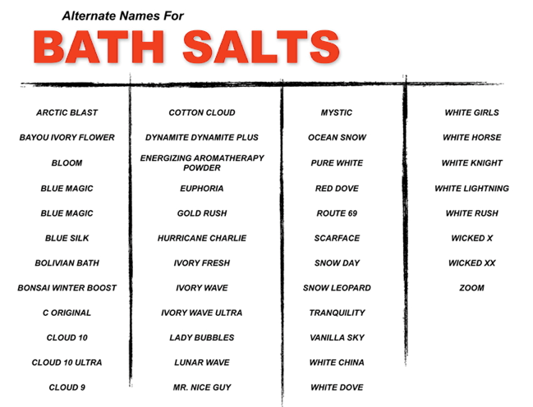
Bath Salts

Slide 13
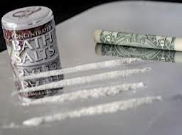
How are bath salts used
Snort
Smoke
Inject
Drink
Rectal

Slide 14
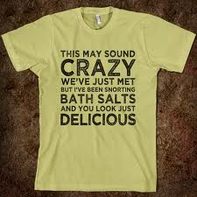
Bath Salts What does it do and how does the patient look?
Extreme agitation, Hallucinations, Violent Behavior
Chest Pain, High Blood Pressure
Suicidal Thoughts, Delirium
Acute Toxicity
Hyperthermia
Foaming at the Mouth
Parkinson-Type Limb Twitching

Slide 15
Bath Salts Treatment/Care
Stay safe and do not try to manage the patient alone
Use restraints if necessary
Manage aggression very carefully with high doses of sedation drugs such as Valium and Ativan/keep patient on monitor!
Treat hypertension aggressively with rapid acting medications like Nitroprusside/Nipride
Hypertension may also be managed by sedation/intubation
NOT DETECTABLE by UDS

Slide 16
DEXTROMETHORPHAN DXM

Slide 17
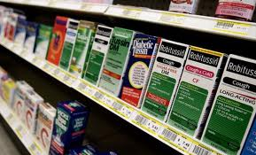
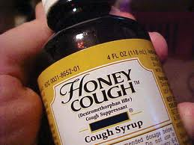
Dextromethorphan
DXM, CCC, Poor Man’s PCP, Robo, Skittles, Triple C, Velvet, Mucinex DM
Generally around $6 per 4 ounce bottle-Free if stolen!!

Slide 18
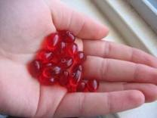
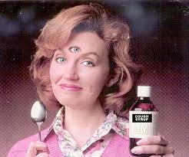
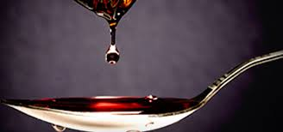
DXM How is it used?
Drinking large volumes of liquid or ingesting large volumes of pills

Slide 19
DXM What does it do and what does the patient look like?
Confusion, Inappropriate laughter
Agitation, paranoia, hallucinations, feelings of floating/changes in hearing and touch. Severe psychological dependence
Convulsions
Lethargy (which is complicated by nausea and vomiting), slurred speech, sweating, hyperthermia and spasmodic eye movement
Difficulty breathing (slow, labored, shallow or NONE)
Blood pressure changes and elevated HR
DEATH Especially in caucasians-poor DXM metabolizers
Mild SX 100-200 mg, Moderate SX 200-400mg, Severe SX 300-600mg and Loss of motor control 500-1500 mg

Slide 20
DXM Treatment/Care
Airway management-intubate if necessary
IVF for pressure support due to tachycardia
Vasopressors only if necessary, goal would be to manage the tachycardia to help maintain the Blood pressure
Zofran or other anti-emetics for nausea
Normal cooling measures for hyperthermia
Charcoal (drink if possible) and follow with laxatives
Narcan to reduce some of their high and help reverse other possible ingested substances
Very long acting drug…monitor for a longer period of time
How would you know, unless they told you…NOT DETECTABLE by UDS/SDS

Slide 21
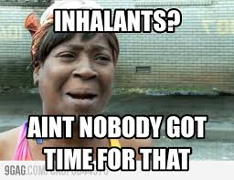
Inhalants

Slide 22
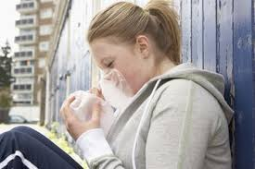
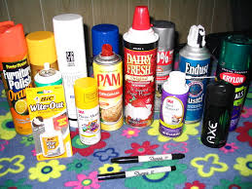
Inhalants
Gluey, Huffing, Rushing, Bagging and Whippets

Slide 23
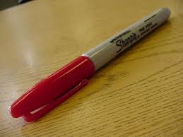
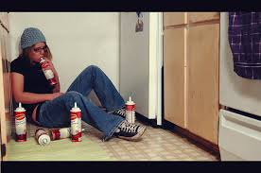
Inhalants how are they USED?
Glue, lighter fluid, cleaning fluids, paint, markers, compressed air, whipped topping
Anything that comes in a can and has propellants is a substance for potential abuse
Any item that has a strong vapor/fume is also a potential product for abuse

Slide 24
Inhalants What does it do and what does the patient look like?
Causes damage to the brain that control thinking, moving, seeing and hearing. Mild impairment to severe dementia
Slurred speech, inability to coordinate movement, euphoria, dizziness, drowsiness, severe headache
Long term users-weight loss, muscle weakness, disorientation, inattentiveness, irritability, depression and damage to the nervous system and organs
SUDDEN SNIFFING DEATH-single session event-usually after butane, propane and aerosols

Slide 25
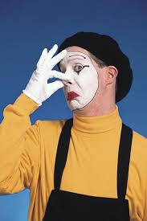
Inhalants Treatment/care
Manage violence
Manage hallucinations
Monitor for cardiac rhythm disturbances
It is rare for a patient to survive this type of event. These patients are frequently found with the propellant container still in their nose or possession, because they arrest during the huffing.
How will you know??
NOT DETECTABLE by UDS/SDS
Look for odors on clothing or unique smells

Slide 26
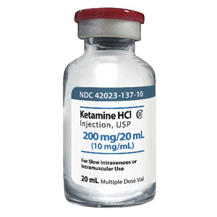
Ketamine

Slide 27
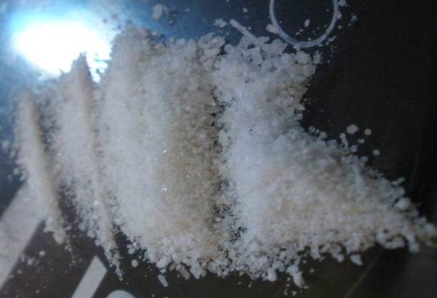
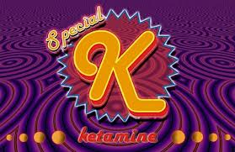
Ketamine
Horse Tranquilizer, Cat Valium, Special K, Kit Kat, Super Acid, Vitamin K, Purple, Jet
Generally not available for street purchase but at Ketamine parties it is $50-$150 per gram

Slide 28
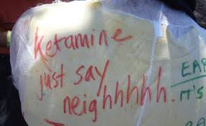
Ketamine How is it used
Clear Liquid and a white powder
Cut into lines and snorted or smoked-usually mixed with marijuana or cigarettes
Liquid form is injected or mixed into drinks
Generally costs around $350 per gram

Slide 29
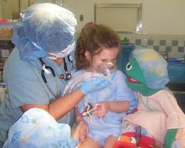
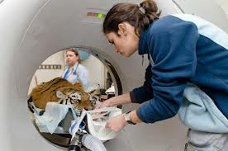
Ketamine
Intended use in sedations for procedures/anesthesia and more commonly now as a pain control medication in various places in the hospital, including the ED.
Can be used in the adult, pediatric or veterinary world
Normally a very safe drug other than a few inherent risks such as laryngospasm…when used in correct dose/situation

Slide 30
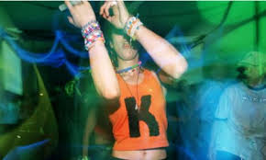
Ketamine What does it do and how does the patient look?
Distorts sight and sound
Agitation, depression, cognitive difficulties, unconsciousness and amnesia
Increased heart rate and blood pressure that then gradually decrease over 10-20 minutes
Depending on dose-can be unresponsive to stimuli
Involuntary eye movement, dilated pupils, salivation and stiffening of muscles. NAUSEA
Worst case…DEATH

Slide 31
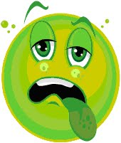
Ketamine Treatment/Care
Short acting drug but risk of over sedation is very high
Airway support/management-ETCO2 monitor
Monitor for risk of aspiration while sedated
Anti-emetics as needed
Be prepared to manage aspiration
Re-emergence phenomenon

Slide 32
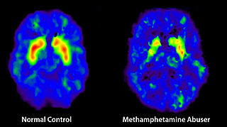
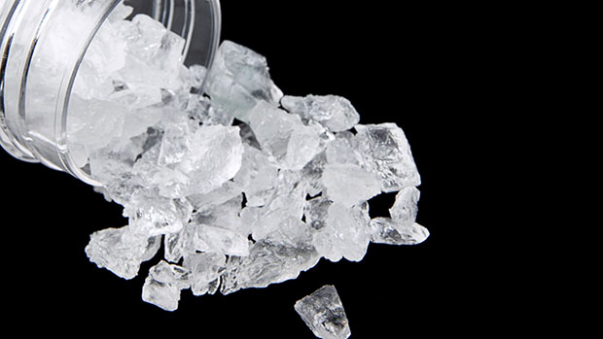
Methamphetamines

Slide 33
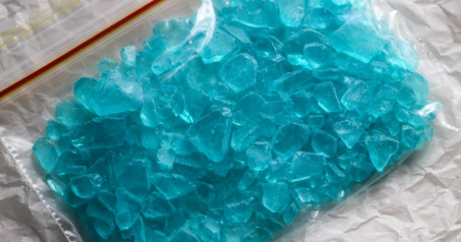
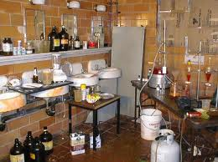
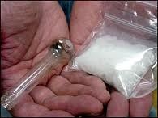
Methamphetamines
Bikers coffee, black beauties, chalk, chicken feed, crank, crystal, glass, ice, meth, poor man’s cocaine, speed, stove top, tina, trash, yellow barn, uppers, tweak

Slide 34
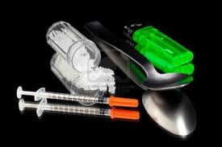
Methamphetamines How is it used
Regular meth is a pill or powder
Crystal meth resembles glass fragments or shiny blue-white rocks of various sizes
Swallowed, snorted, injected or smoked
Frequently go on a “run” where they inject as much as a gram of the drug every 2-3 hours for several days or until they either run out of drugs or become too disorganized to continue

Slide 35
Methamphetamines What does it do and what does the patient look like?
Increased wakefulness, increased physical activity, decreased appetite, rapid breathing and heart rate, irregular heartbeat, increased blood pressure and hyperthermia
Body temp can become lethal, convulsions, cardiovascular collapse and death
Anorexia, memory loss and severe dental problems

Slide 36
Methamphetamines Treatment/care
Circulation, Airway and Breathing
Physical and chemical restraints
Standard cooling methods
Benzodiazepines like Valium or Ativan
Gastrointestinal tract decontamination-charcoal and laxatives if overdose was taken by mouth…IF AWAKE!
IV fluids
EKG
Immediate life saving interventions if MULING

Slide 37
PINK

Slide 38
PINK
Common street names U4, PINK or PINKY
Opioid like drug that is 7 to 8 times stronger than morphine. Made most in clandestine chemical labs in China
2015/2016 increase in deaths that tested positive for this chemical
Prior to 2015, no reports of this in the United States
Schedule 1 as of Nov 14, 2016, “imminent health hazard with no accepted medical use”

Slide 39
PINK-What does it do and what do I expect to see in my patient?
Euphoria and psychoactive effects
Sedation, relaxation
Severe and possibly fatal respiratory depression
Pinpoint pupils
Seizures
Fatal overdose

Slide 40
Pink Used how, treatment & care
Can be swallowed, snorted or injected
Narcan has been shown to reverse at least a few cases
Treat your patient’s symptoms
Each batch will vary so there is no standard time frame for peak and lasting effects of the drug

Slide 41
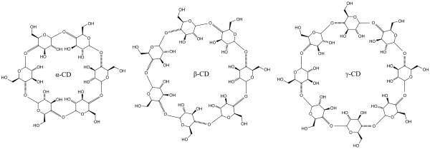
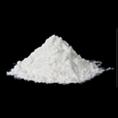
Palcohol

Slide 42
palcohol
April 2014-US Alcohol and Tobacco Tax and Trade Bureau approved labels for a produce called Palcohol that can be added to water to make an alcoholic beverage

Slide 43
Palcohol what is it??
Freeze-dried (sort of) vodka, rum, powderitas and other drinks!
Serves as a lightweight more portable form of alcohol
This product has been sold globally for many years but as of 2016 no company had been successful in selling in the US.
As of April 2017, it is LEGAL in the state of Texas BUT…Currently not available for sale (legally)

Slide 44
palcohol
It can be obviously added to water to make a drinkable product
It can also be snorted for faster onset
TREATMENT…
Just like an alcohol overdose
Support respiratory drive
Protect from aspiration of emesis

Slide 45
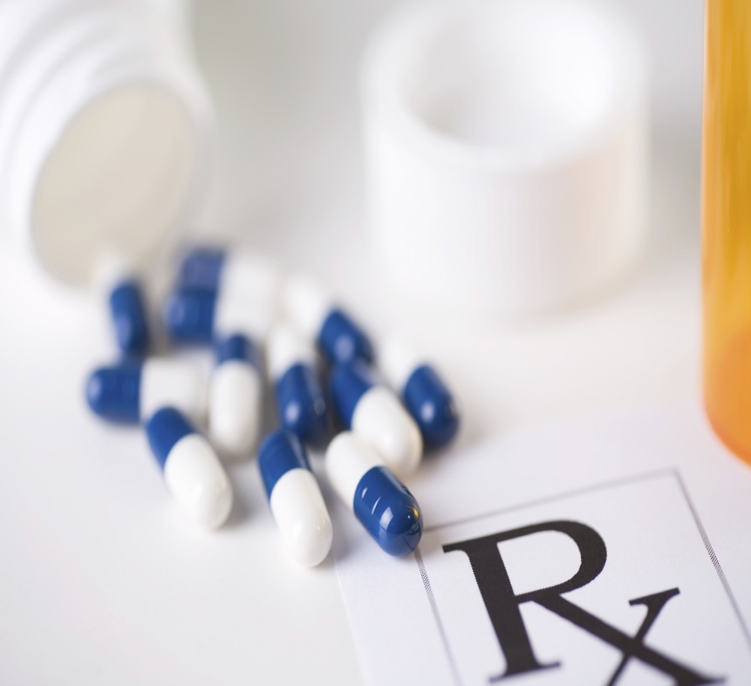
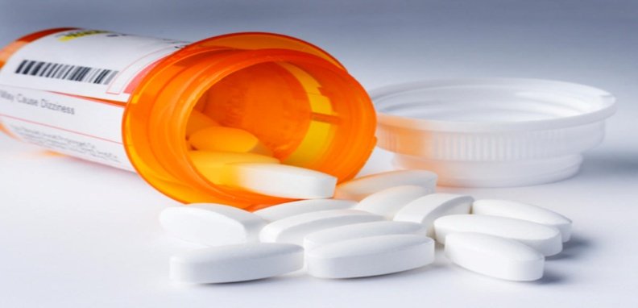
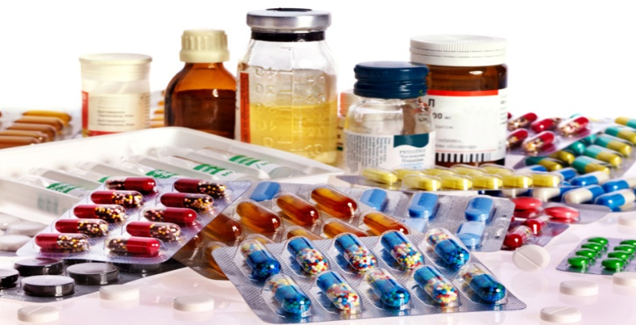
Prescription Drug Abuse

Slide 46
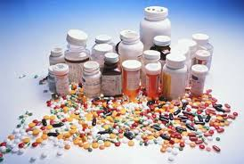
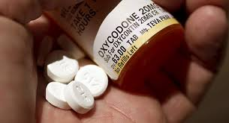
Prescription Drug Abuse
Most common prescription drugs for abuse include:
OPIOIDS….Oxycontin, Vicodin, codeine, morphine and fentanyl
BENZOs…XANAX, Ativan and Valium

Slide 47
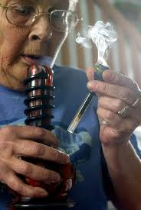
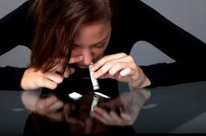
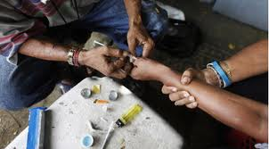
Prescription Drugs How are they Used
Drugs may be swallowed, smoked, sniffed or injected

Slide 48
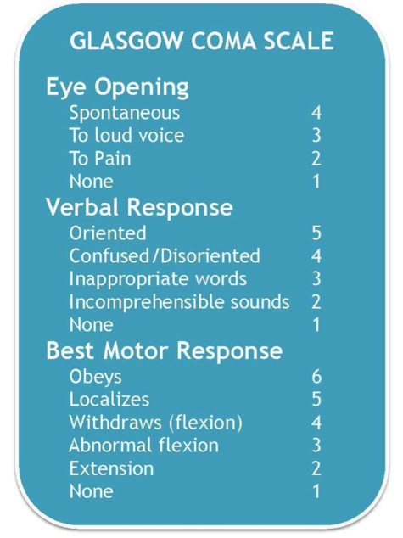
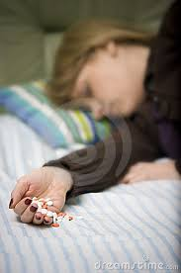
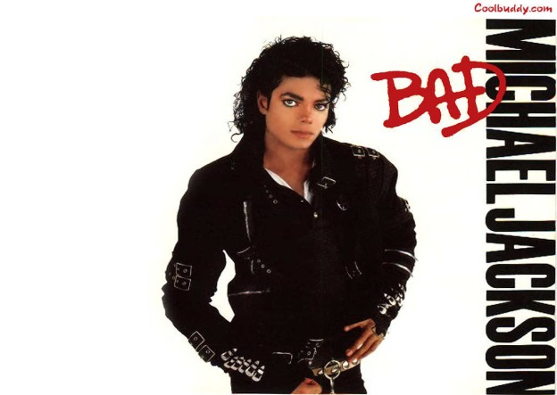
Prescription Drug Abuse What does it do and what does the patient look like?
Drowsiness is the most common symptom you will see
Slowed physical activity, constriction of pupils, flushing of the face and neck, nausea, vomiting and slowed, shallow breathing, difficult to keep awake or aroused

Slide 49
Prescription Drug overdose Treatment/care
Airway support/control
Aspiration prevention with anti-emetics
Narcan for Opioids –DOSE?
Romazicon for Benzodiazepines-DOSE?
Use caution because you are immediately dealing with drug withdrawal as well, especially if patient is a long term user versus a single use event
Notes:
Narcan 0.1 mg/kg IV Q2-3 may repeat PRN (up to 19 kg)…….IF 20 KG or greater: 2mg IV Q2-3 minute then follow with a drip
Romazicon 0.01 mg/kg IV with a max dose of 0.2mg/dose DRIP to follow if effective

Slide 50
Let’s Wrap it up…
Remember to call POISON CONTROL anytime
Open Discussion…NO HIPAA…what substance was your worse OD. Hardest to care for?
Questions/Comments

Slide 51
Resources
Central Texas Poison Control-Jennifer Watson-Educator, Personal interview
National Inhalant Prevention Coalition www.inhalants.org
Drug Enforcement Administration www.dea.gov
A guide to teen drug slang www.imom.com
Office of Diversion Control www.deadiversion.usdoj.gov
Drug.org
CDC.gov
Personal interviews with multiple teenagers/patients, including my own children!

Slide 52
Thank you for your time
DeAnna S. Gillespie BSN, RN, CEN, CPEN
dsgillespie@ascension.org
512-947-2308

