Slide 1
Contraception: Helping adolescents prevent cramps, bleeding and babies
Maria C. Monge, MD
Adolescent Medicine
Dell Children’s Medical Center
Assistant Professor of Pediatrics, Dell Medical School, University of Texas at Austin

Slide 2
Objectives
Review different contraceptive options available to teenagers including indications, pros and cons
Investigate non-contraceptive reasons for use of these medications

Slide 3
Disclosures
No relevant financial disclosures

Slide 4
41%
57%
27%
8.8%
1 in 8
Notes:
2015 YRBS data
41% have had intercourse (24% of 9th graders to 58% of 12th graders)
57% of teens say that they used a condom at LSI
27% of 9-12th grade were using any BC method at LSI
8.8% used dual method (condom and BC)
1 in 8 adolescent females will become pregnant before the age of 20.
https://pixabay.com/en/holding-hands-couple-1149411/

Slide 5
46th of 50
Notes:
2014 final data on birth rates
National rate 26.5/1000
Texas rate 39.7/1000
NOT ALL bad news… rates are declining, but teen pregancy rate in US remains well above that of other developed countries
Hamilton BE, Martin JA, Osterman MJK, et al. Births: Final data for 2014. National vital statistics reports; vol 64 no 12. Hyattsville, MD: National Center for Health Statistics. 2015.
Image: By TUBS [CC BY-SA 3.0 (http://creativecommons.org/licenses/by-sa/3.0)], via Wikimedia Commons

Slide 7
LARC?
Notes:
By CLPramod (Own work) [CC BY-SA 4.0 (http://creativecommons.org/licenses/by-sa/4.0)], via Wikimedia Commons
https://commons.wikimedia.org/wiki/File%3AAshy-crowned_sparrow-lark.jpg

Slide 8
LARC
Long Acting Reversible Contraceptives
WHY?
They work!
Adolescents prefer them
Adolescents continue them
Notes:
Efficacy: Typical use: Failure rate Nexplanon 0.05%; LNG IUD 0.2-0.9%; Copper IUD 0.8%
Trussell J. Contraceptive failure in the United States. Contraception 2011;83(5);397–404. Epub 2011 Mar 12.
Raine TR, Foster-Rosales A, Upadhyay UD, Boyer CB,Brown BA, Sokoloff A, et al. One-year contraceptive continuation and pregnancy in adolescent girls and women initiating hormonal contraceptives. Obstet Gynecol 2011;117:363–71.
Mestad R, Secura G, Allsworth JE, Madden T, Zhao Q, Peipert JF. Acceptance of long-acting reversible contraceptive methods by adolescent participants in the Contraceptive CHOICE Project. Contraception 2011;84:493–8.
Contraceptive Choice project – Wash U
12 month continuation rate of LARCs in teens: 86%
Versus Pills: 40-50%; DMPA: 20%, Patch/Ring: 20%
(Maslyans*** JPAG 2015
https://flic.kr/p/4HzMZB

Slide 9
Currently available LARCs in US
Copper IUD
ParaGard®
Levonorgestrel IUD
Mirena®
Liletta®
Kyleena®
Skyla®
Etonogestrel subdermal implant
Nexplanon®

Slide 10
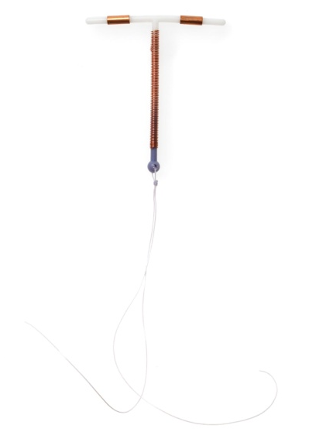
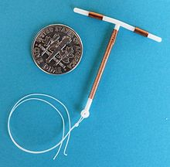
Copper IUD
Mechanism of action
Pros
Cons
Notes:
Mechanism: copper ion produces inflammatory reaction in endometrium that is not conducive to sperm viability, sperm motility, ovum survival
Pros: non-hormonal, does not affect ovulation, 10 year duration
Cons: bleeding can be heavier, insertion
Hatcher RA, Trussell J, Nelson AL, Cates W Jr, Stewart F,Kowal D, editors. Contraceptive technology. 19th rev. ed. New York (NY): Ardent Media; 2007.
Rivera R, Yacobson I, Grimes D. The mechanism of action of hormonal contraceptives and intrauterine contraceptive devices. Am J Obstet Gynecol 1999;181:1263–9.
Stanford JB, Mikolajczyk RT. Mechanisms of action of intrauterine devices: update and estimation of postfertilization effects. Am J Obstet Gynecol 2002;187:1699–708.

Slide 11
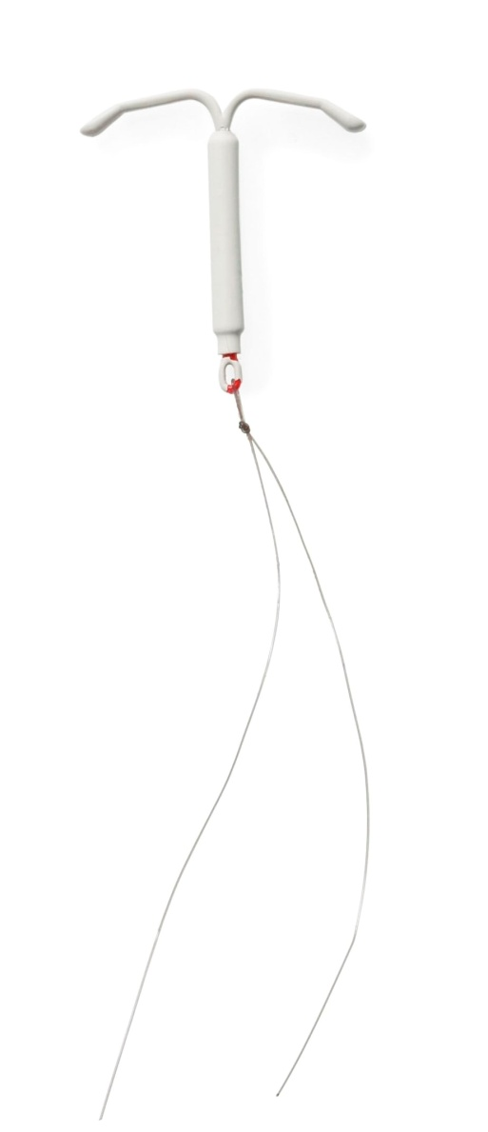
Levonorgestrel IUD
Mechanism of action
52mg
52mg
19.5mg
13.5mg
Pros
Higher vs lower dose
Cons
Higher vs lower dose
Notes:
Mirena – 20mcg/day initially
Liletta – 18.6mcg/day initially
Skyla – 14mcg/day initially
Similar effects as copper IUD
Also causes endometrial suppression and changes in cervical mucus
Pros: Periods lighter/shorter, though less so with 13.5mg; smaller inserter and smaller size with 13.5
Cons: Hormone containing, unpredictable spotting 1st 3-6 months

Slide 12
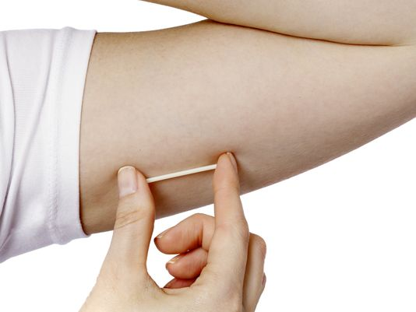
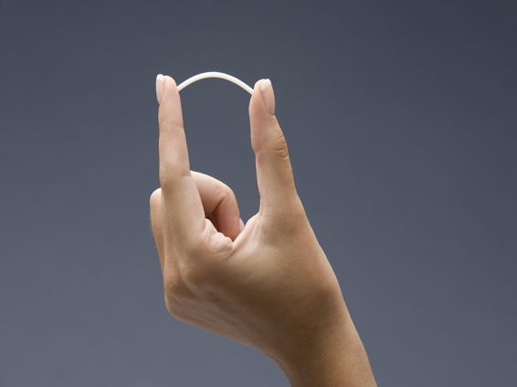
Etonogestrel subdermal implant
Mechanism of Action
Pros
Cons
Notes:
Prevention of ovulation, cervical mucus thickening
Dose of etonogestrel 68mg
3 years
Improved cramping
Short insertion (<1min) and removal (<3 min) time
Weight gain in 6-12%, but only 2.3% discontinue due to weight gain, but studies challenging because no control group in most
Bleeding is the common reason for disconituation, but some women also with amenorrhea – Bleeding pattern in 1st 3-6 months most reliable predictor of continued bleeding pattern
Darney P, Patel A, Rosen K, Shapiro LS, Kaunitz AM. Safety and efficacy of a single-rod etonogestrel implant (Implanon): results from 11 international clinical trials. Fertil Steril 2009;91:1646–53.
- - -
Modified from: Clinical Advisory Committee for New Developments in Contraception: The Single-Rod Implant. Minor Weight Gain [PowerPoint slide]. Washington, DC: Association of Reproductive Health Professionals (ARHP). 2007 July. Available at www.arhp.org/core. Accessed August 1, 2012.
Mansour D, Korver T, Marintcheva-Petrova M, Fraser IS. The effects of Implanon on menstrual bleeding patterns. Eur J Contracept Reprod Health Care 2008;13(suppl 1):13–28.

Slide 13
Depot Progesterone
Mechanism of action
Contraindications
How supplied
Pros
Cons

Slide 14
Progesterone only oral pills
Mechanism of action
Contraindications
How supplied
Pros
Cons

Slide 15
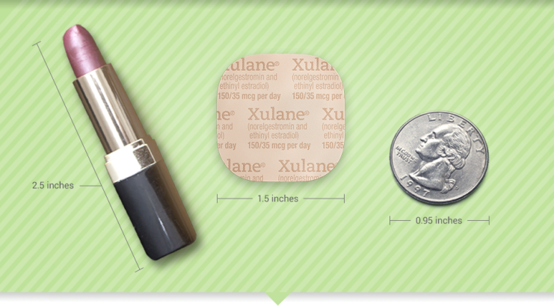
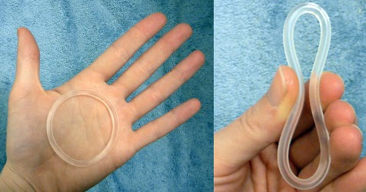
Combination estrogen/progesterone products
Mechanism of action
Contraindications
How supplied
Pros/Cons

Slide 16
Medical Indications for use of hormone containing contraceptives
Dysmenorrhea (cramping)
Menstrual irregularity (once etiology investigated)
Heavy menstrual bleeding
Menstrual related epilepsy
Menstrual related migraines
Endometriosis
PMS/PMDD
Acne
Cyclic breast pain
PCOS
Hygiene/quality of life
Among others….

Slide 17
Case #1
14 year old F with severe dysmenorrhea. Menarche was at age 11. Periods are monthly and last for 6 days. Changes pads every 3-4 hours for the first 2 days. Cramps are bad enough that she misses at least 1 day of school every month. She has tried 600mg ibuprofen TID without appreciable change in symptoms. She is otherwise healthy, takes no medications. What would you recommend?

Slide 18
Case #1
Change to high dose naproxen sodium
Nothing, too young for hormones and just add acetaminophen
Combination product (pill/patch/ring) in regular monthly dosing
Combination product (pill/patch/ring) in extended cycling

Slide 19
Case #1, continued
When you are explaining the contraindications of estrogen, Mom notes that pt has had 2 times where she had vision changes before the onset of a headache in the past. What do you recommend now?

Slide 20
Case #1, continued
Combination product with extended cycling
Injectable depot progesterone
Progesterone only daily pill
Nexplanon implant
Progesterone containing IUD

Slide 21
Case #2
12 yo F comes in to ER for evaluation of 1 month of persistent vaginal bleeding. First period was 2 months ago. This is the second time that she has had a period and it has not stopped. There is a family history of easy bruising, nosebleeds and heavy menstrual bleeding. You are suspicious for a bleeding disorder.

Slide 22
Case #2 ,cont
Aside from ordering a CBC and workup for bleeding disorder, what would you recommend to stop bleeding?
High dose NSAIDs
Tranexemic acid
Combination e/p product
Depot progesterone
Oral progesterone

Slide 23
Main Learning Points
LARCs are first line contraceptives in adolescents. They are well-tolerated and continued.
There are multiple medical indications for hormonal contraceptive medications.
Before use of estrogen, be sure to understand and screen for contraindications
If menses are not regular, investigate why before starting hormones

