Slide 1
Provider/Associate Care Team (PACT):
Care for the Caregiver
Marsha Nichols
Risk Management Specialist
Seton Healthcare Family
Austin, Texas

Slide 2

Reflection
“So, instead of continuing to focus on preventing suffering…Perhaps we should begin entering the suffering, participating in so far as we are able…entering the mystery and looking around for God...”
- Eugene H Peterson (Theologian, Author, Poet)
Notes:
REFLECTION: So, instead of continuing to focus on preventing suffering - which we simply won't be very successful at anyway - perhaps we should begin entering the suffering, participating in so far as we are able - entering the mystery and looking around for God. In other words, we need to quit feeling sorry for people who suffer and instead look up to them, learn from them, and - if they will let us - join them in protest and prayer. Pity can be near-sighted and condescending; shared suffering can be dignifying and life-changing - Eugene H Peterson – Job – The Message

Slide 3

Provider/Associate Care Team (PACT) Program
PACT is a standardized program designed to provide emotional support to providers and associates immediately following a significant work-related event.
Provides:
  Help for the “Second Victim”
  Immediate peer-to-peer support
  Trained peer supporters
  24/7 Accessibility
  Confidentiality
  Proactive approach, rather than reactive
Reinforces:
  Collaborative culture
  Patient safety
  Existing support programs, i.e. Schwartz Rounds and Employee Assistance Program

Slide 4
“Second Victim” Defined
A second victim is a health care provider involved in an unanticipated adverse patient event, a medical error and/or a patient-related injury who becomes victimized in the sense that the provider is traumatized by the event.
Frequently, these individuals feel personally responsible for the patient outcome.
Many feel as though they have failed the patient, second guessing their clinical skills and knowledge base. - Scott 2009

Slide 5
Second Victim: National Statistics
  Initial study: 15% of 1,160 clinicians reported anxiety, depression
    15% of those seriously considered leaving profession
  Follow up study: 30% of 898 clinicians reported emotional distress, concerns regarding ability to do their job
                - Pratt 2012, Scott 2011
Notes:
Point out that 15% seriously considered leaving the profession.

Slide 6

Emotional Impact Survey
3,100 Physicians Surveyed said…
^{(33%)} Even near misses resulted in increased job related stress
^{(42%)} ^{Sleep disturbances}
^{(42%) Reduced job satisfaction}
^{(44%)} ^{Loss of confidence}
^{(61%)} Increased anxiety about future errors
^{(82%)} Reported they would be interested in counseling after a serious error occurred
(90%) Physicians did not feel the hospital or healthcare organization adequately supported them in coping with error-related stress
^{- Waterman 2007}
Notes:
33% of near misses led to increased job related stress even though the error never touched the patient.
I.e., medication error that never reaches the patient because the error is caught before the medication is given
82% of physicians were interested in counseling after a serious event occurred.
90% did not feel hospital or organization supported them adequately.
This is where PACT comes in!

Slide 7




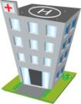


Second Victim: High Risk Scenarios
Patient reminds staff member of their own family or loved ones
Pediatric cases
Medical errors
Unsuccessful codes
First death experience
Unexpected patient demise
Violence towards staff
ER
Rapid Response Teams
Flight Teams
Oncology
Surgery
Obstetrics
ICU’s
Code Blue Teams
Pediatrics

Slide 8
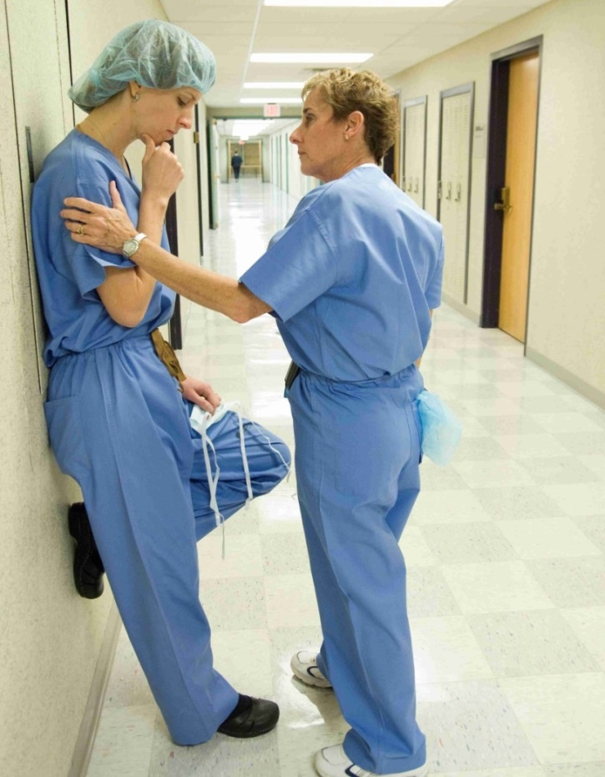
Second Victim: Outcomes
Associated with INCREASE in:
Depression
PTSD
Burnout
Subsequent adverse events
Associated with DECREASE in:
Quality of life
Empathy
Notes:
Implications of not having support after a second victim experience: Why do we care?
Depression, PTSD and increase in subsequent adverse events
Code example: Will my team and I function optimally? Will I be able to make objective decisions? This type of questioning can lead to another adverse event.
Burnout: Implications for ourselves, our loved ones, our patients, and how we work together with one another within the institution.
Decrease in empathy: Maybe if I don’t care so much, I won’t hurt so bad when adverse events occur.

Slide 9
Second Victim Trajectory
Chaos & Accident Response
Intrusive
Reflection
Restoring Personal Integrity
Enduring the Inquisition
Obtaining Emotional First Aid
Moving On
Thrive
Survive
Drop Out
Impact Realization
Notes:
GENERAL INTRODUCTION ONLY. DO NOT GO THROUGH EACH STAGE HERE. DESCRIPTIVE SLIDES TO FOLLOW.
Introducing the stages simply for your education – no need to memorize the stages.
Also no expectation that you are to “fix” these stages
Intention is simply so that you have a big picture view of the process that one might go through following a second victim experience.
Next slides demonstrate these stages through quotes from actual second victim clinicians who were interviewed as part of a UM second victim study. I am not going to read the quotes to you but simply describe characteristics of each stage.

Slide 10
Second Victim Conceptual Model
Dropping Out
Second Victim Reaction
Psychosocial
Physical
Unanticipated Clinical Event
Clinician Recovery
Surviving
Thriving
Notes:
Conceptual model designed by UMCH of the typical second victim experience and potential outcomes.

Slide 11
Second Victim Three-Tiered Intervention Model
Referral network with:
-Employee Assistance Program
-Chaplain
-Social Work
-Clinical Psychologist
Ensure availability and expedite access to prompt
professional support/guidance.
Trained peer supporters and support individuals such as patient safety officers or risk managers who provide one-on-one crisis intervention, peer supporter mentoring, team debriefings and support through investigation and potential litigation.
Tier 3
Referral Network
Department/unit support from manager, chair, supervisor, fellow team member who provides one-on-one reassurance and/or professional collegial critique of cases.
Tier 2
-Trained Peer Support
-Patient Safety & Risk Management
Tier 1
Unit/Department Support
Notes:
This slide looks strange because it is “live” and the sections should move in as they are addressed and the speaker hits the forward button.
University of Missouri – forYou program developed to address second victim phenomenon.
* First Tier – Management Team (manager, supervisor, or co-worker): THINK OF THIS AS GENERALIZED EDUCATION FOR THE ENTIRE INSTITUTION.
Projected to address the needs of ~ 60%
PACT peer supporters and program team are the educators on second victim phenomenon that is the basis for tier 1.
TIER 2: Projected to Address ~30% of identified victims
Interventions Include:
One on one peer support
Team De-Briefings
Referring staff with additional needs
TIER 3: Projected to address ~ 5-10% of wounded healers needs
Expedited referral to other resources – EAP, chaplaincy, social work.

Slide 12
Second Victim: New Conceptual Model
Dropping Out
Unanticipated Clinical Event
Second Victim Reaction
Psychosocial
Physical
Clinician Recovery
Surviving
Institutional
Response
Clinician Support
Thriving
Tier 3
Tier 2
Tier 1
Notes:
New conceptual model includes institutional response.
Prompt recognition of second victim and early support may be able to facilitate greater number of positive outcomes following adverse events.

Slide 13
Seton Emotional First Aid Survey
2,167 co-workers (15% of workforce) responded
  46% of those surveyed experienced a significant work-related event within the last 2 years that caused emotional/moral distress or anxiety, depression or concerns about their ability to do their job.
    Of those respondents, 39% reported receiving NO support.
    Of those receiving support, 54% felt that the support they received was not adequate.
Notes:
Before we really start the day, just want to give you a brief overview of PACT and how it came about here at Seton.
As we started this project in late 2014, we followed the best practice model from the University of Missouri Health System and we sent out an “all-site” survey to every hospital in the Seton system. Without any extra incentive to do so, more than 2,000 people responded and this is what they said.
Go through slide
[This is an example of the information the health ministry should provide as justification for creation of the program. Although everyone is generally in favor of this type of program because it seems like the right thing to do, these numbers help illuminate the need.]

Slide 14
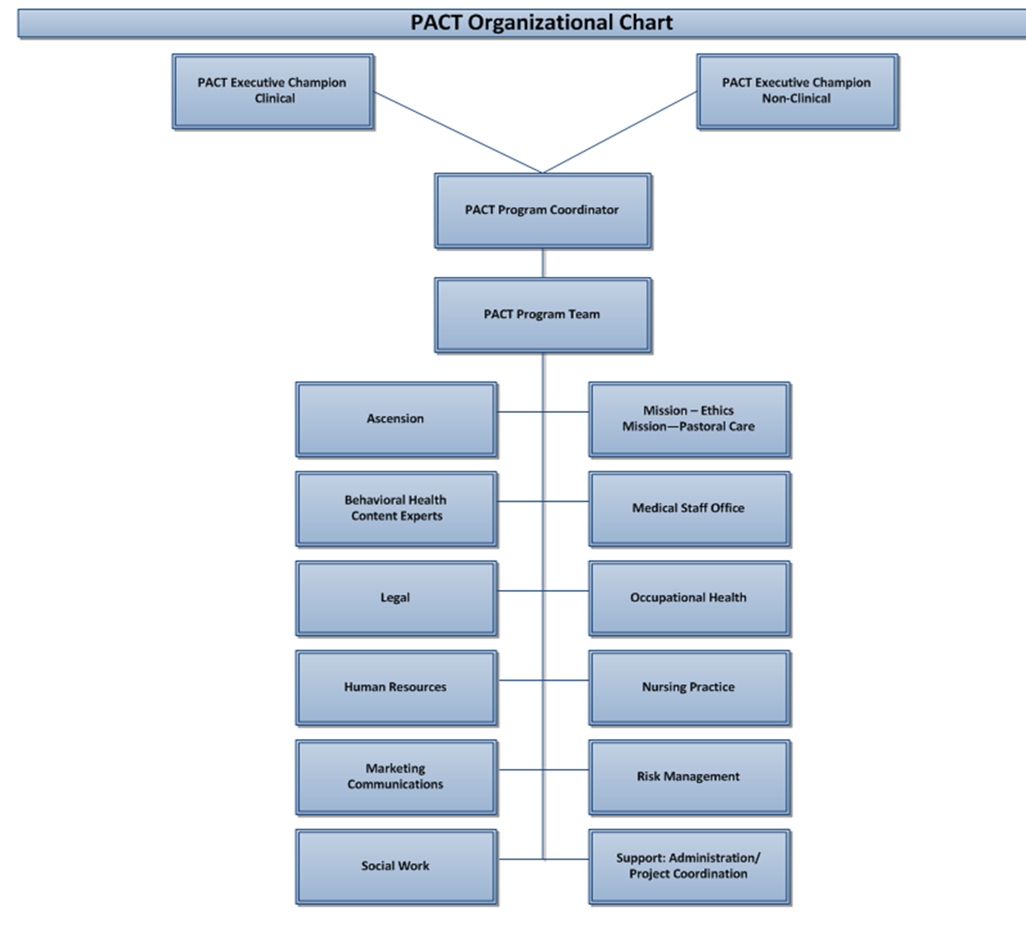
PACT Program Team Formation

Slide 15
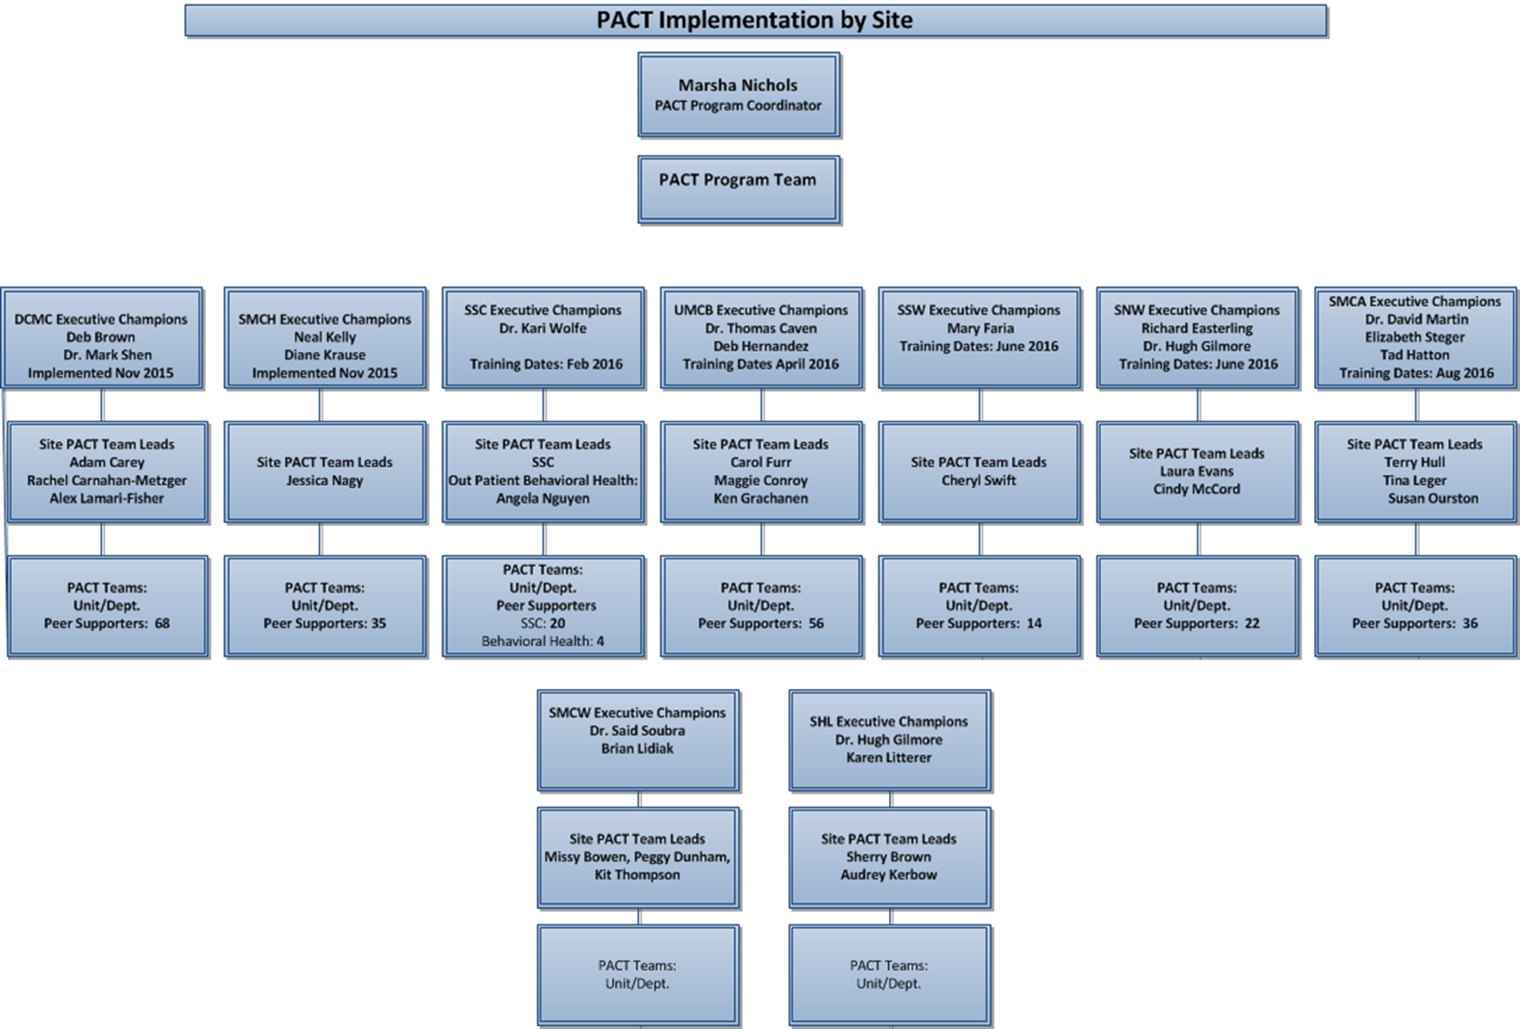
PACT Site Team Formation

Slide 16
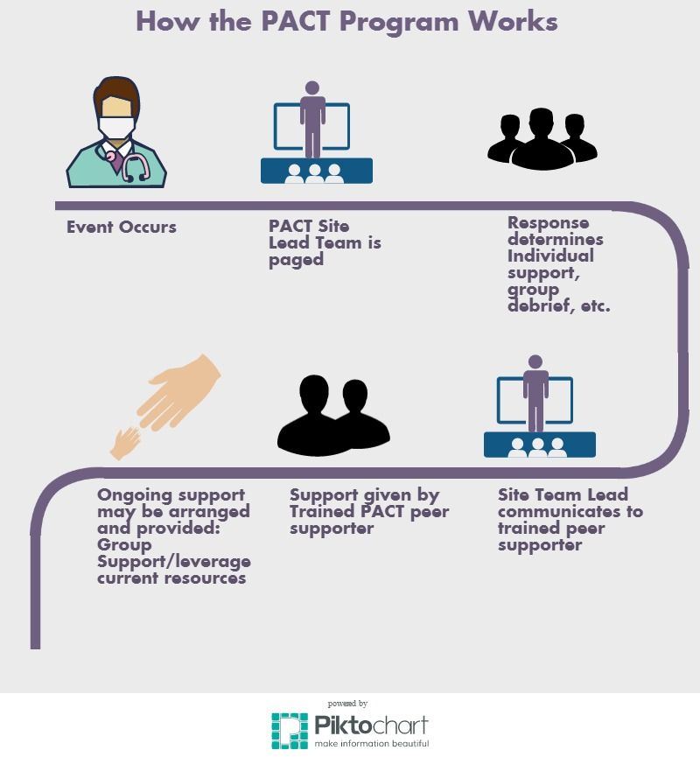
How PACT Works
Peer Supporter’s
Promise:
When you reach out for help . . . I will Provide a listening presence
When you express your painful experience . . . I will use all my training and skill to Assess the need
When concerns and questions turn into fear . . . I will Care as a friend, with compassion, empathy and in confidence
When there is need for ongoing courage . . . I will Turn to all available resources to restore your hope

Slide 17

Peer Supporter Recruiting
Network Operations Council
Network Presidents Council
Site Operations Councils
Medical Executive Committees
Daily Brief Meetings
Nursing Network and Site Meetings
Recruitment of Site Leads
Unit Elevator Speeches
  With Goodies!

Slide 18
Peer Supporter Training: Agenda
    8:00 – 8:45 a.m. Overview/ Introductions
8:45 – 9:45 a.m. Second Victim
9:45 – 10:00 a.m. BREAK
10:00 – 11:45 a.m. Confidentiality, Listening, Role Play
11:45 – 12:30 p.m. Lunch
12:30 – 2:15 p.m. Intervention Process, Role Play, Break
2:20 – 3:00 p.m. Coping, Resources and Difficult Scenarios
3:00 – 3:10 p.m. BREAK
3:10 – 4:00 p.m. Risk Management and PACT Logistics
4:00 – 4:10 p.m. Evaluations
4:10 – 4:30 p.m. Closing

Slide 19
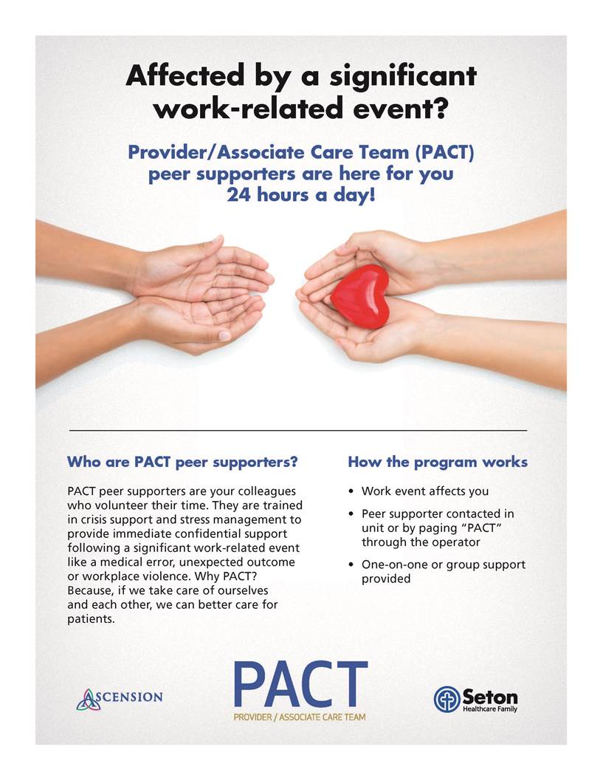
PACT Awareness Campaigns

Slide 20

Provider/Associate Care Team (PACT) Program
Implementation: 11 Hospitals and SAO
  Nov. 2015-January 2017
Peer Supporters Trained: >450
  Nurses
  Physicians, residents
  Other clinical (RT, PT, etc.)
  Non-clinical (translators, security, patient access)
Deployments: >580 (550+ Individual
        and 30+ Group)
“You never know how important a program is until you are in need of its services. This program is very impressive. It helps us to reconnect with ourselves when an unexpected turn takes place. It also reconnects the staff who may be in a temporary state of disbelief. It reminds me of a Lighthouse…helping the boat find its way back to shore. God Bless this program.”

Slide 21
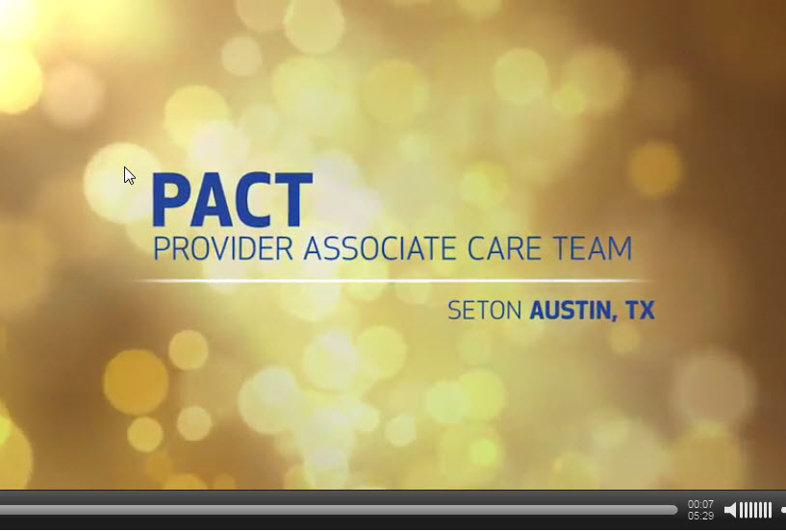
PACT VIDEO: Ascension Mission and Values Award
Notes:
Every two years, Ascension holds what’s called a convocation in Washington D.C. It’s a time when the most senior leaders from across Ascension gather and refocus on the mission and values of the organization and confer about the best way to continue that mission and those values.
As part of the convocation, a “Mission and Values” award is given to an individual, a program, and an organizational component that most strongly demonstrate the mission and values of Ascension in a concrete way. There are many nominees from across the country in each category. At the 2016 Convocation, we are proud to say that the PACT program won the “Mission and Values” award in the “organizational component” category. We are so happy that the Ascension leaders see PACT as an organizational component, rather than merely as a program, because it’s our hope that the atmosphere of emotional safety that PACT helps create will truly become part of our organization’s culture, rather than just being seen as a program.
So, as a result of the award, the Ascension media department put together this video to show at the awards ceremony at convocation. We are so happy they did that because we feel like it is such a useful tool to describe what PACT is, and we hope that you will use it when you go back to your areas and educate your co-workers about PACT. We’ll talk about logistics more later, but this video can be found on the PACT intranet page.
We hope you enjoy it! Play the video.
Internet Site Location: http://www.viddler.com/v/4751189a

