Slide 1
Burnout, Resilience & Rebirth
Krista Gregory, M.Div, BCC
The Center for Resiliency
Dell Children’s Medical Center,
Austin, Texas
Notes:
Who am I and why am I here?
Have worked in healthcare about 25 years.
My professional training/residency, etc. is a hospital chaplain.
I worked for 10 years in the adult hospital world, then spent time in European and African healthcare settings, then returned to the States and moved into the pediatric world.
My view of care of

Slide 2

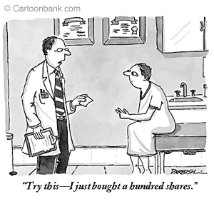
Disclosures
No relevant disclosures to report pertaining to conflict of interest,
commercial interest or
financial interest.

Slide 3
Learning Objectives
Recognize the most common causes of stress and burnout in the changing healthcare profession.
Describe the effects of burnout on quality and patient care.
Identify qualities of resilience in healthcare practitioners..
Discover reliable techniques to restore your passion for the healthcare profession..

Slide 4
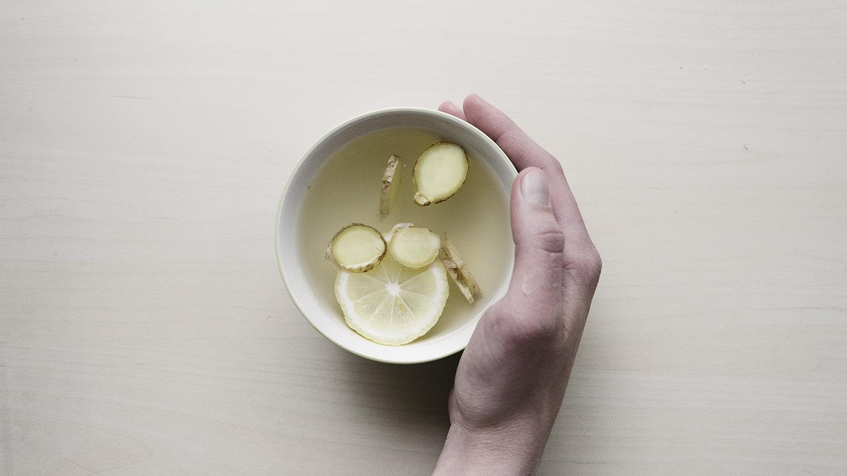
What we are NOT going to talk about …
Time Management
Eating Right
Exercise
Self Care
Massage
Getting plenty of sleep

Slide 5
Who am I and why is this important ?
Notes:
Short intro – Let me give you some context about who I am and why this is important to me…
My dad was a doctor – general surgeon who became an ophthalmologist. Grew up around hospitals and healthcare with lots of significant sick family members.
Ended up doing a residency in hospital chaplaincy after graduate school and I loved it. I loved being with people of all different walks of life, all different cultures and religions and interpretations of the world. I loved medicine and trauma and the adrenaline rush. I actually “enjoyed” being with people in death. My favorite area was always the ICU or the ED. But I really loved all the different languages and cultures of the hospital itself – the culture of the ICU as opposed to Acute Care, Surgery as opposed to NICU. Surgeons versus pediatricians. The languages were different, the personalities were distinct. It was so fascinating to me.
I always saw my role from the very beginning as being one to care for staff, even before patients. Because if the hospital community wasn’t happy, neither would the “Visitors” be.
I worked in the adult world for 10 years. Took a hiatus to work in Europe and Africa with migrating peoples for a bit. And returned to the US to join the pediatric hospital world. I’ve been there ever since.
Several years ago, the Program Director of the Pediatric Medical Residency Program came to me….

Slide 6
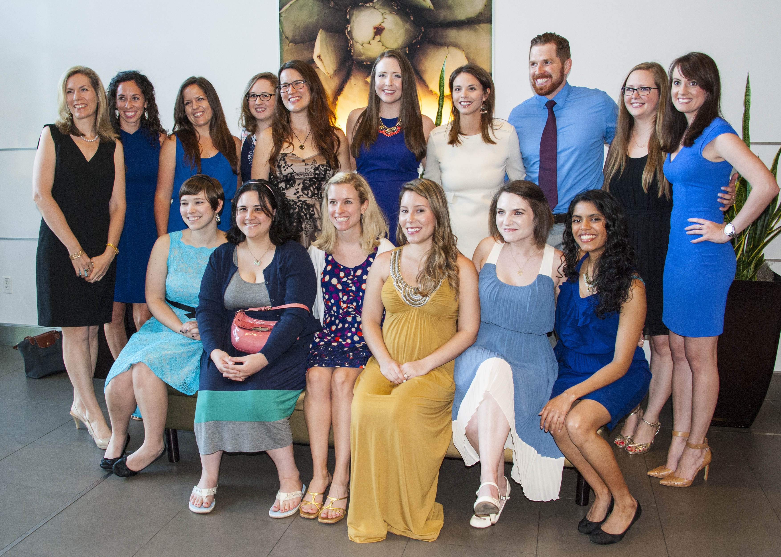
Notes:
Pediatric Medical Resident Class of 2015 – Dell Medical School.
That’s when I really crawled inside their world and realized what a mess it was.
In those early days…
Review SBAR
As they graduated, I realized that I was cheering them off into a world that would eat them alive…. And I vowed to try to do something about that.
Then I began to study burnout…

Slide 7
A few disturbing facts at the beginning…

Slide 8
400
The estimated number of U.S. physicians who take their own life each year.

Slide 9

Leading causes of death of
medical students:
    Accidents
2. Suicide

Slide 10

More than 55 % of U.S. physicians in 2014 reported experiencing professional burnout, up 10% from just three years earlier.
Notes:
Quick poll – How many of you would say that you have experienced burnout in your profession? Keep your hands up – once in your career, twice, three times, you’re in it now.

Slide 11
How many of you have experienced burnout in your profession
at least once?
Notes:
Quick poll – How many of you would say that you have experienced burnout in your profession? Keep your hands up – once in your career, twice, three times, you’re in it now.

Slide 12

The risk of burnout for healthcare practitioners is twice as great as that of the broader U.S. population.
Notes:
Who suffers more – female physicians and nurses or male physicians and nurses?

Slide 13

51% versus 43%

Slide 14
What are the most common causes of stress and burnout in health care?
Notes:
What do you think?

Slide 15
“My armor is wearing thin.
I’m going to have to retire soon.”
~ Pediatrician
Notes:
What do you think he meant by that?
What I used to think… What I’ve discovered in the last few years…

Slide 16

It’s been said that every patient loss is a memorial added to the little cemetery where physicians return to pray.
Dr. Robert Schlechter,
Surgeon-in-Chief,
Dell Children’s Medical Center
What’s the biggest drain on resilience at work?
Harvard Business Review
Jan 2015
Notes:
In the beginning, this is what I thought…. I was so naïve.
Then I put all my eggs in one basket and really got into the weeds….

Slide 17
Other factors that can cause burnout…
Notes:
What I began to learn through ethnographic studies and what was confirmed in some research, not all….
Developmental – stage you are in your profession.
Discipline – physicians versus advanced practitioners. Surgeons versus pediatricians.
Changes in healthcare….. Politics, layoffs, reductions, pressure to perform, SSE committees.
Electronic Medical Record…

Slide 18
“If you want me to take care of myself, I’m going to need a personality transplant.”
~ NICU Clinical Manager
Notes:
Healthcare providers give to others. Don’t take care of self.

Slide 19
What is the biggest drain on resilience at Work?
Survey responses from 835 employees.
Notes:
Harvard Business Review – British employees, January 5, 2015

Slide 20
Maslach Burnout Inventory
What does it measure?
Notes:
Measures: Burnout, Depersonalization (Loss of Empathy) and Reduction of Personal Achievement.

Slide 21
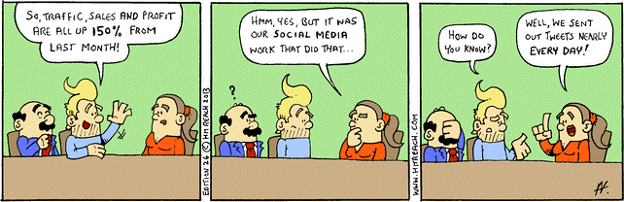
Is there a causal relationship between HCAHPS and burnout measures of providers?
Notes:
2014 published study: Florida Hospital System.
causal relationship between a measure of improved physician well-being and improved HCAHPS (Hospital Consumer Assessment of Healthcare Providers and Systems) scores revealed the possibility that the patient experience, at least as it relates to physician communication, may be intrinsically tied to the physician experience.
2010 – NIH published a study about Nurse Burnout and Patient Satisfaction –

Slide 22
Medscape Psychiatry
Physician Burnout and The Patient Experience:
Are We Overlooking a Crucial Element?
Herdley O. Paolini, PhD; Kathleen C. Gibney, PhD; Richard J. Bogue, PhD
October 31, 2014
Notes:
2014 published study: Florida Hospital System. Introduction
We recently conducted a smallscale,
uncontrolled pilot study postulating a causal relationship between a measure of improved
physician wellbeing
and improved HCAHPS (Hospital Consumer Assessment of Healthcare Providers and Systems) scores
revealed the possibility that the patient experience, at least as it relates to physician communication, may be intrinsically tied to
the physician experience.
Is it possible for physicians to deliver personalized, relational, compassionate care while they are dissatisfied, burned out, and
disengaged? Is it possible to achieve the results that are needed as they relate to the physicianpatient
relationship by
deploying a quick script or course on the "right words to say, eye contact, and sitting down with the patient," regardless of the
physician's state of mind or health?
The results of cognitive attempts, quick fixes, and the teaching of new skills have so far not been encouraging. We believe that
it is because we try to train a physician in technique when what we desire is a compassionate presence. For that, we need
physicians who are experiencing their own wellness, who can access the language of caring, and who will find a way to be
resilient in maintaining their health, wellness, and satisfaction in the midst of the overwhelming everchanging
business of
medicine.
Although the results of this pilot study are insufficient to draw definitive conclusions, one observed phenomenon was a jump in
the institution's HCAHPS score from the 2nd to the 41st percentile. But the real finding is the potential value of additional
research. The issue is important to physicians and hospital leadership alike, because it focuses on what may be the missing
element in today's efforts to transform healthcare.
Physician Health and Wellness
It is common knowledge that the patient experience, marked most noticeably by HCAHPS scores, is at the forefront of
healthcare institution priorities. Much is riding on its success: reimbursement for both hospitals and physicians, and the loyalty
of patients, which in turn can assure future viability in a competitive market. In the past 30 years the Patient Experience
Movement has undergone tremendous change, driven first by the need of hospitals and physicians to generate volume; second
by the Joint Commission, which outlined the need to improve strategies for both quality and service processes; driven now by
HCAHPS and the 2010 Affordable Care Act's use of patient experience data in the calculation of reimbursement.
One of the areas measured by the HCAHPS standardized survey is physician communication with patients, which is scored on
a combination of answers to three questions:
During this hospital stay,
• How often did doctors treat you with courtesy and respect?
• How often did doctors listen carefully to you?
• How often did doctors explain things in a way you could understand?
These three questions are related to an underlying assumption based on relational values, such as an ability to be present,
attentive, and caring. Physicians struggle with the consumeroriented,
commercialworld
model of delivering care and with data
collection that focuses on patient satisfaction without understanding or incorporating the complexities of patient care. Some
have argued that patient satisfaction is a misguided goal. It can be said that this is not the entertainment or hospitality
industry. Some physicians hold that it is demeaning to healthcare professionals to empower patients to grade them without first
engaging patients in understanding and participating in the process of healing.
causal relationship between a measure of improved physician well-being and improved HCAHPS (Hospital Consumer Assessment of Healthcare Providers and Systems) scores revealed the possibility that the patient experience, at least as it relates to physician communication, may be intrinsically tied to the physician experience.
2010 – NIH published a study about Nurse Burnout and Patient Satisfaction –

Slide 23


Slide 24
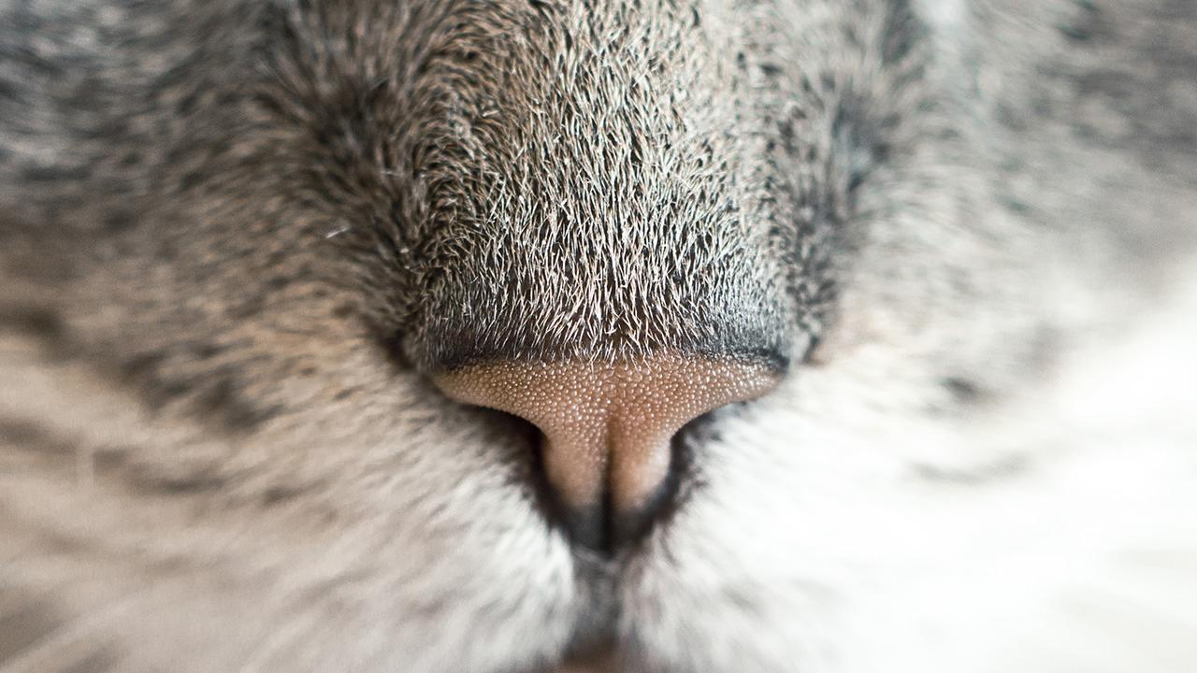
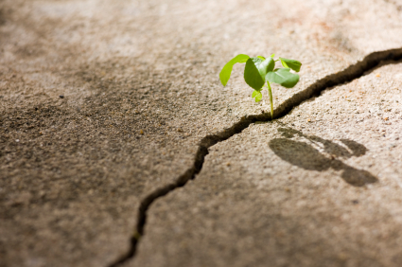
Resilience
Notes:
What is it? Who has it? YOU DO! Overused word these days.

Slide 25
the capability of a strained body to recover its size and shape after deformation caused especially by compressive stress
Notes:
This is the non-human definition, but I like it best.

Slide 26

Who has it?

Slide 27

Notes:
Bridge walking. We walk them to the end of the bridge. We have to go back and get another patient.
How does knowing that prevent burnout?

Slide 28
It’s in the storm that resilience is born.
~ Galveston, 2008
Hurricane Ike

Slide 29
Resiliency through an exploration of
Self-Compassion.
?????
Notes:
Experience with Kristen Neff’s material. Research study at Dell Children’s.

Slide 30

Three elements of self-compassion:
Kristin Neff, PhD
1.
first
2.
second
3.
last

Slide 31
Self-kindness vs.
Self-judgment
Kristin Neff, PhD
1.
first
2.
second
3.
last
Notes:
Self-compassion entails being warm and understanding toward ourselves when we suffer, fail, or feel inadequate, rather than ignoring our pain or flagellating ourselves with self-criticism. Self-compassionate people recognize that being imperfect, failing, and experiencing life difficulties is inevitable, so they tend to be gentle with themselves when confronted with painful experiences rather than getting angry when life falls short of set ideals. People cannot always be or get exactly what they want. When this reality is denied or fought against suffering increases in the form of stress, frustration and self-criticism. When this reality is accepted with sympathy and kindness, greater emotional equanimity is experienced.

Slide 32
Common humanity vs. Isolation
Kristin Neff, PhD
1.
first
2.
second
3.
last
Notes:
Frustration at not having things exactly as we want is often accompanied by an irrational but pervasive sense of isolation – as if “I” were the only person suffering or making mistakes. All humans suffer, however. The very definition of being “human” means that one is mortal, vulnerable and imperfect. Therefore, self-compassion involves recognizing that suffering and personal inadequacy is part of the shared human experience – something that we all go through rather than being something that happens to “me” alone.

Slide 33
Mindfulness vs. Over-identification
Kristin Neff, PhD
1.
first
2.
second
3.
last
Notes:
Self-compassion also requires taking a balanced approach to our negative emotions so that feelings are neither suppressed nor exaggerated. This equilibrated stance stems from the process of relating personal experiences to those of others who are also suffering, thus putting our own situation into a larger perspective. It also stems from the willingness to observe our negative thoughts and emotions with openness and clarity, so that they are held in mindful awareness. Mindfulness is a non-judgmental, receptive mind state in which one observes thoughts and feelings as they are, without trying to suppress or deny them. We cannot ignore our pain and feel compassion for it at the same time. At the same time, mindfulness requires that we not be “over-identified” with thoughts and feelings, so that we are caught up and swept away by negative reactivity.

Slide 34

Back when I started practicing medicine, emotional involvement in a case was considered a sign of weakness. People just stuffed their feelings.
Phillip Berry, M.D.
Retired Nephrologist
Notes:
Dave Bank’s, Associate Chair of Clinical Affairs, DMS - comments in Pilot Study.
Used to compartmentalize everything. No heart for my patients. Thought I had to do that to survive. What we are finding is the opposite. What we are learning affects patient outcomes, patient satisfaction, medical mistakes,
Crystal Bedford’s story -

Slide 35

Why did you get into this work?

Slide 36

Thanks!
The Center for Resiliency at
Dell Children’s Medical Center, Austin, Texas
klgregory@ascension.org

Slide 37
Credits
Special thanks to all the people who made and released these awesome resources for free:
Presentation template by SlidesCarnival
Photographs by Unsplash

