Slide 1
Abusive Head Trauma
What every nurse should know
Kelly Gettig, APRN, MSN, CPNP-PC/AC
CHAT conference
October 27, 2017

Slide 2
Learning Objectives
Describe the prevalence of NAT and distinguish the signs and symptoms of non-accidental vs accidental trauma in children.
Justify the use of non-biased screening for NAT using an objective and systematic algorithm.
Review radiologic findings in skeletal injuries and abusive head trauma and discuss multiple case scenarios.
Illustrate the importance of identifying abuse in its early stages, before fatal or near fatal abuse occurs.
Argue the importance of a high index of suspicion for abusive head trauma (AHT) with non-specific presenting symptoms.

Slide 4
Epidemiology
702,000 substantiated cases of child abuse in 2014
1546 deaths
Estimated <5% of physical abuse reported to CPS
50-80% of fatal/near fatal cases – evidence of prior abuse
Past history of abuse – 50% chance repeat abuse; 10% chance of death
Notes:
US Dept Health & Human Services Child Maltreatment 2014
Deaths – 80% are < 3 yrs of age; 80% perpetrators are a parent
Estimated - <5% of physical abuse episodes reported to CPS – Gilbert et al – studies linking self reports to official stats provide direct evidence of under-reporting.
50-80% with prior abuse – documented confessions of perpetrators describe multiple episodes of shaking (Clarke)
Letson et al (2016) – AHT over 2 yrs at four tertiary children’s hospitals. 232 pts with 22 deaths (10%); 31% had a total of 120 prior opportunities to idenitfy abuse. The most common prior opportunity was vomiting 31.6%, prior CPS contact 20%, bruising 11.7%.
7% children experience abuse at some point during childhood – Rajarem et al, 2011
5-35% experience abuse at some point during childhood – studies in high income countries US< UK< New Zealand, Italy, Finland, Portugal (Gilbert)
Last quote – frequently quoted estimate dating back to pedi textbooks – 1968 (Saunders). Still holds true.
Texas leads nation in child abuse deaths with 150-200/yr and 50% deaths are in families with previous CPS history
180 CPS workers for 15,000 reports to investigate; sadly many abuse deaths happen in Texas in foster homes (13 in 2013-2014)
Recommended caseload/person – 17; Texas average - 28

Slide 5
Clinical manifestations
Soft tissue injury – most common type of injury
Bruising, bites, burns, pattern injuries
Face, neck, ears, torso, buttocks
Intraoral trauma
Petechiae
Notes:
TEN region – torso (covered by girls’ bathing suit), ears, neck
Torn frenulum

Slide 6
Notes:
“burned face in shower” and scratched himself with fingernails vs dog scratched him

Slide 7
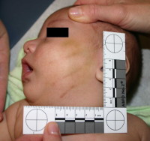
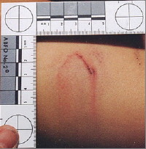
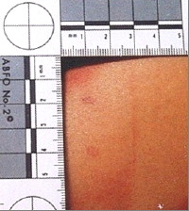
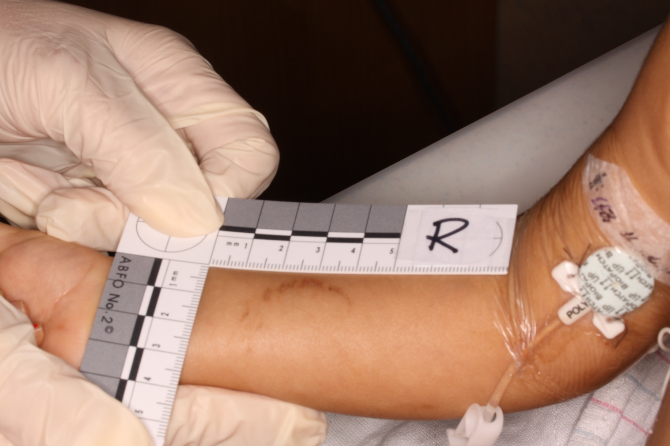

Slide 8
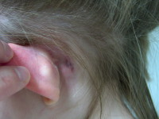
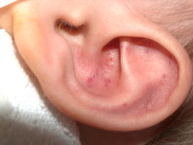
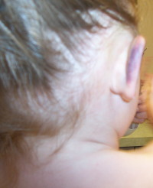
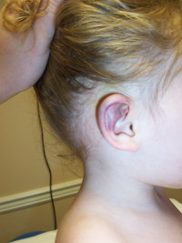
Notes:
Mastoid bruising; petechial ear bruising from punch/blow to head
(Lower) Bruising to pinna from blow to head

Slide 9
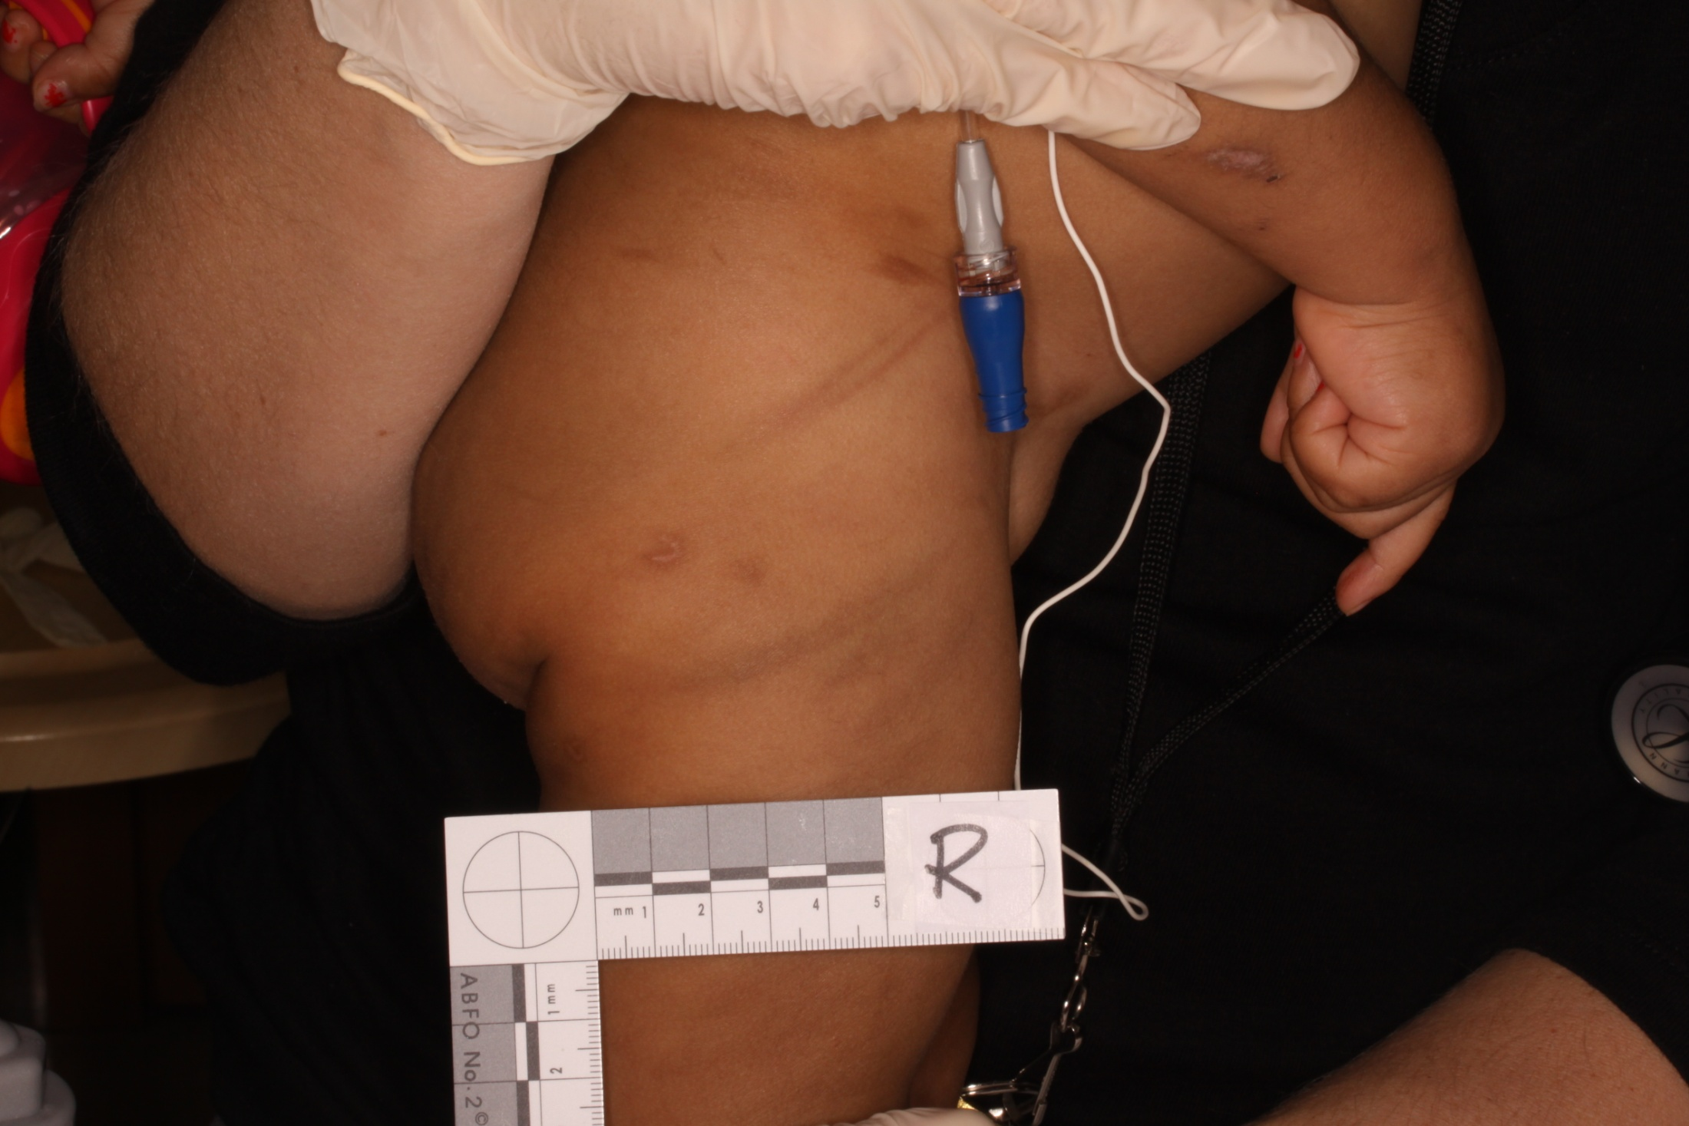
Notes:
Linear pattern bruising from cord on 2 yo with multiple bruises, bites, burns (face)

Slide 10
Clinical Manifestations
Fractures – 2nd most common type of injury
55% of abused children
Multiple fractures more common with abuse
Ribs, radius/ulna, tib/fib, humerus, femur, clavicle, skull
Transverse, spiral, oblique
Metaphyseal fractures
Notes:
Scherl et al 2011
Leventhal et al 2008
Kemp et al 2008
In order from most commonly a/w abuse to least
A child under 3 yrs. with a humeral fx – 1 in 2 chance of being abused; less common with SCH (Kemp et al 2008)
None are pathognomonic – occur in non-abusive trauma as well
Metaphyseal fxs – yank/pull/twist on extremity or shaking type injury
Separation at growth plate; corner, bucket handle fxs
Microfractures from shearing force
To & fro motion/whiplash with shaking, held via chest or foot/hand and shaking
Not possible with blunt force or fall

Slide 11
Incidence of Fractures Attributable to Abuse in Young Hospitalized Children: Results From Analysis of a United States Database
 | 0–11 mo |  | 12–23 mo |  | 24–35 mo |  | 0–36 mo
 | No. of Fractures | Proportion From Abuse, % | No. of Fractures | Proportion From Abuse, % | No. of Fractures | Proportion From Abuse, % | No. of Fractures | Proportion From Abuse, %
Ribs | 809 | 69.4 | 96 | 28.5 | 96 | 27.6 | 1001 | 61.4
Radius/ulna | 261 | 62.1 | 103 | 19.8 | 293 | 4.7 | 657 | 29.8
Tibia/fibula | 493 | 58.0 | 192 | 16.1 | 384 | 4.7 | 1069 | 31.1
Humerus | 518 | 43.1 | 545 | 6.8 | 2108 | 1.6 | 3172 | 9.3
Femur | 1257 | 30.5 | 761 | 4.8 | 2008 | 2.5 | 4026 | 11.7
Clavicle | 227 | 28.1 | 65 | 16.7 | 95 | 6.0 | 388 | 20.7
Skull | 3363 | 17.1 | 948 | 8.6 | 1575 | 3.7 | 5886 | 12.1
Notes:
Leventhal et al 2008
Kids Inpatient Database – hospitalized children <3 yrs. with fx; 3438 hospitals in 36 states - >85% of US population
Inverse relationship with age

Slide 12
Corner fracture
Notes:
Distal femur fx
Shearing forces on fragile growth plate; tiny avulsed bone
Metaphyseal fxs do not typically show callous formation with healing b/c no periosteal disruption

Slide 13
“Bucket handle” fracture
Notes:
Proximal tibia
Essentially same as corner fx with larger avulsed bone fragment
Minimal pain/swelling as with shaft fx

Slide 14
Healing posterior rib fractures
Notes:
Rib fractures have the highest probability of abuse (71%), outside of MVC or confirmed trauma (Kemp et al 2008)
Little displacement so often not evident in acute stages
Repeat skeletal survey helpful – 14-21 days later
Diaphyseal fxs - callous formation/healing – 5 days to 14 days
Violent shaking – child held very tightly around the chest and squeezed while being shaken. Compression of ribs front to back; tends to break them posteriorly, near vertebral attachment and laterally where they are being literally almost folded in half. Lateral and posterior rib fractures are highly specific for abuse – conflicting studies

Slide 15
Case #1
3 mo male, 30 wk preemie
Admitted to PICU in resp distress
Viral illness, high flow NC oxygen, nebs
Exam shows multiple small/mild bruises, abrasions – forehead, trunk, penis/scrotum
Linear pattern bruise to abdomen
Hematologic and metabolic workups started
Notes:
Admitted 3 days prior x 24 hours with resp distress, vomiting “GERD” – petechiae noted around eyes
2 months prior, PCP visit with petechiae noted around eyes – r/t constipation

Slide 16
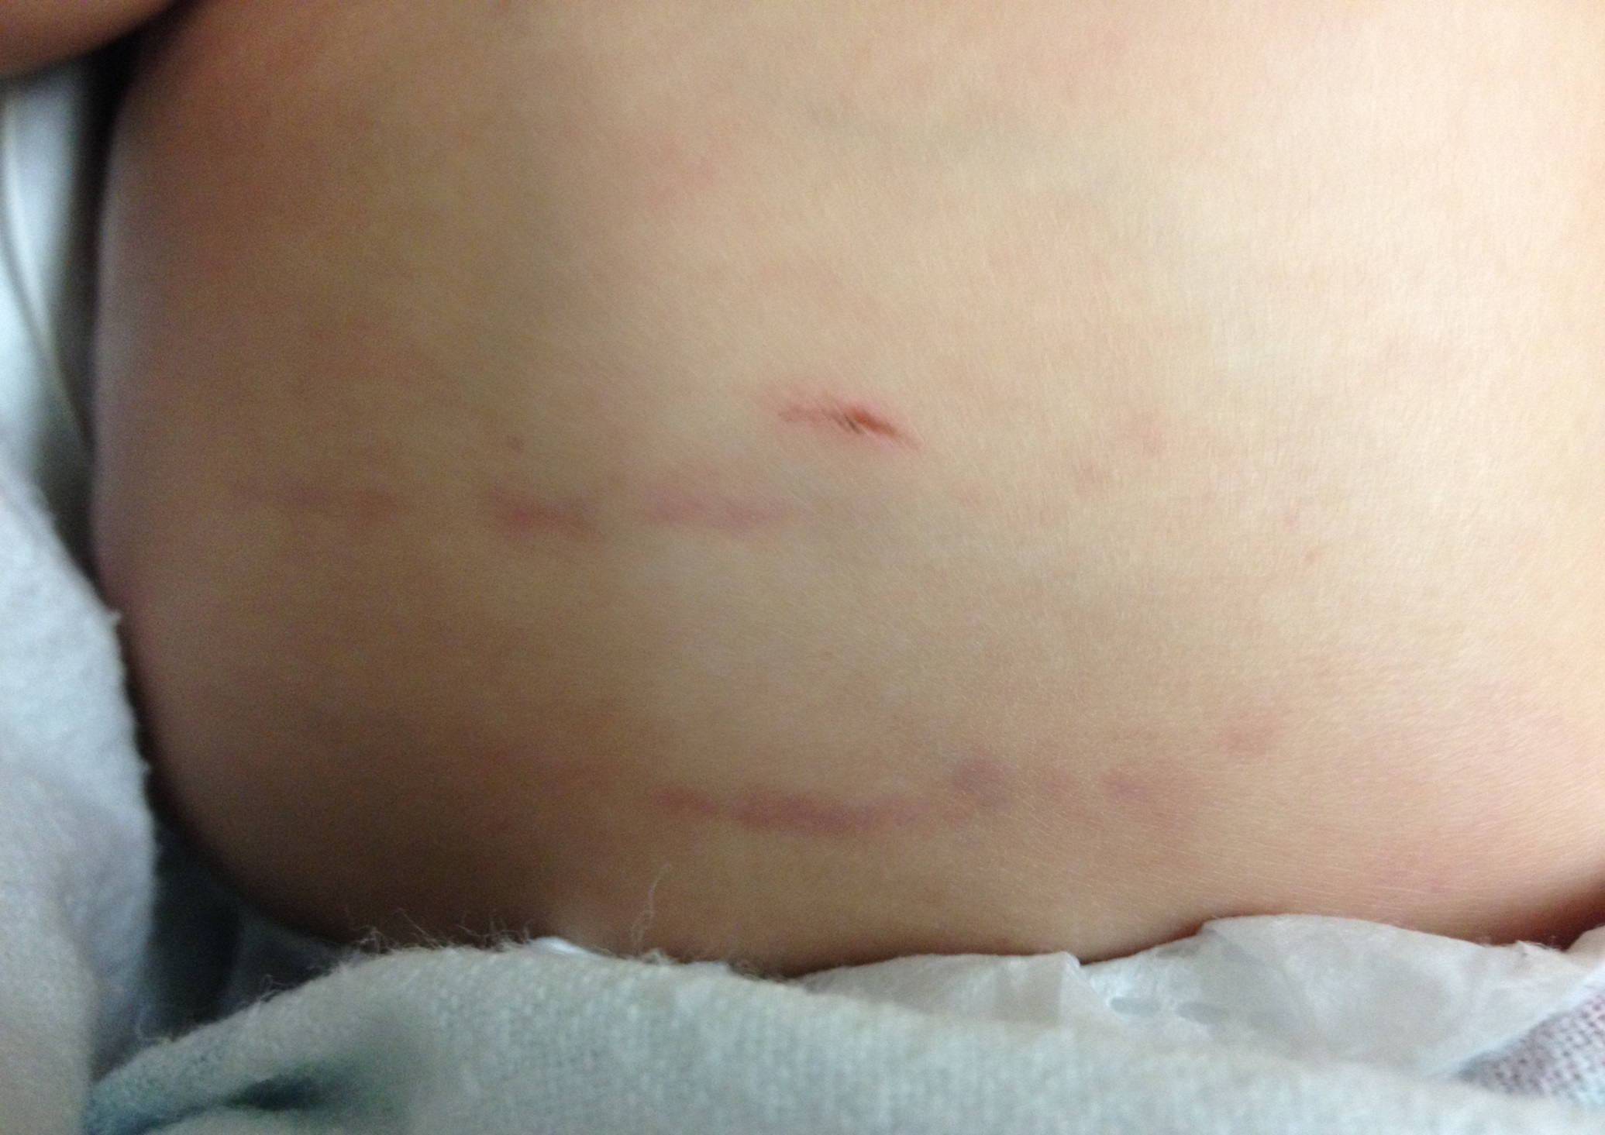
Notes:
Linear pattern bruise
Fingernail mark

Slide 17
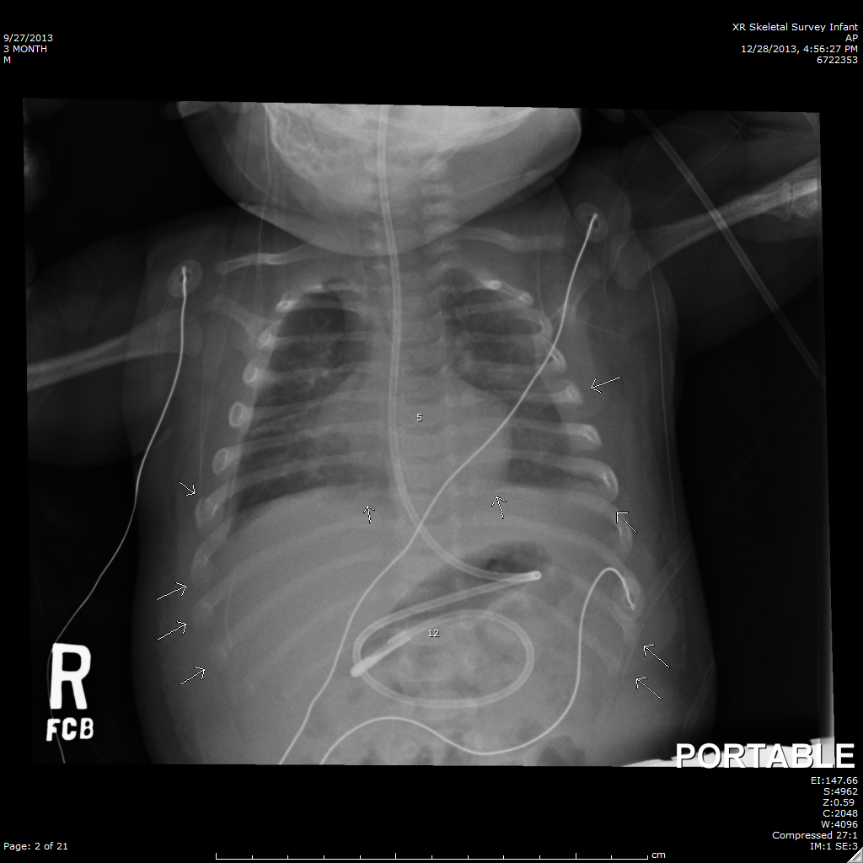
Notes:
CXR demonstrates multiple anterolateral mid-lower rib fxs
*Follow up skeletal survey 10 days later demonstrated
Bilat 3rd-10th lateral healing fxs (callous formation)
Posterior healing 6th-7th fxs
Also showed multiple healing fxs – distal right radial shaft (sclerosis), bilat fem shaft (periosteal rx), as well as right tibial shaft and left fibula shaft
2 prior opportunities missed, but still SAVE – no intracranial hemorrhage

Slide 18
Red flags
Injury inconsistent with mechanism
Vague/varying history, delay in care
Developmentally incompatible history
Notes:
Non-ambulatory child with a fracture
Red flags or lack thereof should not change the decision to follow the protocol – any skeletal injury <12 months but also injuries suspicious for abuse – judgment required to initiate protocol

Slide 19
Case #2
5 wk old male brought in for URI symptoms-Flu A+
RN noted bruising to abdomen
NAT work-up completed
Skeletal survey:
2 right parietal skull fxs
Bilateral distal tibial metaphyseal fx
L proximal tibia metaphyseal fx
CT head: neg
CT abd/pelvis: bilat posterior 6th/7th rib fxs
Notes:
2 additional lucencies on tibias bilaterally; right fibula lucency
LFTs, UA unremarkable but bruising triggered CT abd/pelvis

Slide 20
Notes:
Right parietal skull fracture
Parietal – most common bone fx in abuse and non-abuse

Slide 21
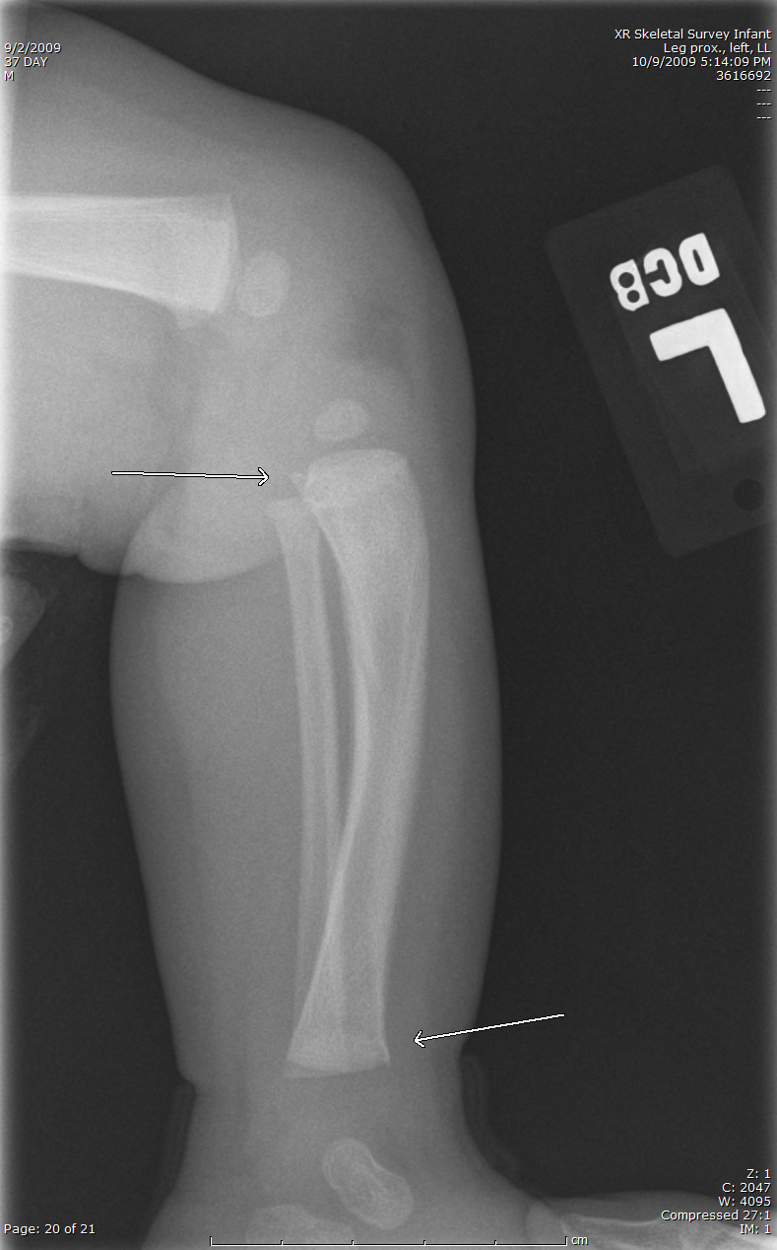
Notes:
Bilateral distal tibia metaphyseal (corner) fractures
Left proximal tibia metaphyseal (corner) fracture

Slide 22
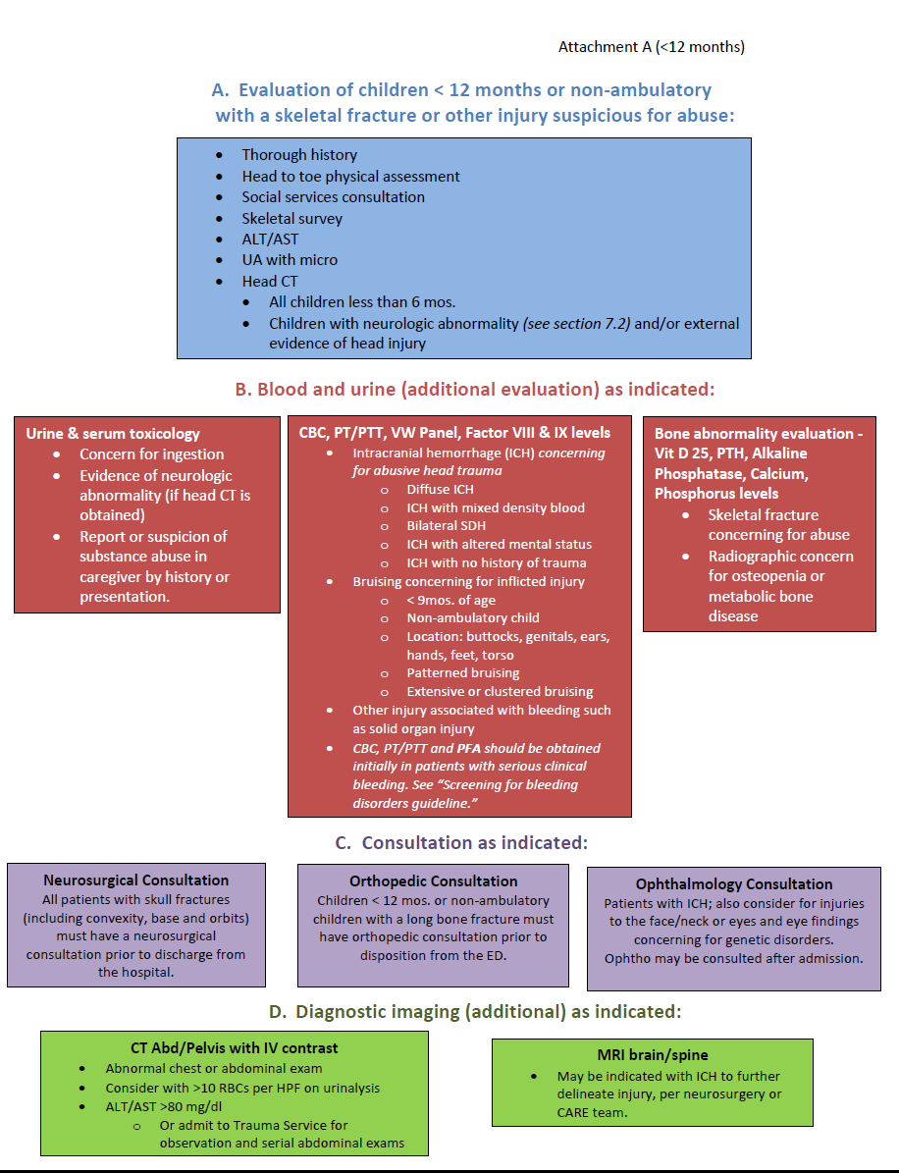
Notes:
DCMC study
Eliminate bias
Screening lower SES children or based on race/ethnicity
ALL non-amb or <1 yr. with fx – follow algorithm, skeletal survey
DCMC study – 18 mos before and after initiation of algorithm, eliminated bias to screen lower SES pts.
Race, ethnicity, SE status – ultimately should not guide decision making or whether or not to evaluate for abuse; in toddlers, seems to be an increased ethnic disparity in children evaluated and referred for abuse.

Slide 23
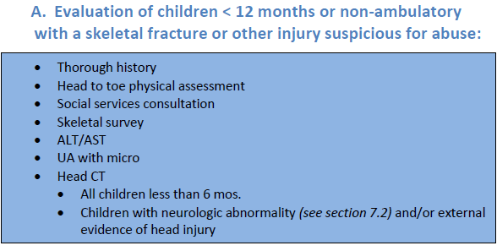

Slide 24
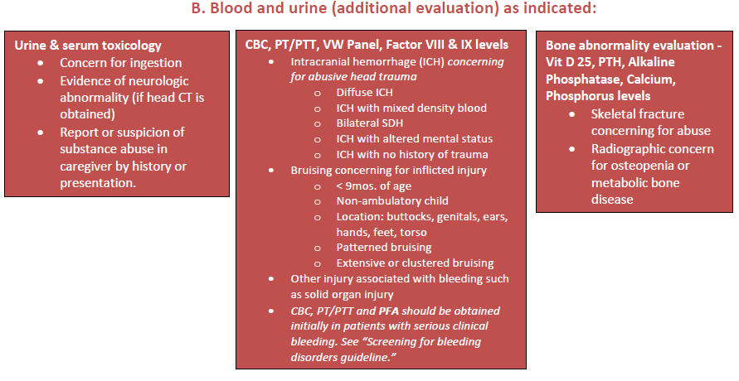

Slide 27
Case #3
4 mo infant presents with scalp swelling following a fall off the changing table onto tile.
Alert, neuro intact and tolerating PO well.
CT head - left parietal non-displaced linear skull fracture with no underlying hemorrhage.
H & P – unremarkable
Skeletal survey – otherwise negative
UA – negative for blood
ALT/AST – normal
SW consult – no concerns
Neurosurgery consult – follow up in clinic in 2 wks
Notes:
Skull fracture – common in falls from 3-6 ft; no serious head injury
Linear skull fractures – as likely to occur from falls less than 4 ft as from falls greater than 4 ft, stair falls, walker down stairs, etc.
Many similar cases – neg screening and no referral to CAT or CPS
More you screen, more likely to identify abuse; but many many will be negative.
Common scenario – several cases every week

Slide 28
Case #4
9 month female presents to ED with mother
Cc: right leg swelling & pain s/p fall from bed
Displaced femur fx identified
NAT protocol followed
Skeletal survey: multiple metaphyseal fxs
Chest CT: right scapula fx & 6th rib fx
Discharged with foster family
Notes:
Left tibia proximal metaphyseal fx, metaphyseal corner fx of bilat prox humeri and right distal tibia
Scapula fx with slight angulation and subacute in nature with minimal healing/periosteal new bone formation
Rib fx also subacute with early signs of healing
Various stages of healing – repeated episodes of abuse

Slide 29
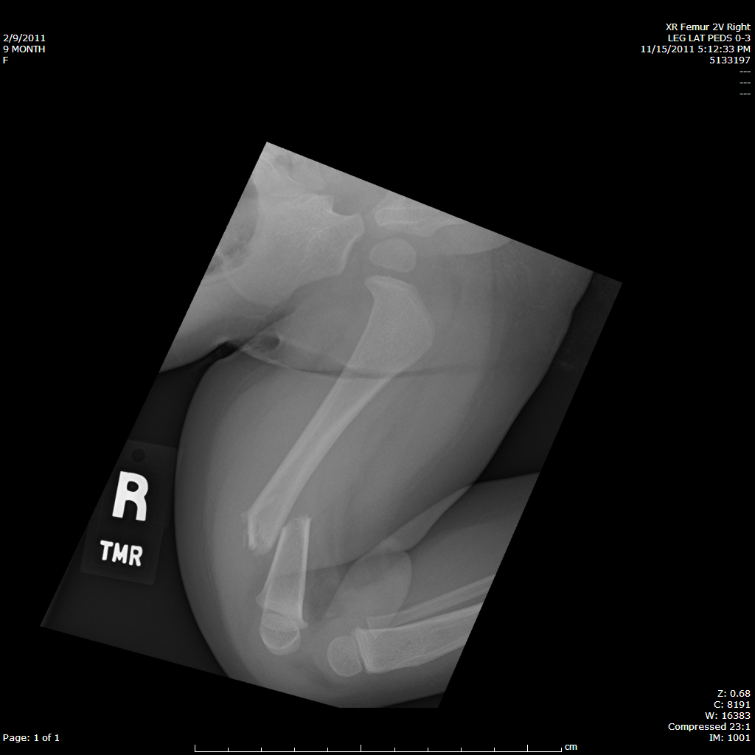
Notes:
Distal shaft transverse vs oblique displaced fx
A child with a femoral fracture has a 1 in 3-4 chance of having been abused (28%) – Kemp et al (2008); confirmed abuse, outside of MVC or confirmed major trauma.
Increased likelihood if non-ambulatory

Slide 30
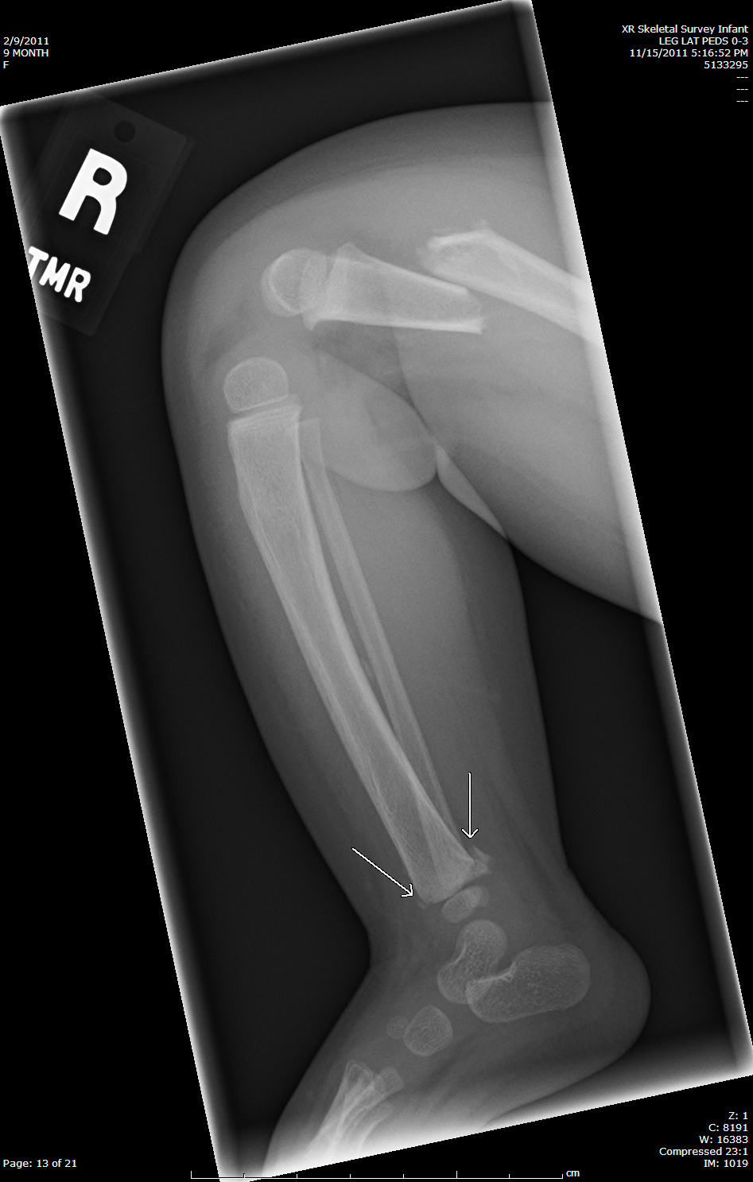
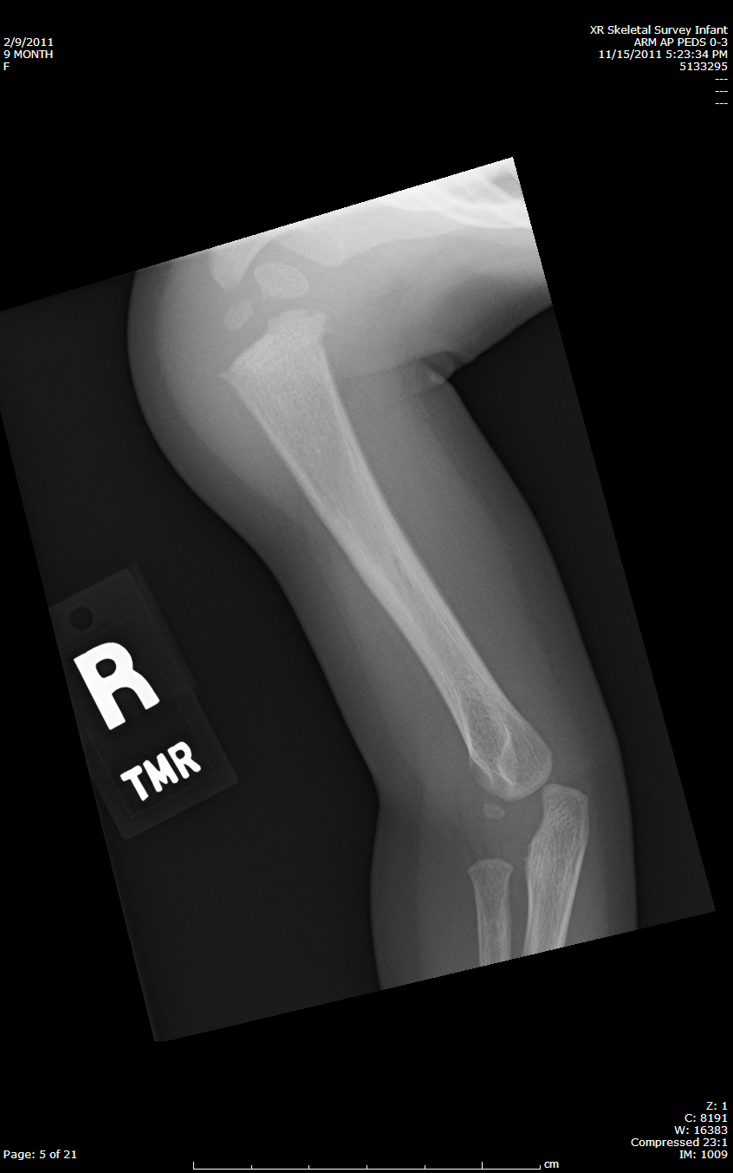
Notes:
Proximal humerus metaphyseal corner/bucket handle fx
Distal tibia metaphyseal corner fx

Slide 31
Abusive head trauma (AHT)
Most common cause of traumatic death under 2 yrs
Most common cause of neurotrauma <2 yrs
30 in 100,000 children in first year of life
Underestimated, underreported, underrecognized
For every identified case, 152 go undiagnosed
3-6% of parents self-report shaking
Notes:
Herman et al (2011)
Seiswerda et al (2011)
Keenan et al (2003)
Adamsbaum et al (2010)
AHT – replaces shaken baby syndrome – shaking or shaking with impact
80% of deaths from TBI in kids < 2 yrs is from AHT.
True incidence unknown – underreporting and underrecognition.
First population-based American study on severe/fatal AHT, Keenan, et al, JAMA (2003)
Range 14-40 per 100,000 – various studies – Scotland, Britain, Switzerland; higher in infants<6mos – 36/100,000
Prevalent as neonatal meningitis - 25-32 per 100,000 live births; ALL - 28.7-36.6 per 100,000 <1 yr
Likely very much underestimated – limitations of study many never present for medical care, many are not identified as abuse (SIDS, accidental), poor surveillance due to lack of standard coding, some not identified till later in life with dev delay, increased FOC – head CT
152 undiagnosed – Theodore et al, Pediatrics (2005)
3% parents report shaking, slapping or smothering their baby at least once; Dutch study of primary health care visitors
Reijneveld et al (2004)
Most of these do not need medical attention – not represented; not all cases in hospitals are recognized; misdiagnosis – SIDS, accidental trauma; lack of standard case definitions making surveillance difficult

Slide 32
Abusive head trauma
13-35% victims die
Survivors
>60% significant neuro impairment
Considerably worse outcomes than non-inflicted
Notes:
Parks et al (2011)
Sieswerda et al (2011)
Death within hours to days – likely underestimated; survivors have severe handicaps with shorter life expectancy (not counted in numbers)
1/3 severe impairment, 1/3 moderate, 1/3 mild or no impairment
Compared with non-inflicted head trauma <10% have significant neuro deficits (mod-severe)

Slide 33
Risk factors
Prematurity
Physical/mental disability
Male
Age 2-6 months
Young parents, lower SE status
Unstable family situation, military service
Substance abuse, mental disorders
Unreasonable developmental expectations
Notes:
Disability including hyperactivity
Stepchildren & adopted children - more likely to be abused
62-77% of victims are boys
Age correlates with peak of normal crying
Parental history of abuse
Stressors – divorce, illness, job loss
Social isolation; lack of support system

Slide 34
Epidemiological factors cannot guide decision-making.
Notes:
Screen based on objective data – not SES, race/ethnicity
Tendency for health care providers to NOT report concern in white families and high SE families so abuse is missed in these populations.

Slide 35
Perpetrators
#1 - Father
#2 - Mother’s boyfriend
#3 - Female babysitter
#4 – Mother
Notes:
Herman et al (2011)
80% deaths – parent is perpetrator

Slide 36
Pathophysiology
Rotation-acceleration forces
Tearing of bridging veins across subdural spaces
Bleeding and subdural hematoma (SDH)
Diffuse brain dysfunction
Cerebral edema, hypoxic-ischemic injury
Retinal hemorrhages
Notes:
Shaking or shaking with impact
Bilateral thin-film SDH
Repeated episodes with apnea, seizures etc. leads to HII
Delay in care – no opportunity to prevent secondary brain injury – may present with significant edema, ischemia and even herniation
Thick gelatinous vitreous is tightly adherent to retina; shaking forces set vitreous in motion – traction and shearing forces to retinal vessels – retinal hemorrhages of varying severity; most severe – retinoschisis (splitting of retinal layers)
Ret hem – bilat., multiple layers and to the periphery

Slide 37
Clinical presentation
History of minor trauma or no trauma
No trauma – 92% PPV
Neurological impairment
Altered LOC (77%)
Seizures (43-50%)
Vomiting (15%)
Notes:
Hettler et al (2003) PPV statistic
Sieswerda et al (2011)
Short falls – 1 in a million chance of dying
Even moderate fall – bunk beds, shopping carts, down stairs – 0-8% chance of ICH – typically focal with skull fracture; no devastating brain trauma
Mechanism not consistent with injury
Inconsistent or changing history; developmentally incompatible history
Blaming sibling or another child – frequently abuse
No trauma a/w 92% PPV abuse (Hettler et al) – 100% PPV if neuro deficits at discharge
Diagnosis is very difficult – no outward signs of abuse with non-specific CC
Percentages based on <3 yr with acute ICH admitted to pedi hospital

Slide 38
Clinical presentation
Apnea - critical distinguishing factor
93% PPV
Respiratory insufficiency complicated by delayed care
Repeated trauma to respiratory centers
Out of hospital CPR
Hypoxic-ischemic brain injury
Notes:
Sieswerda et al (2011)
Kemp et al (2011)
93% PPV (c/w accidental head injury)
Confessions of shaking in AHT cases are frequently (55%) reported to be multiple over weeks/months (2-30 times);
100% report violent shaking because it STOPS the crying
Seizures may further exacerbate resp insufficiency/apnea
93%PPV cited in Sieswerda-Hoogendoorn et al (2011)

Slide 39
Abusive head trauma should be considered in ALL young children presenting with neuro changes & neurotrauma.
Notes:
*Outside of MVC
Neurotrauma - ICH

Slide 40
Case #1
3 mo female ex 33 week twin, in care of father and reported to be “not acting right.”
Presented to ED with eye deviation concerning for seizure activity.
Fussy with multiple episodes of vomiting.
Minor facial/scalp bruising noted.
Loaded with 3% NaCl and keppra and to CT scanner
SDH, SAH, bilat. skull fractures, cervical ligamentous injury, healing radius/ulna fxs, rib fxs, bilat. retinal hemorrhages
Notes:
Initially there was no reported trauma, but then father described a fall out of a bouncy seat

Slide 41
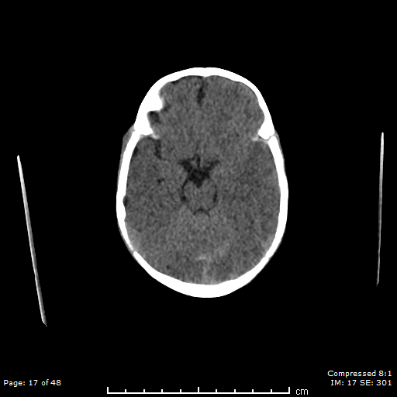
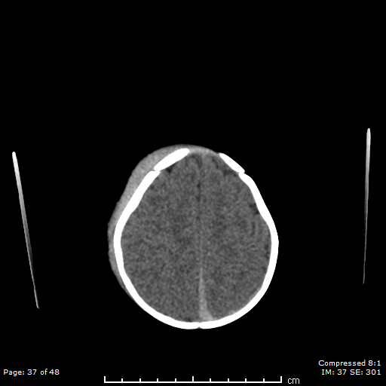
Notes:
Subdural hematoma in the tentorium and falx
Bone windows: left stellate skull fracture, right linear skull fx near mastoid

Slide 42
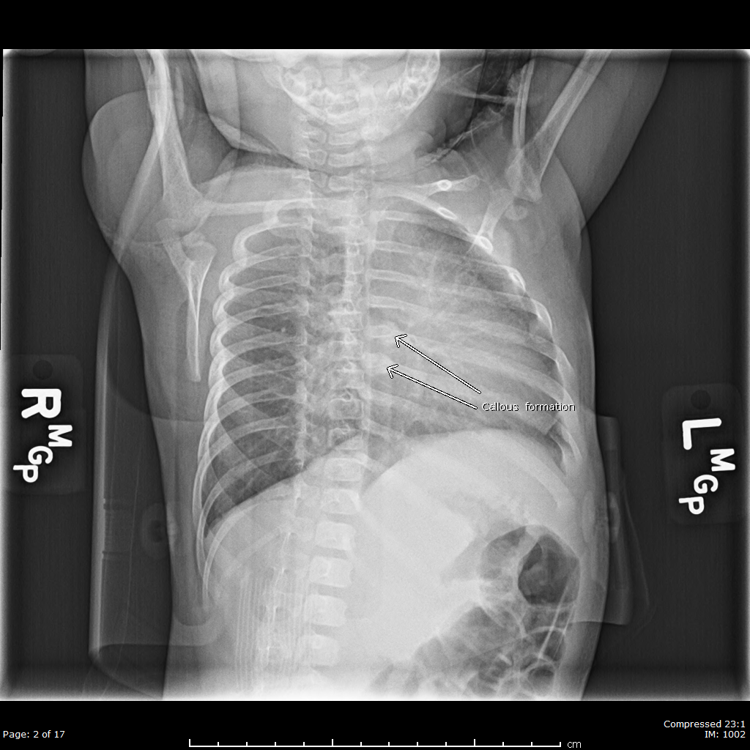
Notes:
healing rib fxs

Slide 43
Notes:
Healing radius/ulna fxs

Slide 44
Case #1
9 day hospital stay, seizures resolved
Patient discharged with no neuro deficits
Twin removed and both placed in foster care
Notes:
Mother reported past “accidents” while in dad’s care – taken to OSH with bruising & told he was too young for films or scans.
She described the twin as having a “cry that no one can deal with.”

Slide 45
Case #2
4 yo female presents to ED with Cc: vomiting. No diarrhea or fever.
Petechiae noted around eyes.
Dx with UTI and sent home.
48 hrs later, found unresponsive by caregiver.
EMS to scene - GCS 4, posturing, blown right pupil
Extensive abdominal bruising; facial and extremity bruising.
100% BVM, spine immobilized, transported to ED
Notes:
EMS asked caregivers about recent trauma, striking child, falls, car accidents, etc. but denied; family stated pt “self abuses” – hits self, throws self on floor.
UA showed +ketones, trace protein, positive LE, negative nitrites; micro 21-50 WBCs, few bacteria
Culture pending; ultimately grew 10-50,000 mixed growth c/w skin flora

Slide 46
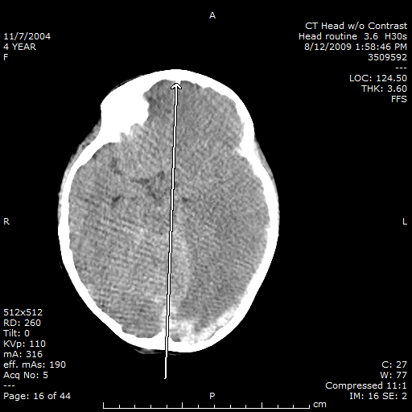
Notes:
SDH – interhemispheric and convexity
Midline shift, ventricles disappearing
SDH in the tentorium, midline shift, herniation
Cerebral edema, tight, HII

Slide 47
Case #2
CT head with diffuse edema, loss of gray-white differentiation, SDH, and extensive herniation. CT abd/pelvis with mesenteric hematoma.
To OR for evacuation and hemicraniectomy, ventriculostomy, ICP monitor; exploratory laparotomy.
Notes:
Renal, pancreatic, duodenal injuries/hematomas
Bilateral severe retinal hemorrhage to the periphery
Skeletal survey negative
10 days of TBI protocol including pentobarb coma
Refractory ICPs
Extubated successfully HD#19
Gtube placement
Right hemiparesis, non-verbal
Transfered to rehab
Bone flap replacement/VP shunt approx 4 weeks after admission
Rehab with mother around HD#42

Slide 48
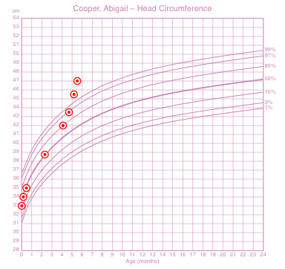
Case #3
5 mo female with vomiting x 1 mo
No fever or diarrhea, no hx of GERD
To ED and PCP multiple times
Given Zofran Rx, refilled
Notes:
1st ED visit (OSH) – given zofran and sent home
Phoned PCP for refill a week or two later
Visit with PCP and referred to DCMC ED for vomiting/lethargy
Pt had started daycare just prior to onset of vomiting
Abuse team consulted and began pulling records – FOC increased from 85th% to off charts in 6 week period

Slide 49
Notes:
Retinal hemorrhages also noted
Skeletal survey negative
No bruising head to toe
To OR for subdural drain
Discharged with supervision of parents per CPS with ongoing daycare investigation

Slide 50
Case #5
5 month old male - fall off bed 3-4 ft.
No LOC, but fussy, vomited
Brought to ED by parents later in day
Presented alert but very quickly deteriorated
Minor bruising to left cheek/FH
Notes:
Pupils became unequal with dilated right pupil

Slide 51
Notes:
Remainder of NAT workup negative
To OR for evacuation of EDH; home day 3 with no neuro deficits
EDH – associated with non-AHT
SAH – equally associated with both AHT and non-AHT
Focal parenchymal injury – not discriminatory (can be either)

Slide 52
Case #5
2 month old reported to fall off the couch at babysitter’s.
Caregiver stated “he’s not breathing right.”
EMS found pt apneic and responsive only to pain
100% BVM with color improved
Posturing en route, right pupil dilated, deviated gaze
IO placed, valium given
Notes:
EMS did place Ccollar
Small hematoma to temporal-parietal area – otherwise no outward signs of trauma

Slide 53
Case #5
Arrived in the ED; intubated and to CT scanner
Left parietal skull fracture, SDH with herniation
3% NaCl, phenobarb, PRBCs
To OR for decompressive craniectomy, ICP monitor
ICPs 50s despite maximum medical management
Parents decide to withdraw care on HD# 7
Notes:
Mixed density blood
Multiple rib fxs in various stages of healing
Bilat retinal hemorrhages

Slide 54
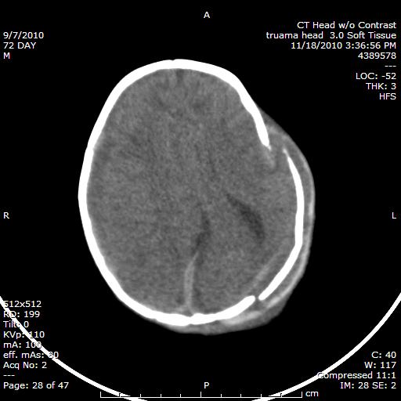
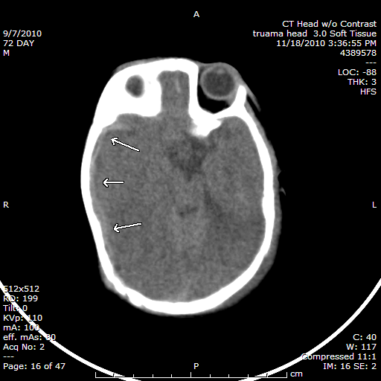
Notes:
Thin film SDH
Brain herniating thru diastatic skull fxs
Cerebral edema and HII
Skull fxs – shaking with impact

Slide 55
Abusive head trauma
High index of suspicion:
Vomiting
Seizures
Apnea, resp distress/arrest
Change in mental status
Notes:
Abuse is pattern of behavior
Head CT for any of above
If abuse is not in the differential for ALL cases of non-specific presenting s/sx in young children, we’re missing an opportunity to protect a child and potentially save a life.

Slide 56
Take home points…..
Identify abuse in early stages
Examine patients head to toe
Skeletal survey
Notes:
Identify abuse in early stages (bruising, soft tissue injuries, fractures) before neurological changes and fatal or near fatal abuse
Remove all clothing and put patients in hospital gowns

Slide 57
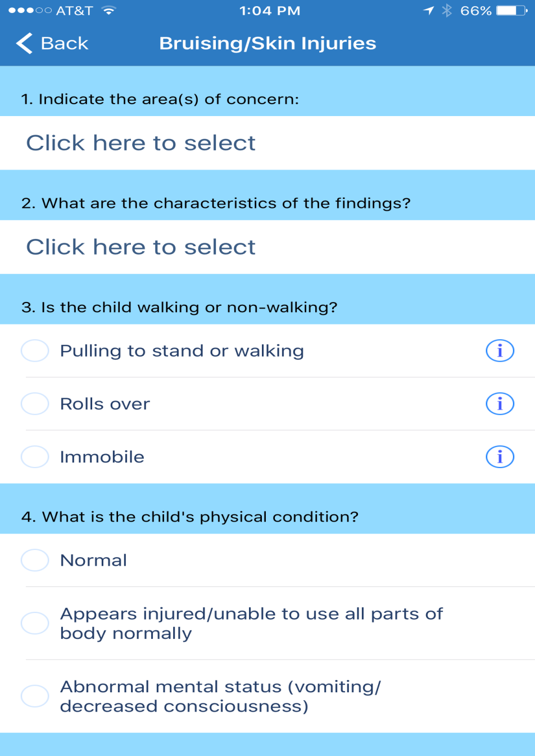
Child Protector APP

Slide 58
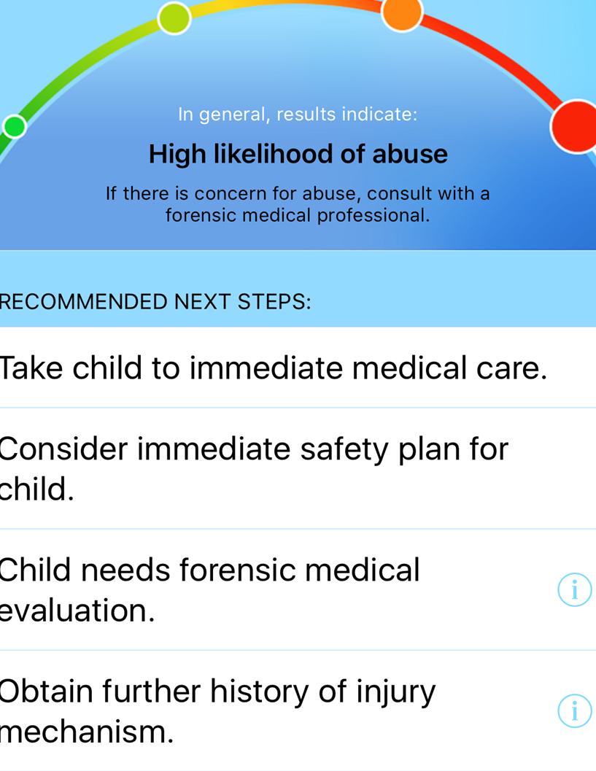
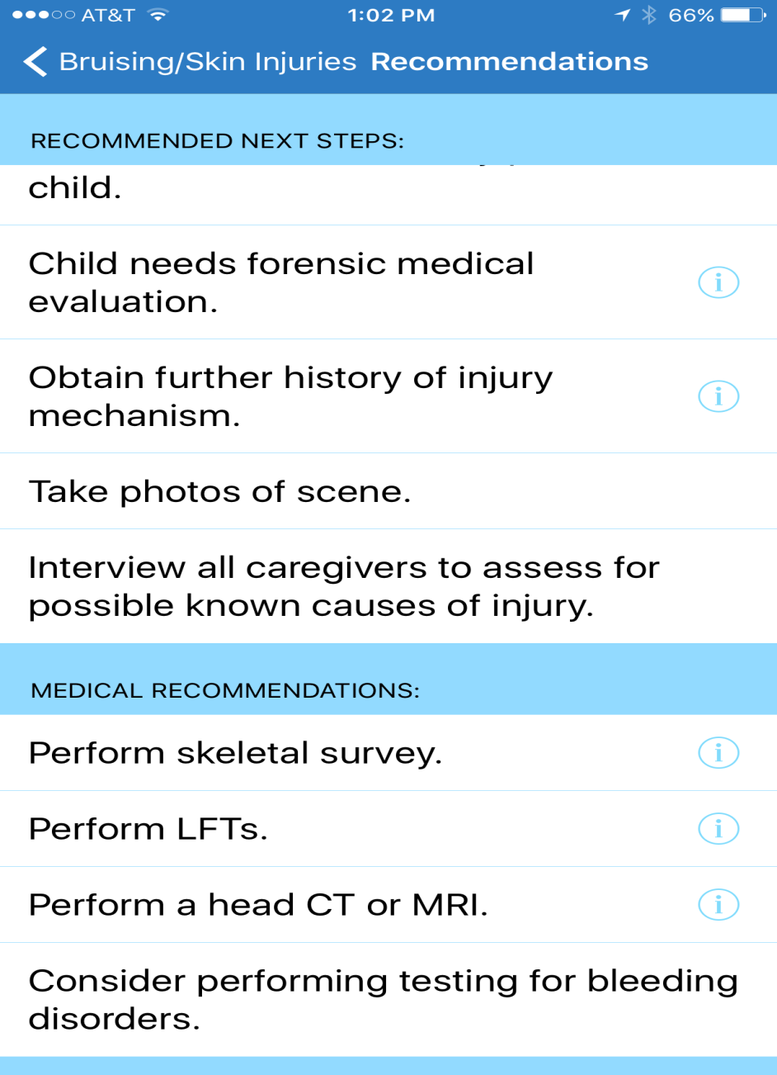
Child Protector APP

Slide 59
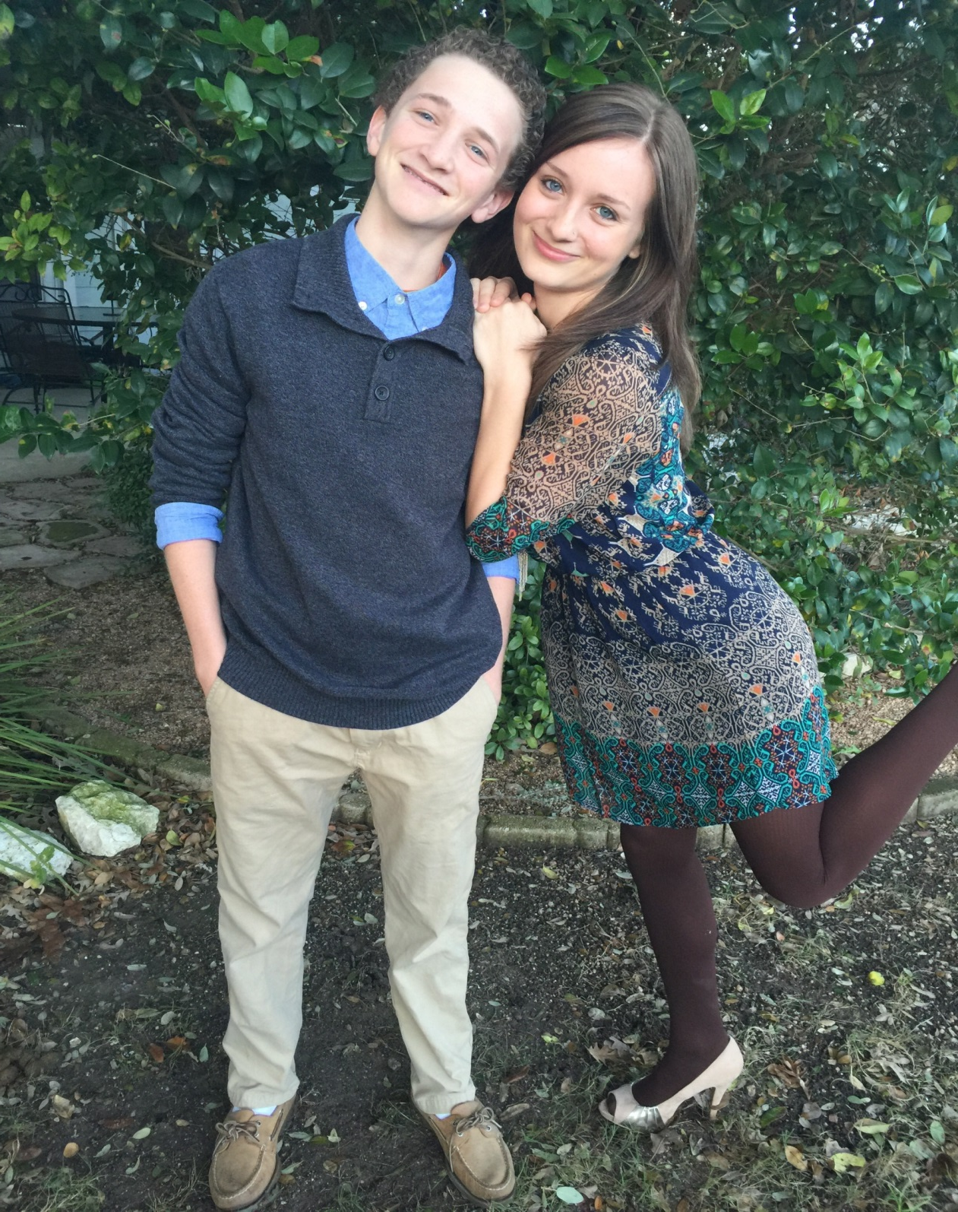

Slide 60
Notes:
Port Aransas

Slide 61
References
Adamsbaum, C. Grabar, S., Mejean, N., Rev-Salmon, C. (2010). Abusive Head Trauma: Judicial Admission Highlight Violent and Repetitive Shaking. Pediatrics, 126(3), 546-555.
Abusive head trauma: an epidemiological and cost analysis. J Neurosurg Pediatr. 2016; 18(5): 542-549.
Boos, SC, Endom, EE, Lindberg, DM, Drutz, JE & Wiley, JF. Physical abuse in children: Epidemiology and clinical manifestations. Retrieved from www.uptodate.com on 8/29/2014.
Christian, C, Greenbaum, JV, Lindberg, DM, Drutz, DE, Nordli, DR & Wiley, JF. Child abuse: Epidemiology, mechanisms, and types of abusive head trauma in infants and children. Retrieved from www.uptodate.com on 8/29/2014.
Clarke, NMP, Shelton, F, Taylor, CC, Khan, T & Needhirajan, S. The incidence of fractures in children under the age of 24 months – In relation to non-accidental injury. Journal of Injury. 2011; 08.024.
Gilbert, R. et al. Burden and consequences of child maltreatment in high-income countries. Child Maltreatment. 2009; 373(3)
Haney, SB, Starling, SP, Heisler, KW, Okwara, L. Characteristics of Falls and Risk of Injury in Children Younger Than 2 Years. Pediatric Emergency Care 2010; 26:12.
Hansen, JB et al. Evaluation of the Hypothesis That Choking/ALTE May Mimic Abusive Head Trauma. Acad Pediatr. 2016; Dec 22.
Harris, TS. Bruises in children: normal or child abuse? Journal of pediatric health care. 2009; 24:4, 216-220.

Slide 62
References
Herman, BE, Makoroff, KL & Croneli, HM. Abusive head trauma. Pediatric Emergency Care. 2011; 27:1, 65-69.
Hettler, J. & Greenes, D. S. Can the Initial History Predict Whether a Child With a Head Injury Has Been Abused? Pediatrics. 2003; 111(3), 602-607.
Higginbotham, N, Lawson, KA, Gettig, K. Utility of a child abuse screening guideline in an urban pediatric emergency department. J Trauma Acute Care Surg 2013; 76(3):871-877.
Keenan, HT, Runyan, DK, Marshall, SW. A population-based study of inflicted head injury in young children. JAMA. 2003; 290:621-626.
Kemp, AM. Abusive head trauma: recognition and the essential investigation. Arch Dis Child Educ Pract Ed. 2011; 96: 202-208.
Kemp, AM, Jaspan, T, Griffiths, J, Stoodley, N, Mann, MK, Tempest, V & Maguire, SA. Neuroimaging: what neuroradiological features distinguish abusive from non-abusive head trauma? A systematic review. Group.bmj.com, 2011.
Kemp, AM, Dunstan, F. et al. Patterns of skeletal fractures in child abuse: systematic review. BMJ; 2008: 337.
Kim, PT & Falcone, RA Jr. Nonaccidental Trauma in Pediatric Surgery. Surg Clin North Am. 2017; 97(1): 21-33.
Letson, MM et al. Prior opportunities to identify abuse in children with abusive head trauma. Child Abuse Negl, 2016; 60:36-45.

Slide 63
References
Levanthal, JM et al. Prevention of Pediatric Abusive Head Trauma: Time to Rethink Interventions and Reframe Messages. JAMA editorial; 2017.
Leventhal, JM, Martin, KD, Mphil, AG, Asnes, MD. Incidence of fractures attributable to abuse in young hospitalized children: results from analysis of a US database. Pediatrics, 2008; 122:3.
Lindberg, DM, et al. Utility of Hepatic Transaminases in Children With Concern for Abuse. Pediatrics. 2013; 131:2: 268-275.
Loder, RT & Feinberg, JR. Orthopaedic Injuries in Children With Nonaccidental Trauma. Journal of Orthopedics. 2007; 27:4.
Maguire, S., Hunter, B., Hunter, L., Sibert, J.R., Mann, M. & Kemp, A.M. Diagnosing abuse: a systematic review of torn frenulum and other intra-oral injuries. Archives of Disease in Childhood. 2007; 92: 1113-1117.
Nadarasa, J. et al. Update on injury mechanisms in abusive head trauma—shaken baby syndrome. Pediatr Radiol. 2014; 44(4).
Niederkrotenthaler, T. et al. Descriptive factors of abusive head trauma in young children—United States, 2000-2009. Child Abuse Negl. 2013; 37(7): 446-55.
Oral, R, Yagmur, F, Nashelsky, M, Turkmen, M & Kirby, P. Fatal Abusive Head Trauma Cases: Consequence of Medical Staff Missing Milder Forms of Physical Abuse. Pediatric Emergency Care 2008; 24:12.

Slide 64
References
Pandya, NK, Baldwin, K, Wolfgruber, H, Christian, CW, Drummond, DS & Hosalkar, HS. Child Abuse and Orthopaedic Injury Patterns: Analysis at a Level I Pediatric Trauma Center. J Pediatr Orthop. 2009; 29:6.
Parks, SE, Kegler, SR, Annest, JL, Mercy, JA. Characteristics of fatal abusive head trauma among children in the USA: 2003-2007: an application of the CDC operational case definition to national vital statistics data. Injuryprev.bmj.com, 2011.
Pfeifer, CM et al. Non-accidental trauma: the role of radiology. Emerg Radiol. 2016; Nov 10.
Rajaram, S, Batty, R, Rittey, CDC, Griffiths, PD & Connolly DJA. Neuroimaging in non-accidental head injury in children: an important element of assessment. Postgrad Med J. 2011; 87:355-361.
Scherl, SA, Endom, EE, Phillips, W & Lindberg, DM & Wiley, JF. Orthopedic aspects of child abuse. Retrieved 8/29/2014 from www.uptodate.com.
Sedlak AJ, Mettenburg J., Basena M, et al. (2010). Fourth National Incidence Study of Child Abuse and Neglect (NIS-4): Report to Congress. Washington, DC: U.S. Department of Health and Human Services, Administration for Children and Families. http://www.acf.hhs.gov/sites/default/files/opre/nis4_report_congress_full_pdf_jan2010.pdf.
Serinelli, S. et al. Deaths Due to Child Abuse: A 6-Year Review of Cases in The Cook County Medical Examiner’s Office. J Forensic Sci. 2017; 62(1): 107-118.
Sieswerda-Hoogendoorna, T, Boos, S, Spivack, B, Bilo, RAC & van Rijn, RR. Abusive head trauma part I: clinical aspects. Eur J Pediatrics, 2011.

