Slide 1
Caring for the Suicidal Patient in a Pediatric Medical Hospital:
Development of Ancillary Staff
Jaime Choate BSN, RNC-OB
Lindsay Gregory MSN, RN, CPN

Slide 2
Emoji Left Side Sad
OUTCOMES
By the end of this learning activity, the learner will have enhanced knowledge regarding the delivery of education for a new ancillary staff role:
Float Pool Patient Sitter

Slide 3
Emoji Left Side OK
OBJECTIVES
Describe the process of creating an educational curriculum for a new patient sitter float pool job role
Identify the educational adaptions made based on gaps in practice
Examine the pre- and post-test results after a refresher course

Slide 4
Emoji Left Side Happy
2015: Patient Sitter Process
2 – Hour Patient Sitter Workshop (PSW)
Passive/Active
A variety of Texas Children’s Hospital (TCH) employees were eligible
PCAs, MAs, Dental Assistants, ASRs, & others
Post PSW: House Supervisor (HS) was notified by the PS of course completion
Name added to Master List (spiral notebook)
For Patient Sitter Needs
HS utilized list to find a PS
PS would call HS to request a PS assignment for overtime
PS would go sit with patient
Non-PCA PS did not have access to EMR
Challenges: Training, Tracking & Documentation

Slide 5
Emoji Left Side Excited
Challenge Accepted: Changes 2016 - Present
Developed collaborative partnerships:
1. PCA professional development team
2. Centralized Staffing Office
3. Float Pool Unit Leadership

Slide 6
Emoji Left Side Excited
Challenge Accepted: Changes 2016 - Present
Tasks Completed:
PS Master List created
Process developed for routine updates and verification
PS Cost Center created
All PCAs formally trained as Patient Sitters
Patient Sitter Float Pool job role: created, hired, & trained
Duties & roles specifically outlined for managers and staff
All PSs given appropriate documentation access
Room Safety Sweep Sheet

Slide 7
Emoji Left Side Anger
Hiccups
Identifying roles between PCA and FPPS
Role responsibilities aligned to patient diagnosis & needs
Gaps in practice
Identified by:
PS request for education
TCH specific reports
Unannounced safety checks by PS educators/leadership
Documentation audits

Slide 8
Emoji Left Side Anger
Hiccup Remedy
More Collaboration! :
Behavioral Health Operations Committee
Float Pool Educators & Leadership
Re-evaluation of educational material
Developed and facilitated:
refresher course
sweep sheet simulation
documentation case scenarios
additional role play
de-escalation classes
unannounced safety checks
collaboration with other institutions

Slide 9
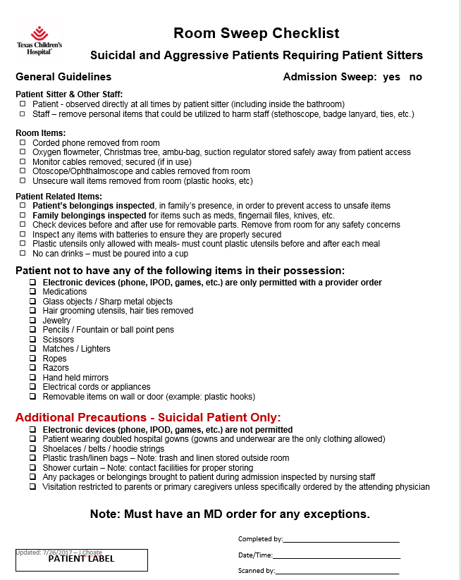
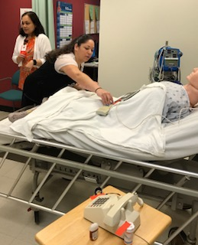
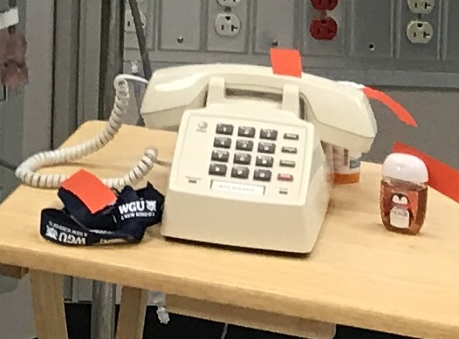
Emoji Left Side Anger
Hiccup Remedy: Sweep Sheet Simulation

Slide 10
Emoji Left Side Excited
Results
Fulfilled Refresher Course Training 100% of FPPS
Pre & Post Test Evaluation
Identification of:
job role
terminology
role responsibility
Room safety sweep
91.3%
Post - course
80%
Pre - course

Slide 11
Emoji Left Side Excited
Future Plans
PCAs to complete Refresher Course
Nursing and other identified staff to complete PSW
All identified staff to complete additional education
Proposed Timeline:
Planning stage through December 2017
January 2018 – June 2018 facilitate classes
Dates/Times – To be determined post
executive approval

Slide 12
Emoji Left Side Anger

Slide 13
Emoji Left Side Anger
References
Broussard, M. (2017). Postdebriefing activities following simulation. Teaching and Learning in Simulation, 12(3), 220-222. Doi:10.1016/j.tein.2017.03.010
Dickerson, P. (Ed.), (2017). Core curriculum for nursing professional development (5th ed.). Chicago, IL: Association for Nursing Professional Development
West, M., Boshoff, K., & Hugh, S. (2016). A qualitative exploration of the characteristics and practices of interdisciplinary collaboration. South African Journal of Occupational Therapy, 46(3). http://dx.doi.org/10.17159/2310-3833/2016/v46n3a6

