Slide 1
A Creative Evidence-Based Educational Approach to Revving the Engine on Catheter Associated Urinary Tract Infection (CAUTI) Prevention
Katy Yanez, MSN, RN, CNOR
Abbie Garcia, BSN, RN, CPN

Slide 2
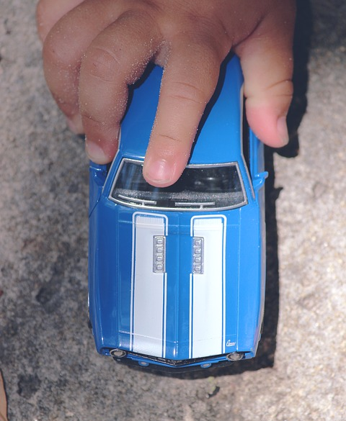
Purpose & Objectives
Describe a creative, evidence-based educational approach used to teach nurses about CAUTI prevention.
The learner will be able to:
Examine how gaming can be used to effectively engage adult learners.
Summarize post-educational knowledge outcomes.

Slide 3
Evidence
Lecture-Based Learning | Game-Based Learning
Instructor-centered approach² Surface level, passive learning² Efficient way to deliver material in a short period of time² Engages only auditory and visual learners¹ for a limited amount of time⁵ Either showed no statistical difference in learning outcomes or was shown to be less effective than active learning principles¹ | Learner-centered approach^{6,5} Active, engaging style of learning⁶ Large volume of material can be covered in one activity⁷ Improved learning outcomes⁶ Engages multiple learning styles¹ Collaborative² and motivating³ Instant feedback provided¹ Enhanced retention of material⁶ Promotes problem based learning and critical thinking development⁴

Slide 4
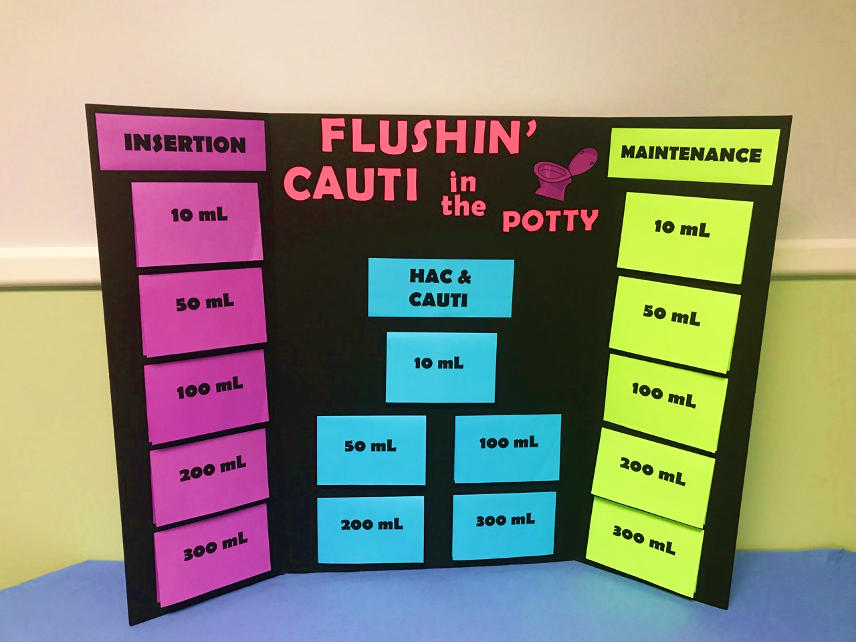
Flushin’ CAUTI in the Potty

Slide 5
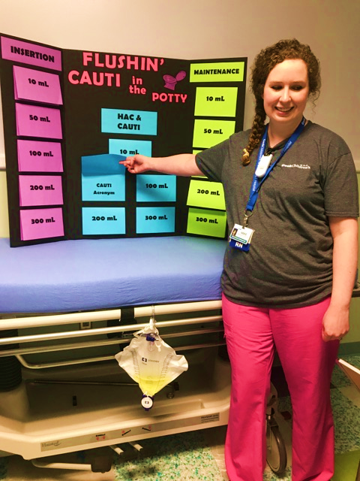
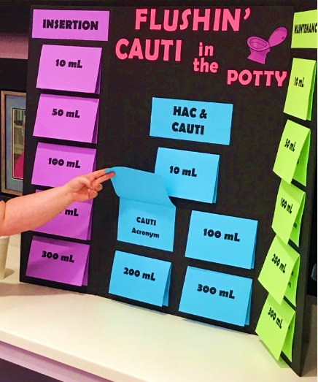
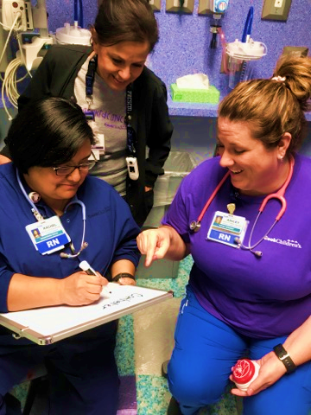

Slide 6
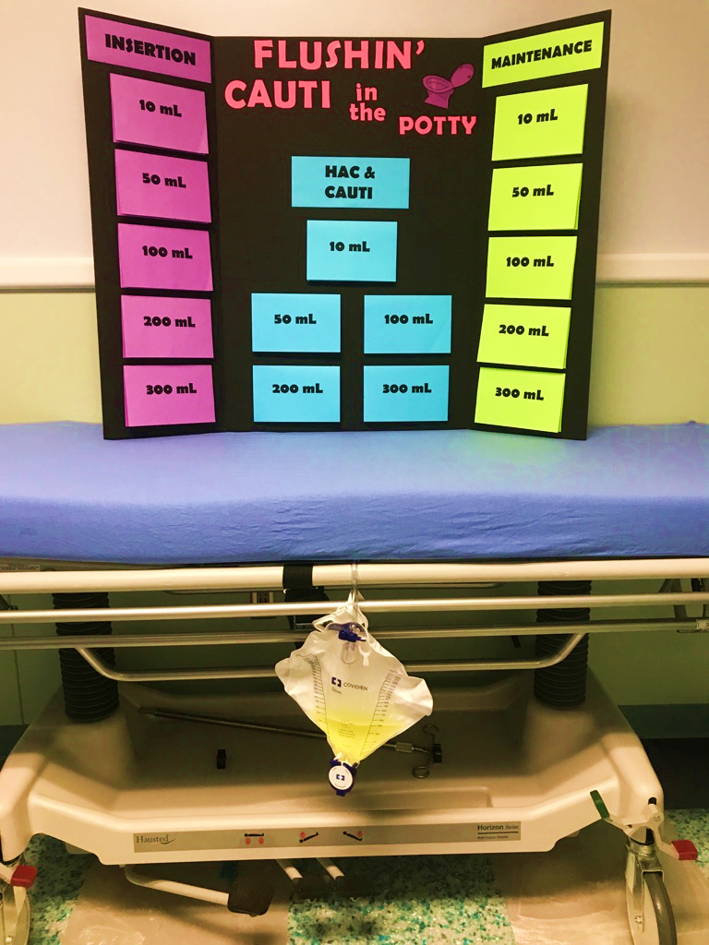
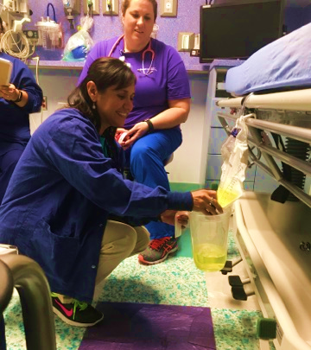
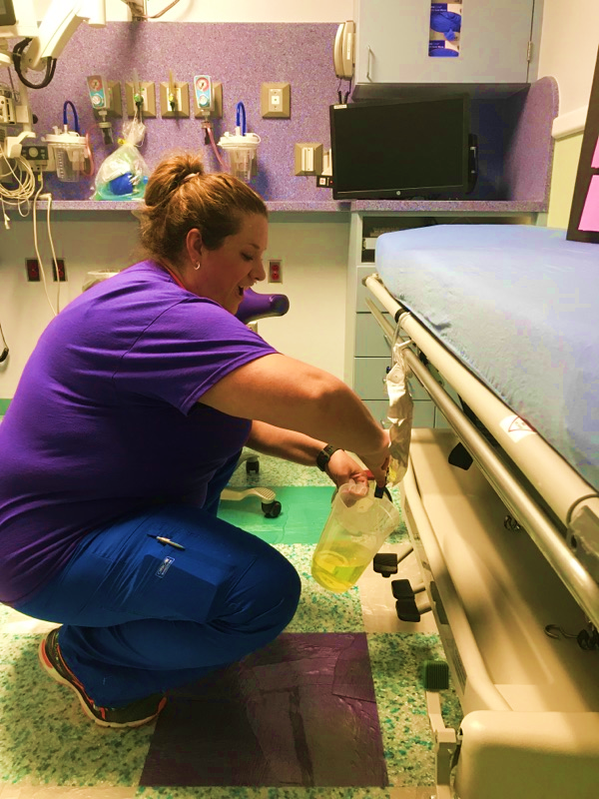

Slide 7
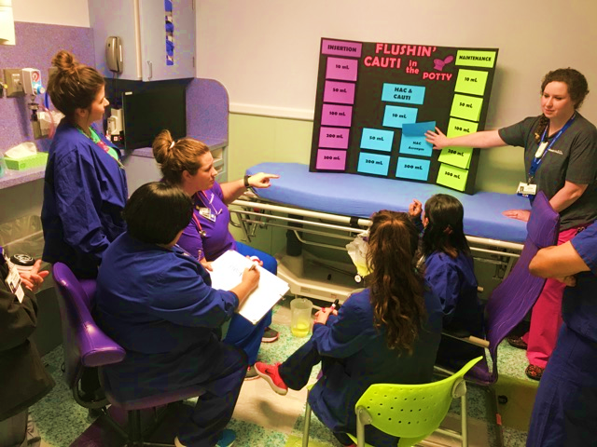
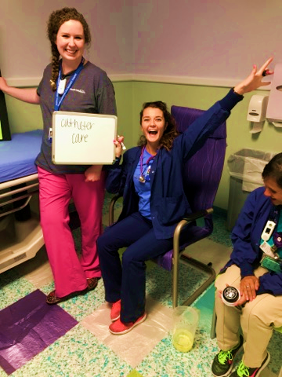
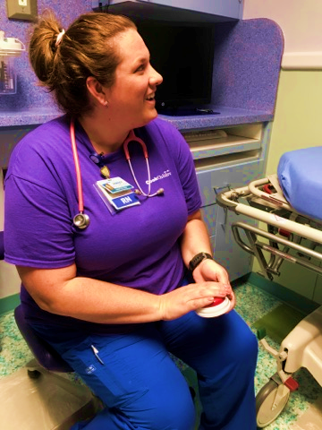

Slide 8
Data Collection
Survey
Pre-Education
Post-Education
Post-Test
3 months post activity

Slide 9
Pre-Education Survey Results
STAFF COMFORT LEVEL:
INSERTION & MAINTENANCE BUNDLES
14.8%
12.4%
31.4%
Very Comfortable
Comfortable
Somewhat Comfortable
Not Comfortable

Slide 10
Post-Education Survey Results
STAFF COMFORT LEVEL:
INSERTION & MAINTENANCE BUNDLES
0.6%
7.6%
46.6%
Very Comfortable
Comfortable
Somewhat Comfortable
Not Comfortable

Slide 11
Post-Test Results
7.9%
92.1%
Comfort Level Post-Education
8%
Scored > 85%
92%
Scored < 85%

Slide 12
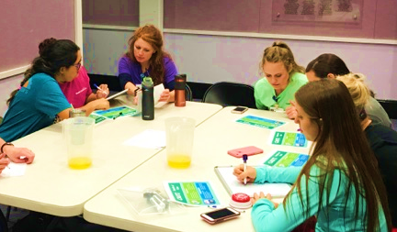
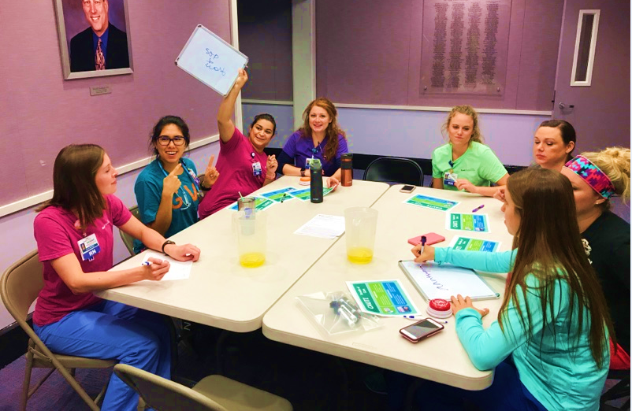
Desired Outcomes
Prevention of CAUTI
Decrease hospital length of stay and costs
Retention of CAUTI bundles of care
Nurse satisfaction with creative learning methodologies

Slide 13
Feedback
“Excellent!”
“Great activity and interaction.”
“Fun way of learning!”
“Games are the best way to learn.”
“The game was a lot of fun and we learned a lot.”
“I say it’s a blast!”
“LOVE this game!”

Slide 14
Questions

Slide 15
References
1. Bluestone, J., Johnson, P., Fullerton, J., Carr, C., Alderman, J., & BonTempo, J. (2013). Effective in-service training design and delivery: evidence from an integrative literature review. Human Resources for Health, 11
2. Boctor, L. (2013). Active-learning strategies: the use of a game to reinforce learning in nursing education. A case study. Nurse Education in Practice, 13(2), 96-100. doi:10.1016/j.nepr.2012.07.010
3. de-Marcos, L. l., Garcia-Lopez, E. e., & Garcia-Cabot, A. a. (2016). On the effectiveness of game-like and social approaches in learning: Comparing educational gaming, gamification & social networking. Computers & Education, 9599-113. doi:10.1016/j.compedu.2015.12.008
4. Koivisto, J., Haavisto, E., Niemi, H., Katajisto, J., & Multisilta, J. (2016). Elements explaining learning clinical reasoning using simulation games. International Journal of Serious Games, 3(4), 29. doi:10.17083/ijsg.v3i4.136
5. McLaughlin, J. E., Roth, M. T., Glatt, D. M., Gharkholonarehe, N., Davidson, C. A., Griffin, L. M., Esserman, D. A., & Mumper, R. J. (2014). The flipped classroom: a course redesign to foster learning and engagement in a health professions school. Academic Medicine, 89(2), 236-243.
6. Popil, I., Thompson, D. D., Billings, D. M., & Kowalski, K. (2015). A game-based strategy for the staff development of home health care nurses. Journal of Continuing Education in Nursing, 46(5), 205. doi:10.3928/00220124-20150420-14
7. Strickland, H. P., & Kaylor, S. K. (2016). Bringing your a-game: Educational gaming for student success. Nurse Education Today, 40101-103. doi:10.1016/j.nedt.2016.02.014

