Slide 1
Shh… I’m Trying to Heal:
Implementing Quiet Time in the PICU
Lori Kahil, MSN, RN, CPN, CCRN;
Traci Brooks, MSN, RN
Danika Meyer, MSN, RN-BC, CPN

Slide 2
Objectives
Identify the benefits of structured quiet time on staff satisfaction and implications of care for pediatric patients in an intensive care unit.
Understand the importance of structured quiet time in order to promote restorative sleep patterns
Comprehend different, individualized methods and interventions that staff members may utilize in order to promote restorative sleep for patients of different acuity levels.

Slide 3
Purpose
This quality improvement project implemented standardized quiet times during day shift and night shift in a pediatric intensive care unit in order to improve patient recovery and improve staff satisfaction.

Slide 4
Background/Significance
Evidence has shown that sleep is needed for:
Normalization
Circadian synthesis of hormones
Repair
Restoration
Consolidation of learning

Slide 5
Background/Significance
Sleep hygiene is imperative in the pediatric intensive care unit (PICU).
Critically ill patients experience severely fragmented sleep and routines are significantly disrupted.

Slide 6
Assessing the Situation
Survey Distribution
PRE:
Surveys were distributed prior to the implementation of roll-out.
POST:
All PICU Staff members then had the opportunity to repeat this survey approximately
3 months following implementation.
Decibel Study
Sound devices measured noise levels throughout the unit during various times of a 24 hour period. The devices were placed near patient’s heads to account for environmental noise level, as well as in open areas of differing location in the unit.

Slide 7
PRE-INTERVENTION RESULTS
73% of staff surveyed identified they AGREED the noise level in the PICU is significantly LOUDER than what he/she feels is an ideal noise level.
92% of staff surveyed identified they AGREED the level of noise in the PICU can impact his/her patient’s ability to heal.

Slide 8
Implementation
TIMELINE
MAY 2017
ICU Liberation forum and Quiet Time Presentation delivered.
Education distributed and assigned via LMS
FEBRUARY 2016
PICU Quiet Time team is assembled from Patient Experience Champions
Quiet Time Go-Live!
June 20, 2017
SPRING 2015
MARCH 2016 – MAY 2017
Nurse Residency Cohort 15 EBP Project on Quiet Time
Meetings with change champions and interdisciplinary team members occurred to determine:
Barriers for implementation
Finding solutions to potential challenges
Identifying groups to disseminate information to (consulting physicians, PT/OT/ST, etc.)
Creating education plan and dissemination of Quiet Time parameters.

Slide 9
Characteristics of Quiet Time

Slide 10
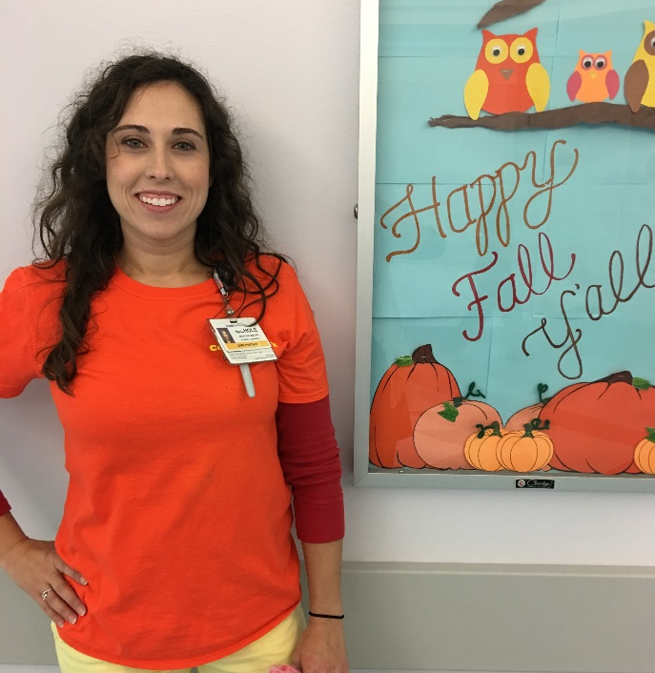
Staff Education
PRESENTATION
COMPUTER BASED TRAINING
CHANGE CHAMPIONS
Interdisciplinary members!
RN’s, Charge RN’s, Patient Care Technicians (Care Partners), Unit Secretaries, Child Life, MD’s, NP’s
POST TEST
“ONE PAGE” LECTURE
RESOURCE BINDERS
Presentation was bundled with “ICU Liberation” presentation day. A total of 130 staff members completed CBT within 1 month prior to go-live.
One side: research based and evidence; other side: parameters and characteristics of Quiet Time
Offered solutions to potential barriers, one page lecture sheets, and checklists

Slide 11
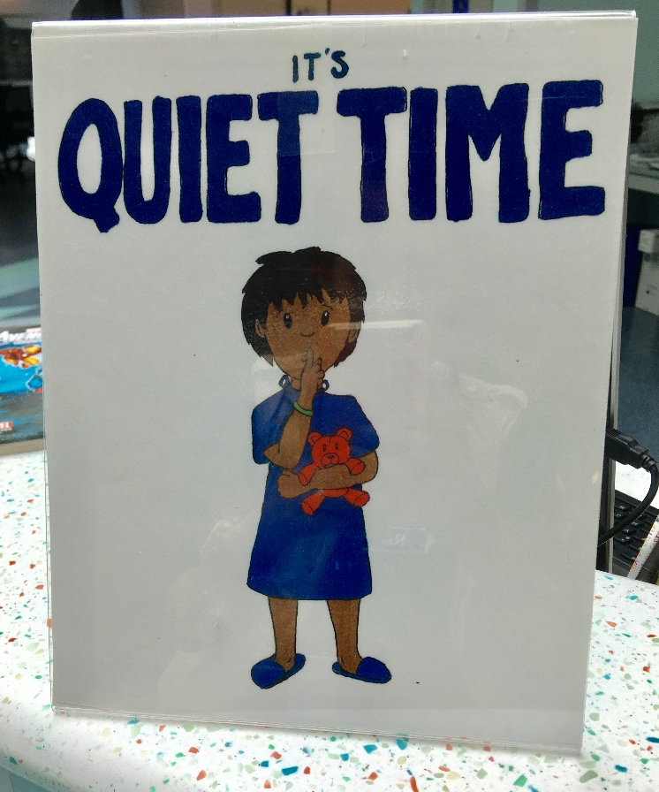
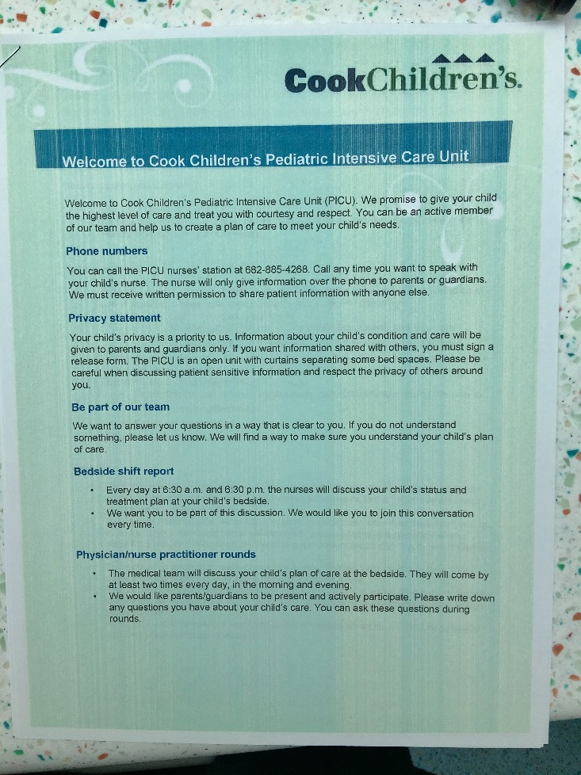
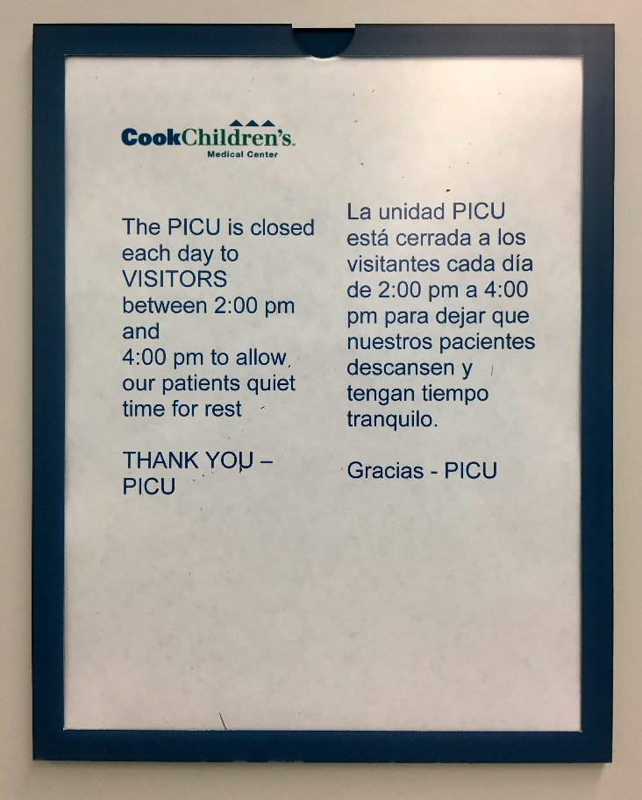
Patient/Caregiver Education
UNIT SIGNAGE / REMINDERS
ADMISSION PACKET INSERT
PICU ENTRANCE SIGNAGE
+ Face-to-face education and overhead announcement

Slide 12
POST-INTERVENTION RESULTS
48% of staff DISAGREE that the noise level in the PICU is significantly louder than what he/she feels is an ideal noise level.
74% of staff disagree or neither agree/disagree that the noise level in the PICU is significantly louder than what he/she feels is an ideal noise level.
25% of staff feel the noise level in the PICU is significantly louder than what he/she feels is an ideal noise level.
100% of staff agree the level of noise in the PICU can impact the patient’s ability to heal.

Slide 13
STAFF RESPONSE TO IMPLEMENTATION
“Since the implementation of Quiet Time, there is a noticeable difference in the way we conduct patient care in the PICU. Staff are more cognizant of wake and sleep cycles, the need for adequate rest and recover, and have a higher tendency to cluster or delay care that can wait during Quiet Time hours. The unnecessary, distracting, and overstimulating loud conversations in the unit are certainly noticed less. Quiet Time Champions are very cognizant of increased noise levels and work to ensure that stimulation is decreased in any way possible to ensure rest and recovery for our patients.”
CCMC PICU NP

Slide 14
STAFF RESPONSE TO IMPLEMENTATION
“I have heard nothing but great things about PICU quiet time. It is very nice for dayshift because we never get a “down” time and it helps calm the unit even when it is hectic by limiting those in the unit and turning the lights down.”
Day Shift RN
“I think quiet time has been great for the patients, families, and the staff. It gives the patients and families a break from extra staff in and out, and allows them to rest. It also gives them a way to have some time from all of the visitors that come in as well, without them having to be the bad guy. The staff also appreciate a quiet time from the craziness of the day to be able to cluster their cares, and allow the patient a break when possible.”
Day Shift RN

Slide 15
STAFF RESPONSE TO IMPLEMENTATION
“It has been a collaborative effort from many different disciplines to make sure that quiet time hours are put into effect from nursing staff even to the secretary level. It also has encouraged the stocking of the room supplies to be done at awake hours versus in the middle of the night causing additional/excessive noise in the patient's room.
I believe that the quiet time hours have also made the PICU staff much more aware of the decibel of their voices in the middle of the night especially in regards to some of the open room areas on B-side.”
Night Shift RN

Slide 16
PATIENT/CAREGIVER RESPONSE
Education
Empowerment
Healing
Allotted time to rest

Slide 17
FUTURE IMPLICATIONS
Continual data collection; specifically sound measurement assessment post-implementation
Real time assessment of patient/family satisfaction scores with targeted questions specific to Quiet Time practice enabled through Get Well Network
Sustaining practice; support on daily basis, including interdisciplinary and ancillary implications
Maintenance of environment to prevent pediatric ICU delirium

Slide 18
References
AL-Samsam, R., & Cullen, P. (2005). Sleep and adverse environmental factors in sedated mechanically
ventilated pediatric intensive care patients. Pediatric Critical Care Medicine, 6(5), 562-567 6p.
Bailey, E., & Timmons, S. (2005). Noise levels in PICU: an evaluative study. Pediatric Nursing, 17(10), 22-26 5p.
Cranmer, K., & Davenport, L. (2013). Quiet Time in a Pediatric Medical/Surgical Setting. Journal Of Pediatric Nursing, 28(4), 400-405 6p. doi:10.1016/j.pedn.2013.02.028
Daniels, J., & Harrison, T. (2015). A Case Study of the Environmental Experience of a Hospitalized Newborn Infant With Complex Congenital Heart Disease. The Journal of Cardiovascular Nursing, 00(0), 00-00.
Harrington, M., & DeLeskey, K. (2015). Shh! Quiet time in the ICU. Nursing Management, 46(5), 21-23 3p. doi:10.1097/01.NUMA.0000463894.82790.33
Haupt, B. (2012). Instituting Quiet Hour improves patient satisfaction. Nursing, 42(4), 14-15 2p. doi:10.1097/01.NURSE.0000412941.66125.C6
Jousselme, C., Vialet, R., Jouve, E., Lagier, P., Martin, C., & Michel, F. (2011). Efficacy and mode of action of a noise- sensor light alarm to decrease noise in the pediatric intensive care unit: A prospective, randomized study*. Pediatric Critical Care Medicine, 12(2), E69-E72.

Slide 19
References
Kol, E., Aydın, P., & Dursun, O. (2015). The effectiveness of environmental strategies on noise reduction in a pediatric intensive care unit: Creation of single-patient bedrooms and reducing noise sources. Journal For Specialists In Pediatric Nursing, 20(3), 210-217 8p. doi:10.1111/jspn.12116
Lower, J., Bonsack, C., Guion, J., (2003). Peace and quiet. Nursing Management, 34, p. 40A
Maidl, C. A., Leske, J. S., & Garcia, A. E. (2014). The Influence of “Quiet Time” for Patients in Critical Care. Clinical Nursing Research, 23(5), 544-559 16p. doi:10.1177/1054773813493000
Milette, I., & Carnevale, F. (2003). I'm trying to heal... noise levels in a pediatric intensive care unit. Dynamics, 14(4), 14-21 8p.
Morrison, W., Haas, E., Shaffner, D., Garrett, E., & Fackler, J. (2003). Noise, stress, and annoyance in a pediatric intensive care unit. Critical Care Medicine, 31(1), 113-119 7p.
Shaffner DH. What does it take to get some peace and quiet in the pediatric intensive care unit? Pediatric Critical Care Med. 2011 Mar; 12(2):238-40. doi:10.1097/PCC.0b013e3181e28a2c. PubMed PMID: 21646958.
Stafford, A., Haverland, A., & Bridges, E. (2014). Noise in the ICU. American Journal Of Nursing, 114(5), 57-63 7p. doi:10.1097/01.NAJ.0000446780.99522.90

