Slide 1
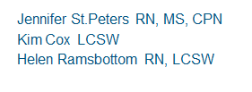
STOP, COLLABORATE and LISTEN: One Hospital’s solution to the rising number of psychiatric patients on a medical unit
Jennifer St.Peters RN, MS, CPN
Kim Cox LCSW
Helen Ramsbottom RN, LCSW
Jennifer St.Peters RN, MS, CPN
Kim Cox LCSW
Helen Ramsbottom RN
Jennifer St.Peters RN, MS, CPN
Kim Cox LCSW
Helen Ramsbottom RN, LCSW
RN
October 9, 2015
Notes:
Title: Suicide Prevention
By: Janine Glassman, MSSW, LCSW
Date: 10/9/15
My name is Janine Glassman, I am a licensed clinical social worker. I have been a social worker for 12 years, and a LCSW for 2 years. I have worked at Cook’s for almost 6 years, 4 years as a social work case manager, and two years as a clinical therapist.
Trisha Otey, SW on 3P raised awareness that the children and adolescents who attempted suicide and were admitted for medical stabilization were not receiving any intervention while waiting to transfer to a psychiatric unit. This was an ethical dilemma for Trisha and her department . Sometimes patients are transferred to an outpatient psych facility within 24 hours, other times they are with us for several days for different reasons - for medical stabilization, insurance issues or self-pay, undocumented patients. Fortunately, this is not a full time job. It’s those patients admitted for more than 24 hours that were identified as needing therapeutic intervention while they are here. My position was created in response to this need. My goal is to see all kids who have attempted suicide, but there are a few times when that is not possible. Fortunately, this is not a full time job. My other responsibilities include
Member of pain management team, trauma team and the on-call psychiatry team.

Slide 2
OBJECTIVES
Identify the educational interventions used to increase nursing competence and confidence in caring for these patients
Identify the multidisciplinary interventions used to address the rising number of these patients
Identify interventions utilized by a multidisciplinary task force to communicate and analyze outcomes

Slide 3
Clinical Therapy Consults & Suicide Attempts
Year | Suicide Attempts | Consults
2014 | 82 | 233
2015 | 144 | 335
2016 | 213 | 444
2017 (Jan-Aug) | 128 | 363
Female attempts outnumber males 4 to 1. Average age is 14.
Notes:
According to the National Institute of Mental Health suicide is the 3rd leading cause of death between the ages of 10-14 and 2nd leading cause of death between 15-24.
Our experience at Cook Children’s Medical Center was a 43% increase in suicide attempts from 2014-2015 and nearly doubled between 2015-2016.
The consults for psychiatric needs of medical patients (clinical therapist) have nearly doubled from 2014-2016 as well.

Slide 4
Quality Improvement Initiative
Does staff education and coaching increase their comfort and confidence in caring for children with comorbid medical psychiatric issues?
Does the implementation of a daily schedule and resources to improve coping skills show a difference in the management of psychiatric patients on a medical floor?
Notes:
Literature review yielded limited information but it was clear that this was a national and international issue. Nurses felt ill prepared to deal with psychiatric patients on medical units and literature revealed no solution or interventions as guidelines.

Slide 5
Timeline
Oct 2015
Policy revision
Apr 2016
Identify unit for focused education
May 2016
Nursing staff education
Education and awareness
Notes:
Jennifer – Nurse Staffing Advisory Council concerns from staff for sitters, education and safety. Hospitalists concerns.
April – asked the staff first

Slide 6
Timeline
Jun 2016
Change in bed placement process
Jul 2016
Needs assessment for staff education/new roles
Feb 2017
Post- assessment for staff education

Slide 7
Medical Unit Nursing Staff Education
Crisis Prevention Intervention certification
Suicide ComCrisis Prevention Intervention certification
Suicide Competency training
Restraint use and documentation
Managing patients and families in crisis training
petency training
Restraint use and documentation
Managing patients and families in crisis training

Slide 8
Creating a Safe Environment
Notes:
Let’s look at the picture and see if you can identify potential “High Risk” Items that would need to be removed and why. (Phone)
** The phone has a cord which could be used for self harm. Also the patient will be restricted from making phone calls while on Suicide Precautions, so it is best to remove it from the room.
**Even with the phone removed, there are still lots of cords in the room that cannot be removed. . (Cord for COW, bed cord, Pillow Speaker)
It is the responsibility of the direct care staff in the room to be keenly aware and monitor these items to ensure the patient does not try to harm him/herself

Slide 9
Room Restriction
Patient on SPs is restricted to room
Educate patient and family/guardian about room restriction
Notes:
Documentation
There is a Suicide Precautions information sheet attached to the policy that should be printed and reviewed with the patient and parents to ensure their understanding and so that any questions can be answered. This form also reviews 1:1 monitoring, Environment Checks, Social media and internet access, and the Visitation policy.

Slide 10
The # 1 Rule
Gathering Information
Not agreeing or disagreeing
Listening without
judgment
EMPATHY
Notes:
How to interact effectively with patients and their families

Slide 11
The Development of New Roles and Risk Analysis
Clinical Therapist
Behavioral Health Care Partner
Behavioral Health Case Manager
Behavioral Health Social Worker

Slide 12
Clinical Therapist Interventions

Slide 13
Notes:
June 2016 Pre-education nursing staff survey
Post-Education survey was Feb 2017

Slide 14
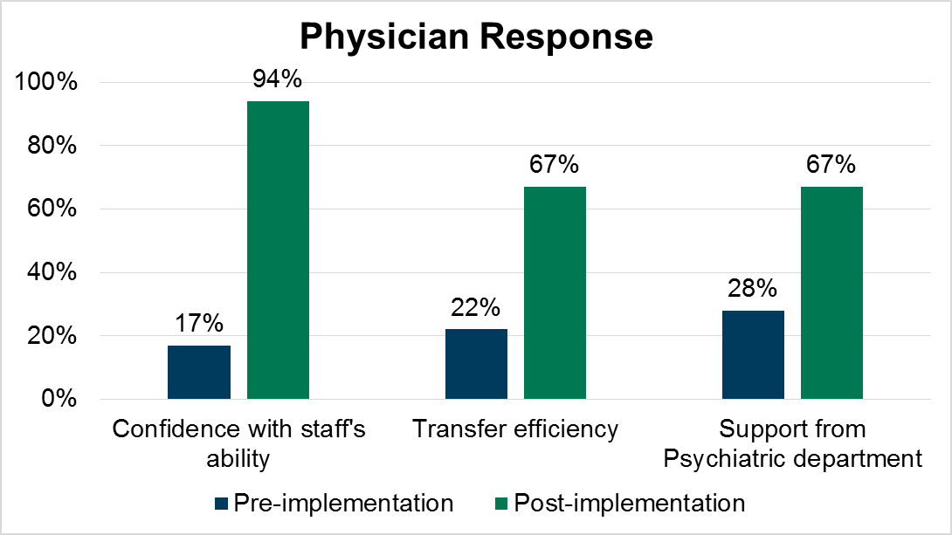
Notes:
Pre-cohorting survey includes house-wide placement of pts

Slide 15
