Slide 1
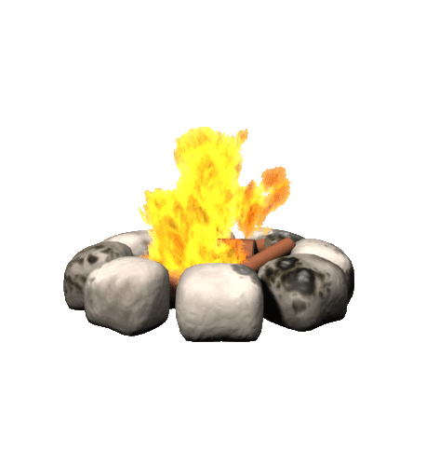
Fire Side Chat
Megnon Stewart, MSN RN

Slide 2
Objective
Discuss the implementation of a reflective group process known as “Fireside Chat” to improve job satisfaction and retention in new graduate nurses.

Slide 3
Professional
Practice
Academia
Nurse Residency

Slide 4
Partnership With Employee Assistance Program ( EAP)
Identify Core Facilitators
Group Process Training
Preparation, Exploration, Anxiety, Cohesion, Termination & Closure.

Slide 5
FIRE SIDE CHAT

Slide 6
Evaluation
Survey 74 Nurse Residents
Fireside Chat is a new implementation to the Nurse Residency Program. Would you like to see this activity continued in the Nurse Residency Program?
Yes/ 70 responses
How did the Fire Side Chat aid in your transition to professional nurse? 41 responses
Realized I was not alone other residents had similar feelings
Allowed me to vent in a save place.
Loved the fireside chats. It was nice to meet and talk with other people about similar things we all are struggling with.
I enjoyed doing the fireside chat. It was an easy way to talk openly without having to do it in front of the entire group.

Slide 7
References
Bolden, L., Cuevas, N., Raia, L., Meredith, E., & Prince, T. (2011). The use of reflective practice in new graduate registered nurses residency program.. Nursing Administration Quarterly, 134-139.
Locaste-Wilken, B.R., (2017) Group Process Training. [PowerPoint slides]. Unpublished. Department of Human Resources Employee Assistant Program, Texas Children’s Hospital, Houston , Texas.
Pineau Stam, L. M., Spence Laschinger, H. K., Regan, S., & Wong, C. A. (2015). The influence of personal and workplace resources on new graduate nurses' job satisfaction. Journal of Nursing Management, 190- 199.
Spence Laschinger, H. K. (2012). Job and career satisfaction and turnover intentions of newly graduated nurses. Journal of Nurse Management, 472-484.

