Slide 1
A Multidisciplinary Approach to Better Pediatric Outcomes:
Tuberculin Skin Testing (TST)
Sharon Wright-Speice, MSN, RN, CPEN
Mona Clark, MSN, RN
Angie Rangel, MSN, RN-BC, CCRN, LNC
Notes:
Mona

Slide 2
Learning Outcome
Discuss the strategies to create & implement a robust multidisciplinary approach to deliver exceptional care to the pediatric population
Course Objective
Identify the essential elements of TST competency utilizing blended learning.
Notes:
Mona

Slide 3
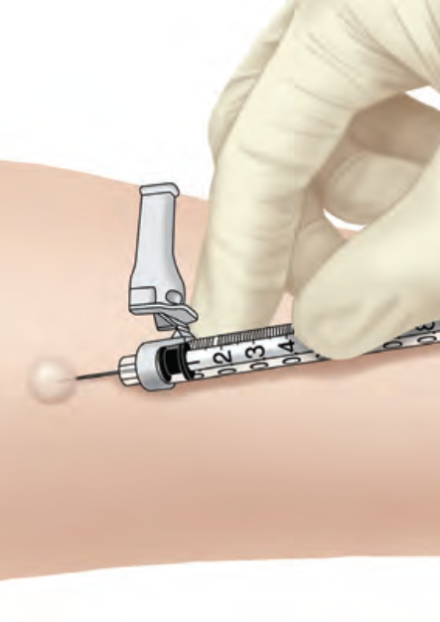
Learn how one large pediatric hospital developed a standardized TST training to ensure delivery of safe patient care for children
Notes:
Mona
.

Slide 4
Background
Tuberculosis (TB) remains a leading cause of morbidity and mortality
The Center for Disease Control (CDC) goal was to eradicate tuberculosis (TB) by 2010.
TB skin test is commonly used in the pediatric population, however, various factors influence outcomes
Notes:
Mona

Slide 5
TB History
Top 4 States:
New York
Florida
California
Texas
Text about what the graphs say.
2015
Over 9,000 New Cases
2010
2016
2014
TST New Program to Support the CDC Initiative and the Organization’s Mission
Centers for Disease Control and Prevention (CDC) goal – Stop TB
Notes:
Sharon
Tuberculosis (TB) remains a leading cause of morbidity and mortality in the world, especially in developing countries. Worldwide over 2 billion are infected with Mycobacterium tuberculosis, the bacteria responsible for TB. The Center for Disease Control (CDC) goal was to eradicate tuberculosis (TB) by 2010.
In 2014 an astounding 9,412 new cases were reported in the United States with 50.9% of the highest incidence coming from four states; California, Florida, New York, and Texas (Center for Disease Control and Prevention, 2015).
Organization
Foundational is the program’s value that is guided by the philosophical belief of the organization, “Texas Children’s mission is to create a healthier future for children and women throughout our global community by leading in patient care, education and research” (Texas Children's Hospital, 2016, para 2).
Texas Children’s Hospital (TCH) is employed by many industry standards at the local, state, and federal level and paired with nursing organizations which align with the mission statement.

Slide 6
Background
CDC Tuberculosis (TB) Transmission and Pathogenesis Video
Notes:
Sharon

Slide 7
Implications for Healthcare Clinicians
Every pediatric nurse need to be aware of the latest guidelines from CDC in regards to TST key components
Notes:
Angie
False readings may occur if the nurse has insufficient knowledge and skill. A correctly applied test can be invaluable in the assessment of a child with suspected TB. Reading the result, however, is often difficult, with different clinician using different induration sizes to indicate a positive reaction.
Every pediatric nurse need to be aware of the latest guidelines from CDC in regards to TST key components to avoid negative consequences and decrease the risk for the patient, the nurse, and the organization.

Slide 8
METHODOLOGY
Education Design Process
Assessment
Outcome Statement Defined
Planning of the Education
Implementation of the Education
Evaluation Process and Types
Notes:
Angie
When planning the education design – good logistical planning creates an exceptional experience for participants
LNA: Identification of gap in knowledge, skills and practice (Difference between “what is & what should be”
Build upon experience
Meet regulatory and accreditation criteria
Define outcome statement: What will the learner demonstrate as a result of participating in the ed. activity
Planning Committee: list here. Multidisciplinary XXXX. Also had a nurse planner to award contact hours.
Identification of Target Audience Core group - Timeline
Buy in from executives – already done, Budget, Education plan (LMS, flyers, email)

Slide 9
Curriculum Development
Pre-Assessment
E-learning
Live Training
IM Informal Questionnaire
Needs Survey
Data Analysis
Communication
LMS Module
Pre-test
CDC podcast
Post-test
Power Point Lecture
Small group discussion
Team scenarios
Low-fidelity Simulation
Notes:
Sharon
Teaching Strategies: Flipped classroom, lecture, video, discussion, simulation. Return demonstration
Incorporation of learning principles:
Adult learning principles
Active Learning
Repetition
Use of emotion
Evidenced-based curriculum (Current literature)
Organization of content
Including IPE
Effective use of AV

Slide 10
Pre-Assessment
Informal and Formal
1 | IM Messaging via Spectra Link identified 22 areas.
2 | Learning Needs via Survey Monkey 62.5% response rate.
Notes:
IM Messaging identified areas involved in TST.
Analysis demonstrated a significant gap in the RN perceived versus actual knowledge.
The Tuberculin skin test (TST) practicum survey distributed via email to 96 nurses with 60 completed; a 62.5% response rate. Both qualitative and quantitative data were analyzed and displayed by statistics table or graph. Demographic questions 1-4 is shown by descriptive statistics. The quantitative analysis used for categorical data questions 5-7, 9-13, and 17. Quantitative analysis also used for binary questions 8 and 14-16. Qualitative analysis of questions 18-20 completed by looking at commonly occurring themes, assigning the themes a category name, and then placing open-ended responses into the designated categories: skill/practice, reading, management, or documentation. Responses making a statement (not a question) and those containing N/A, none, or not at this time excluded in the analysis.

Slide 11
E-Learning
Part I
 | Learning Management System (LMS)
1 | Pre-test
2 | Module with CDC podcast
3 | Post-test

Slide 12
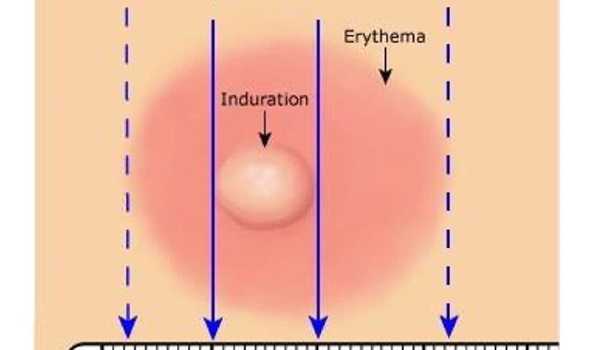
LIVE Training
Part II
 | Classroom attendance with lecture and skills lab
1 | Small group discussion and team scenarios
2 | Breakout skills stations to include: practice, administration, and reading
3 | Policy and documentation
Notes:
Pre and post survey completed.

Slide 13
LIVE Training
Part II
 | Classroom attendance with lecture and skills lab
1 | Small group discussion and team scenarios
2 | Breakout skills stations to include: practice, administration, and reading
3 | Policy and documentation
Notes:
Pre and post survey completed.

Slide 14
Evaluation Summary
95.4% Change in Practice
Place
Measure
& Read
Policy
Document
Notes:
Sharon

Slide 15
Program Metrics
Confidence Survey
Post-Class Evaluation
Purpose:
To measure change (+/-) in the level of confidence and perception of the learners in regards to the course
Purpose:
To measure if the program met the learning objectives of the course
Notes:
Angie

Slide 16
Pre and Post Summary Data Comparison
Each question was rated on a scale of 1-4 (1 = Strongly Disagree, 4 = Strongly Agree)
QUESTION / INDICATOR | PRE | POST
1. I have had formal training on tuberculin skin testing (TST). | 42 % | 95 %
2. I feel confident in my skill to administer a TST. | 68 % | 96 %
3. I feel confident in my skill to measure a TST. | 62 % | 97 %
4. I feel confident in my skill to read a TST result. | 58 % | 92 %
5. I know what vaccines/medications are incompatible with TST | 38 % | 90 %
6. I know where to document TST results in EPIC | 48 % | 98 %
7. I know the reporting process for an abnormal TST | 62 % | 98 %
Notes:
Angie

Slide 17
Nurses Completed
Delineated By Campus
Main Campus and Health Centers
Total 237
The Woodlands Campus
West Campus
Notes:
Mona

Slide 18
Overall Summary
Education Tied to Outcome
The response to indicators around the confidence and perception of the learners demonstrates a statistically significant difference prior to the TST course and post course.
Notes:
Angie

Slide 19
Questions

Slide 20
References:
American Nurses Credentialing Center, (2013). Educational design Process 2013 mini manual. Silver Spring, MD: American Nurses Credentialing Center.
Center for Disease Control and Prevention. (2016). Trends in Tuberculosis, 2014. Retrieved from http://www.cdc.gov/tb/publications/factsheets/statistics/TBTrends.htm
Centers for Disease Control and Prevention, . (Year 2015, March 12). Mantoux Tuberculin Skin Test [Audio podcast]. Retrieved from CDC Featured Podcasts website: https://www2c.cdc.gov/podcasts/player.asp?f=3739

Slide 21
References:
Jest, A. D., & Tonge, A. (2011). Using a learning needs assessment to identify knowledge deficits regarding procedural sedation for pediatric patients. Association of Operating Room Nurses. AORN Journal, 94(6), 567-74; quiz 575-7. doi: http://dx.doi.org/10.1016/j.aorn.2011.05.020

