Slide 1
Cystic Fibrosis Update
Bennie McWilliams, MD
Director Dell Children’s Medical Center CF Center
October 28, 2017

Slide 2
Objectives
Pathophysiology of CF
Genetics of CF
Diagnostic evaluation for CF
Respiratory issues in CF
GI and nutrition issues in CF
Infection control guidelines
QI Considerations
Inpatient and outpatient nursing considerations

Slide 3
Cecilia Farthington
Cecilia presents as a new patient to your practice with a chronic cough
She is a 5 year old girl who recently moved to Austin
They do not have any medical records and are not the best historians

Slide 4
Cecilia Farthington
Cecilia was born at term and had no neonatal issues
In her first few months of life she had a lot of difficulties with tolerating formula and was switched to different formulas including cow’s milk and soy as well as anti-reflux formula.
She had a lot of vomiting with feedings and frequent episodes of diarrhea
Currently she has about 5 stools per day which are very foul. When she has a stool the smell is so bad that people have to leave the house
Other kids tease her because of the smell

Slide 5
Cecilia Farthington
At 3 months of age she was diagnosed with RSV bronchiolitis and hospitalized for 3 days.
Shortly after that, she was diagnosed with reflux and started on nexium. She improved for a while
By 6 months of age, she had recurrent episodes of wheezing and was diagnosed with asthma and started on pulmicort.

Slide 6
Cecilia Farthington
She moved to different apartments and often her family would loose her medications and she frequently missed them.
When she missed her treatments she would get sick and need admission.
Her weight was marginal and went from the 50% to 25% to 3% and at 8 months was below 3%. Currently her BMI is <<3%.

Slide 7
Cecilia Farthington - PE
Irritable and very thin with very little subcutaneous fat tissue
Congested nasal passage with a possible polyp
Tachypneic but no distress
Bilateral crackles and occasional wheezing
Abdomen distended with hepatomegaly
Very foul gas and loose diarrhea
Cyanotic fingers with significant clubbing

Slide 8
Cecilia Farthington
SaO2 89%
CXR bilateral infiltrates with bilateral bronchiectasis
Sweat chloride test was 95.
Fecal elastase was 20

Slide 9
Carlos Fernandez
Carlos is an 8 month old child with recurrent pneumonias (hospitalized 4 times in the last 4 months)
He has poor weight gain and has always struggled with his weight
He has 4 stools per day which are generous in size.
His mother noted that when she kissed the child, he tasted “dirty” and felt she was not cleaning him enough and he gets several baths per day on average.

Slide 10
Carlos Fernandez (Cont)
Carlos has a sweat chloride test with a value of 65
He is diagnosed as having CF.

Slide 11
Cecilia and Carlos
How often do you see these presentations in CF?
A. 80% of the time
B. 50% of the time
C. 10% of the time
D. Never

Slide 12
Cecilia and Carlos
How often do you see these presentations in CF?
A. 80% of the time
B. 50% of the time
C. 10% of the time
D. Never
This is due to newborn screening!!

Slide 13
Callie Fields
Currently the Most Common Presentation
2 week old infant referred for positive newborn screening for CF
The patient has a vigorous appetite and when it is time for her feeding she gets a bit frantic and they cannot wait longer than 3 hours to feed her.
She has been at 50% for weight.

Slide 14
Callie Fields (Cont)
Upon presentation, Callie was a beautiful girl and the only abnormality in her exam was that she had just slightly decreased subcutaneous fat tissue that you might expect from a 2 week old.
Her fecal elastase was 20
Her sweat chloride test was 90

Slide 15
Cystic Fibrosis
Newborn screening has made an incredible difference in these patients.

Slide 16
Cystic Fibrosis
Described in 1935 as a pancreatic disease causing malabsorption leading to lethal malnutrition with pneumonia in infancy
2014: an autosomal recessive disease of epithelial salt and water metabolism leading to a highly variable syndrome of chronic multi-organ disease, explained by the molecular biology of ion channels
Notes:
Our understanding of CF and subsequently it’s treatment has made rapid progress

Slide 17
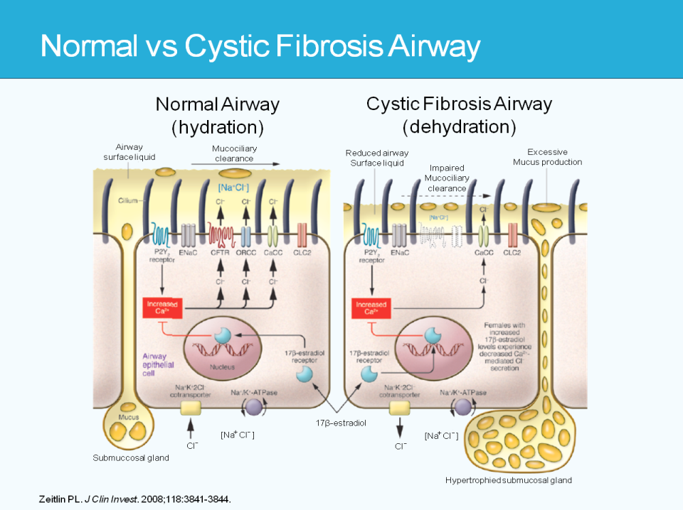

Slide 19
Pathophysiology of CF
Pathogenesis
Genetic and protein defect
Abnormality in salt and water transport
Poor mucus clearance
Persistent airway infection
Chronic Inflammation
Exacerbations of infections
Airway
Obstruction
Progressive lung destruction
Early death

Slide 20
Epidemiology
> 30,000 patients in the US
Caucasians
  3 - 5 % carrier rate (7 million people)
  1 in 2,500 live births in US
Hispanics 1 in 8,500
Blacks 1 in 15,000 births
Asians 1 in 31,000 births
Reported in Native Americans, Africa, Middle East, Asia, Pacific Islands
Notes:
When look at high carrier rate, there should be more people diagnosed with CF. Probably missing some of the milder cases
High frequency of 508 in caucasions accounts for increased frequency
The high incidence of CF in Northern Europeans has led to the theory that a single CF mutation may be beneficial if some way. Protection against cholera in the endemic areas of northern Europe is the most common theory
Stress to residents never not think of CF just because a patient is not white

Slide 21
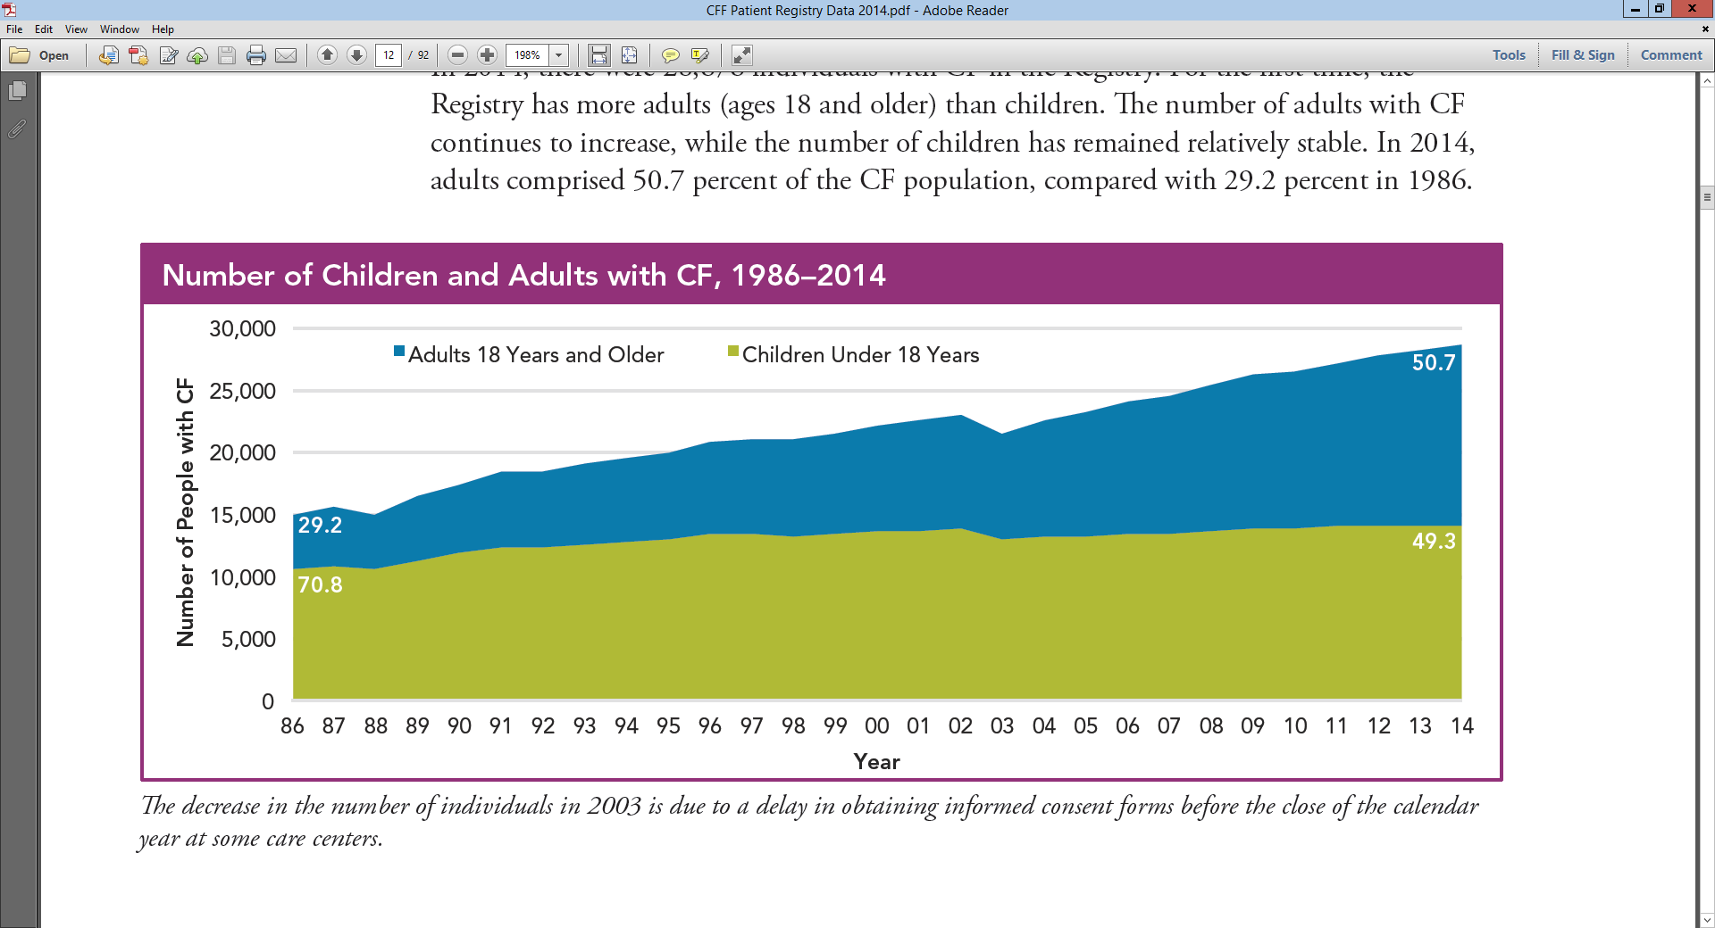
Number of Children and Adults with CF
1986-2014
Year

Slide 22
Number of Children and Adults with CF
1986-2014
Year

Slide 23
Diagnosis of Cystic Fibrosis
Cystic Fibrosis is a Clinical Syndrome
Chronic Sino-Pulmonary Disease
Gastrointestinal/Nutritional Abnormalities
Predisposition to biliary cirrhosis
Obstructive Azoospermia/CBAVD in Males
Salt loss Syndromes
± family history
Notes:
Chronic Sino-Pulmonary Disease
chronic sinusitis
copd
infection with organisms associated with CF (staph, pseudomonas, cepacia)
GI/Nutritional
intestinal manifestations (meconium ileus, pancreatic insufficiency, DIOS, rectal prolapse, recurrent pancreatitis)
hepatobiliary disease
FTT
hypoproteinemia/edema
ADEK vitamin deficiency
Clinical spectrum of disease severity from classic CF to more atypical presentations – half of patients with CBAVD have 2 CFTR mutations, but no other symptoms. Adults with chronic pancreatitis or recurrent rhinosinusitis have been shown to have at least 1 CFTR mutation

Slide 24
Diagnosis of Cystic Fibrosis
Elevated sweat chloride concentration
  Pilocarpine iontophoresis
  > 60 mmol/L Chloride
  > 100 mg of sweat
  Two sites or two test dates
Or two CF-producing genetic mutations – there is one defective gene but almost 2,000 specific mutations that cause CF
Or nasal potential difference profile consistent with CF
Notes:
Sweat Chloride
Mutation Analysis
hundreds of mutations identified
85% of patients with delta F508
50% homozygous delta F508
NTPD
complicated method of measuring electrical potential of nasal epithelium
requires complex apparatus and skill in performing
infusions of 4 different salt/drug solutions to measure changes in NTPD
used clinically to give additional evidence for or against CF in atypical cases
used primarily as tool to measure response to therapy in clinical trials

Slide 25
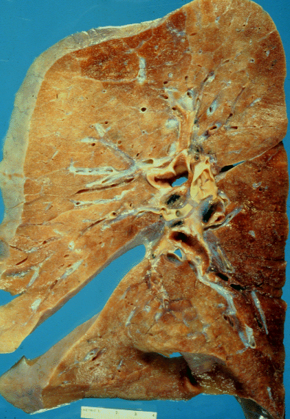
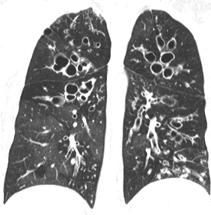
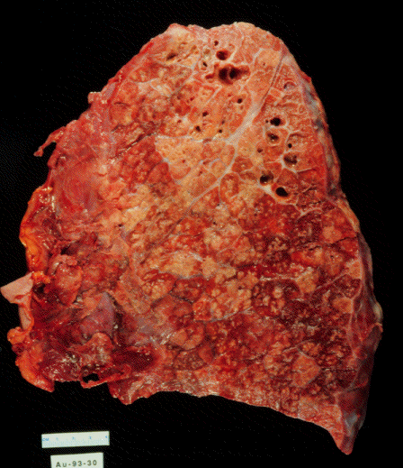
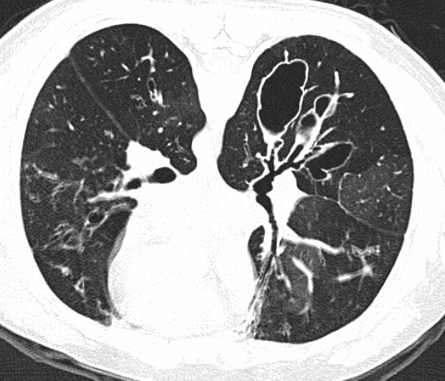
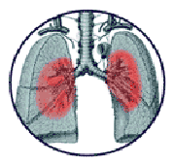
Pulmonary Disease in CF
Bronchial
Obstruction
Inflammation
Infection
Impaired
Mucociliary
Clearance
Normal at birth
Bronchiectasis

Slide 26
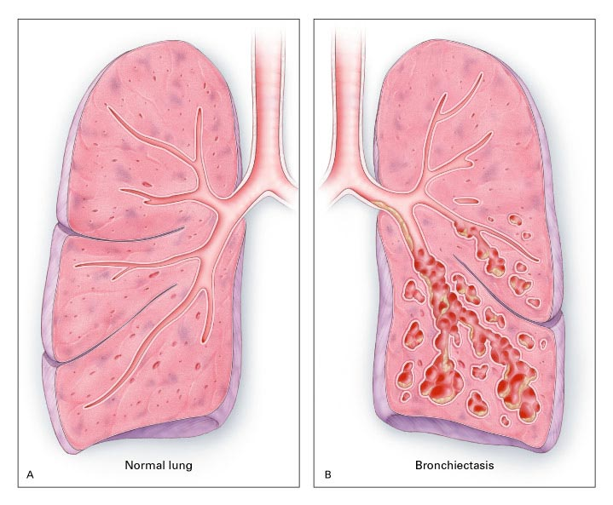
Bronchiectasis

Slide 27
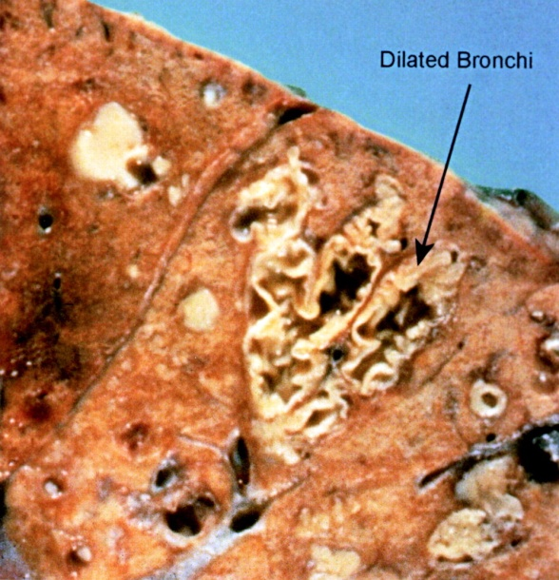
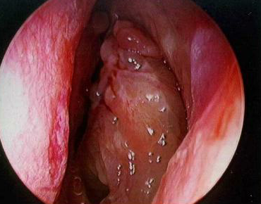
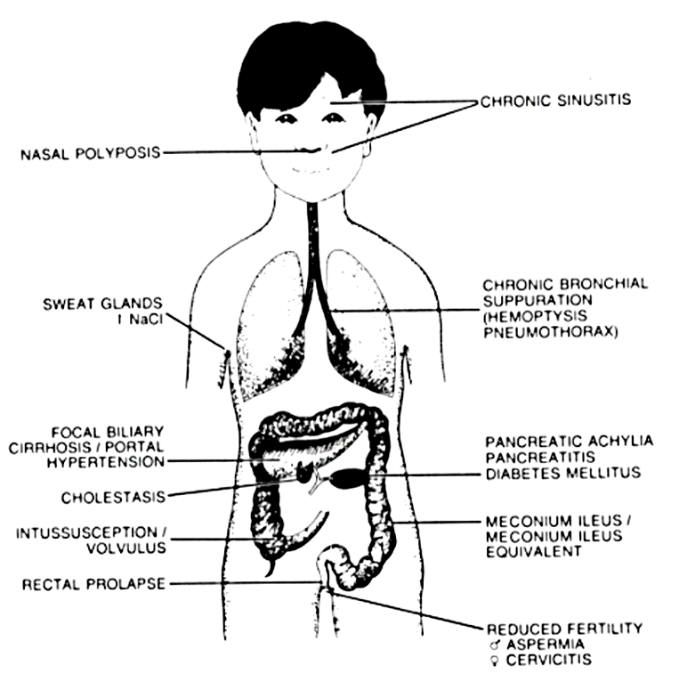
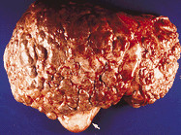
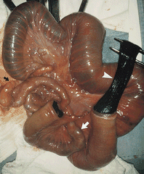
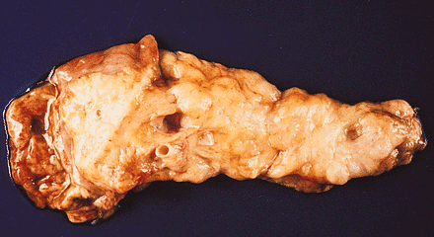
CF is a Systemic Disease
Notes:
100 % of CF patients with chronic or recurrent sinus disease
symptoms include headache, anosmia, deformity of boney structures, halitosis, etc
therapy is generally topical coupled with antibiotics
Nasal polyps are present in 25 % of CF patients
can develop polyps with AR but finding of polyps should prompt suspicion of CF
therapy includes nasal steroids and anti-inflammatory drugs

Slide 28
CFTR Genetics
Notes:
Because of the different severity in gene defects coupled with other genetic components such as modifier genes and environment insults CF is a disease that cause a wide clinical spectrum
Severe Mutations (G551D, deltaF508) have < 1% activity and patients are PI
Mild mutations (R117H, or A455E) have greater CFTR activity and are PS
Vas Deferens require >20 % activity so men with “very mild” mutations ( 5T and 7T exon mutations) may have CBAVD as only manifestation of CF
Pulmonary disease varies widely among individuals with the same genotype, so clearly other factors effect expression of airway disease

Slide 29
Aggressive Treatment - Therapeutic Intervention in CF
Pathogenesis
Genetic and protein defect
Abnormality in salt and water transport
Poor mucus clearance
Persistent airway infection
Chronic Inflammation
Exacerbations of infections
Airway
Obstruction
Progressive lung destruction
Early death

Slide 30
Aggressive Treatment - Therapeutic Intervention in CF
Pathogenesis
Clinical Trials
Genetic and protein defect
Gene Transfer Chaperones
Abnormality in salt and water transport
Ion Transport
Regulators
Poor mucus clearance
ACT devices,
Mucolytics – Pulmozyme, Hypertonic Saline
Persistent airway infection
Early Antibiotics
Chronic Inflammation
Anti-
inflammatories – Ibuprofen, Azithromycin
Exacerbations of infections
Airway
Obstruction
Inhaled and IV antibiotics
Progressive lung destruction
Early death

Slide 31
Fundamentals of CF Therapies – How they relate to Research
Restore airway surface liquids therapy
Mucus alteration therapy
Anti-inflammatory therapy
Anti-infective therapy
The approach used in clinical care is being used to develop research initiatives

Slide 32

Why are CF patients doing better?

Slide 33
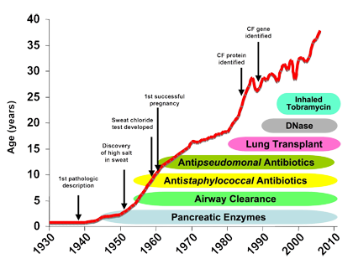
www.NationalJewish.com

Slide 34
Keys to Improved Survival
Early diagnosis
Aggressive treatment
  Coordinated care team
    Nutrition
    Infection control
    Aggressive treatment of infection – suppression and treatment
    Airway clearance
  Quality Improvement
  New therapies/Research

Slide 35
Aggressive Treatment - The CF Team
Multidiciplinary approach
  Physician (typically pulmonologist)
  Nurse
  Respiratory therapist
  Dietician
  Social worker
  Close interaction with endocrinologist, gastroenterologist, psychologist/psychiatrist
Notes:
Well established model in CF and has improved care

Slide 36
Coordinated Care Team
110 accredited centers – CFF provides grant funding
Patients have access to MD, nurse coordinator, dietician, respiratory therapist, social worker
Recommended to see patients quarterly
All data entered in a registry. This data used for research and quality improvement – publically available

Slide 37
Typical Cystic Fibrosis Program
Physicians and Midlevels
  Center Director
  Adult Program Director
  Pediatric Program Director
  Other pulmonary physicians
  Mid-level providers
  GI
  Endocrinology
  Mental Health
Multidisciplinary Team Members
  Pediatric Nurse Coordinator
  Adult Nurse Coordinator
  Dietician
  RRT
  Social Work
  Research Coordinators
  Child life
  Additional team members
Notes:
Close relationship with inpt and out pt nurses, RTs, PTs. GI coming to clinic. Maybe endo.

Slide 38
Aggressive Treatment -Recommendations for Routine Care and Screening
Schedule | Screenings
Quarterly | Clinic Visit
 | Respiratory Culture (surveillance for P. aeruginosa)
Biannually | Pulmonary function testing
Annually | CBC, LFTs, IgE, vitamin levels, serum glucose or OGTT screening for CFRDM
As clinically appropriate | CXR, HRCT, DEXA scan
Cystic Fibrosis Foundation. Clinical Practice Guidelines for Cystic Fibrosis. 1997
Notes:
Focus on early maintenance of pulmonary function and good maintenance of growth and nutrition
All patients receive screening for hyperglycemia. If casual screening >126 or fasting glucose > 100 perform 2 hour GTT. ? Do on all patients > 14 years
As I talk more about therapy. I’m going to focus on Pulmonary therapy. Plays largest role in CF. Nutrition is important. Pancreatic enzyme replacement, treatment of CFRDM and liver disease also important.

Slide 39
Quality Improvement
“We believe that, during the next 5 years, the life expectancy of patients with CF can be extended by 5-10 years through the consistent implementation of existing evidence-based clinical care.”
  Cystic Fibrosis Foundation
Every center has to participate in QI work
Notes:
LLC in Adult care and transition, CFRD, Adherance etc.

Slide 40
FEV₁ Decline Remains a Challenge
Median FEV₁ by Age 1985-1989 CF Birth Cohort
CFF FEV₁ Goal for
Pediatric Patients
(Actual=85%)
100
100%
90
FEV₁ Percent Predicted
80
CFF FEV₁ Goal for
Adult Patients
(Actual=67%)
75%
70
60
6
7
8
9
10
11
12
13
14
15
16
17
18
19
20
21
22
23
24
25
26
27
28
29
Age (Years)
Cystic Fibrosis Foundation. Patient Registry: Annual Data Report. 2014.

Slide 41
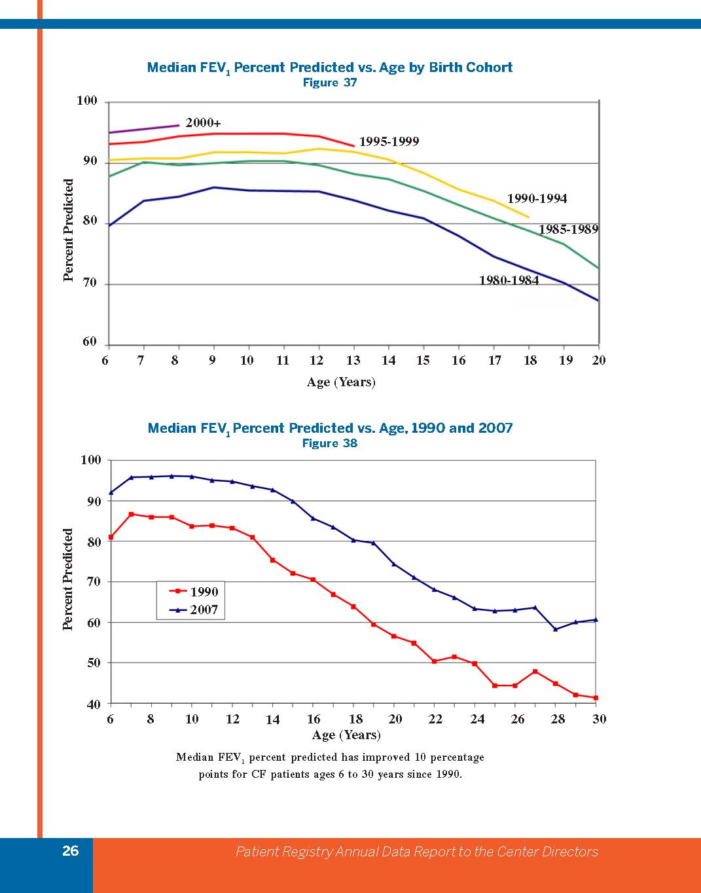
Pulmonary Disease and Lung Function Decline

Slide 42
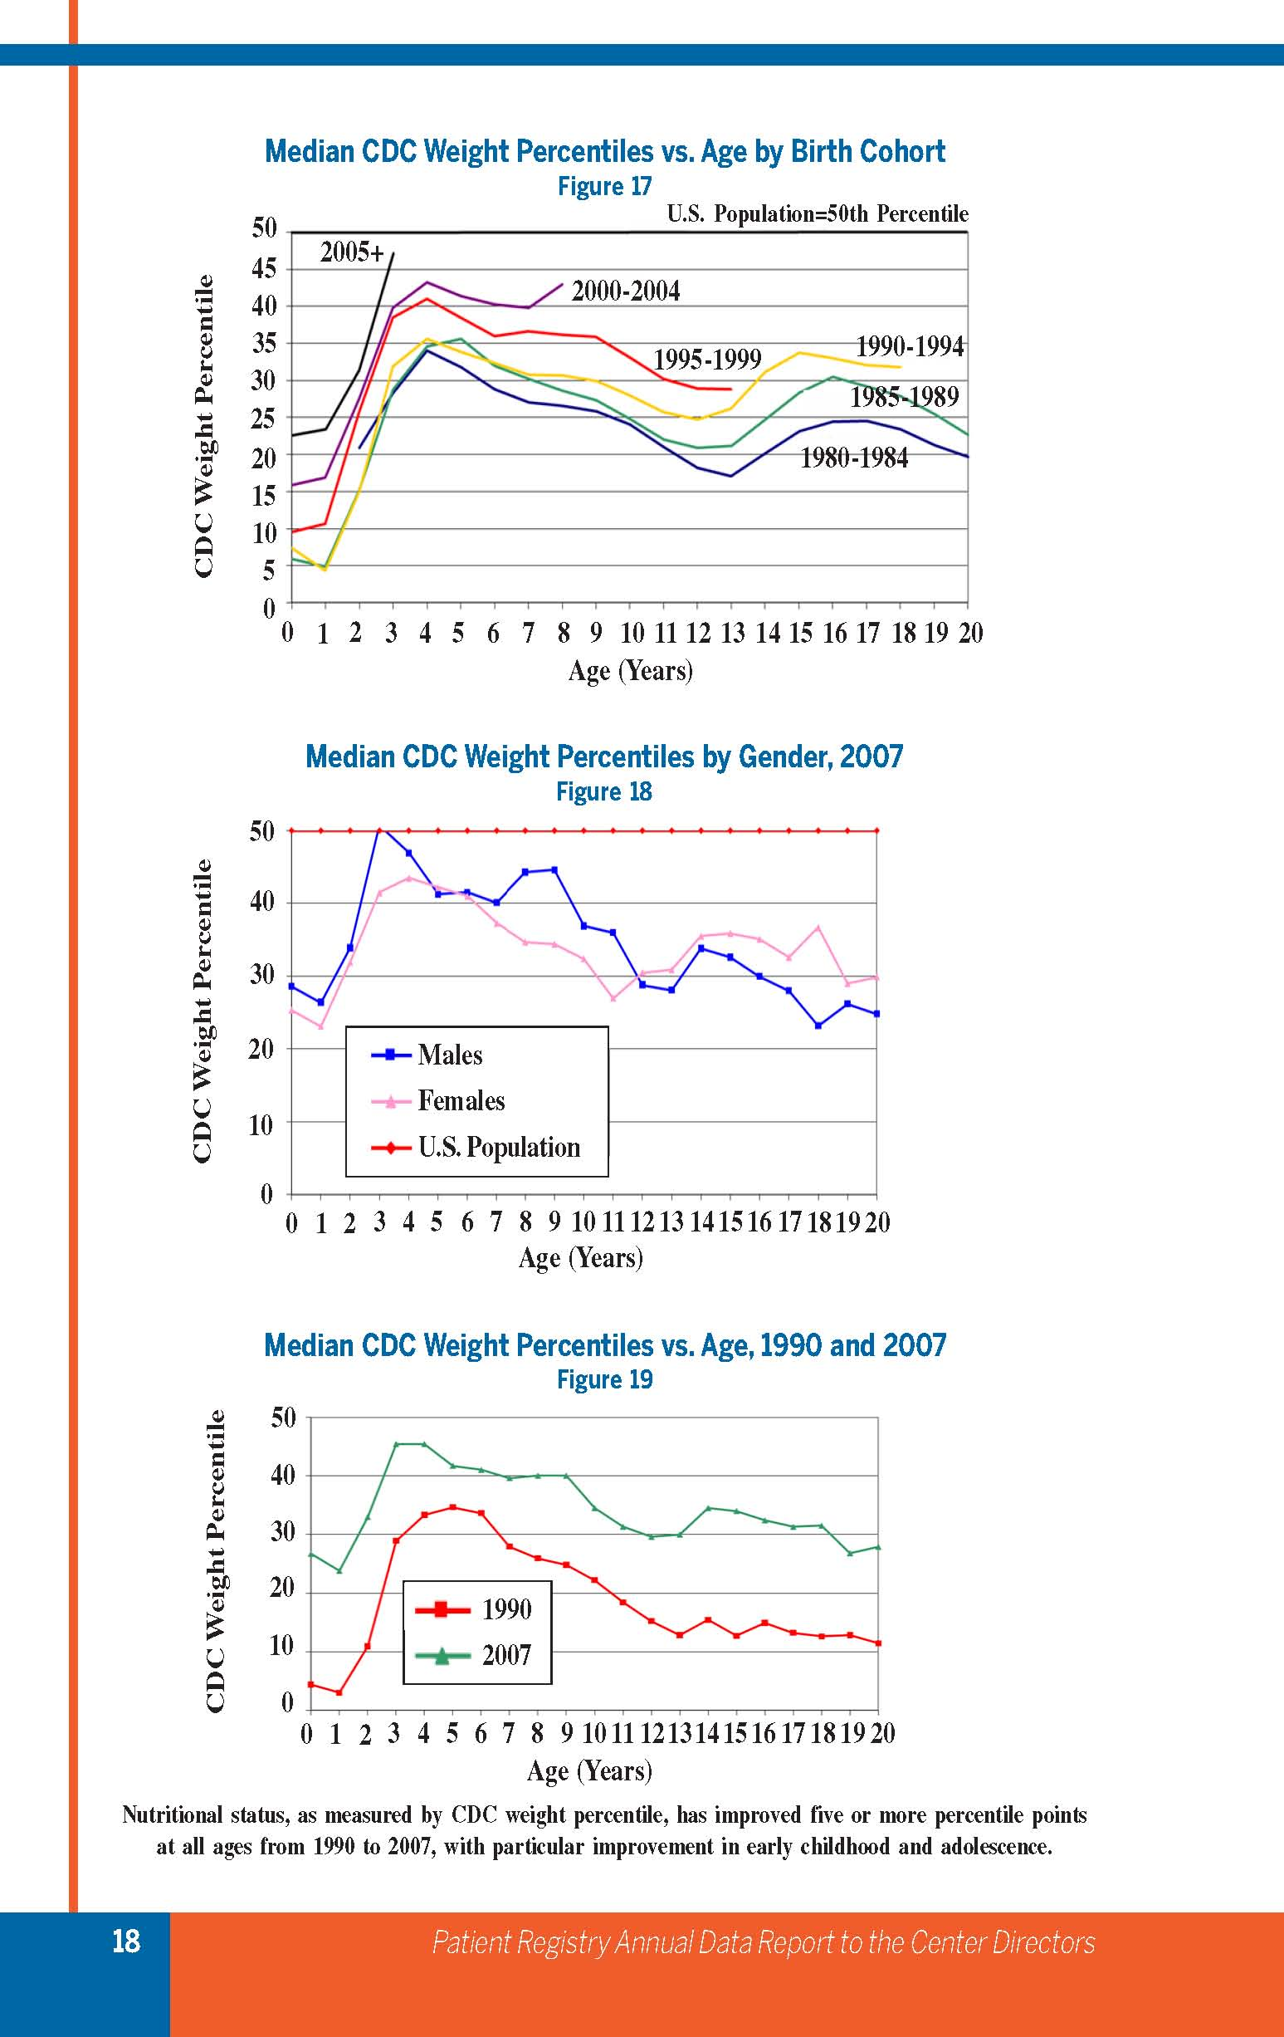
Notes:
Patterns are similar, need to start out from the best possible point

Slide 43
Early Diagnosis
 | Age at Diagnosis | Diagnostic Odyssey | Cost | Nutrition Status | Sputum Culture
Case 1 Conventional Diagnosis | 4 months | Yes | $$$$$ | Moderate Risk Weight for height 10% | Staph Aureus Pseudomonas Aeriginosa
Case 2 Newborn Screening | 6 weeks | No | $80 | Well nourished weight for height – 50 -75% | Staph Aureus
Budget for CF NBS 2010 - $2,878,453

Slide 44
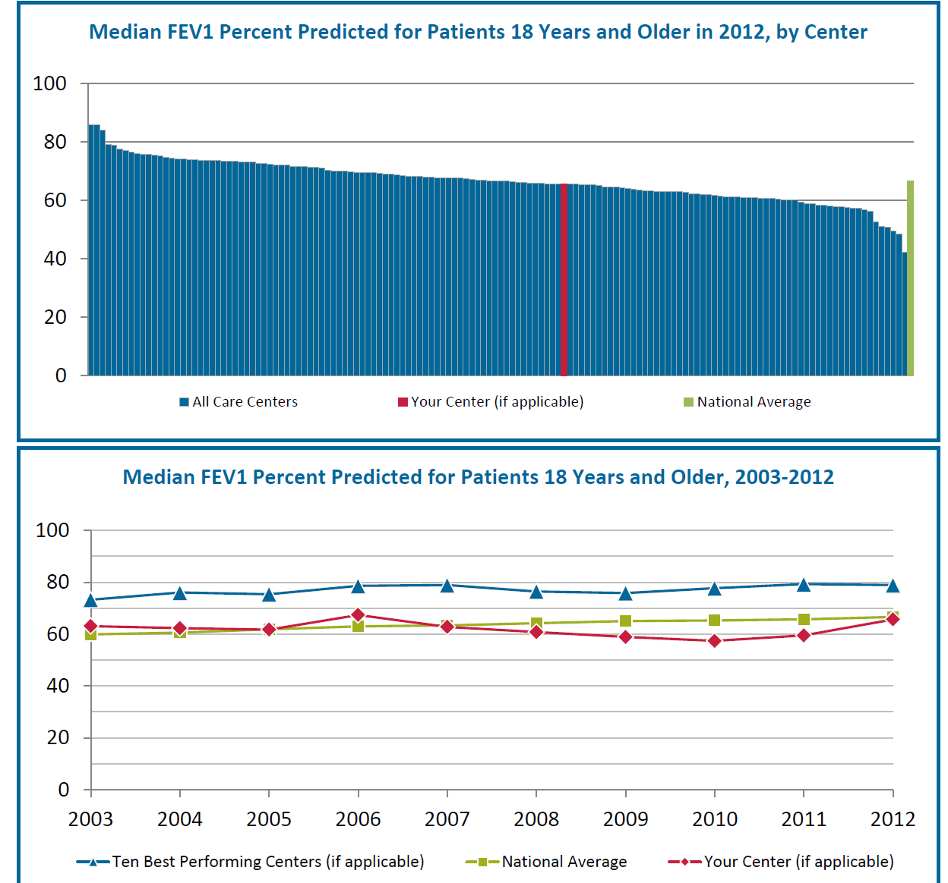
CF Registry Data

Slide 45
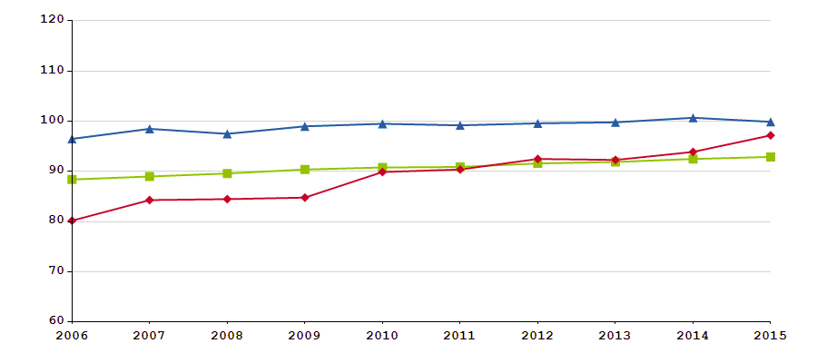
Median FEV1 6 to 17 Years
Blue – 10 best performing Centers Green – National Average Red - DCMC CF Program

Slide 46
Prognostic Factors
¹M Corey et al, J Pediatr 1997; 131:809
Genetic
Gender¹
Pancreatic Status¹
CFTR Genotype
Modifier Genes
Diabetes
Environmental
P. aeruginosa Infection
B. Cepacia Infection
Nutrition
Socioeconomic Status
Diagnosis/Care
Pollution-Smoking
Notes:
Patients with CF loose about 2% fev1 per year. Certain prognostic factors that can lead to worse disease

Slide 47
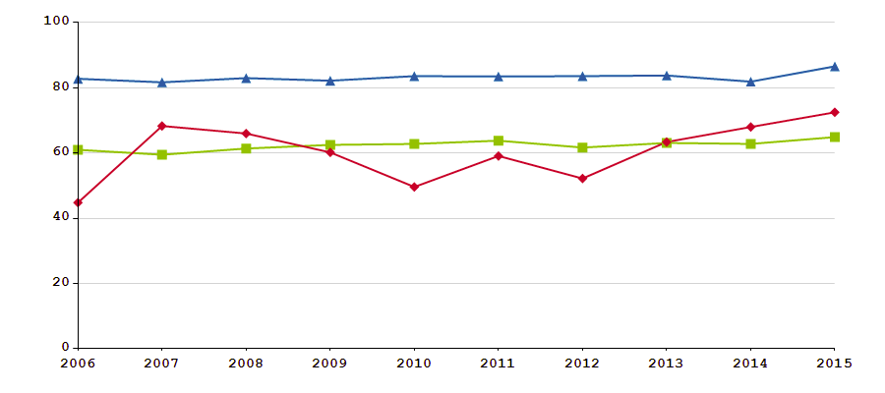
Weight for Length Percentile
<2 years of age
Blue – 10 best performing Centers Green – National Average Red - DCMC CF Program

Slide 48
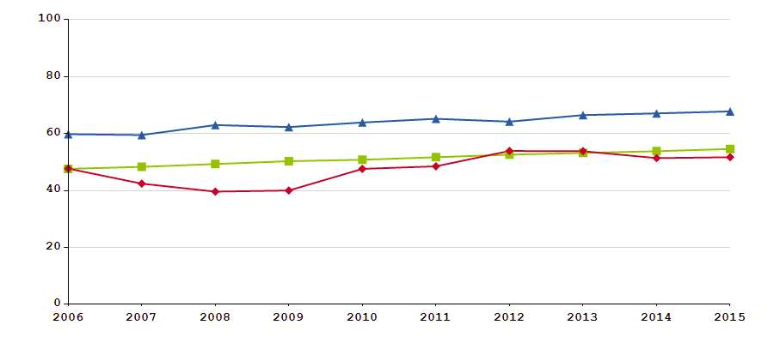
Median BMI Percentile 2-18 years of Age
Blue – 10 best performing Centers Green – National Average Red - DCMC CF Program

Slide 49
Anti-Infective Therapies
Because of the impaired mucociliary clearance, chronic colonization of different bacteria occurs
The most common pathogens in CF patients are Pseudomonas aeruginosa and methacillin-resistant Staph aureua (MRSA)
There are other pathogens

Slide 50
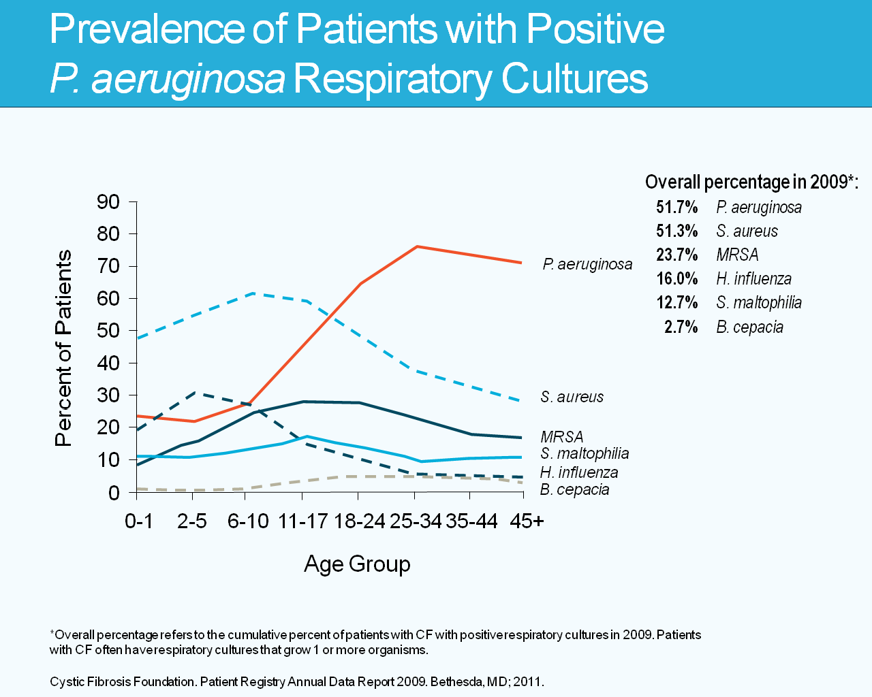

Slide 51
By the Time CF Patients are Adults, ≥60% are Infected with Pa
9.8% decrease in patients with a positive Pa culture since 2004
100
Prevalence of Respiratory Microorganisms by Age¹
90
2004²
P. aeruginosa
80
70
2014
60
Percent of Patients
50
40
30
20
MDR-Pa
10
0
<2
2 to 5
6 to 10
11 to 17
18 to 24
25 to 34
35 to 44
>45
Age (Years)
P. aeruginosa
H. influenzae
B. cepacia complex
S. aureus
MRSA
A. xylosoxidans
S. maltophilia
Multidrug resistant-Pa
MRSA=Methicillin-resistant S. aureus
Cystic Fibrosis Foundation. Patient Registry: Annual Data Report. 2014.
Cystic Fibrosis Foundation. Patient Registry: Annual Data Report. 2004
Notes:
Additional Perspective
Despite the 9% decrease in the number of patients infected with chronic Pa, this infection remains a problem
From 2004 to 2014, the curve depicting the percentage of CF patients with a positive Pa culture shifted to the right
There has also been an increase in multi-drug resistant Pa over the same period of time (shown in the dark blue line toward the bottom of the figure)

Slide 52
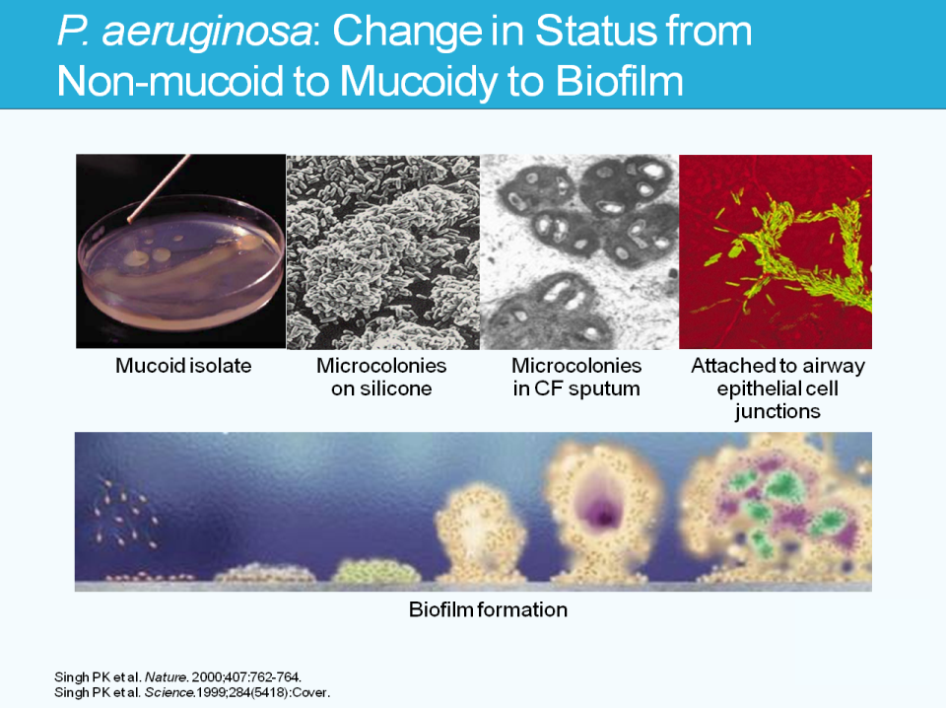

Slide 53
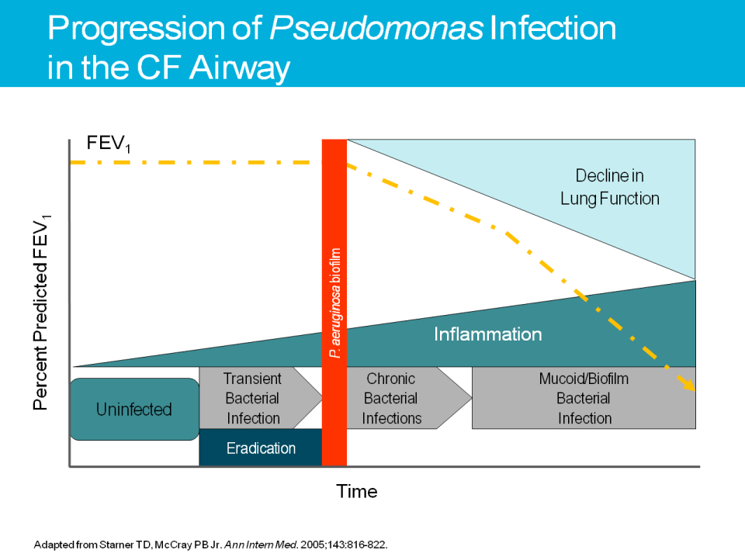

Slide 54
Consequences of CFTR Mutations
Alternate Chloride Channels
+
Na
ENaC
Apical
Cl
-
P
2Y2
Mutant CFTR
Cl⁻
ER
Nucleus
Δ F508
Basolateral
Notes:
CFTR has multiple functions involving fluid balance across epithelial cells
cAMP activated chloride channel, and inhibits sodium reabsorption by epithelial sodium channels
Mutations lead to defective chloride transport in epithelial cells in resp, GI, hepatobiliary and reproductive tracts. Decreased chloride accompanied by decreased sodium and water
Results in dehydrated, viscous secretions that are associated with luminal obstruction and destruction and scarring

Slide 55
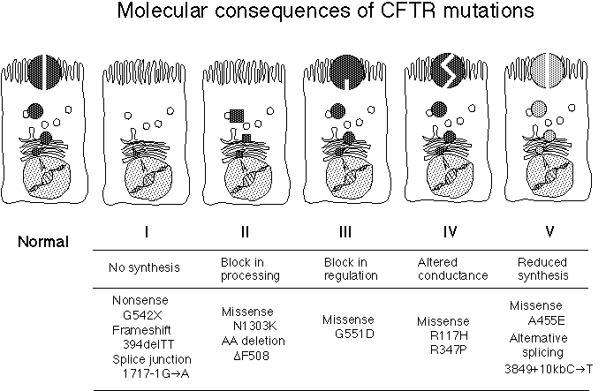
All CFTR Mutations are not equal
Notes:
Around 1000 gene defects reported, around 22 account for the vast majority of gene defects
By grouping CFTR mutations into classes specific approaches can be developed that address the underlying molecular defect on a an individual patient level.
Depending on type of mutation, variable amount of CFTR or functionality of CFTR
First drug – Kalydeco in phase III mutation (gating) – improved NPD, sweat chloride (decreased on ave 48mEq!), 10% increase in FEV1, 50% reduction in exacerbations, 3.1kg weight gain, improved resp symptoms.
F508 – a three base pair deletion that codes for phenlyalanine at position 508 of CFTR protein causes a block in processing- CFTR does not reach cell surface
Defects in splicing and production – class 5, leading to a deficit of normal CFTR at the cell surface with around 10% of wild type levels
Different drugs in the pipeline work on different levels that may improve phenotype

Slide 56
All CFTR Mutations are not equal
PTC Suppressors
Ataluron
Corrector + Potentiator
VX 809 or VX661 + Kalydeco
“Potentiator”
Kalydeco
Potentiator”
Kalydeco
Notes:
Around 1000 gene defects reported, around 22 account for the vast majority of gene defects
By grouping CFTR mutations into classes specific approaches can be developed that address the underlying molecular defect on a an individual patient level.
Depending on type of mutation, variable amount of CFTR or functionality of CFTR
First drug – Kalydeco in phase III mutation (gating) – improved NPD, sweat chloride (decreased on ave 48mEq!), 10% increase in FEV1, 50% reduction in exacerbations, 3.1kg weight gain, improved resp symptoms.
F508 – a three base pair deletion that codes for phenlyalanine at position 508 of CFTR protein causes a block in processing- CFTR does not reach cell surface
Defects in splicing and production – class 5, leading to a deficit of normal CFTR at the cell surface with around 10% of wild type levels
Different drugs in the pipeline work on different levels that may improve phenotype

Slide 57
VX809 Phase 3 (Orkambi)
>12 years
6-11 years
0-5 years
809-103
double blind
(Traffic study)
COMPLETED
809-104
double blind
(Transport study)
809-106
advanced lung
disease
809-109
double blind
COMPLETED
809-115
In process
(Possibly
will do)
809-011B
open label rollover
Blinded dose
(from 809-109)
COMPLETED
809-105
open label rollover
from 809-103
COMPLETED
809-901
Expanded access program
until insurance approval
COMPLETED
809-110 open label rollover
(from 809-011B)
ACTIVE BUT CLOSED FOR ENROLLMENT

Slide 58
VX 661 Phase 3
>12 years
6-11 years
661-106
homozygous
del 508
661-107
one del 508 and
one null allelle
(little to no
CFTR function)
COMPLETED
NO EFFECT!!!
661-108
one del 508 and
one with residual
Function
COMPLETED
661-109
with one del 508 and
one gating mutation
661-113
either homozygous or
heterozygous for del 508
OPENING FOR ENROLLMENT SOON
661-110 Rollover
(from 107 and 108)
PATIENTS ACTIVE IN STUDY BUT NO MORE ENROLLMENT

Slide 59
Vertex 371
VX661/ivacaftor plus an ENaC Inhibitor (causes decreased reabsorption of sodium) - previously Parion (P1037)
>12 years
371-101 two del 508 and
Currently on Orkambi
ENROLLING

Slide 60
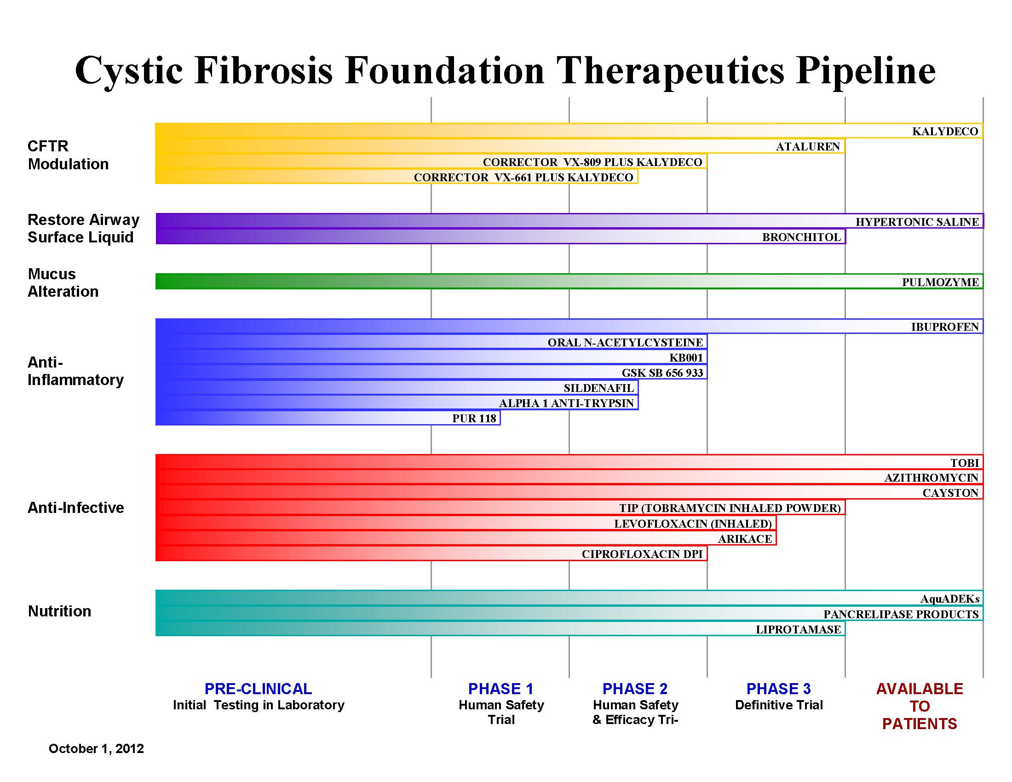
CFF.org

Slide 61
Cystic Fibrosis Foundation Therapeutic Pipeline
2017
https://www.cff.org/trials/pipeline

Slide 62
Change from Baseline in Sweat Chloride
Treatment effect through Week 24
– 47.9 mmol/L
P < 0.0001
Treatment effect through Week 48
– 48.1 mmol/L
P < 0.0001
Ramsey et al., N Engl J Med. 2011 Nov 3;365(18):1663-72
Notes:
Treatment effects are point estimates of VX-770 minus placebo using a mixed model for repeated measures
Values shown at each visit obtained from descriptive statistics, not model-derived measures
Week 48 and Week 24 estimates obtained from the mixed model for repeated measures (MMRM) with dependent variable absolute change from baseline, fixed effects for categorical visit (Day 15, Week 8, Week 16, Week 24, Week 32, Week 40, and Week 48) and treatment group, and adjustment for continuous baseline values of age and percent predicted FEV1, using an unstructured covariance. matrix.

Slide 63
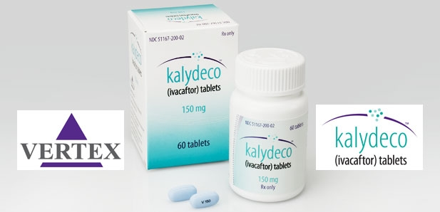
Cost of Kalydeco
$294,000 per patient, per year
Notes:
$400 per pill

Slide 64





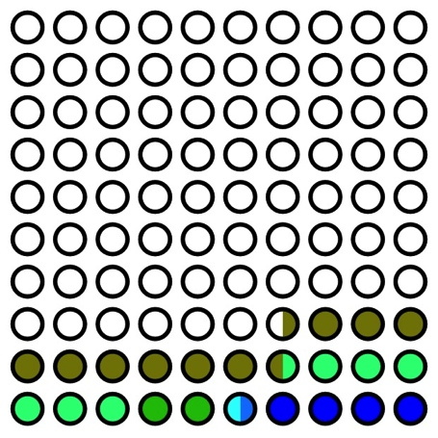
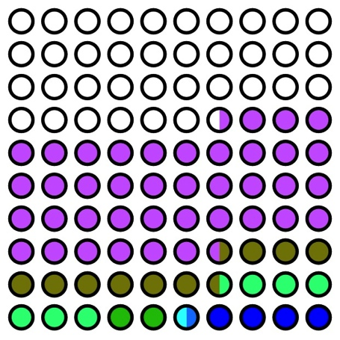
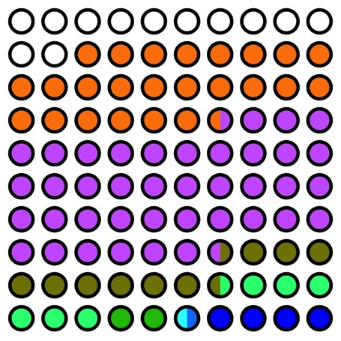
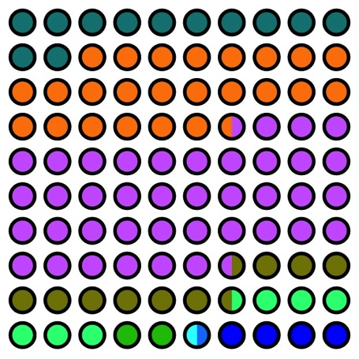

A Vision for the Future
Rowe SM. Plenary Session I: Reversing the Basic Defect: A Vision for the Future.
NACFC 2012

Slide 65

Typical regime – Albuterol and Hypertonic Saline twice a day, Pulmozyme once a day, inhaled antibiotics cycled. Airway clearance two to four times a day
Azithromycin MWF
Pancreatic enzymes and CF vitamins
Antiacids
Calcium, extra vit D
Asthma meds?, Allergy meds? Antidepressants, Anxiety?, Chronic Pain
Doing all the therapies takes
approximately 16-20 hours per week.
Notes:
Aggressive treatment has a price

Slide 66
CF: an exciting era
Decades of steady progress
Improving application of current therapies
Pipeline of new mutation specific therapies that correct the basic defect in CF
An orphan disease with a track record of success, albeit costly therapies!

