Slide 1
Respiratory Therapists Driving the Pathway: Bronchodilator Frequency Weaning for Inpatient Asthma Patients
Jennifer Horn MSN, RN, CPN
Mary Bina MS, RRT-NPS
Jason Reese BSRC, RRT-NPS

Slide 2
Pediatric Inpatient Asthma Pathway
Inconsistency with weaning orders
Physicians only round daily
CHAT Asthma Collaborative- does not specify when or how to wean asthmatic patients
RT-driven pathway based on scoring tool
Goal: Develop a pathway that encouraged weaning based on patient assessment.

Slide 3
Rational: What are the benefits?
Decrease in length of Stay
Decrease Costs
Increase in patient & staff satisfaction.
Notes:
goal of a clinical pathway is to improve the quality and efficacy of care, reduce risks, and improve patient satisfaction (De Bleser et al., 2006).
Sylvester and George (2014) reported that eight of the nine studies reviewed found a decrease in LOS when compared to traditional asthma treatment
Johnson et al. (2000) was also able to demonstrate initiation of a nurse-directed protocol led to decreased LOS as well as a decrease in β-agonist therapy. A nurse driven pathway is a safe effective method to reduce LOS stay, number of β-agonist treatments, and overall costs associated with admission.
No studies that measured patient satisfaction specifically. Nowever, satisfaction is becoming a more and more important issue- press Ganey used to determine reimbursement. Standardized care will improve the process. Cared for same way if patient has multiple admissions.
saved time because frequent treatments were weaned more quickly. Nurses also expressed greater autonomy in decision-making after initiation of the pathway

Slide 4
Trial on Short Stay Unit ?
Collaboration & Education of Our Team
Notes:
My role as educator was to collaborate efforts and understanding for the Short Stay staff for this new bronchodilator weaning trial. Education was delivered to the RT’s, RN’s & short stay providers which included nurse practitioners and hospitalists. We were fortunate to have the support of a Hospitalist Physician champion, Dr. Phillip Scott who provided valuable support of this RT driven pathway. Dr. Scott helped develop the eMAR order that could be seen by RN’s, RT’s & providers collaboratively. Our ED RT Core Team became superusers for initiating this new pathway and providing education on the frontline. Some of the initial challenges was with communication. The RT Superusers were essential in the success of communicating changes in their patients respiratory assessment and treatment weaning to the RN’s and providers.

Slide 5
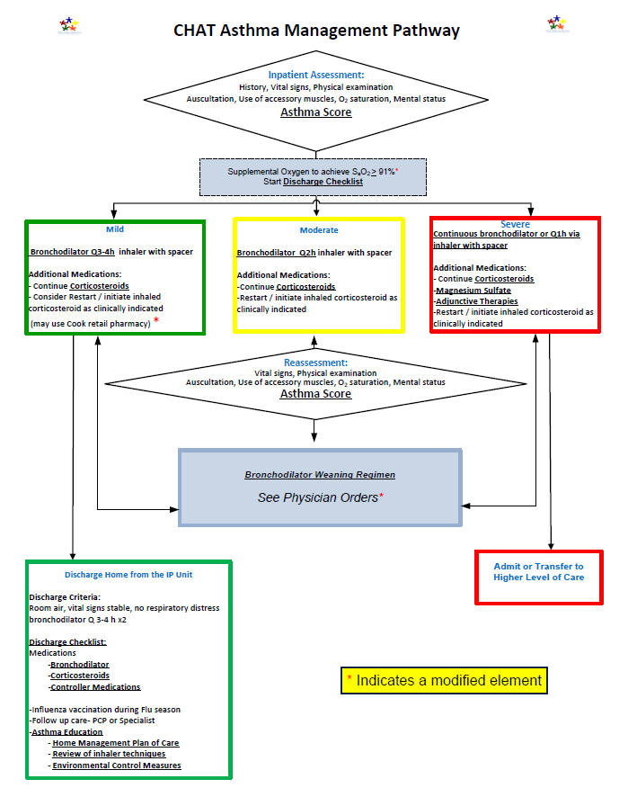
2014 Modified
CHAT Asthma Pathway
Bronchodilator Weaning Regimen
Continuous Q2H
Q2H Q3H
Q3H Q4H
If moderate symptoms develop, give bronchodilator
IF needing bronchodilator more often than Q2H, notify physician
Notes:
In 2014 our hospital implemented the pathway you see here which listed the physicians under Bronchodilator weaning regimen for inpatients. This weaning only occurred once a day or when the RT called the provider for changes. As you can see there is no mention of the score count or when to wean the patients based on the therapists assessment. Slide-Last year the changes made to this pathway showed a description of mild moderate or severe with a numerical score. With each score there was direction on how and when to wean the treatments. These changes to the pathway provided clarification for the entire team regarding bronchodilator weaning. Only frequency could be weaned. The frequency could only be weaned one hour at a time. So Q2 to Q3. The dose would remain the same throughout the weaning process..

Slide 6
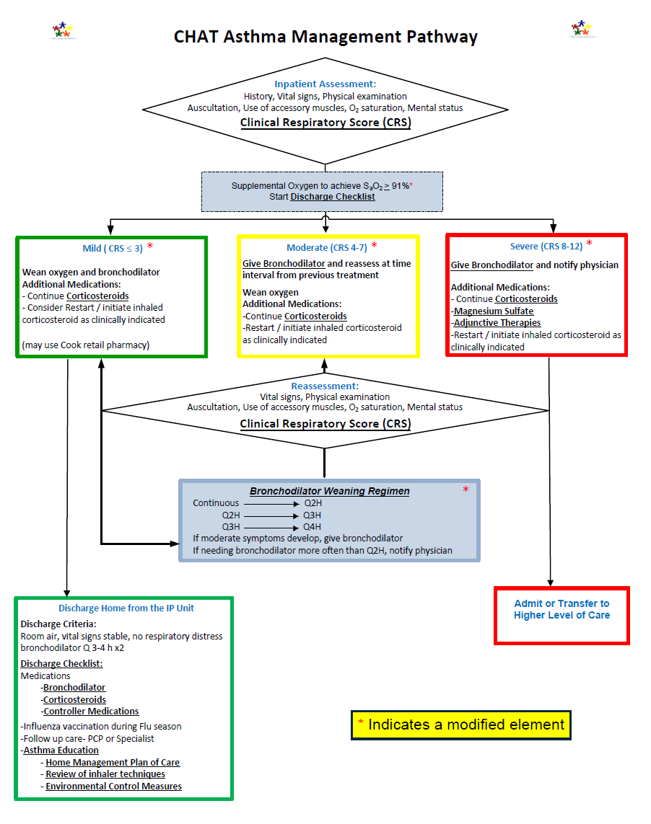
2016 Modified
CHAT Asthma Pathway for Weaning Treatments
Severe (CRS 8-12)
Give Bronchodilator and notify physician
Additional Medications:
-Continue Corticosteroids
-Magnesium Sulfate
-Adjunctive Therapies
-Restart/initiate inhaled corticosteroids as clinically indicated
Moderate (CRS 4-7)
Give Bronchodilator and reassess at time interval from previous treatment
Wean Oxygen
Additional Medications:
-Continue Corticosteroids
-Restart/initiate inhaled corticosteroids as clinically indicated
Mild (CRS ≤ 3)
Wean oxygen and bronchodilator
Additional Medications:
-Continue Corticosteroids
-Restart/initiate inhaled corticosteroids as clinically indicated
(may use Cook retail pharmacy)
Notes:
If the patient scored 3 or less they were considered Mild and the therapist would wait another hour and reassess the patient.
Moderate- Score 4-7 the patient received at treatment and the frequency stayed the same. If the patient scored 8-12 they were considered Severe and they also received a treatment but the physician was notified.
If the patient scored Mild the treatment could only be weaned one hour at a time. So Q2 to Q3hr. Even if the score remained mild.

Slide 7
CRS Clinical Respiratory Score (eMAR)
Assess | Score 0 | Score 1 | Score 2
Respiratory Rate | < 2 months <50 2-12 months < 40 1-5 years < 30 > 5 years <20 | < 2 months 50-60 2-12 months 40-50 1-5 years 30-40 > 5 years 20-30 | < 2 months > 60 2-12 months > 50 1-5 years > 40 > 5 years > 30
Auscultation | Good air movement, expiratory scattered wheeze or loose rales/crackles | Depressed air movement inspiratory and expiratory wheezes or rales/crackles | Diminished or absent breath sounds, severe wheezing, or rales/ crackles, or marked prolonged expiration
Use of Accessory Muscles | Mild to no use of accessory muscles, mild to no retractions OR nasal flaring on inspiration | Moderate intercostal retractions, mild to moderate use of accessory muscles, nasal flaring | Severe intercostal and substernal retractions, nasal flaring
Mental Status | Normal to mildly irritable | Irritable, agitated, restless | Lethargic
Room Air Spo2 | >95% | 91-95% | <91% or on O2
Color | Normal | Pale to Normal | Cyanotic, dusky
Notes:
The RT’s at our hospital had implemented a Clinical respiratory Score prior to the CHAT asthma pathway in 2014, However they did not use the score to adjust the frequency of treatments. Implementation and education of using this CRS assessment with our new bronchodilator weaning pathway lead to decision making based on evidence for the RT to drive treatment weaning frequency.

Slide 8
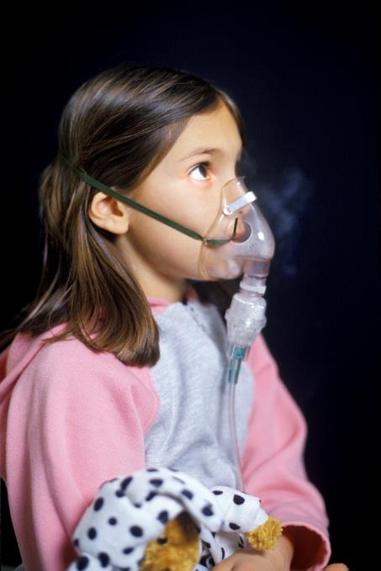
Let’s Practice!
Ruby is a 6 year old ordered to have 2 puffs Albuterol MDI Q2H and to follow the Asthma Treatment Weaning Protocol. Her last MDI was at 0400.
It is 0600 - 2 hours since Ruby’s last tx.
You arrive in her room to assess her:
RR: 26
BS: Inspiratory and expiratory wheezing
Intercostal retractions with nasal flaring
Happy child, content holding her puppy
Sp02 on RA: 96%
Normal color
What should the RT do?

Slide 9
Assess | Score 0 | Score 1 | Score 2
Respiratory Rate | < 2 months <50 2-12 months < 40 1-5 years < 30 > 5 years <20 | < 2 months 50-60 2-12 months 40-50 1-5 years 30-40 > 5 years 20-30 | < 2 months > 60 2-12 months > 50 1-5 years > 40 > 5 years > 30
Auscultation | Good air movement, expiratory scattered wheeze or loose rales/crackles | Depressed air movement inspiratory and expiratory wheezes or rales/crackles | Diminished or absent breath sounds, severe wheezing, or rales/ crackles, or marked prolonged expiration
Use of Accessory Muscles | Mild to no use of accessory muscles, mild to no retractions OR nasal flaring on inspiration | Moderate intercostal retractions, mild to moderate use of accessory muscles, nasal flaring | Severe intercostal and substernal retractions, nasal flaring
Mental Status | Normal to mildly irritable | Irritable, agitated, restless | Lethargic
Room Air Spo2 | >95% | 91-95% | <91% or on O2
Color | Normal | Pale to Normal | Cyanotic, dusky
CRS
MILD
Score ≤ 3
Notes:
RR: 26, BS: Inspiratory and expiratory wheezing, Intercostal retractions with nasal flaring, Happy child, content holding her puppy, Sp02 on RA: 96%, Normal color

Slide 10
What should I do?
Based on your assessment at 0600 it looks like Ruby scored a 3.
Ruby will wean to Q3hr and a treatment will be given at 0700
Ruby will be reassessed in 3 hours (1000) and if CRS is categorized at MILD, she can wean to Q4hr treatments
Susie RRT-NPS
Notes:
Answer: Give a treatment and change frequency from Q2 to Q3 hr. Do not go to Q4!

Slide 11
WOO
HOO!
Look at those results!
Notes:
Data
Exclusion Criteria
LOS
Roll out hospital wide by the hospitalists.

Slide 12
Knowing that every child’s life is sacred, it is the promise of Cook Children's to improve the health of every child in our region through the prevention and treatment of illness, disease, and injury.
-Cook Children’s Promise

Slide 13
References
Agency for Healthcare Research and Quality. (2014). Module 1: Making the Case for Asthma Care Quality Improvement. Retrieved from http://www.ahrq.gov/professionals/quality-patient-safety/quality-resources/tools/asthmaqual/asthmacare/module1.html
American Lung Association. (2014). Asthma and Children Fact Sheet [Data file].Retrieved from http://www.lung.org/lung-disease/asthma/resources/facts-and-figures/asthma-children-fact-sheet.html.
De Bleser, L., Depreitere, R., Waele, K., Vanhaecht, K., Vlayen, J., & Sermeus, W. (2006). Defining Pathways. Journal of Nursing Management, 14(7), 553-563.
Gordon, D. (2014). Average cost per inpatient day across 50 states. Retrieved from http://www.beckershospitalreview.com/lists/2011average-cost-per-inpatient-day-across-50-states.html
Grimshaw, J. M., & Russel, I. T. (1993). Effect of Clinical Guidelines on Medical Practice: A Systematic Review of Rigorous Evaluations. Lancet, 324(8883), 1317-1322.
Hsu, LTC D. P., Lee, Capt T. J., & Barker, COL J. A. (2013). Outcome of Pediatric Inpatient Asthma clinical Pathway Implementation in a Military Medical Center. Military Medicine, 178(April), 477-482.
Johnson, K. B., Blaisdell, C. J., Walker, A., & Eggleston, P. (2000). Effectiveness of Clinical Pathway for Inpatient Asthma Management. Pediatrics, 106, 1006-1012.
Lier, M. B., Pettinichi, A., Sebastian, K. D., & Kotagal, U. (1999). Trial of a Therapist-Directed Protocol for Weaning Bronchodilator Therapy in Children with Status Asthmaticus. Respiratory Care, 44(5), 497-503.
Press Ganey Associates, Inc. (2015). Hospital Patient Satisfaction. Retrieved from http://www.pressganey.com/resources/hospital-patient-satisfaction
Rogers, E. M. (2003). Diffusions of innovations (5th ed.). New York, NY: Free Press
Ruhe, M. C. (n.d.). Stakeholder analysis in health services management. Retrieved from http://www.cwru.edu/med/epidbio/mphp439/Stakeholder_Analysis.htm?nw_view=1374190686&
Sylvester, A. M., & George, M. (2014). Effect of a Clinical Pathway on Length of Stay and Cost of Pediatric Asthma Admissions: An Integrative Review. Clinical Nursing Research, 23(4), 384-401.
US Department of Health and Human Services. (2009). Code of Federal Regulations- Protection of Human Subjects. Retrieved from http://www.hhs.gov/ohrp/humansubjects/guidance/45cfr46.html

