Slide 1
Our iceberg was melting
A Tool for Introducing and Affecting Change in Practice
By Randal Lysack, BSN, RN, CPN
Cardiology Patient Care Unit
Notes:
4:3
Header and affiliation is locked and may not be altered

Slide 2
(n.d.). [Book Cover of Our Iceberg is Melting]. Retrieved September 29, 2017, from https://www.amazon.com/Our-Iceberg-Melting-Succeeding-Conditions/dp/0399563911
Cardiology Patient Care Unit
Notes:
Our unit will soon be moving to a brand new building, and we knew we needed to look at some of our processes to improve on inefficiencies so that we did not take them to the new space. The book Our Iceberg is Melting by John Kotter was introduced to us by our Medical Director to provide a method for implementing some changes to processes needing change

Slide 3
Introduction
In 2016, the unit noted a steady decline in our patient satisfaction scores. Our iceberg was melting, and we knew we had to act to improve our patient’s experience.
(n.d.). [Legacy Tower] Retrieved September 29, 2017, from https://www.texaschildrens.org/new-pediatric-tower-coming-2018
Cardiology Patient Care Unit

Slide 4
Objectives
At the end of this presentation, the learner will be able to:
Understand the purpose of the Change Scorecard from Our Iceberg is Melting by John Kotter
Identify the Eight Steps of Change
Apply processes and outcomes to the utilization of the Scorecard
Cardiology Patient Care Unit

Slide 5
8 Steps of Change
1. Create Urgency
2. Build a Coalition
3. Form a Vision
4.Communicate the Vision
5. Empower Action
6. Generate Short Term Wins
7. Never Let Up
8. Make it Culture
Kotter, J. P., & Rathgeber, H. (2016). Our iceberg is melting: changing and succeeding under any conditions. NY, NY: Portfolio/Penguin.
Cardiology Patient Care Unit

Slide 6
Step 1 – Creating urgency
Help others see the need for change and the importance of acting immediately
The Patient Care Manager noted a decline in the scores for CPCU and shared the information with the Unit Quality Practice Council (UQPC).
(2016). [CPCU Patient Satisfaction Graph FY2016] Retrieved 2016, from www.pressganey.com
Cardiology Patient Care Unit

Slide 7
Step 2: Building a coalition
Make sure there is a committed group guiding the change – one with the right mix of leadership skills, bias for action, credibility, soft skills, analytical skills, and ability to communicate.
The CPCU UQPC developed a focus group of staff members committed to improving Patient Satisfaction Scores.
(n.d.). [Coalition Building]. Retrieved September 29, 2017, from http://www.malkinross.com/Service-Areas/Partnership-Coalition-Building/
Cardiology Patient Care Unit

Slide 8
Step 3: Form a vision
Clarify how the future will be different from the past, and how you can make that future a reality.
The UQPC Focus Group formed a vision of how we wanted our unit to improve.
We wanted our patients and families to be more satisfied with their care, and our Patient Satisfaction scores to meet or exceed unit goals of 89.5.
(2015, March 3). [Nursing Heart] Retrieved September 24, 2017, from http://voiceofnursing.org/bullying-is-not-welcome-here/
Cardiology Patient Care Unit

Slide 9
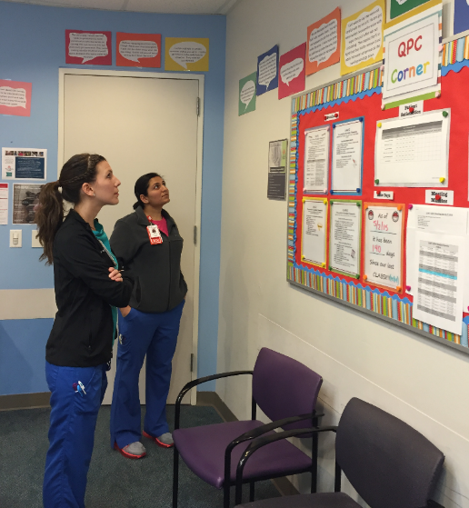
Step 4: Communicate the vision
Make sure as many people as possible understand and accept the vision and strategy.
Created a “Gallery of Truth” with verbatim comments that identified areas that needed improvement.
Created a presentation with tools to improve those identified areas of improvement
Gallery of Truth [Personal photograph taken in Texas Children's Hospital]. (2016).
Cardiology Patient Care Unit

Slide 10
Step 5: Empower Action
Together, Everyone Achieves More! 4 P’s Pain Potty Plan of Care Position AIDET Ask for permission / Acknowledge patient and family Introduce oneself and role Describe Duration of task Explain care Thank you Phrase statements in a “heart, head, heart” manner Powerful words: Comfort Safe, Safety Private, Privacy Care, Vigilance Choice, Preference
Remove as many barriers as possible so that those who want to make the vision a reality can do so.
Staff were given badge cards to help in remembering and using tools.
Staff were motivated to make a change after seeing the negative patient/family comments from Press Ganey in the “Gallery of Truth”.
Cardiology Patient Care Unit

Slide 11
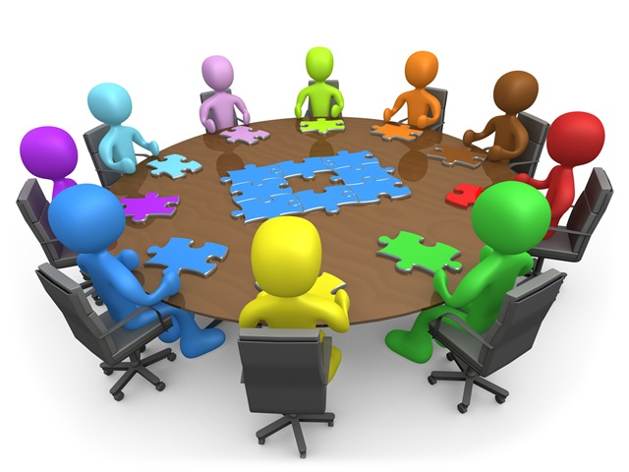
Step 6: Generate short term wins
Create some visible, unambiguous successes as soon as possible
Positive comments from families collected by Press Ganey were included in staff meetings to show that our changes were making a difference in how they felt about our care.
(2014, October 23). [Team Meeting]. Retrieved September 21, 2017, from https://www.cit-asl.org/new/board-meeting-minutes-august-2014/
Cardiology Patient Care Unit

Slide 12
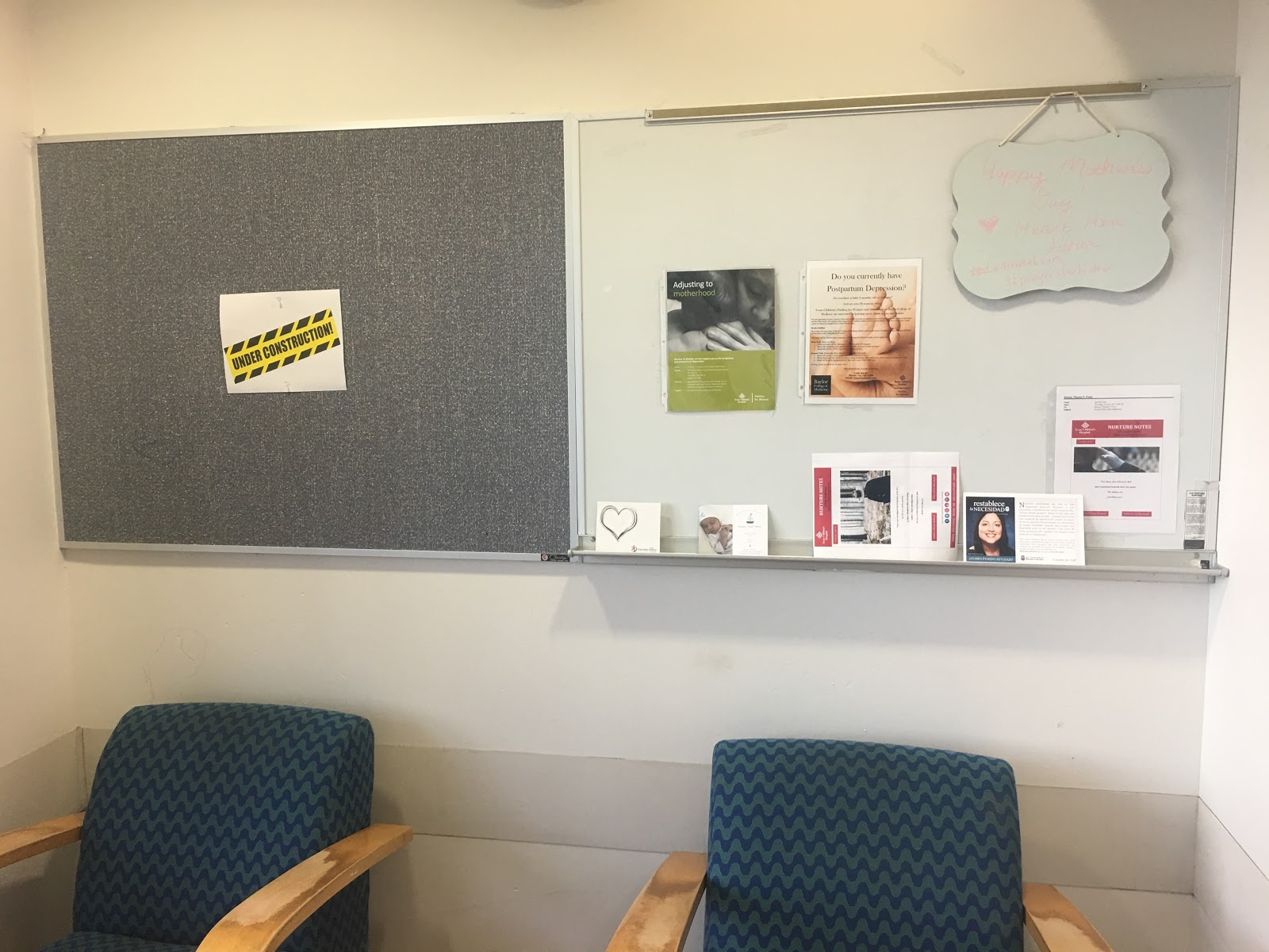
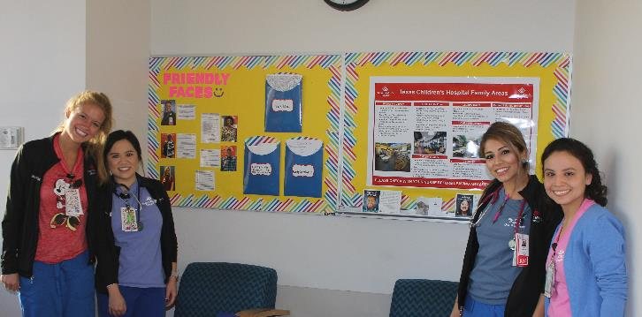
Step 7: Never let up
Press harder and faster after the first successes. Be relentless with instituting change after change until the vision becomes a reality.
The unit continues to strive for excellence in Patient Satisfaction Scores by challenging staff to make improvements when scores begin to fall.
In June 2017, our family lounge was revamped by staff nurses after receiving negative feedback about the room.
In September 2017, we implemented an initiative called Power Rounds where staff round on 100% of patients just before shift change to address needs and prevent wait times due to shift report.
Cardiology Patient Care Unit

Slide 13
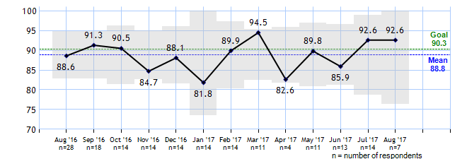
Step 8: Make it culture
Hold on to the new ways of behaving, and make sure they succeed, until they become a permanent part of the colony’s culture
Patient Satisfaction Scores are discussed during shift huddles and staff meetings
Positive and negative comments are shared with staff along with ways to make improvements.
Staff are familiar with unit and hospital goals to keep these scores high.
(2017). [CPCU Patient Satisfaction Graph FY2017] Retrieved 2017, from www.pressganey.com
Cardiology Patient Care Unit

Slide 14
Evaluation and impact
The tools and methods defined in Our Iceberg is Melting by John Kotter assisted in implementing change successfully on the unit. The book provided an organized and thoughtful way to present the information to staff that allowed for optimum buy in and acknowledgement of our vision to make Patient Satisfaction scores a part of our culture.
CPCU continues to use the methods in Our Iceberg is Melting by John Kotter as a way to implement new processes on our unit
Cardiology Patient Care Unit

Slide 15
References
(n.d.). [Book Cover of Our Iceberg is Melting]. Retrieved September 29, 2017, from https://www.amazon.com/Our-Iceberg-Melting-Succeeding-Conditions/dp/0399563911
(n.d.). [Legacy Tower] Retrieved September 29, 2017, from https://www.texaschildrens.org/new-pediatric-tower-coming-2018
(n.d.). [Coalition Building]. Retrieved September 29, 2017, from http://www.malkinross.com/Service-Areas/Partnership-Coalition-Building/
Family Lounge Before [Personal photograph taken in CPCU Family Lounge]. (2017, June).
Family Lounge After [Personal photograph taken in CPCU Family Lounge]. (2017, June).
Gallery of Truth [Personal photograph taken in Texas Children's Hospital]. (2016).
(2014, October 23). [Team Meeting]. Retrieved September 21, 2017, from https://www.cit-asl.org/new/board-meeting-minutes-august-2014/
(2015, March 3). [Nursing Heart] Retrieved September 24, 2017, from http://voiceofnursing.org/bullying-is-not-welcome-here/
(2016). [CPCU Patient Satisfaction Graph FY2016] Retrieved 2016, from www.pressganey.com
(2017). [CPCU Patient Satisfaction Graph FY2017] Retrieved 2017, from www.pressganey.com
Kotter, J. P., & Rathgeber, H. (2016). Our iceberg is melting: changing and succeeding under any conditions. NY, NY: Portfolio/Penguin.
Cardiology Patient Care Unit

