Slide 1
Implementation of a Provider-In-Triage Process to Reduce Patients Length of Stay
Caitlin Dulle, BSN, RN, CPEN

Slide 2
Disclosure
I have no actual or potential conflict of interest in relation to this program/presentation.

Slide 3
Objectives
Explain how an increase in patient use for emergency departments for nonurgent complaints has created the need for process improvement
Explain the Provider in Triage Process
List at least four benefits of implementing the PIT process

Slide 4
Background
https://www.youtube.com/watch?v=4oRgU9WpAro

Slide 5
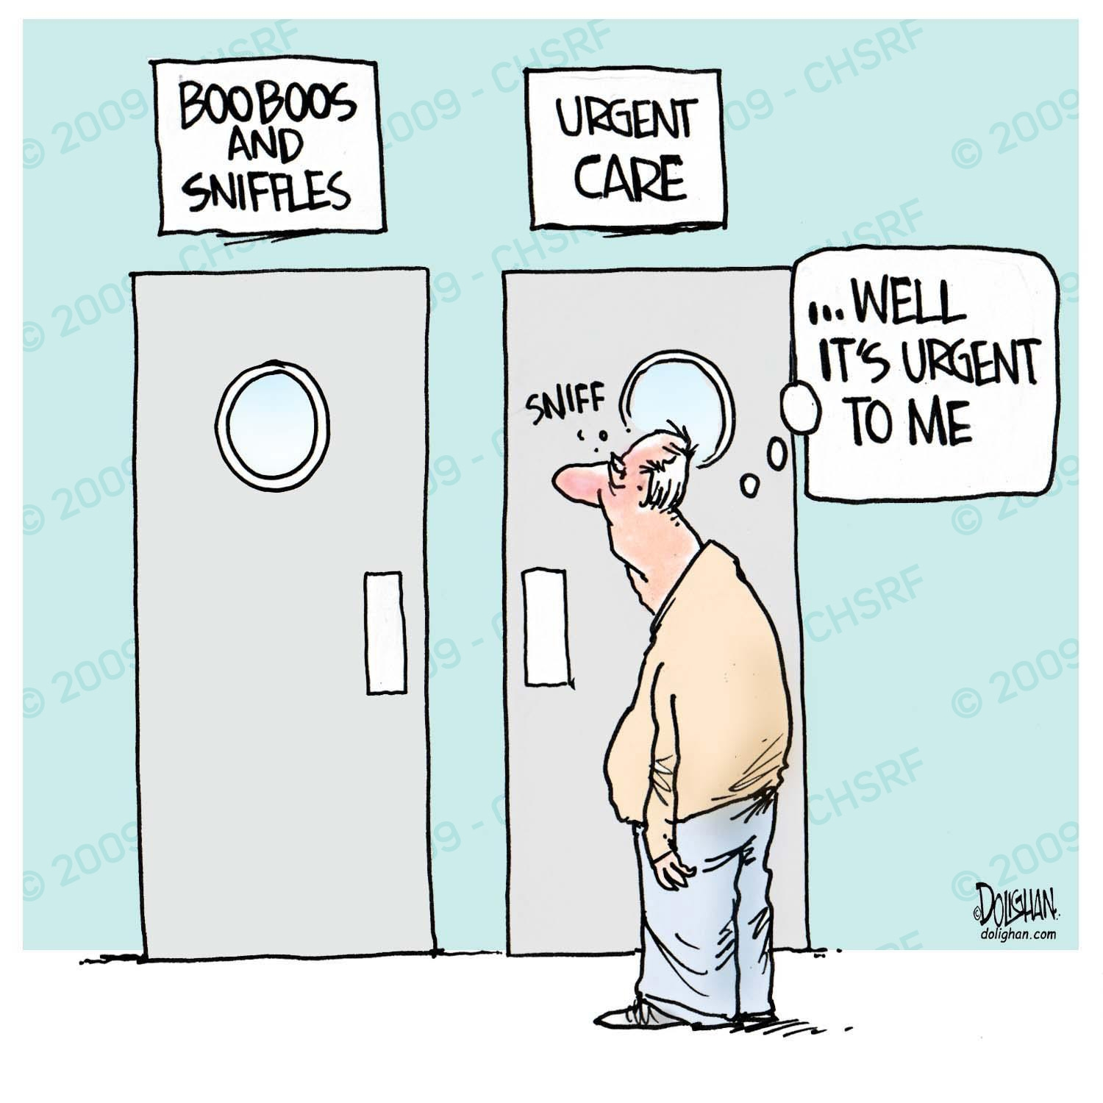
Background
67% non-emergent

Slide 6
Goal

Slide 7
Method

Slide 8
Median Arrival Time to Triage

Slide 9
ED Arrival Time to Treatment Room

Slide 10
Median Arrival Time to Provider Evaluation

Slide 11
Left Without Treatment

Slide 12
Conclusion

Slide 13
References
1.Institute of Medicine, Committee on the Future of Emergency Care in the United States Health System (2006). Hospital-based emergency care: At the breaking point. National Academies Press, 2006.
2.Barish, R.A., Mcgauly, P.L., & Arnold,T.C. (2012). Emergency room crowding: A marker of hospital health. Transactions of the American Clinical and Climatological Association 123, 304-311. Retrieved from https://www.ncbi.nlm.nih.gov/pmc/articles/PMC3540619/
3.United States Government Accountability Office. (2009). Report to the Chairman, Committee on Finance, U.S. Senate. Hospital Emergency Departments, GAO-09-347.
4.Guttman A, Schull MJ, Vermeulen MJ, Stukel TA. Association between waiting times and short term mortality and hospital admission after departure from emergency department: population based cohort study from Ontario, Canada. BMJ. 2011;342:d2983. Retrieved from PubMed
5.Metzger, N., Gunnett, M., Prante, C., Daly, K., Friedberg, B., & Rivas, J. (2014). Emergency department triage: A physician in triage collaborative process. Retrieved from http://www.cepamerica.com/news-resources/perspectives-on-the-acute-care-continuum/july-2014/emergency-department-triage-a-physician-in-triage
6.The Joint Commission. Specifications manual for national hospital inpatient quality measures (ED & 2). Last updated October 2016. Retrieved from https://www.jointcommission.org/specifications_manual_for_national_hospital_inpatient_quality_measures.aspx

