Slide 1

The Importance of Integrating Inpatient and Outpatient with Complex Patients
Presented by Katie Dillon, BSN, RN, CPN
& Kelsi Kliment, BSN, RN, CPN

Slide 2



Continuum of care
Inpatient- hospitalization
Outpatient- clinics, specialists, pediatricians
Home- medical home created to care for the medically complex child- home health care

Slide 3
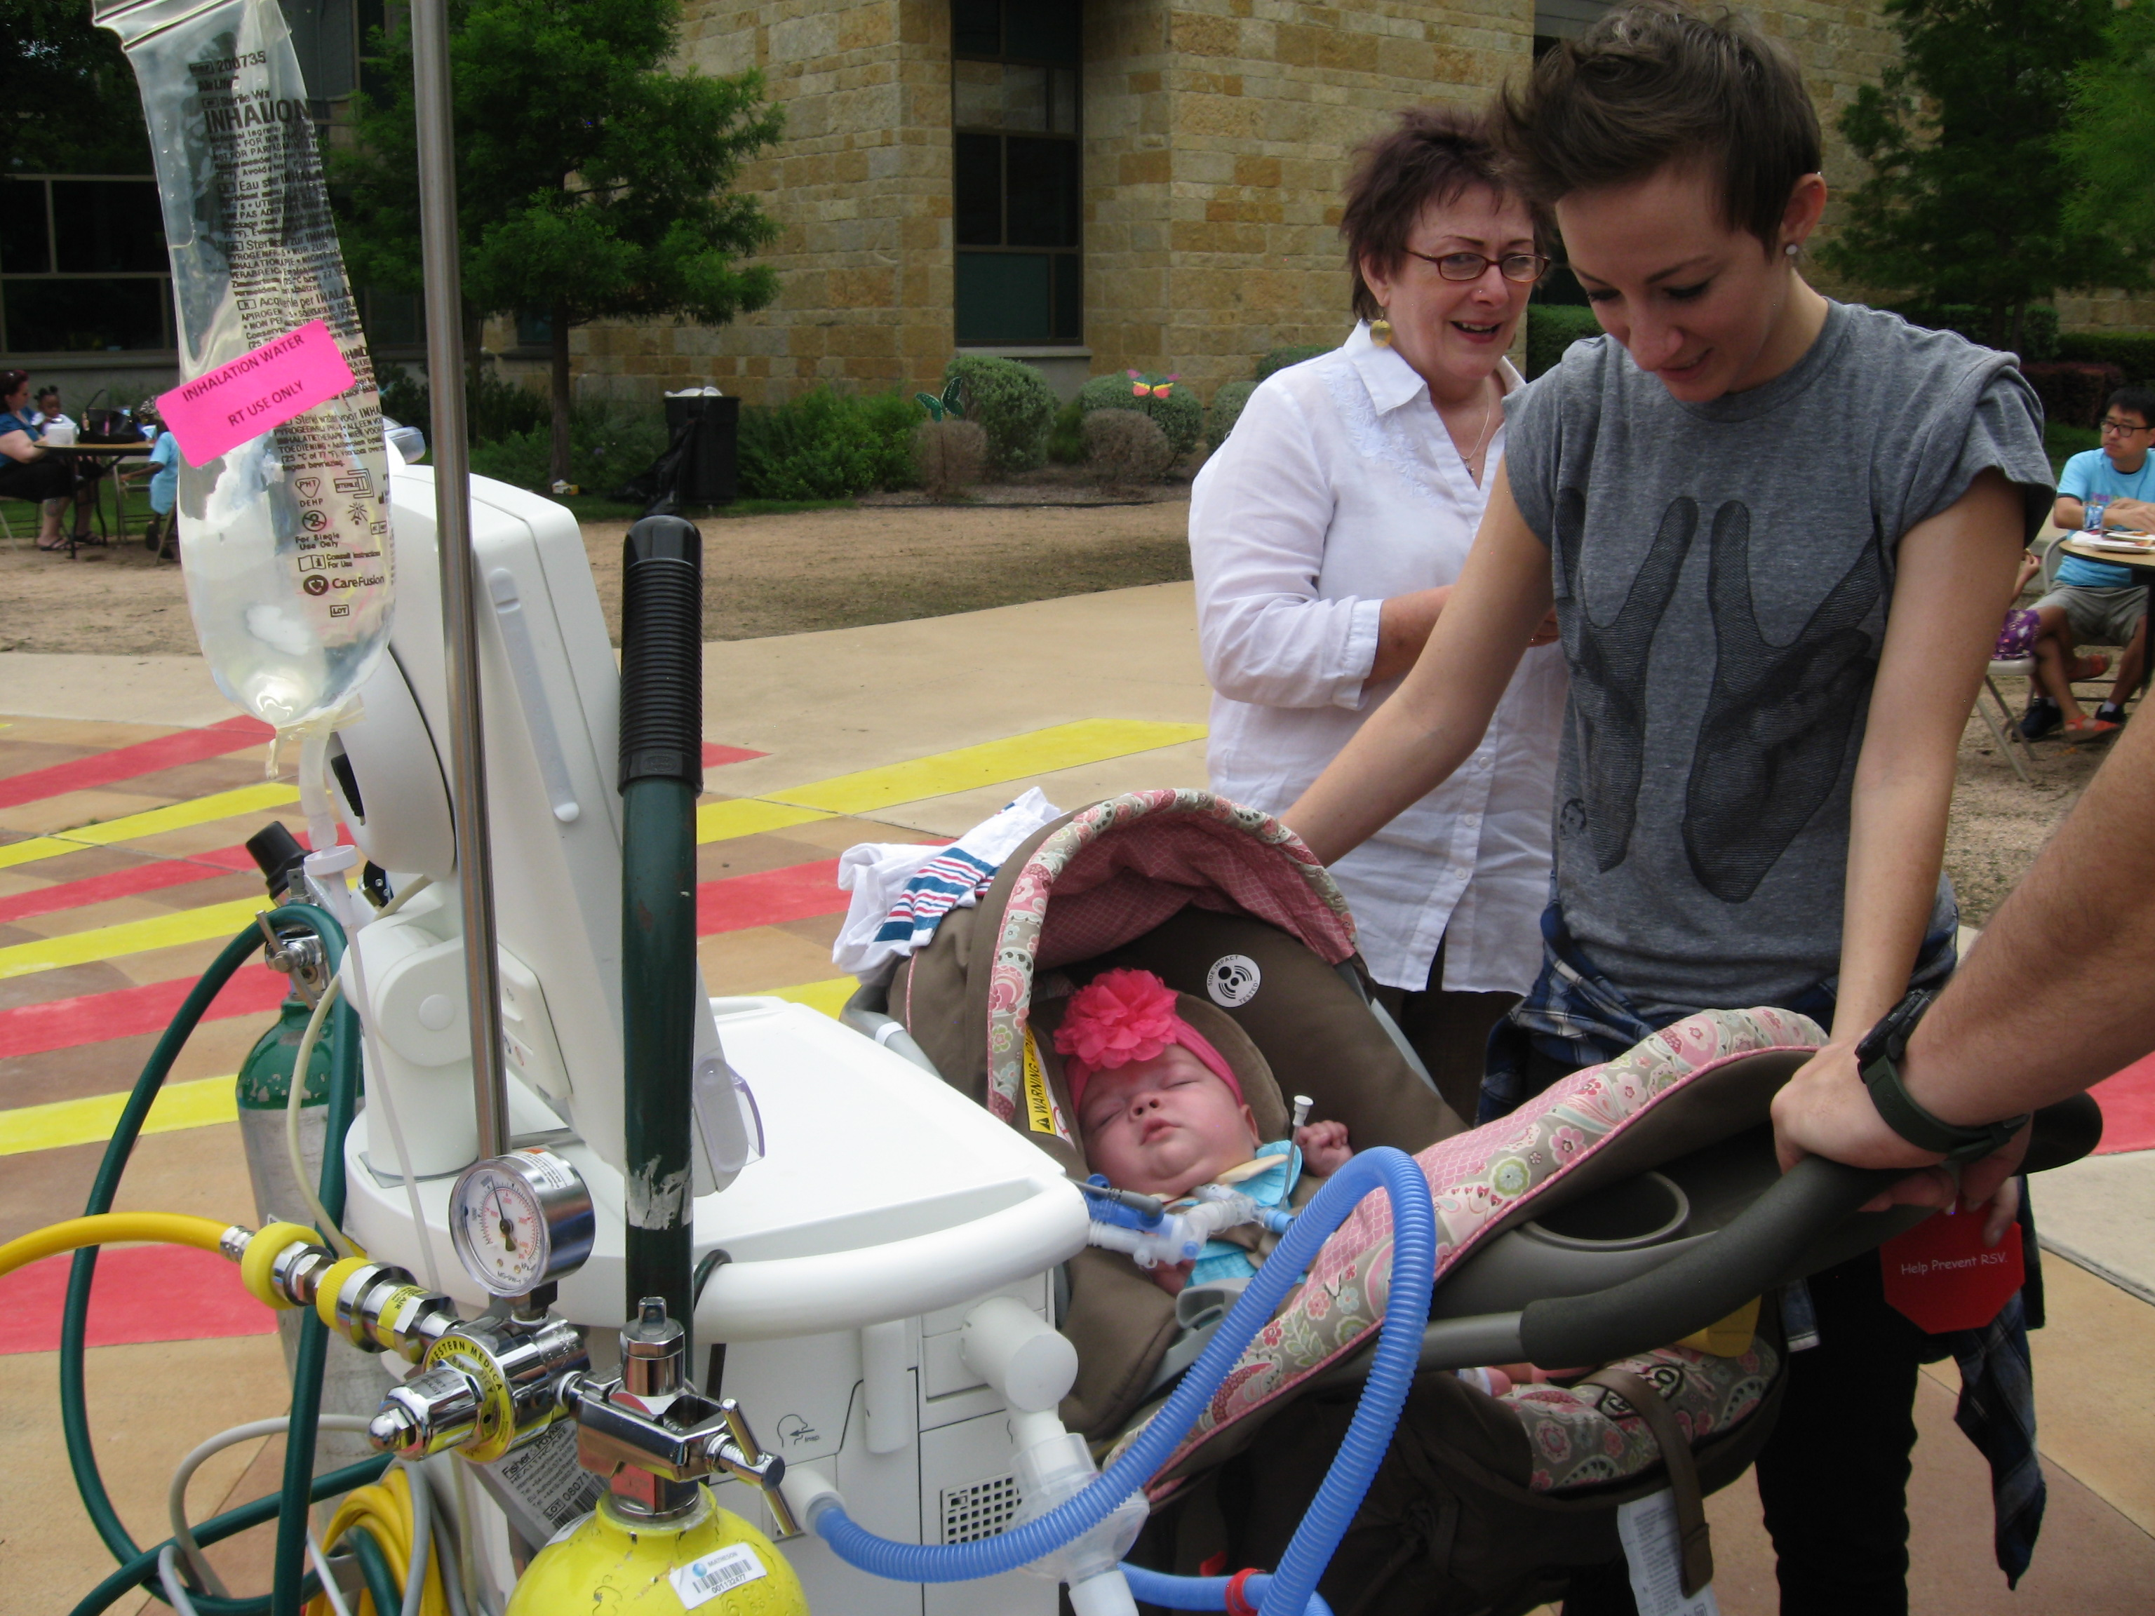
The lives we are hoping to improve

Slide 4
A bit of history
The Dell Children’s Trach Committee

Slide 5
Innovation through Knowledge in Ventilator and Tracheostomy for In-patient and Out-patient Network care
InKnowVation-
A formal name for our trach committee

Slide 6
Monthly Trach Meetings between Inpatient and Outpatient Settings
In 2011 Dell Children’s “InKnowVation” Trach Committee was established to meet monthly to discuss our trach patients and their needs in the hospital, home, and in the clinic.
The Committee is composed of passionate and dedicated case managers, respiratory therapists, Advanced Practice Nurses and RNs, from the inpatient units and the trach/vent clinic of Dell Children’s.

Slide 7
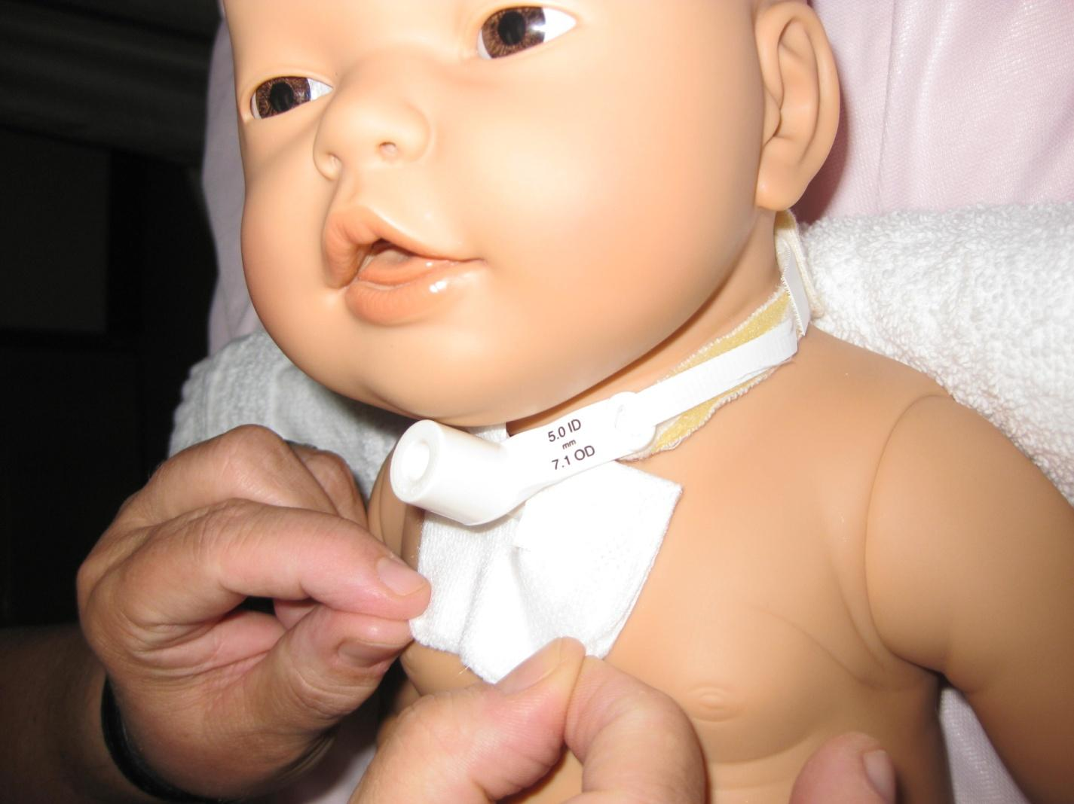
The committee members have developed educational tools for family teaching and a trach care manual for reference for both families, inpatient staff and community home care nurses.
Our goal is to provide a consistent standard care between hospital units, the outpatient clinic and home setting.

Slide 8
Following the conference
In 2013 we hosted our first ever Tracheostomy conference.
InKnowVation: Pediatric Tracheostomy and Ventilator Education Conference
123 participants from hospital staff to community providers including home health and school nurses.
Surveys after conference showed need for hands on education of the trach/vent patient for both hospital staff and community.
Requests for training by area school districts on care of the tracheostomy child followed.
August 2015- Tracheostomy Care hospital to Home: In-service for acute care staff
December 2015- trach care 101, the basics: Hands on demo of trach care to promote consistent care throughout hospital.
2016-Trach CPR- train the trainer, RN CPR instructors train RNs to teach families trach CPR
2015-2016-Trach suction depth cards- insuring proper measure and depth of tracheal suctioning
2017-Emergency trach bags “GO BAGS”

Slide 9
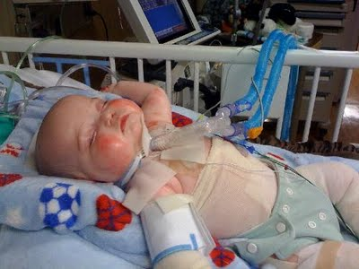
Objective 1: Educate our local Austin home health nurses on emergency respiratory management of a child with a tracheostomy tube

Slide 10
Emergency Respiratory Management of the Tracheostomy Patient
CE Course
Our trach population is continuing to become more fragile with the advancement of medicine.
In 2016, three of our patients died from trach related deaths in their homes.
Dell Children’s Medical Center requested our trach committee to meet, plan and strategize on how to improve care of our patients in the home setting.
WHY?

Slide 11
Emergency Respiratory Management of the Tracheostomy Patient
CE Course
Once discharged from Dell Children’s, the medical care of the patient is transferred to the home nursing agency and family to care for the patient. Emergency situations in the hospital are markedly different then the care of a patient in the home setting. Resources and responders are limited.
As the Children’s Hospital in the area we had a responsibility to offer education to our community providers caring for our patients.
WHY?

Slide 12
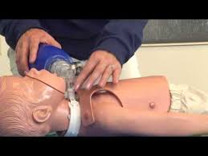
Objective 2:
Improve our teaching methods and delivery of information to our established trach patients and their caregivers.

Slide 13
Emergency Respiratory Management of the Tracheostomy Patient
CE Course
The Trach Committee came together to work on putting this CE course together.
To get the support of the home health agencies, we invited many of the agencies in the area who care for our trach patients to be a part of the planning process.
We decided on hands on scenario training of respiratory emergencies of the trach child in the home setting.
Each home health agency wrote and instructed their own scenario.
CE class participants rotated the scenario stations.
Pre and post test to assess knowledge.
HOW?

Slide 14
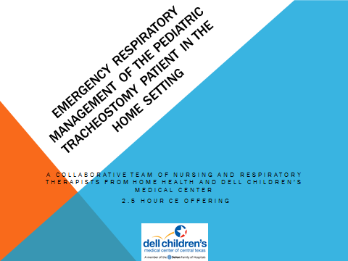
April 13, 2017 CE class
AM and PM session
59 in attendance
44 RNs
10 LVNs
3 CRNP
1 MD
Excellent response,
More education
requested

Slide 15
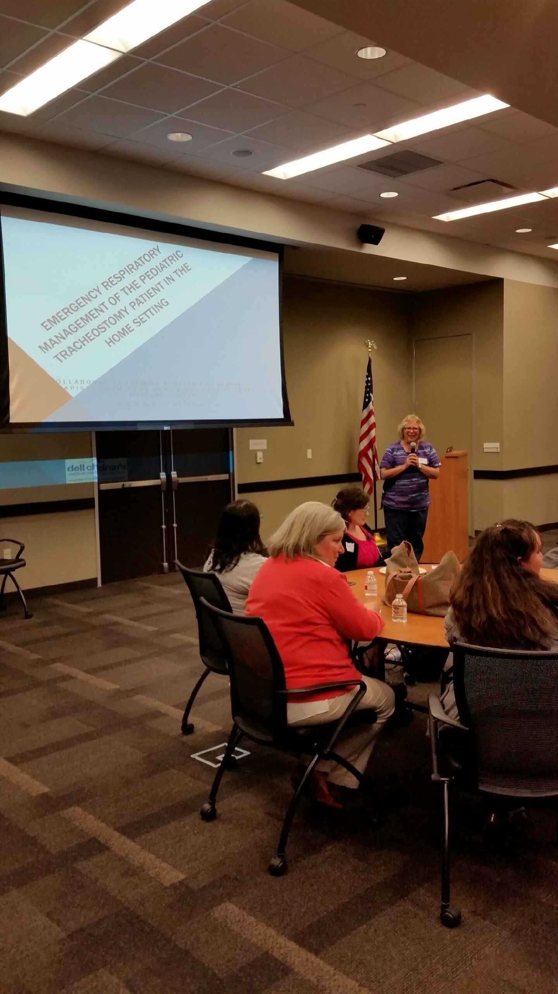
CE Class
AM and PM sessions for home health nurses

Slide 16
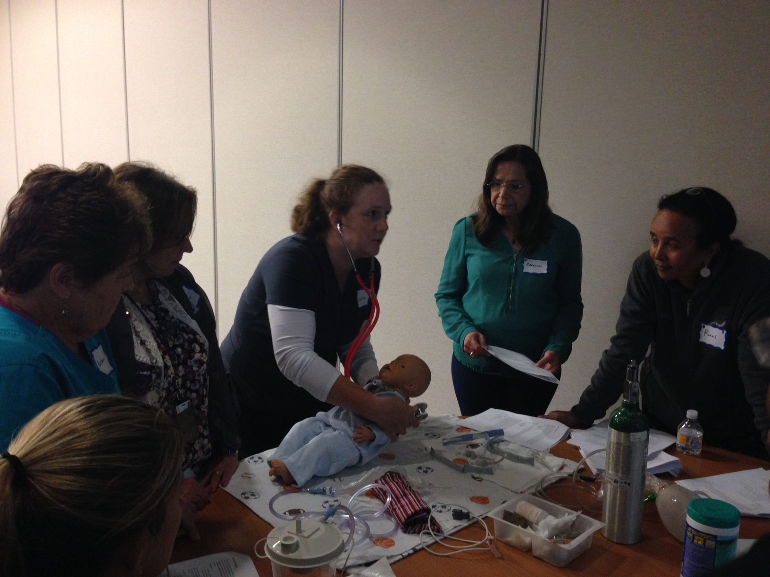
Scenario
x
Managing a Mucus Plug

Slide 17
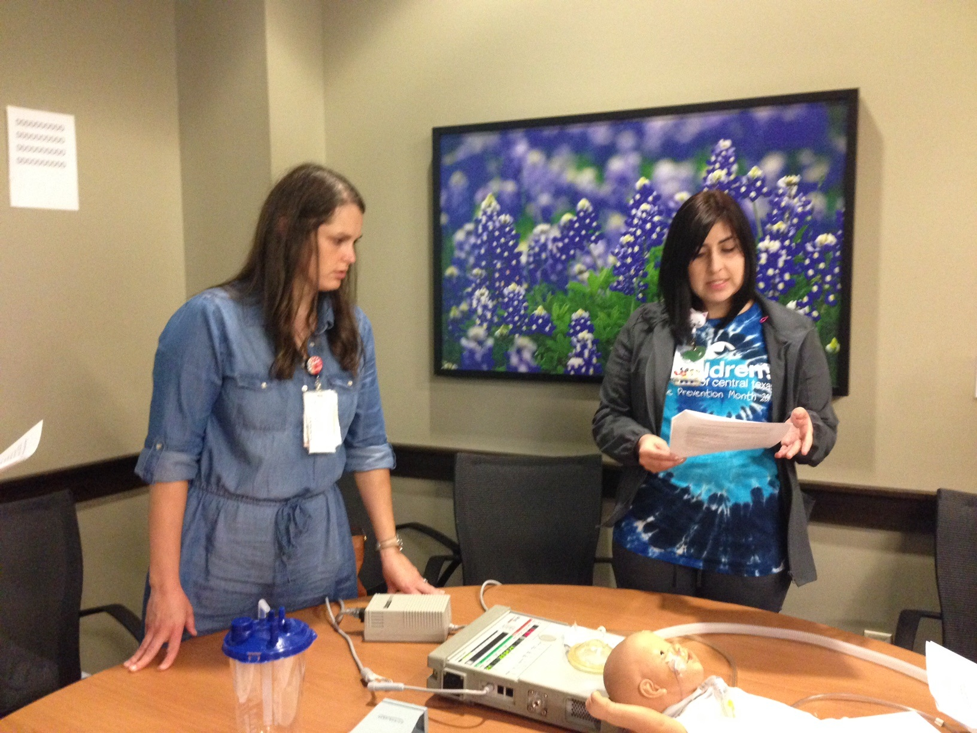
Scenario
Ventilator Troubleshooting

Slide 18
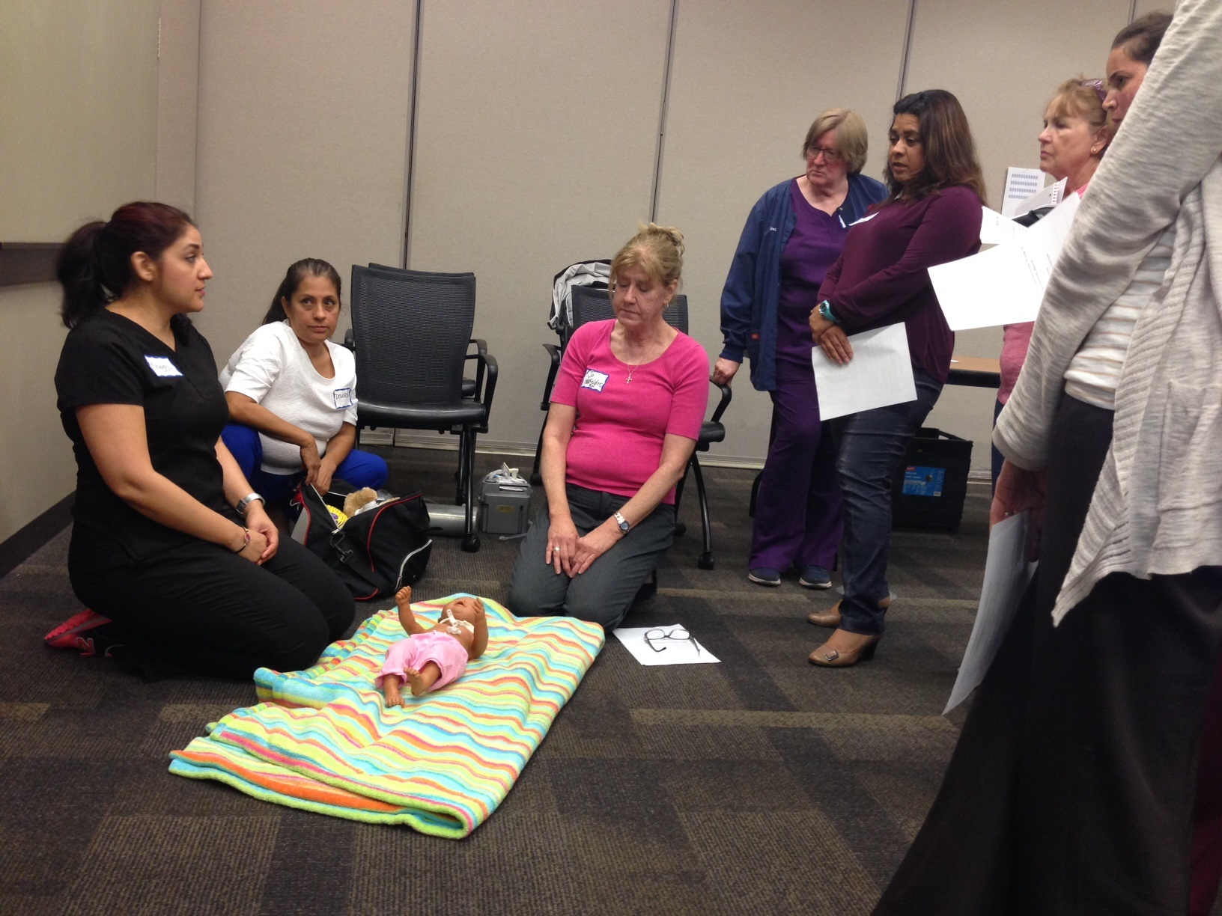
Scenario
Accidental decanulation of the trach patient

Slide 19
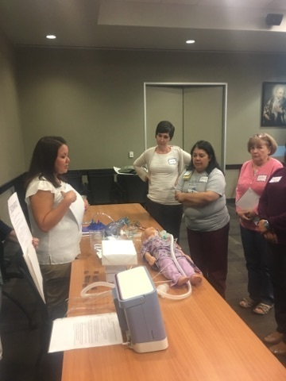
Scenario
Code Blue

Slide 20
Bridging the gap between hospital and home
CE class was successful.
Collaboration and teamwork of hospital staff and home health.
Respect for each other in the care of our medically complex and fragile patients.
Learning the need for continuing education of care for the established trach patient.
Home nurses better prepared for a respiratory emergency as a result of the class.
Having the Trach Emergency “Go Bag” ready and equipped.
Having oxygen and ambu bag
available for an emergency.

Slide 21
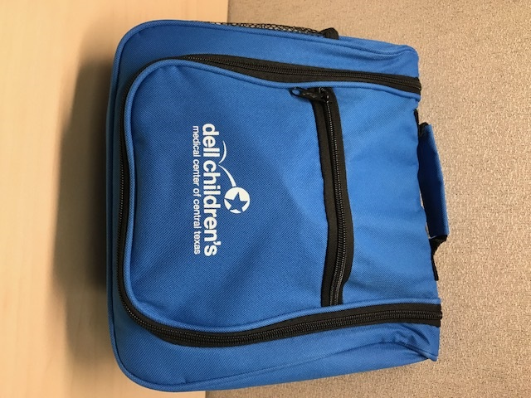
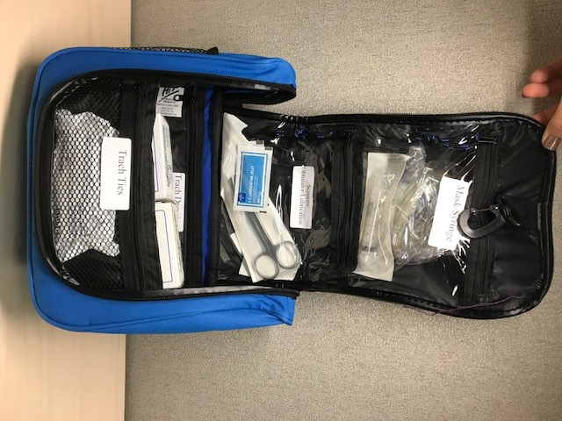
Emergency trach GO BAGS

Slide 22

Dell Children’s
Trach Family Committee
In 2015 the trach committee invited parents of trach patients to meet and plan what they would like to do for their families. Socialization of the trach children was the plan. The Trach Family Fun Day became the goal.

Slide 23

Trach Family Fun
Day
We had no budget, but after talking with our DME, home health agencies, and community we were fully funded.

Slide 24
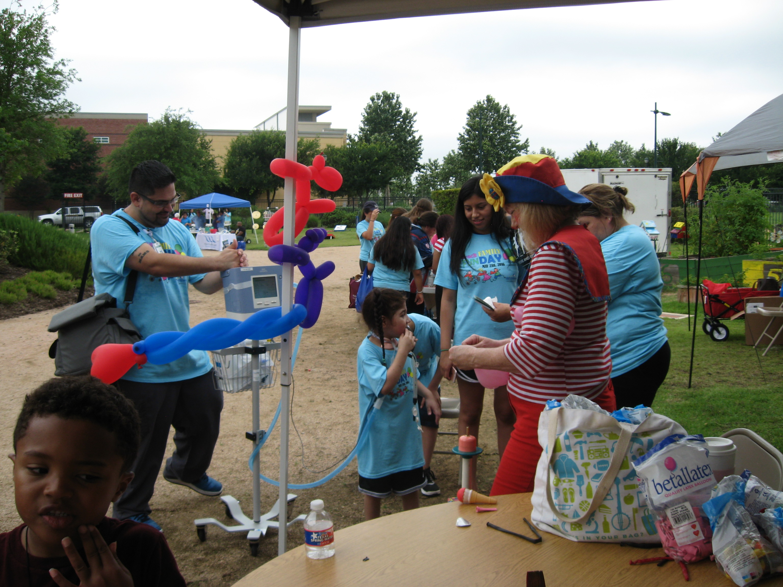

Slide 25
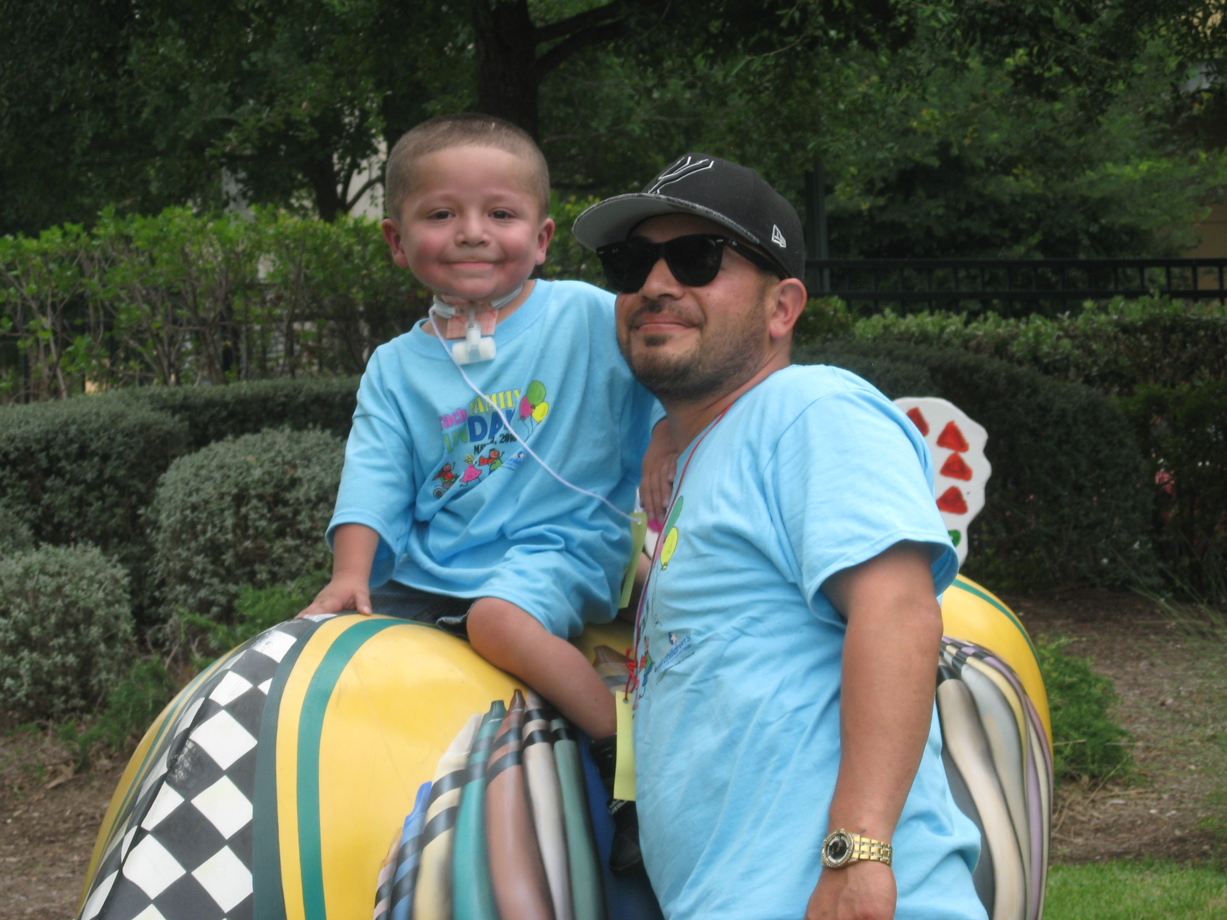
Trach Family Fun
Day
It was a special fun filled day with games, prizes, and treats.

Slide 26
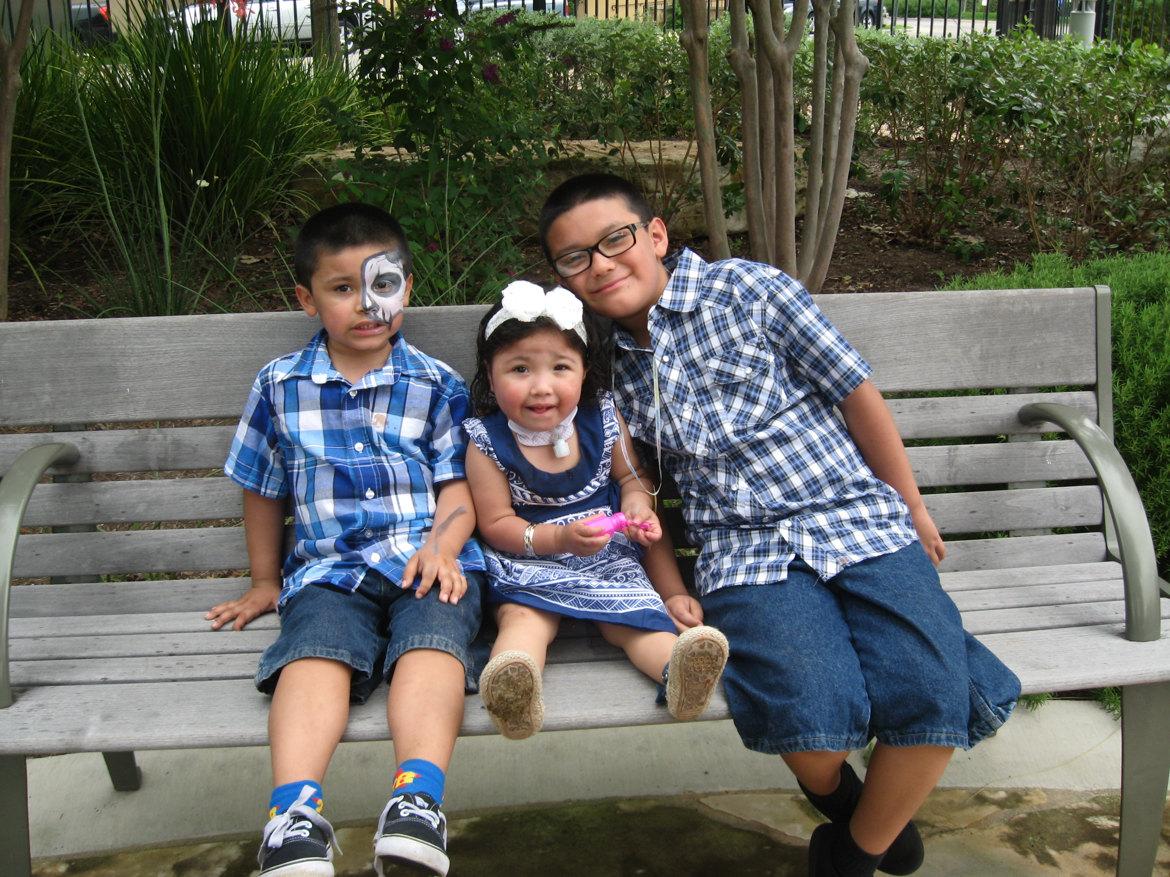
Trach Family Fun
Day
We took into special account to make sure there was a charging station for vents, feeding pumps and suction machines.

Slide 27
What is next for Dell Children’s?
Grant funded educational videos on the care of trach patients
Revised Trach Care Manual
Additional CE offerings on the management of the tracheostomy/ ventilator patient

