Slide 1
Rooming-in for success: preparing patient/families for discharge
Julia Sigren, BSN, RN, CPN
CARDIOLOGY PATIENT CARE UNIT
Notes:
4:3
Header and affiliation is locked and may not be altered

Slide 2
introduction
Being discharged from the hospital can be an overwhelmingly challenging event for families. Their loved ones may enter the hospital without any kind of special care, but leave on enteral feeds, medications, and oxygen.
CARDIOLOGY PATIENT CARE UNIT

Slide 3
Introduction continued…
The Cardiology Patient Care Unit (CPCU) at Texas Children’s Hospital wanted to create a tool to aide in the Rooming-In process that patients and their caregivers complete before discharge to ensure they are efficiently ready to go home. In addition, the unit aimed to increase discharge patient satisfaction scores.
CARDIOLOGY PATIENT CARE UNIT

Slide 4
Press ganey Patient satisfaction scores
Average for FY 2016 = 87.4%
CARDIOLOGY PATIENT CARE UNIT

Slide 5
Objectives
At the end of this presentation the learner will be able to:
Understand the Texas Children's Hospital Cardiology Patient Care Unit Rooming-in Guideline and Checklist
Recognize the impact of Rooming-in on Patient Satisfaction Discharge Scores
CARDIOLOGY PATIENT CARE UNIT

Slide 6
planning
A group consisted of multidisciplinary CPCU staff (RNs, MD, etc.) met over the course of Summer 2016 to create an efficient Rooming-in Checklist of items families need to proficiently demonstrate before discharging safely.
CARDIOLOGY PATIENT CARE UNIT

Slide 7
CARDIOLOGY PATIENT CARE UNIT

Slide 8
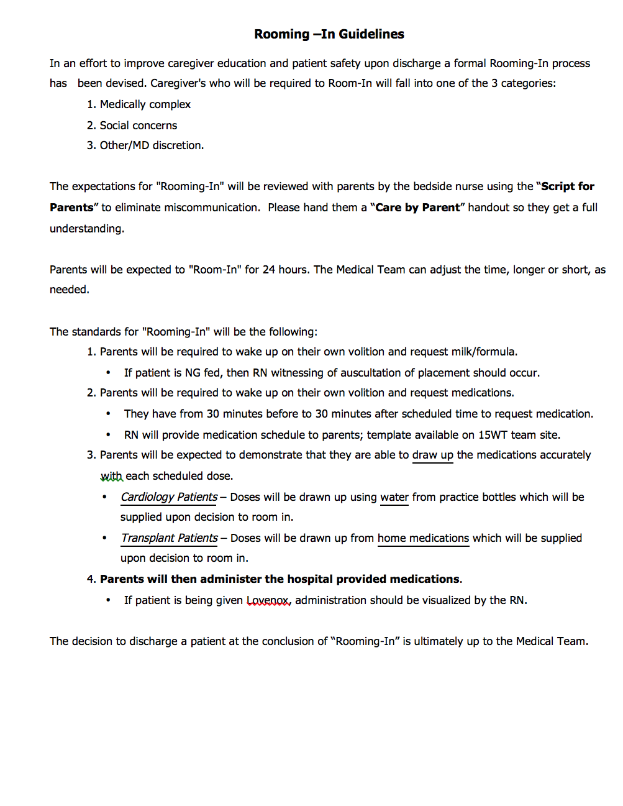
CARDIOLOGY PATIENT CARE UNIT

Slide 9
initiation
The group began to trial the checklist in August 2016. The process included:
When the patient’s primary medical team deemed that the family needed to room-in before discharge, they notified the bedside RN and wrote a “Nursing Communication” indicating when rooming-in would begin.
The patient’s bedside RNs explained the process to the family and consistently filled-out the checklist throughout the duration of the rooming-in process.
The results and recommendations were discussed at Care Progression or Medical Rounds.
CARDIOLOGY PATIENT CARE UNIT

Slide 10
additions
Most recently, in June 2017, a “Care by Parent” handout was added to the packet so that families may further understand the process and expectations of rooming-in with their child.
CARDIOLOGY PATIENT CARE UNIT

Slide 11
CARDIOLOGY PATIENT CARE UNIT

Slide 12
IMPACT
Average for FY 2017 = 91.55%
CARDIOLOGY PATIENT CARE UNIT

Slide 13
Impact continued…
Although the unit was excited to see the change in discharge satisfaction scores, the most rewarding aspect was the increased ability to help patients and families feel empowered and confident on their journey home. CPCU is continuing to use the tool to this day.
CARDIOLOGY PATIENT CARE UNIT

Slide 14
references
Figure 1. [Home Letters] [Photograph]. (n.d.). Retrieved September 29, 2017 from http://news- trhl.ernesthealth.com/blog/index.php/2015/03/09/leaving-inpatient-rehab-trustpoint- hospital-going-home-vs-skilled-nursing-facility/
Figure 2. [Texas Children’s Heart Center] [Photograph]. (n.d.). Retrieved September 29, 2017 from http://houstonlifestyles.com/wp-content/uploads/2014/01/TX-Childrens-Hospital- Houston-Woodlands-TX-0114.jpg
Figure 3. [Heart and Stethoscope] [Image]. (n.d.). Retrieved September 29, 2017 from http://nursinglink.monster.com/nfs/nursinglink/attachment_images/0017/4059/
stethescopeheart4.jpg
Figure 4. [Lost Signs] [Image]. (n.d.). Retrieved September 29, 2017 from http://www.prhomecare.com/choosing-a-home-health-care-provider-before-hospital- discharge/
Figure 5. [Parents Kissing Little Girl] [Photograph]. (n.d.). Retrieved September 29, 2017 from http://theparentingcafe.com.au/what-do-children-need-from-their-parents/
CARDIOLOGY PATIENT CARE UNIT

Slide 15
THANK YOU!

