Slide 1
How to Maintain Competency for ECMO Specialists in a Low Volume ECMO Center
Kimberly Estavillo MSTD, RRT
Natasha Siddiqui, BSRT

Slide 2
What is ECMO
Extracorporeal Membrane Oxygenation (ECMO)- is a complex therapy used to treat critically ill patients with cardiac or respiratory failure.
The ECMO system consists of a blood pump with plastic tubing circuit which connects to catheters in a patients neck, groin, or chest. The system drains the venous blood from the patient, adds oxygen and removes carbon dioxide, using an artificial lung, warms and then returns the oxygenated blood back to the patient, either via a vein or artery.
Supplementary components are used to monitor the patient and provide additional safety measures.

Slide 3
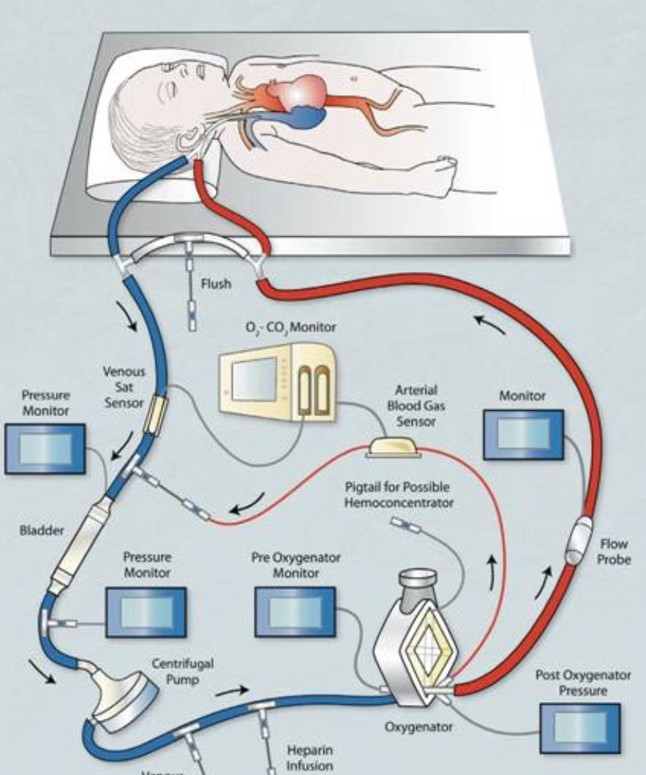
Figure 1. Extracorporeal membrane oxygenation circuit. Retrieved from http://www.elso.med.umich.edu/SpecialistToc.html

Slide 4
Specialist Training
ELSO- guidelines and standards
  24-36 hours of didactic lectures, water labs, and simulations
  New ECMO team members should be mentored by senior specialists
  36-72 hours of bedside training
Lectures
  Physiology of the diseases
  Criteria
  Components
  Physiology of VV vs VA
Water Drills
  Circuit assembly
  Circuit check
  Basic procedures
  Emergency procedures
Simulation
  Water drills on steroids
Notes:
Extracorporeal Life Support Organization (ELSO) is an international organization dedicated to the scientific advancement of ECLS. The ELSO registry database contains over 58,000 ECMO patients and provides ECMO centers with the opportunity to compare their outcomes with other centers internationally.
Initial education and training is extensive and expensive. ELSO recommends both didactic lectures in ECMO theory and water lab training. Currently, ELSO does not have any course work available for purchase; therefore, most ECMO specialists, worldwide, attend ECMO training at their own facility, utilizing curriculum suggested by ELSO but developed by their own institution.

Slide 5
What exactly are we training for
Circuit Check
Tubing
Pigtails
Pump head/raceway
Bladder
Servo-regulation
Pressure monitoring
Oxygenation
Water heater
O2 blender
Bridge
Sweep gas
Flow sensors
Bubble detector
Basic Procedures
Lab draws
ACT
Pigtail or Stopcock
Flushing the bridge
Blood product delivery
Anticoagulation
Continuous blood gas
Monitoring
Weaning
Decannulation
Emergency ECMO Procedures
Oxygenator failure
Tubing rupture/repair
Clamp off pump
Massive bleeding
Air in circuit
Accidental decannulation
Pump head failure
Hand cranking
Loss of venous return
Loss of power
Circuit or component change
Evacuation
Note. Adapted from the EMCO Specialist Training Manual (3rd ed.), by R. H. Bartlett, 2010, Extracorporeal Life Support Organization.
Notes:
The ECMO specialists are specially trained healthcare personnel, (RT, RN, Perfusion) who monitor and maintain the ECMO circuitry on a sick patient. These specialists, who are the first line of defense for maintaining the safety of ECMO patients, must be able to respond quickly to rare but potentially catastrophic emergency events. The ECMO is a high-technology device-dependent service.
The ECMO specialists must acquire the skills to recognize and respond rapidly to emergency mechanical complications .
Anderson et al. (2006) found that healthcare professionals are often required to make critical decisions about patients despite an acute lack of practical experience with the patient-care situation. These critical decisions require a certain level of knowledge as well as the technical and behavioral skills needed to respond accurately and effectively. Since ECMO therapy requires a robust level of knowledge and skills, any education and training of specialists must be comprehensive and include highly specific skill practice
Over 19% of ECMO-related perfusion accidents are due to a mechanical device malfunction or misuse. Human errors have been associated with over 73% of these perfusion accidents(Kotani et al. 2013)

Slide 6
Low volume vs High volume
What's the big deal
Low volume center vs High volume center
  Low-volume centers typically treat fewer than six patients per year with ECMO (Heard, Davis, & Fortenberry, 2010)
Low volume centers may experience large gaps of time between patients.
  Low patient volumes make it extremely difficult for bedside caregivers to achieve and maintain competency in ECMO management and techniques (Heard, Chou, & Zwischenberger, 2011).
Staff involved in care at larger centers could gain more experience and theoretically become more competent.
Notes:
To improve safety, ECMO training and education should be designed to optimize individual specialist’s performance. A robust quality improvement methodology can be used to study and improve upon the current ECMO educational course design.
A medical education program that integrates human factors with clinical scenarios has been shown improve patient safety
Decision-making skills are often developed at the bedside as a caregiver gains experience with critically ill patients. Instead, decision-making skills can be taught to caregivers, using a training program that integrates decision-making with skill development.

Slide 7
Continuing Education
What constitutes adequate continuing education?
  Continuing education is left up to each center
    12 hour shifts
      12 hours of education each week
    PRN
      4-8 hours of education each month
A redesign of the ECMO education and training process is needed to train specialists to run the pump safely and effectively
Notes:
Initially our program was given .3 positions for each of our Specialists; however, being a low volume center, that was not fiscally responsible or sustainable. We were transitioned to PRN positions and given 4-8 hours of month of education.
Unlike in large centers, that have patients on ECMO consistently, low volume programs need to work twice as hard because there can not only be a skills gap on how to run the pump and emergencies but also a gap in policies, procedures, and overall familiarity with the nuances of maintaining a patient on ECMO.
How can we turn 4 hours a month into what feels like 12 hours of learning?

Slide 8
Historically
I | Wet Drills | Initials | Dates
a) | Biannually completed a timed “Wet Drill Emergency Skills” check off under supervision of an ECMO Program Primer (Spring)
b) | Biannually completed a timed “Wet Drill Emergency” Skills checkoff under the supervision of an ECMO Program Primer (Fall)
II | Simulations
a) | Completes all department high fidelity simulation training under the supervision of an ECMO Program Primer
III | Equipment and Process Verification
a) | Biannually demonstrated mastery of all basic skills and ECMO equipment components and disposables (Spring)
b) | Biannually demonstrated mastery of all basic skills and ECMO equipment components and disposables (Fall)
IV | ACT POCT Testing
a) | Annually completes Seton requirements related to Activated Clotting Time (ACT) point of care testing (POCT)
V | Didactic Testing/ Review
a) | Annually completed an ECMO Basic Knowledge test and all associated Seton Mylearning ECMO related modules
b) | Has been notified of all new, updated or otherwise altered ECMO procedures, guidelines and protocols related to clinical practice throughout the calendar year
 | Verify________________ ____ Credentials___________ Initials________ Date________________
Notes:
Water drill practice with the ECMO pump and circuit is an important component of the curriculum suggested by the ELSO. These drills should provide new specialists with the opportunity to practice important skills before they start taking care of patients.
The guidelines state that water drills should include both basic and emergency skill development experiences. The water drills should include a circuit and pump that is customized to resemble the institution’s own ECMO tools. There is no recommendation as to how many hours of water drills are necessary for the initial training (Ogino et al.,)
Change the way we look at education
We use to focus mainly on emergency drills and annual simulation; however, that left a huge gap at the bedside for normal everyday procedures.
Where do I find that supply item again
Where to draw labs
How to give blood products
Heparin management
How to manage recirculation
What are the causes of high negative pressures
Weaning
Taking a patient off ECMO
Since mechanical complications or equipment malfunctions occur in at least 14.9% of ECMO
cases, a robust training course is needed to improve specialists responses to emergencies
and increase patient safety (Heard et al., 2010).
Vary the education, use high fidelity simulations; review policies and procedures; have specialists perform a scavenger hunt (cart, stock room, OR)

Slide 9
Current
Data Interpretation/Intervention: □ ECMO Bleeding Guidelines
Objective | Interpretation | Application/Correction
Understands purpose, interpretation and application of guidelines to control bleeding in the ECMO patient. Understands when they are no longer needed | Locates printed guidelines, verbalize purpose and how to interpret them □ Meets interpretation □ Fails Interpretation | Verbalizes how to apply Level I & II guidelines to pt care and evaluate effectiveness
Critical Action | Time to Achieve | Comments
Describes when bleeding guidelines are beneficial/needed for pt care
Locates bleeding guidelines document
Able to interpret and apply suggested steps from Level I and Level II guidelines
Able to explain application of DCMC Massive Transfusion Protocol
Notes:
Going back to basics-
Don’t assume people remember what to do in every circumstance and don’t assume people remember where to find the information in times of emergency.
Pick a policy, procedure, or guideline to review every month. Don’t wait for an something to occur for you to go over a specific policy or procedure. Be proactive in your approach.

Slide 10
Circuit/Hardware Interventions: Pump Scenario
□ Severely Under-occluded Raceway - Roller Pump
Objective | Interpretation | Application/Correction
Able to recognize loose pump rollers and makes corrective action | Recognizes indicators of loose raceway | Able to make corrective action and resume appropriate support to pt.
Critical Action | Time to Achieve | Comments
Recognizes insufficient ECMO support to pt
Attempts increases flow on pump for increased support – without change in flow to patient
Notes High RPM and switches display to calculated flow on pump (L/min)
Recognizes calculated pump flow is significantly higher than actual pump flow displayed on post ox transonic flow monitor Performs “% deoccluded” calculation | Y/N
Increases occlusion on raceway rollers sequentially □ Performs procedure overriding pump cover □ Performs procedure by lifting pump head
Correctly Calculates ~ 10-15% occlusion on raceway
Adjusts pump occlusion to 10- 15% | Y/N
Verbalizes how de-occlusion can affect labs (high SHgb) and impact on patient physiology (renal failure, high LDH, High Bili)
Notes:
Pick scenarios that occur often enough; however, not seen by everyone.
This is a good scenario because it usually occurs either right after initiating ECMO or within 24 hours post initiation. Not everyone is trained to initiate ECMO and with so few pumps a year not everyone has been the bedside specialist within the 12-24 hour period; furthermore, it doesn’t happen on every patient.
Being reminded and learning where pitfalls might occur, or how to identify them, helps bring everything together into a bigger picture.

Slide 11
Recognizing oxygenator failure
Notes:
A viable alternative to animal lab training may be simulation-based training. A simulated environment provides many educational opportunities beyond the traditional classroom lecture. Simulations offer the opportunity to learn by doing and to practice the behavioral skills needed to successfully care for a
patient in a safe, controlled environment (Vardi, 2008).
Simulation Training
Necessary skills that are well suited for a simulated learning opportunity include emergency medical responses. Practicing emergency responses in a simulation fosters the development of key habits that can become second nature to the care provider (Dickinson, 2011).
Critical skill development, incorporating hands on experiences during a simulation, uses active learning techniques to facilitate skill acquisition (Ogino et al.,
2012). Critical thinking is another crucial competency that is difficult to practice in the clinical setting.
As a core component of the decision-making process, critical thinking can be practiced and perfected during simulated learning experiences (O’Donnell & Goode, 2008).
Simulations have been shown to facilitate the development of a novice nurse into an expert nurse (Cates & Wilson, 2011).
Our education now incorporates simulations and a policy/procedure every month. It can be as simple as walking a raceway and cutting out a connector or it can be as complicated as identifying a failing oxygenator and being required to change out the component, following all of the essential steps, within 5 minutes.
The more our specialists have hands on education with the pump which incorporates minor interventions along with major emergencies, the more robust educational experience we will provide.
We have also started incorporating research and lectures into our educational process. Each specialist is required to give a presentation on something they have researched.
Furthermore, I want to start to emailing out case scenarios, which will encourage the specialists to think about what they would do in some of these circumstances and then we can discuss them in a staff meeting.

Slide 12
Experiences of an ECMO Specialist
(a Specialists point of view)
How to remain competent/ confident when experiencing long gaps in between ECMO patients
Setting time aside to perform drills
  Repetition (practice makes perfect)
Utilizing your down time to your advantage
  Learn from previous runs
  Set up process improvement
  What do other centers do
  DRILL, DRILL, DRILL
Notes:
1.) Setting aside time to do drills, as deemed required by ECMO program, in allotted timeframe- extremely important to put patient back on safely but just as important to do in a timely manner for better patient outcomes (practice makes perfect).....repitition
2.) Utilize your "downtime" to your advantage. When you experience long gaps between patients, this is the time to get things done. Learn the barriers to overcome from the previous run, set up process improvement plans, educate others (non-ECMO), familiarize yourself with what other centers do, and last but not least DRILL, DRILL, DRILL!!!

Slide 13
No Such Thing As
TOO PREPARED
Further your education
  Expand knowledge beyond one’s expected role
Understanding and dealing with your limitations
  Use checklists
Proactive patient selection
  Get ahead of the game with patient selection
  Implement steps as early as possible
Notes:
3.) Further education- expanding knowledge above one's expected role will further develop and build on their current role (example.....you can or cannot write this part down but I will verbally use the example of learning how to build a circuit and prime has made me understand the circuit better and therefore made me a better bedside specialist)
4.) Understanding and dealing with your limitations: having large gaps in ECMO runs opens the door for lack of confidence and second guessing. One way we deal with this is to review what is about to take place several times with several people present and attempt to ensure we take an "all hands on deck" approach ( nothing emergent happens on night, we reserve this for the day when an abundance of people are available)
In a low volume center you do not always have the luxury of having a more experience person around to guide you. During an event or initiation, especially on nights, you have to wait for the Primer or Coordinator to come in. Checklists are a great way to know what to do, get organized, and help prepare the pump, supplies, and equipment need for any type of intervention before the Primer arrives
5.) Proactive patient selection ( might fall in with dealing with limitations). Much easier in a low volume center to get ahead of game with a potential, implement steps as early as possible to allow yourself more time. Better to be over prepared and not need it than under prepared and in an emergency situation
Working in a low volume center definitely can have it obstacles; however, its all in how you look at it, prepare for the inevitable, and be proactive in your education that makes all the difference in the world.

Slide 14

QUESTIONS

