Slide 1
Development of a Real Time Quality Indicator Assessment Program for Use in the Epilepsy Monitoring Unit Althea “Linda” Wasson, MSN, RN awasson@ascension.org (512) 324-0000 ext. 15842 (office) (512) 773-4344 (mobile)

Slide 2
Objectives/Purpose
Objectives:
Describe the importance of quality measures
Recall the reason why quality measures were created in the EMU
The purpose of this study is to:
Define patient-centric quality metrics for evaluating epilepsy monitoring unit (EMU) staff performance.
Assess improvements following staff education on defined quality metrics

Slide 3
Why is quality measures important in the EMU?
Quality Measures – improve health outcomes
Gaps in quality of care in epilepsy patients
Improve quality of care by creating a standard for response times in the EMU
Faster response times:
Patient Safety: reactivity and intervention
IOM: 17% gap in patients going to Level IV Epilepsy Centers

Slide 4
Patient-centric Quality Measures
Conservative response times agreed upon by the team
Electrographic seizure identification by EEG technologist < 20 seconds,
Clinical seizure identification by EEG technologist < 10 seconds,
RN response time < 30 seconds,
First medication treatment < 5 minutes from RN response time
Second medication treatment < 30 minutes of first medication treatment
Notes:
The numbers on the response times are conservative and are based on agreed upon response times from the team.

Slide 5
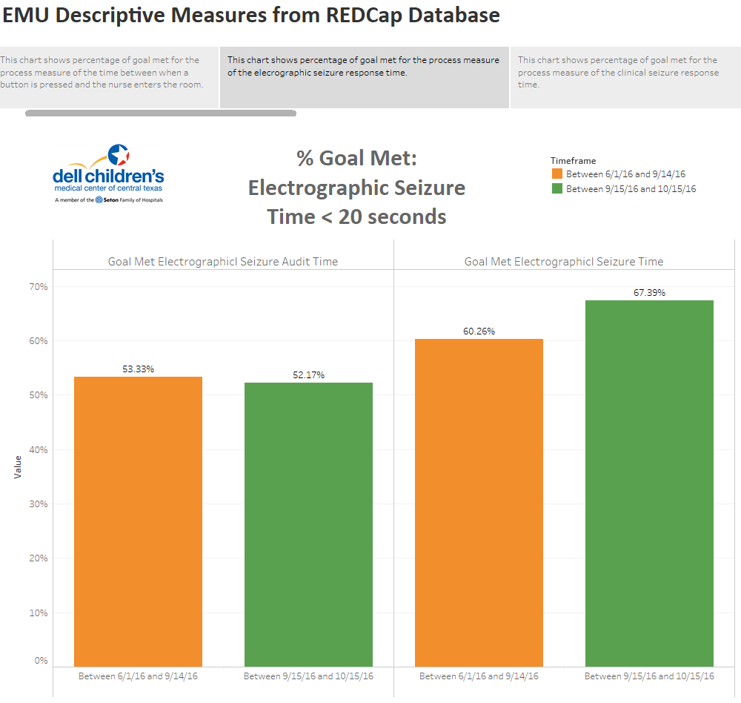
Notes:
% Goal Met: This is what how we were doing based on Tech times and auditor response.

Slide 6
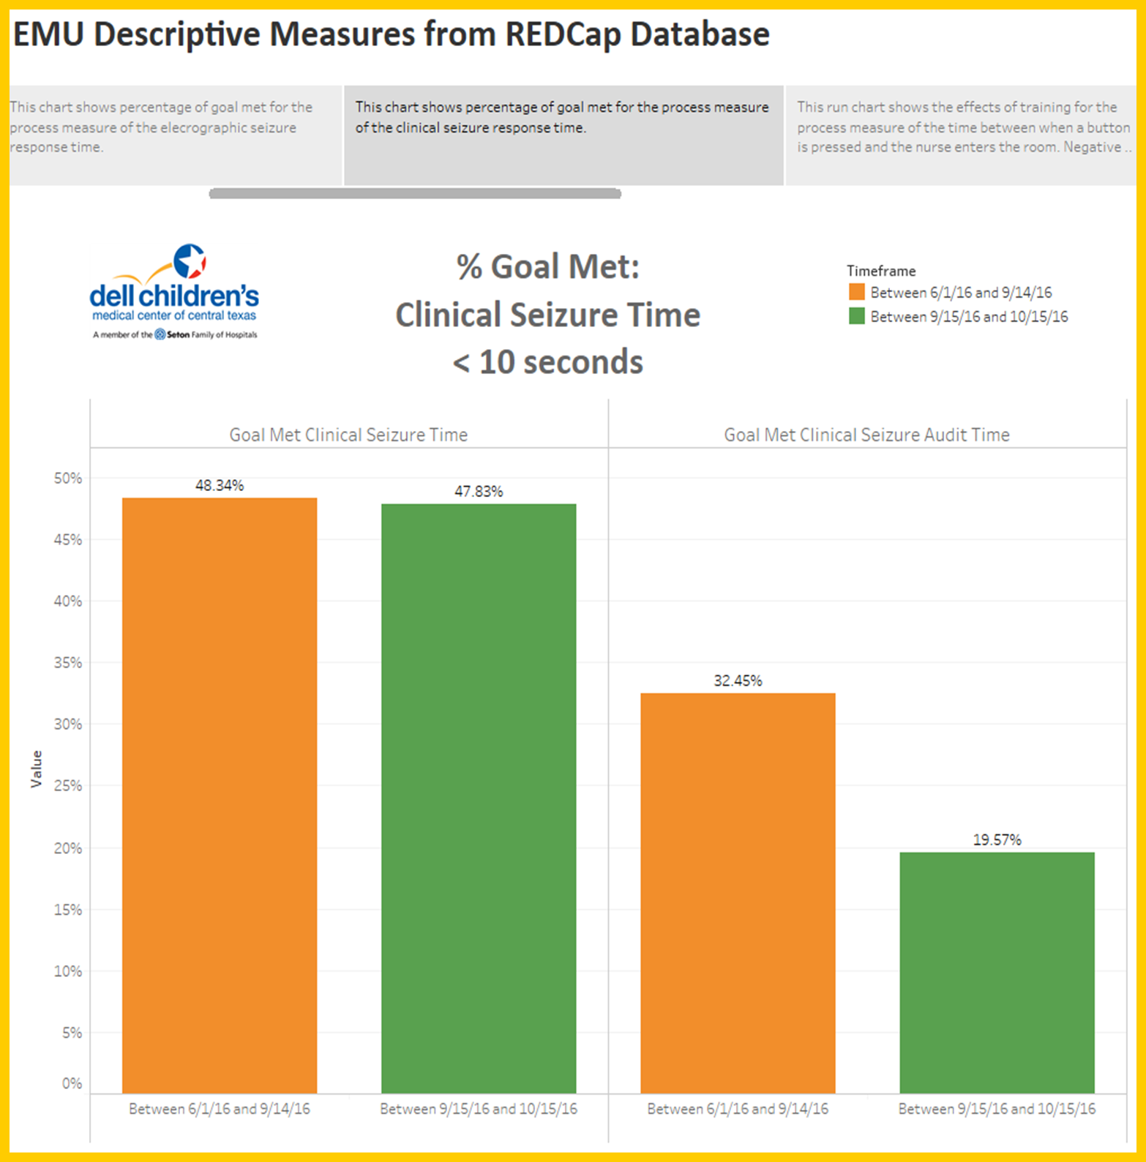

Slide 7
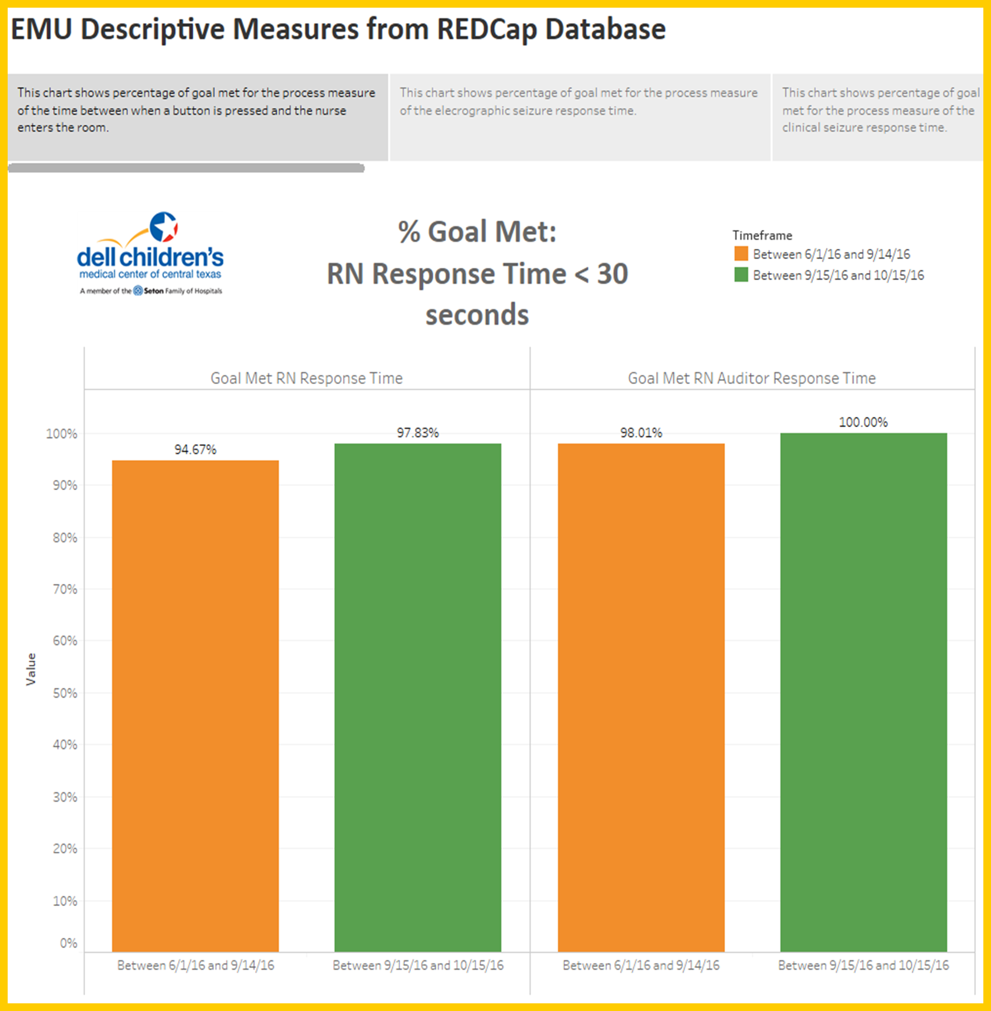

Slide 8
Intervention/Education Nurses and EEG Technologists
EMU Rounds
Began Sept 2016
Weekly rounds
Discuss cases including EEG findings
Monthly meetings with supervisors/staff to review outcomes
1:1 Tech reviews

Slide 9
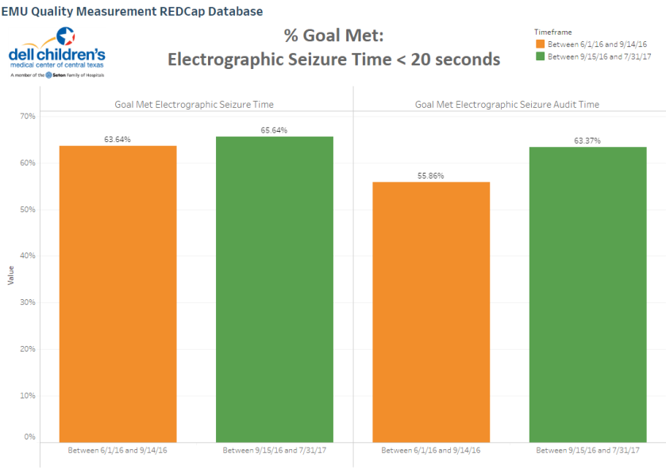

Slide 10
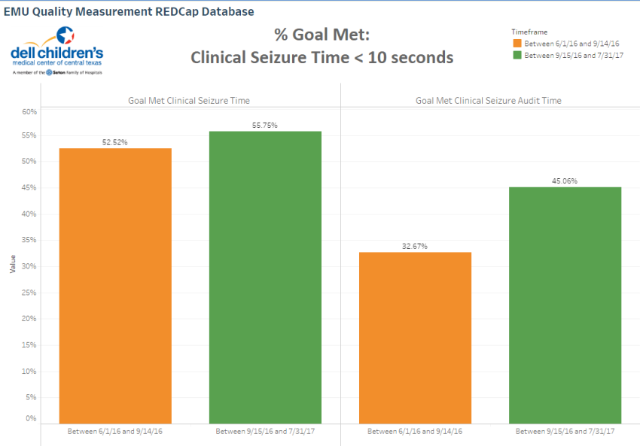

Slide 11
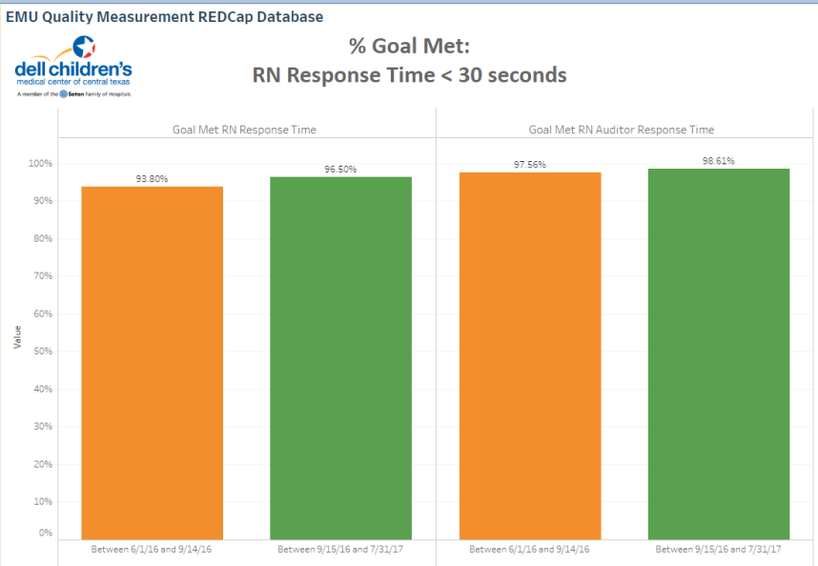

Slide 12
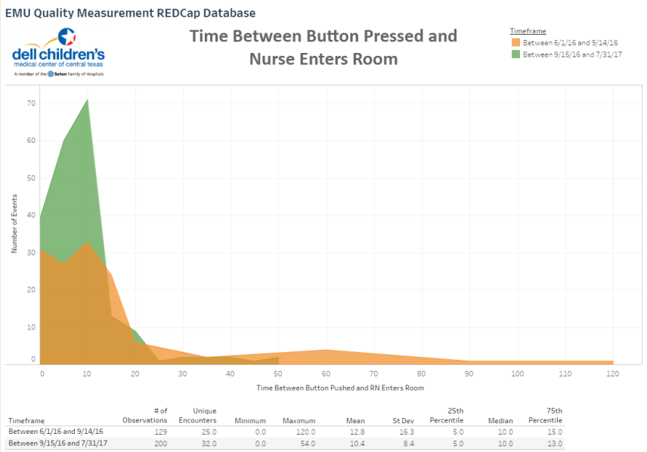

Slide 13
Data Analysis – Statistically Significant
 | Initial Mean 06/01/16 - 09/14/16 n=162 | Current Mean 09/15/16 - 07/31/17 n=603 | Difference | P-Value
Electrographic <20 seconds | 29+50 seconds | 16+13 | 4.41 (1.75, 7.07) | 0.001
Clinical <10 seconds | 26+50 seconds | 13+11 | 5.02 (2.59, 7.46) | 0.0001
RN Response Time <30 seconds | 6+17 seconds | 11+5 | 2.31 (0.520, 4.108) | 0.012

Slide 14
Conclusion
Negative confounding factors – new EEG technologists
Trends revealing positive change in response times

Slide 15
Authors
Althea Linda Wasson, MSN, RN
Kevin Moon, R.EEG.T
Collin Hovinga, PharmD, MS, FCCP
Freedom F. Perkins, MD
Christie Stanworth, RN, MSN, MBA, HCM
Teresa Ontiveros, MSN, RN
Miriam Jackson, MSN, RN, CPNP-PC/AC
Dolly Martin, END Tech II
Kristin Robbins, RN
Courtney Keene, BSN, RN
John Grantham, MBA
Dave F. Clarke, MD

Slide 16
Questions?

Slide 17
References
IOM. Epilepsy across the spectrum: promoting health and understanding. Washington, DC: The National Academies Press; 2012
What are clinical quality measures? FAQs. (2013, January 15). Retrieved September 06, 2017, from https://www.healthit.gov/providers-professionals/faqs/what-are-clinical-quality-measures
Understanding Quality Measurement. (2012, September 01). Retrieved September 06, 2017, from https://www.ahrq.gov/professionals/quality-patient-safety/quality-resources/tools/chtoolbx/understand/index.html
Shaw, G. (2011). AAN Develops Quality Measures for Epilepsy. Neurology Today, 11(2), 7. doi:10.1097/01.nt.0000394622.71339.a1
Jouny, C. C., Franaszczuk, P. J., & Bergey, G. K. (2011). Improving Early Seizure Detection. Epilepsy & Behavior : E&B, 22(Suppl 1), S44–S48. http://doi.org/10.1016/j.yebeh.2011.08.029

