Slide 1
Be a Nurse Manager, They Said… It Will Be Fun, They Said!
D. Keith Faison, MBA, BSN, RN, Director of Nursing Administration
Jarrett Dawson, BSN, RN, CST, Nurse Manager Surgery
Crista Schronk MSN, RN, CPN, Nurse Manager Medical Nursing

Slide 2
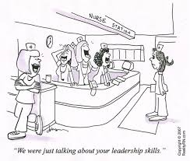
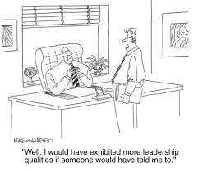

Slide 3
Brief History
April, 2014 – participated in research study with Akron Children’s Hospital.
Our Tasks:
Develop educational curriculum that is required to become a Nurse Manager
Outline activities that correlate to each of our learning objectives.

Slide 4
Learning Objectives
Objective #1
Listing of 5 item-needs assessment survey
Content of job description of nurse manager
Objective #2
Brief discussion of research findings on courses needed to enhance new nurse leader knowledge and skill competencies
Discussion and listing of course curriculum from 8 hours of New Nurse Leader Workshop
Objective #3
Quantitative and qualitative results from workshop program evaluation survey by attendees

Slide 5
Why develop a mentoring program?
Mentoring is future-oriented
New nurse leader is more engaged
Optimistic about plans for his/her career path
2016 – Began bringing Cook Children’s program to fruition.

Slide 6
Discovery !!!
New Nurse Managers already in the role
Offer workshop to new Nurse Managers
4 workshops offered 2017

Slide 7
Development Focus
Organized Nurse Leader steering committee
Chief Nursing Officer
Nursing Director
5 experienced Nurse Managers
Content needs are similar for most leaders
Content focus narrowed for Nursing Leadership
Steering committee managers transitioned to become content experts

Slide 8
Workshop Development
Additional Survey Fall 2016
Fall/Winter 2016 Course development
Part 1 (January 2017)
Part 2 (April 2017)
Full Day Course (June 2017), (September 2017)

Slide 9
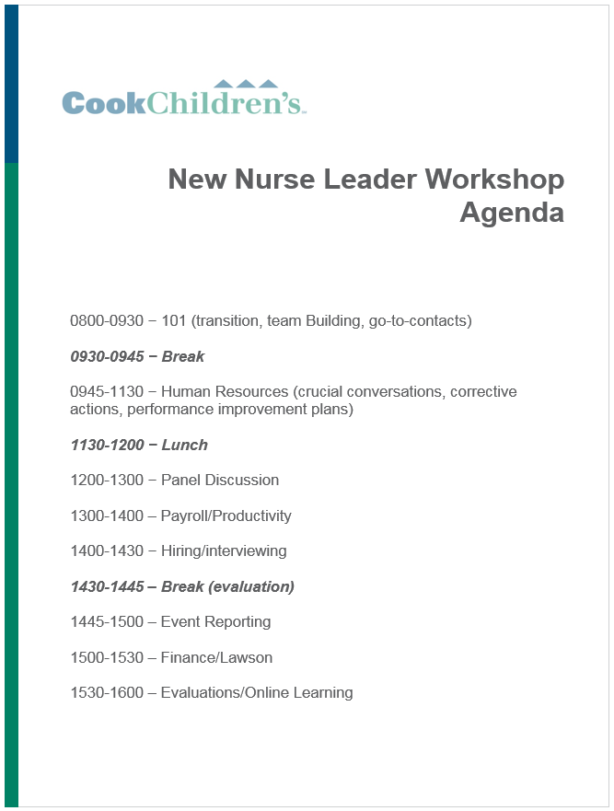
Workshop Agenda Content
Full day course
Content designed from current nurse manager survey feedback.
Curriculum modified based on feedback from both pilot classes.

Slide 10
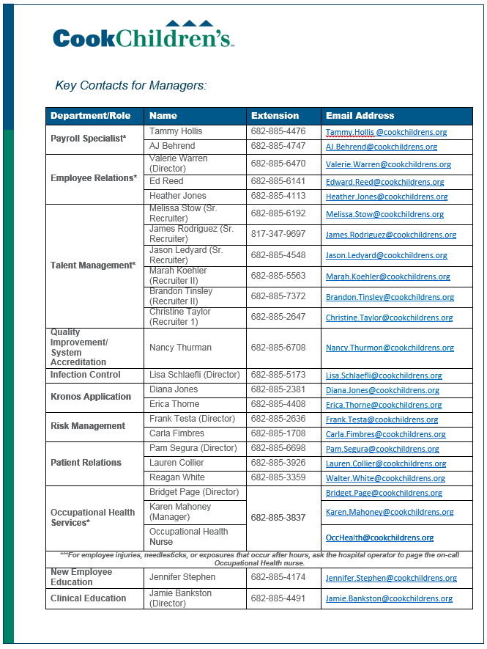
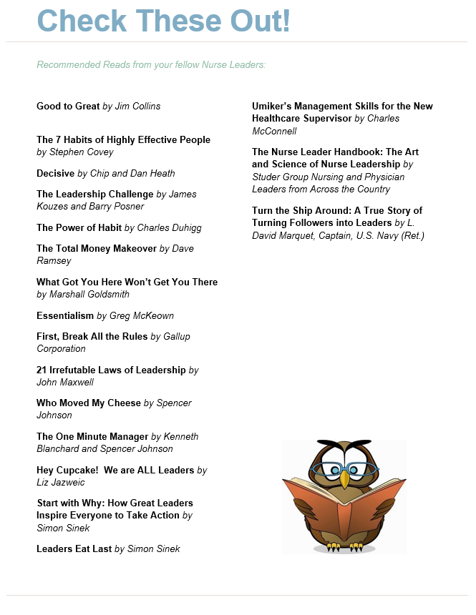
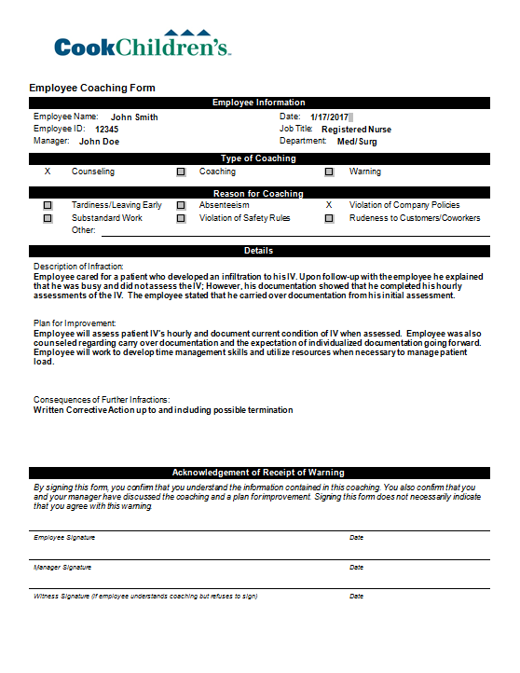
Recommended Reading

Slide 11
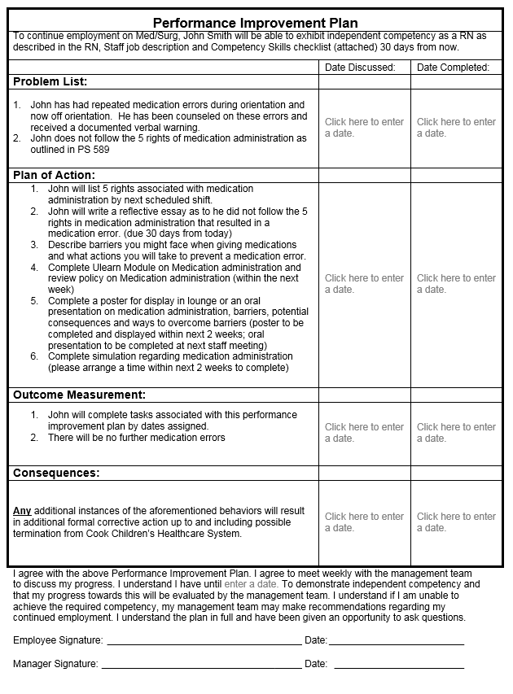

Slide 12
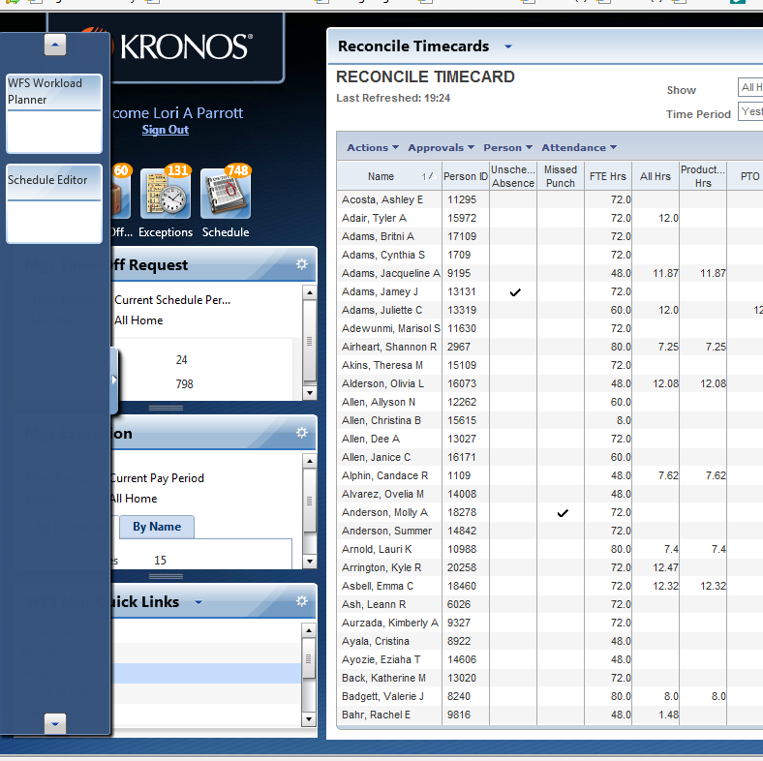
2
Setting up a Schedule
1
Click on little triangle to pull out drawer that has your workload planner in it. Pull into center screen

Slide 13
Transfers
In most cases, you’ll need to have an approved req created in position manager to transfer the employee into.
Select an effective date at the beginning of a pay period!

Slide 14
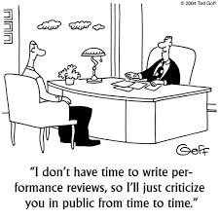

Slide 15
Employee Evaluations

Slide 16
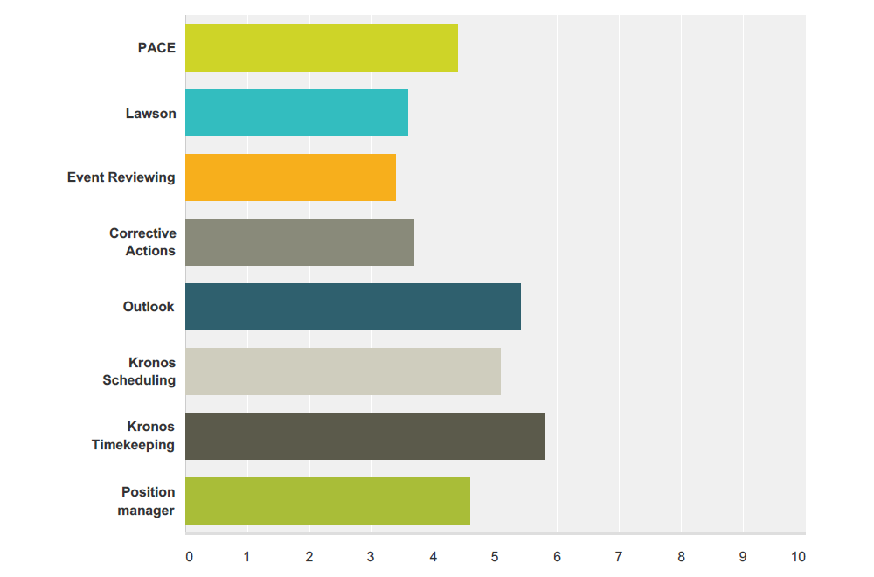
Survey Results
Survey question asked managers to rate the importance of certain organizational systems
These included systems such as Evaluations, Position Requisitions, Scheduling, etc.

Slide 17
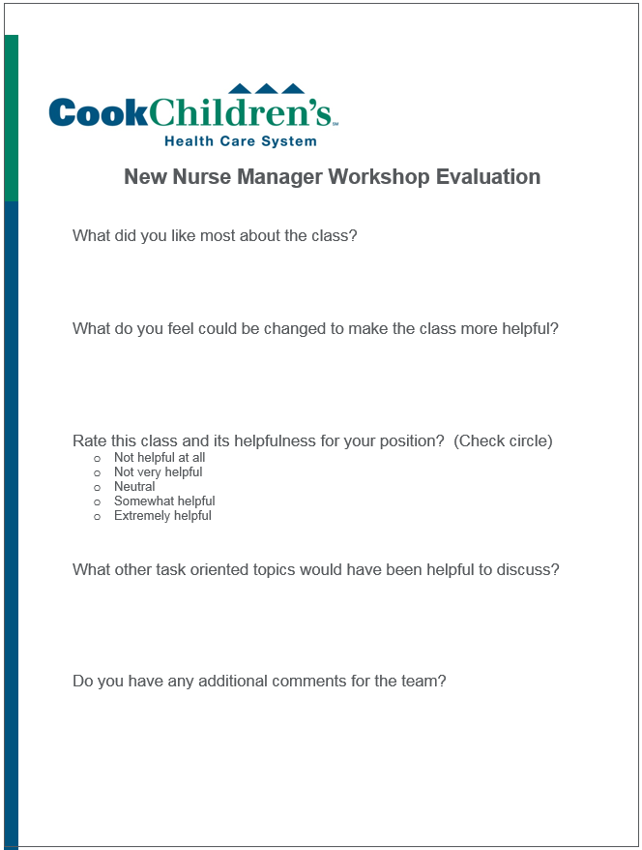
Survey Results
Of 18 participants who completed surveys
(72%) found the workshop “extremely helpful”
(31%) found the workshop to be “somewhat helpful”
(0.05%) stated the helpfulness as “neutral”

Slide 18
Feedback
Feedback from participants on what they LIKED about the class
“PIP and Crucial Conversations”
“Panel discussion was great, hearing what works/doesn’t work was helpful”
“The round-table discussion and the laid back environment was more like friends talking than a class”

Slide 19
Feedback
Feedback from participants on how the class can be IMPROVED
“More time on payroll, so much to learn”
“Expert Panel and Transition discussion should have been together”
“Merge parts 1 and 2 into one class”
“Be recommended to take within first 1-3 months in role”

Slide 20
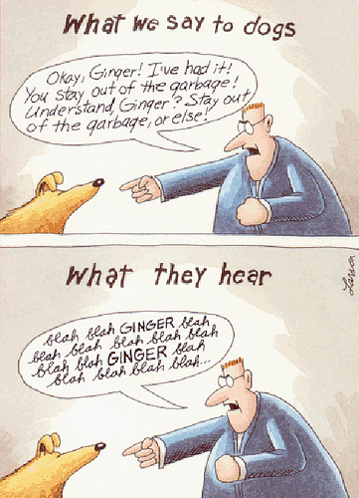

Slide 21
Next steps
Now offered quarterly; mandatory for leaders within their first three months of transition/hire
Circling back to original path for succession planning; opening a class for people who may be interested in becoming leaders
Growing own leaders by promoting within
Possibility of expanding program to other clinical disciplines

Slide 22
Questions?

