Slide 1
Pediatric Palliative Medicine
By
Elizabeth Vasquez APRN

Slide 2
SUNRISE
Creative Presentation
Child Mortality
18.2%
1960
*Almost every 5th child born in that year died in childhood.
Child Mortality
Causes of Child Mortality in 2013
2013
*Preterm birth complications 15%
*Pneumonia 13%
*Sepsis 7%
*Congenital abnormalities 4%
*Other Disorders 15%
*Child Mortality is a core indicator for child health and well-being.
*Child Mortality is measured as the number of children who die before their 5th birthday.
*Unprecedented growth of infants, children living longer with complex conditions.
*As many as 17 million adults are caregivers for a seriously ill child.
Global Decline in Child Mortality

4.3%
2105
*Declining poverty
*Increase in Knowledge
*Increase in Health sector
* Prevalence of children suffering from a chronic illness in the US > 400,000
Our World Data
CAPC
48

Slide 3
SUNRISE
Creative Presentation
ABOUT US
Emerging Population: Children with Medical Complex Needs
Have medical fragility and intensive care needs that are not met by our existing health care models.
Congenital, Acquired Multisystem Disease, Severe Neurologic impairment, Cancer, and Cancer survivors.
Medical success in survivorship rising rates of complications &
childhood disability.
Greater incidence of emotional, behavioral and psychiatric symptoms than healthy children.
Chronologic age is not equivalent to mental age. May not develop at the same rate as healthy children due to delayed neurocognitive development, disruptions in education and treatment influences on intellectual, somatic growth and maturation.
Resilience is common in children.
Turkel & Pao, 2007
9

Slide 4
Pediatric Palliative
Medicine
SUNRISE
Creative Presentation

Improves Health

Better Care

Lower Cost
Strengthens communication decision-making & family satisfaction/well-being
Skilled communication about what matters most to patients and their families.
Coordinates medical and practical needs across settings.
Cost Analysis and Policy Implications of a Pediatric Palliative Care Program.
Reduces Resource utilization and cost by matching treatment to patient and family goals.
50% reduction in the average number of inpatient days per month, from 4.2 to 2.3.
Overall Savings totaled nearly $7million. Pilot data spanned Jan 2010-2012.
Improves QOL & Prognostic understanding
Relieves pain, distress, uncertainty
Expert pain and symptom management
Patient at Center of Care
Hadler, Chen et.al, 2015
21

Slide 5
OUR GOALS
SUNRISE
Creative Presentation
Diagnosis & Early Treatment

*Advance Care Planning
*Establishing Rapport
*Assessment of symptom management needs, QOL needs
*Medical Understanding & Establishment of Goals of care
*Assessment of spiritual /Cultural beliefs
Active Disease

*Modifying treatment and Intervention
*Medical Understanding, Medical counseling & Goals of Care
* Symptom Management, QOL needs
Hospice/Death

*Goals of Care
*Palliative Sedation
*Spiritual /Cultural assessment
*Grief and Bereavement support
Hinds, Sources, & Wolfe, 2011
8

Slide 6
SUNRISE
Creative Presentation
Who’s Afraid of Palliative Care?


Palli-Phobia

Message matters
Word palliative has negative connotations evocative of termination of care and death.
Silent fear of death
2009 study investigated pediatricians definition of palliative care: 41.9% Pediatricians defined Palliative care as hospice care, 31.9% offered alternative definitions and 26.2% did not know.
2014 American Childhood Cancer organization online survey n=275 parents: 89% think it is important that PPC services are available in all hospitals caring for children.
Lindsay et al, 2009.
Adequate Timing of Referral
World Health Organization recommends early referral
5 year retrospective audit: referral practices of pediatric oncologists
(n=1135) 72.4% had
advanced disease at time of
referral.
Goshal et al, 2016
Palliative Care Model
Interdisciplinary system vs Hierarchic system
“They are just not ready for it syndrome”
Pediatric Palliative Care and Pediatric Medical Ethics
Research sharing & Research collaboration (Center for Advancing Palliative Care)
Fuedtner & Nathanson, 2014
7

Slide 7
SUNRISE
Creative Presentation
When to Refer to Palliative Care




Category I
Category II
Category III
Category IV
Life-threatening conditions for which curative treatment is possible but may fail, where access to palliative care services may be beneficial alongside attempts at life prolonging treatment and/or if treatment fails
*Cancer, heart failure, liver failure ,kidney failure.
Conditions where early death is inevitable, where there may be long periods of intensive treatment aimed at prolonging quality of life, allowing participation in normal activities and maintaining quality of life.
*Cystic Fibrosis, Duchenne muscular dystrophy.
Progressive conditions without curative treatment options, where treatment is exclusively palliative after diagnosis and may extend over many years.
*Batten disease, mucopolysaccharidoses
Irreversible but non progressive conditions with complex healthcare needs causing extreme vulnerability and leading to complications and likelihood of premature death.
*Severe CP, brain spinal cord injury
Source: National Hospice and Palliative Care Organization, 2009
16
Notes:
Mucopolysaccharidosis: metabolic disorder, absence or malfunction of lysosomal enzymes needed to breakdown molecules, X linked
Hurler syndrome, Sanfilippo syndrome
Batten disorder : fetal inherited disorder of the nervous system. Recessive disorder.

Slide 8
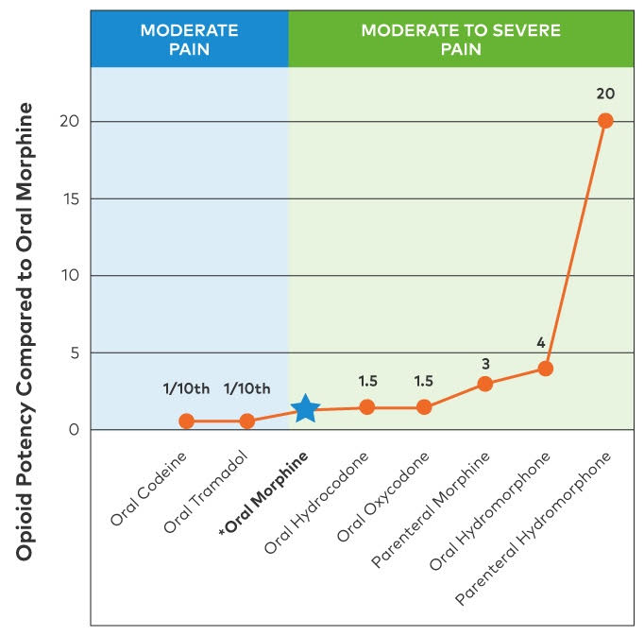
Pain Management
SUNRISE
Creative Presentation


Somatic Pain, Visceral Pain, Neuropathic Pain
Choose a drug classification that matches your patients pain type:
Acetaminophen, NSAIDS, Corticosteroids,
Antidepressants , AED, Opioids
Opioid Trail
Ongoing Assessment
Opioid-Naive patient
Lowest possible starting dose
Short acting-acting opioid.
Consider potency, half-life & conditions that alter drug metabolism
Common RX opioids *Opioids are not identical
Morphine, hydrocodone, hydromorphone,
codeine, oxycodone, Fentanyl patch,
methadone
Pain intensity
Overall well-being, level of function ex mobility
Side effects (constipation, nausea, sedation).
Consider potential risk & side effects (prolonged QTC, diminished kidney function, diminished liver function, heart failure, sleep apnea
Pain crisis = Medical Emergency


Adapting the Treatment Plan
Opioid Withdrawal
Short acting opioids best for: Dose finding, incident pain acute, breakthrough
Long acting opioids best for: persistent pain, better adherence
Indications for converting to a long-acting opioid include:
Stable short-acting regimen, continuous
pain.
Know the child’s baseline for proper WAT-1 score assessment
Prescribers should always taper patients opioid therapy
Safe /proper discharge (outpatient rx therapy)
Proper use of rescue medications
CAPC
52
Notes:
When prescribed and used properly opioid can provide benefit to patients and are no more dangerous than many other commonly used medications.
Pain can be managed but complete elimination of pain is difficult without side effects. The goal is to reach acceptable pain levles. Goal improved pain, improved function improved sleep
NSAIDS are contraindicated in patients with diminished kidney function.
Avoid morphine in patients with acute renal failure/anuria
Avoid NSAIDS in cardiac and renal patients
Do not use Fentanyl or methadone for opioid-Naïve patients
Hydrocodone is roughly equipotent to morphine on a mg per mg basis
Codeine and morphine are contraindicated in renal insufficiency due to accumulation of toxic metabolites
Hydromorphone is preferred for patients with renal dysfunction because it has a wider safety profile than morphine
Most opioids are at least partially metabolized by the liver, complicating their use in patients liver failure. Codeine is contraindicated , potential drug interaction involving cyp450 enzyme

Slide 9
SUNRISE
Creative Presentation

Identify Mechanisms of Dyspnea

Identify Underlying Problem
Dyspnea
Management
Increased ventilatory demand (hypoxia, hypercarbia, acidosis or exertion) *sepsis, fever
Decreased ventilatory capacity (Structural or functional reduction of lung volume) *Neuromuscular
Increased airway resistance (Impedance of flow of air) * Chronic lung disease
Decreased pulmonary compliance (Restricted ventilation from decreased pleural or lung compliance) *Pulmonary Fibrosis
Treat underlying problems
Pneumonia, Adjustment of pulmonary
medical regimen.
Reassess progression of disease burden.
Know baseline dyspnea, o2 requirements, CPAP requirements, recurrent intubation
Refers to the sensation of difficult or uncomfortable breathing.
Occurs in over 50% of patients with underlying serious illness.
Uncontrolled dyspnea can impact QOL, increased ED visits, depression, anxiety, fatigue, deconditioning.

Interventions

Opioids
Symptomatic treatments include pharmacologic (Anticholinergic medications), non-pharmacologic, airway management and surgical interventions. (Environmental modifications, use of fan, oral corticosteroids, oxygen therapy, HFNC, CPAP, BiPAP for HS use, lay flat car seat)
Identify parent’s goals of care
Opioids are the mainstay for 1st line treatment of dyspnea after other therapeutic options are optimized
Opioids can relieve breathlessness by decreasing the respiratory rate without causing hypercapnia or hypoxia.
Start with a very low dose: Goal is to achieve the lowest effective dose possible based on patients response
Clinician fears of respiratory depression=underuse of opioids for dyspnea treatment.
Benzo +opioids must be closely monitored
CPAPC
52
Notes:
Your treatment strategy for dyspnea will be influenced by whether or not the root cause is reversible and treatment of symptoms distress
Benzo +opioid risk of rep depression and changes in mental status. Benzo should only be added when titratedopiod therapy failed to control symptoms

Slide 10
SUNRISE
Creative Presentation
Communication
Is
Complex
10

Slide 11
What The Medical Team Says
SUNRISE
His Creatinine is better
She is stable today.
We have an experimental treatment.
Do you want us to do CPR?
Do you want us to do everything for your child?
What Parent Hears
He will get well.
She is getting better.
This new therapy will cure my child.
You think CPR will help.
Doing everything means you think my child will survive and get well.
24

Slide 12
SUNRISE
Creative Presentation

Silence
Normal part of processing
Anticipatory Grief becomes reality

Family Perspectives on the Quality of Pediatric Palliative Care

Difficult Conversations
Inability to have hope
Single events can cause complicated grief years later.
Mixed messages resulted in confusion & turmoil.
Consistent caregiver viewed as essential to QOL.
Parents reported feeling overwhelmed and fear of repercussions to file a formal complaint.
Assess Understanding
Determine how much family wants to know
Cultural Considerations
Be Honest
Use The D word (Death/Die)
Parents need concrete honest terms
Avoid vague/confusing messages
Control, Cohen et al, 2002
22
Notes:
*Family perspectives on the QOL: English and Spanish speaking family's of deceased pediatric patients who received care at Lucile Salter Packard Children's hospital , stanford university medical center, Palo alto, calif. 68 family members of 44 deceased children were interviewed regarding treatment , transition to palliative care, and bereavement follow up.
Realistic hope !

Slide 13
SUNRISE
Creative Presentation

Hospice
Life expectancy < 6 months
Physician referral required
Concurrent Care Act 2010
(CCCR)
Palliative Sedation
Palliative Medicine is not Hospice
Palliative Medicine

Specialized team
Life prolonging curative treatment
QOL oriented
Timely referral is vital
23

Slide 14
SUNRISE
Creative Presentation
WELCOME
Parent Panel
5

Slide 15
SUNRISE
Creative Presentation
References
Ananth, P., Melvin, P., Berry, J. G., & Wolfe, J. (2017). Trends in Hospital Utilization and Costs among Pediatric Palliative Care Recipients. Journal Of Palliative Medicine, 20(9), 946-953. doi:10.1089/jpm.2016.0496
Contro N, Larson J, Scofield S, Sourkes B, Cohen H. Family Perspectives on the Quality of Pediatric Palliative Care. Arch Pediatr Adolesc Med. 2002;156(1):14–19. doi:10.1001/archpedi.156.1.14
Compas, B. E., Jaser, S. S., Dunn, M. J., & Rodriguez, E. M. (2012). Coping with Chronic Illness in Childhood and Adolescence. Annual Review of Clinical Psychology, 8, 455–480. http://doi.org/10.1146/annurev-clinpsy-032511-143108
Ghoshal, A., Salins, N., Damani, A., Deodhar, J., & Muckaden, M. (2016). Specialist Pediatric Palliative Care Referral Practices in Pediatric Oncology: A Large 5-year Retrospective Audit. Indian Journal of Palliative Care, 22(3), 266–273. http://doi.org/10.4103/0973-1075.185031
29

Slide 16
SUNRISE
Creative Presentation
References
Hinds, P., Sourkes, B., & Wolfe, J. (2011). Textbook of interdisciplinary pediatric care. Philadelphia, PA: Elsevier Inc.
Turkel, S., & Pao, M. (2007). Late Consequences of Pediatric Chronic Illness. The Psychiatric Clinics of North America, 30(4), 819–835. http://doi.org/10.1016/j.psc.2007.07.009
Roser, M. Child Mortality. Retrieved from https://ourworldindata.org
29

