Slide 1
Getting Your New Staff “Up to Speed” with Pediatric Care
Leigh Anne Campbell, MSN, RN, CPN
Abby Morse, MSN, RN, CNOR
CHAT Conference
October 27, 2017
Notes:
Introduce ourselves

Slide 2
Notes:
LAC
The idea for this class came from leadership and staff concerns regarding assessment techniques, developmental considerations, and overall comfort caring for pediatric patients. As many of you may have personally experienced, pediatric clinical experiences are decreasing or being replaced with simulation. We set out to create a class to bridge that knowledge and skill gap…giving new clinical staff tools in their tool box to begin their journey in pediatrics.

Slide 3
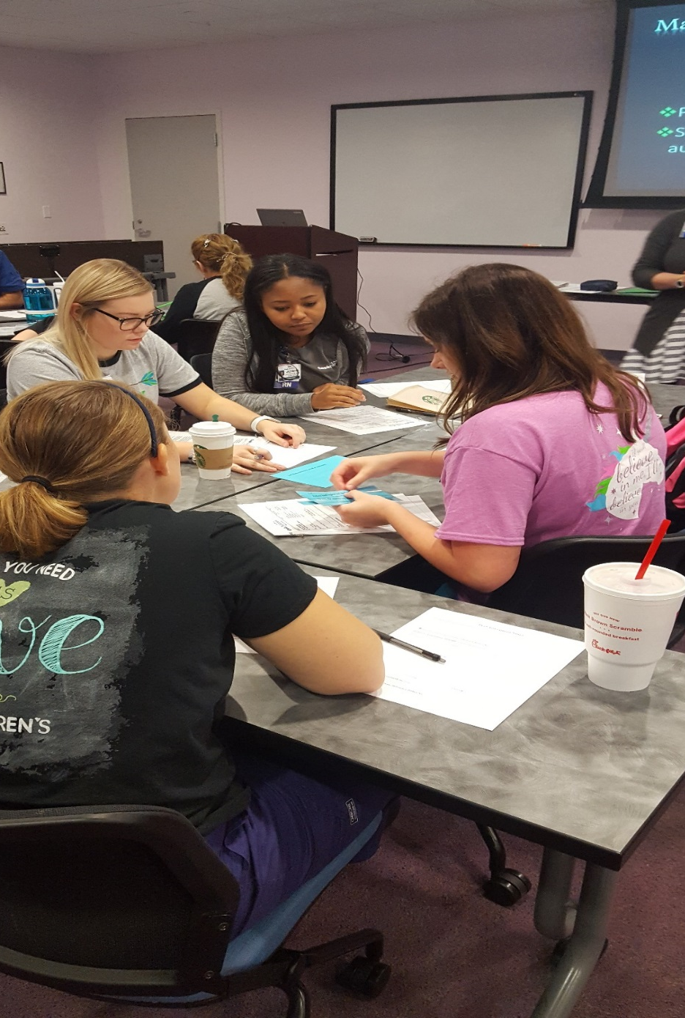
Policy
Procedure
Critical Thinking
Develop-mental age
Notes:
LAC
We provide this class during the first month of orientation. The session begins in a classroom with didactic learning utilizing adult learning techniques. For example, this is one of our groups piecing together elements of the blood pressure policy and procedure and to identify improper steps and techniques in the kits.
Afterwords, participants brainstorm how to implement these steps on, say, a screaming 2-year old or a crying 6-week old. Participants quickly identify that one size does not fit all (whether by technique or size of equipment utilized).

Slide 4
Pediatric Assessment Triangle
General appearance
Sick
Sicker
Sickest
Work of Breathing
Circulation
Notes:
LAC
One of the most important tools shared with new staff to prioritize their patient care assignment is the The Pediatric Assessment Triangle-PAT. This is a quick, doorway assessment based upon general appearance, work of breathing, and circulation.
Every patient that comes to Cook Children’s is sick. It is up to us to prioritize who is “sicker” and “sickest”. We will do that based upon whether one or more elements of the PAT are abnormal.

Slide 5
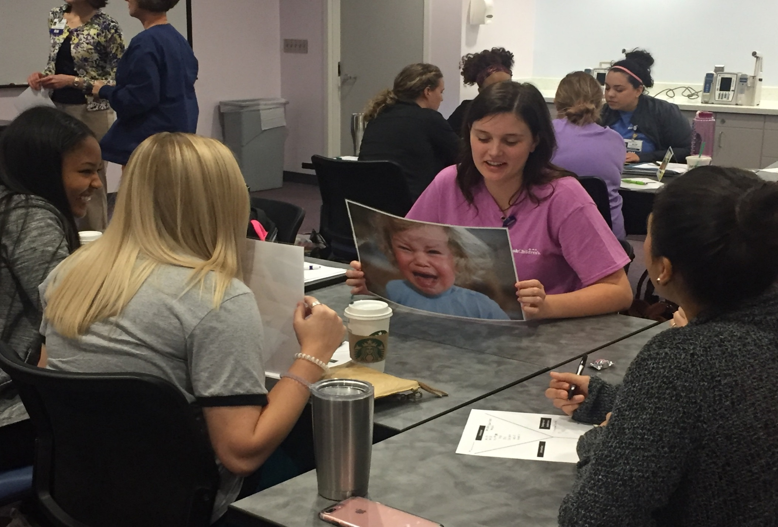
Notes:
Abby
Employees are placed into groups and asked to determine which of the following four patients is the sickest patient and why.

Slide 6
Notes:
Abby
6-week old
2-year old
7-year old
17-year old
Knowing the basics of the PAT (work of breathing, circulation and general appearance)…looking at all four of our patient pictures, to yourself, identify which patient(s) you would identify as sick, sicker and sickest. For example, are there any elements of the PAT that are abnormal? How about two elements?

Slide 7
Assessment(s)
Intervention(s)
Developmental
Consideration(s)
Notes:
Abby
After prioritizing care, laminated ‘y’ sheets are provided to help participants collect their assessment and intervention data for when they “go see” their patients in the simulation lab.

Slide 8
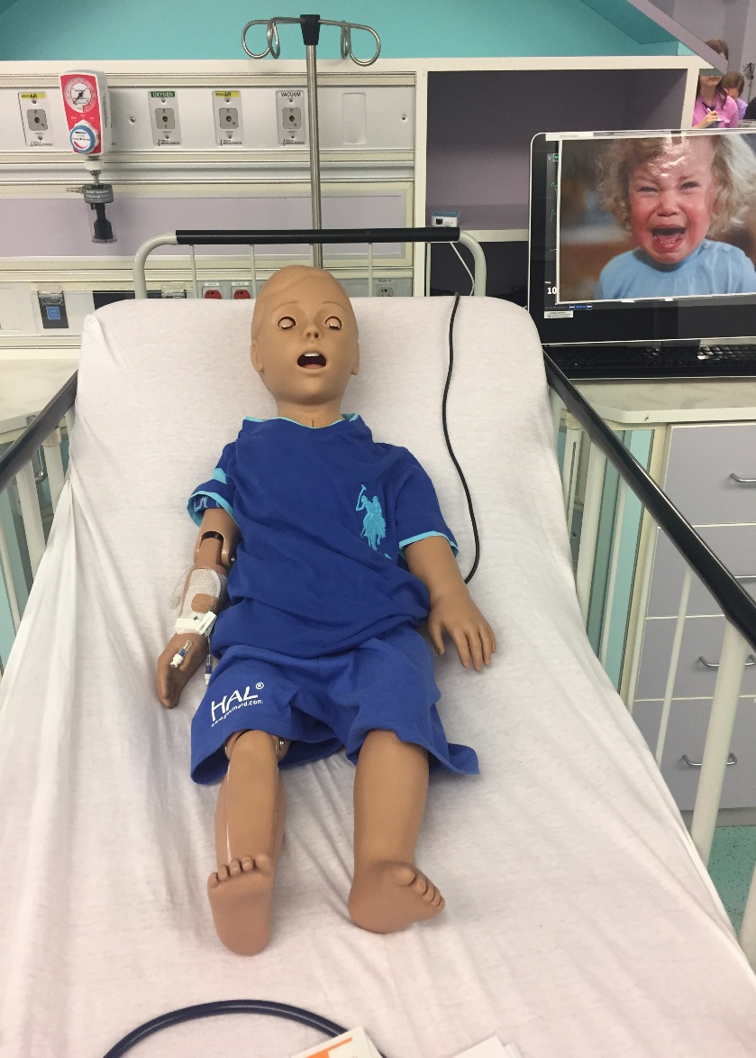
Notes:
Abby
In the simulation lab, groups rotate through all 4 high-fidelity simulated stations based upon the patients presented in the classroom setting.
Here you see two of our mannequins. It is important to note that these are still pictures that you are seeing but let me confirm to you that both of these patients are crying and grunting---loudly—the whole time we are in the sim lab which represents real life in a pediatric hospital! On the left is our 6 week old with respiratory distress and difficulty feeding. On the right is Tommy (my favorite) our two year old presenting with abdominal pain who is inconsolable but has periods of playfulness.

Slide 9
Facilitator guide: 6 week old-respiratory
Normal VS Range for 3 month old
HR 114-159
BP 70-90/50-65
RR 28-52
Temp 36-37 C range
Scenario pearls:
Assess patient—not the monitor
They can only breathe that fast for so long before they quickly decompensate
Insensible water loss—monitor I/O; consider IV fluids
Suction, suction, suction
If albuterol didn’t work in ED, will likely not have as an option
Assessment tips:
Assess vital areas first i.e. heart/lungs
Count respirations/HR for a full minute
Have parent hold to assist with consoling crying infant
Stage of Development: Trust vs. mistrust (ages 0-2 years)
Centers around basic needs being met: safety, shelter, food
Infant depends on the parents, especially the mother, for sustenance and comfort
Parent is primary in the eyes of the child
Notes:
Abby
One clinical educator is stationed at each simulated patient. The educator serves to facilitate the station and is provided a guide (as seen above) with further information about the patient to aid in prompting discussion among the participants.

Slide 10
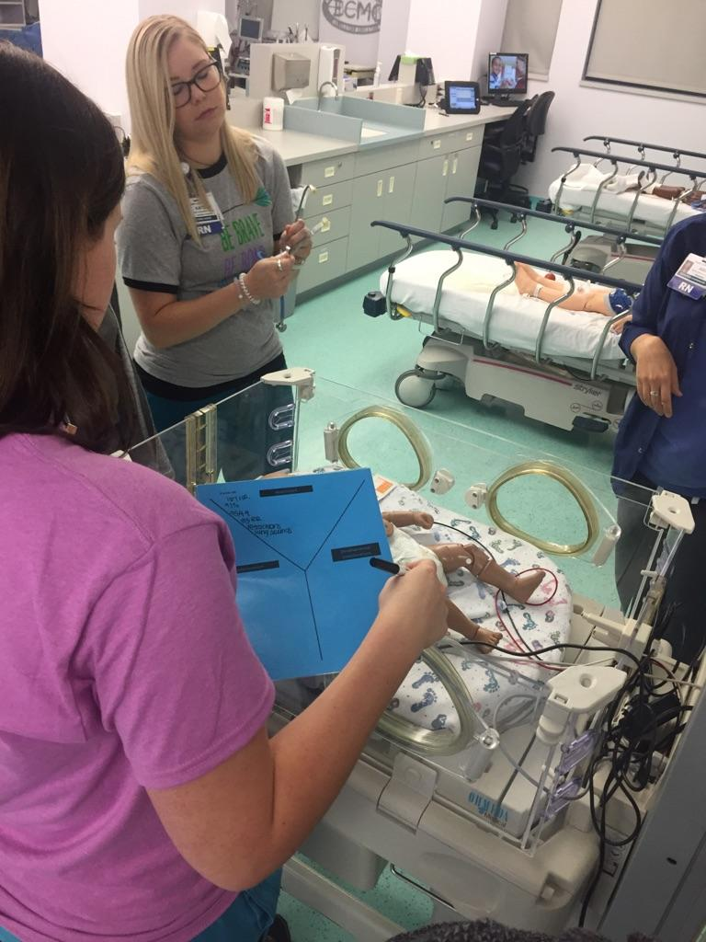
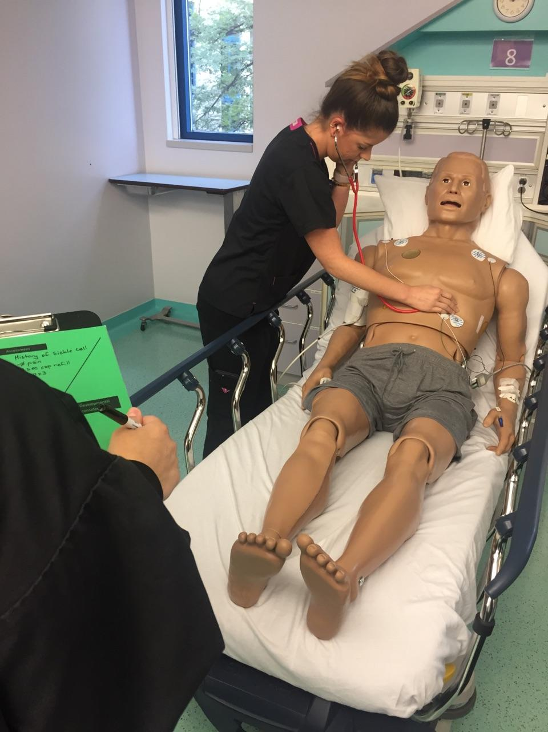
Notes:
Abby
Since groups have already received pictures & the initial impression information in the classroom, this is their time to get their hands on practicing assessments.
Participants are encouraged to practice age-specific assessment strategies such as checking brachial pulses, assessing fontanels, differentiating bowel/lung/heart sounds all within a small space.
On the right is a nurse listening to our 17 year old patient “jack”. Jack is here for a sickle cell crisis and has now developed into acute chest syndrome.

Slide 11
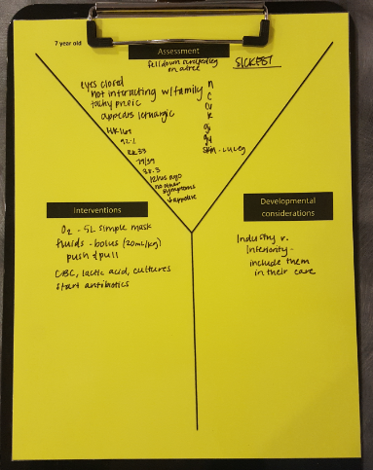
“Sickest”
?
Notes:
Abby
Based upon their focused assessment, participants identify key interventions they anticipate initiating for the care of each patient. Here is an example of interventions a group identified for the patient they assessed. You can see this group has prioritized the patient as “sickest” and list key interventions for anticipated sepsis in the 7-year old patient.
So if this was an anticipated sepsis patient, what interventions would you expect? (have audience participate).
Bolus: 20ml/kg via IV syringe, not IV pump
Oxygen delivery of 5ml simple mask regardless of o2 sat
Labs-CBC, cmp, lactate, CBG
Cultures-when to draw before Abx given
Antibiotics
Sepsis pathway and sepsis alert
After suggestions are received, facilitator uses this opportunity to question staff and clarify facility specific processes. For example, one that we hear often is related to bolus and oxygen administration

Slide 12
Notes:
Abby
To wrap up each station, participants are prompted to think about ways to accommodate their care to Erikson’s developmental stage for each patient.

Slide 13
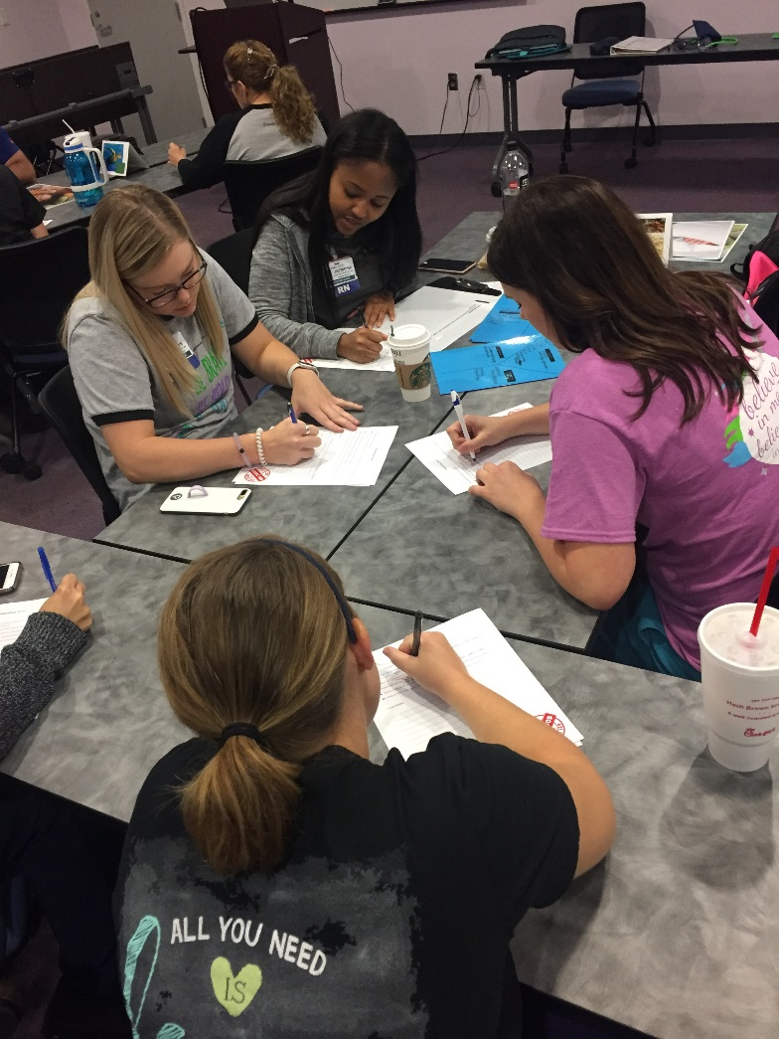
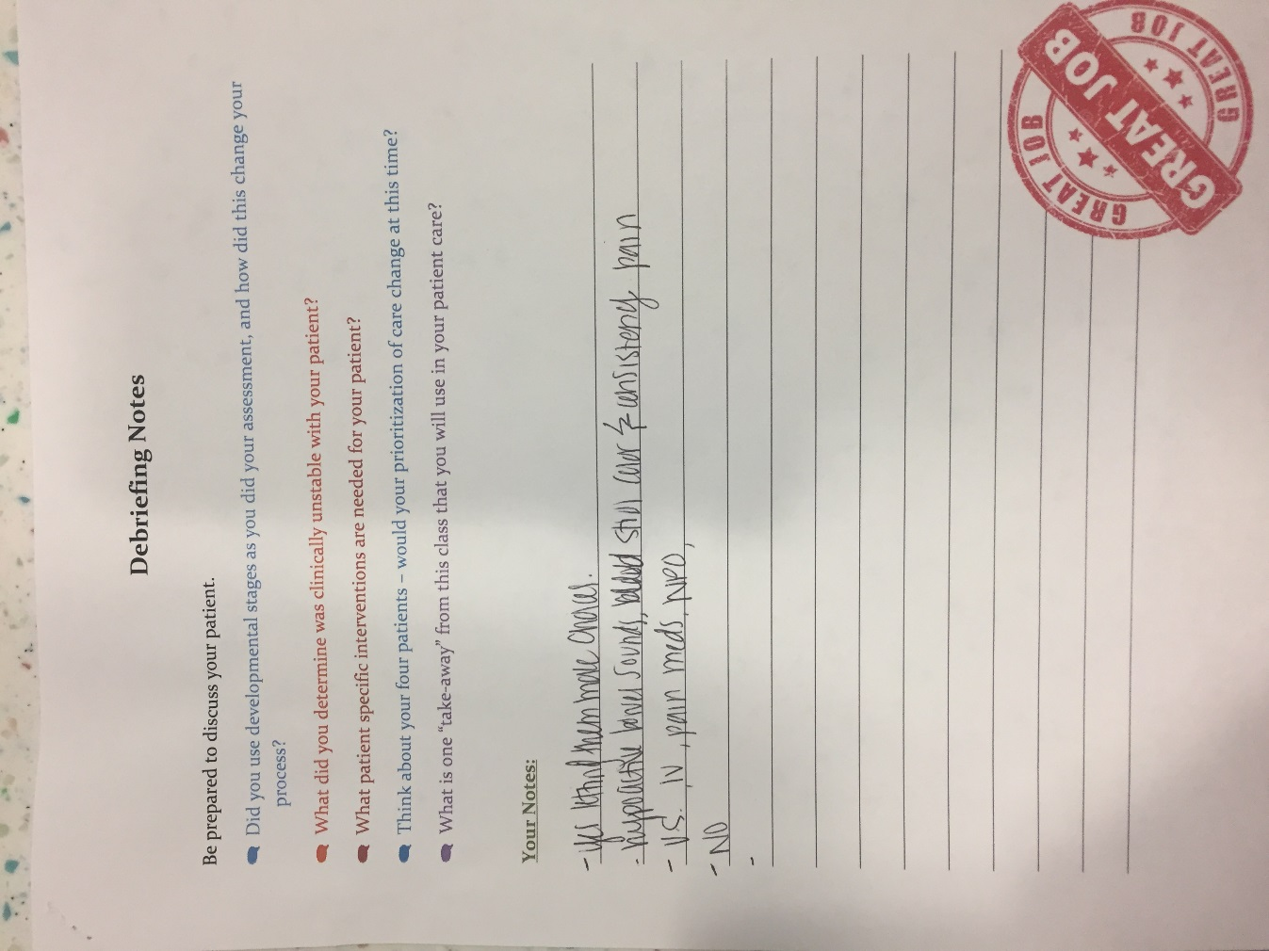
Notes:
LAC
After completing their assessment of each patient, participants reconvene back in the classroom to discuss their findings and oftentimes reprioritize their patients based upon the information they collected in the simulation lab.

Slide 14
Developmental Considerations
Vital Signs
PAT
Assessment Techniques
Notes:
LAC
By the end of this class, participants have had the opportunity to practice pediatric assessment techniques, anticipate interventions and tailor their care based upon pediatric developmental stages.
They also come away with foundational tools for pediatric practice related to prioritization and time management.

Slide 15
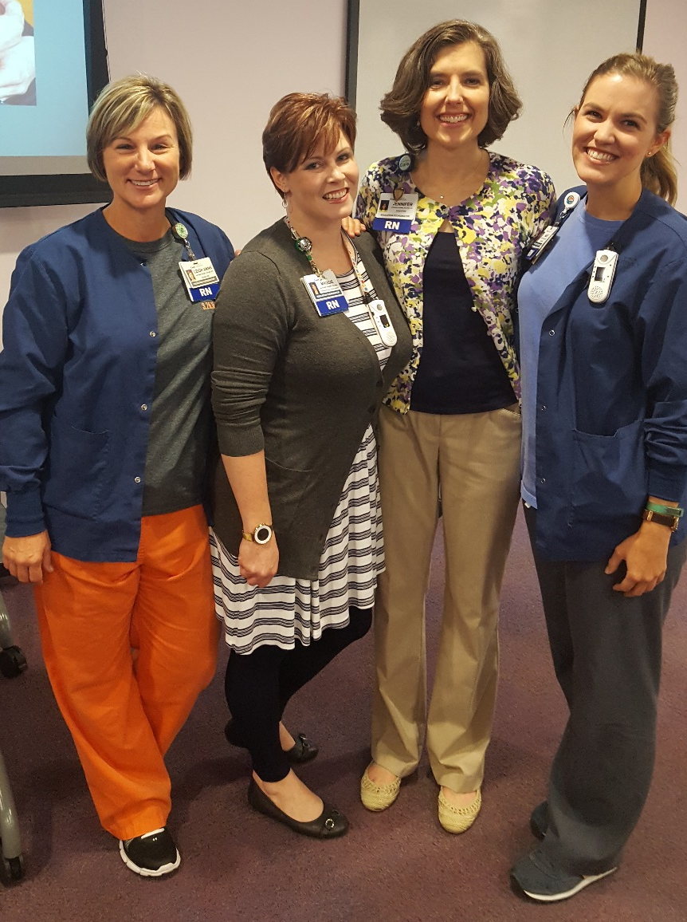
Acknowledgements
We would like to thank the following individuals:
Jennifer Stephen
Maggie Higgins
Amy Kotter
Alaina Strain
Aquila Greer
Notes:
LAC

Slide 16
Questions?
Notes:
Abby

Slide 17
References
Leon, C. Samson, R.A., Schexnayder, S.M., Hazinski, M.F. (2016). Pediatric Advanced Life Support. Dallas, TX: American Heart Association.
Benner, P. (1984). From Novice to Expert: Excellence and Power in Clinical Nursing Practice. Upper Saddle River, NJ: Prentice Hall Health.
Erikson, E. & Erikson, J.M. (1998). The Life Cycle Completed. New York, NY: W.W. Norton.

